Slide 1
Unet beats CNN in topology optimization
Sy Nguyen-Van
School of Mechanical, Aerospace and Manufacturing Engineering
Final project: Deep Learning
November, 2025
Notes:
Hello everyone, today, I am going to talk about “Multiscale Topology Optimization of Structures
Made of Triply Periodic Minimal Surface (TPMS) Lattices”

Slide 2
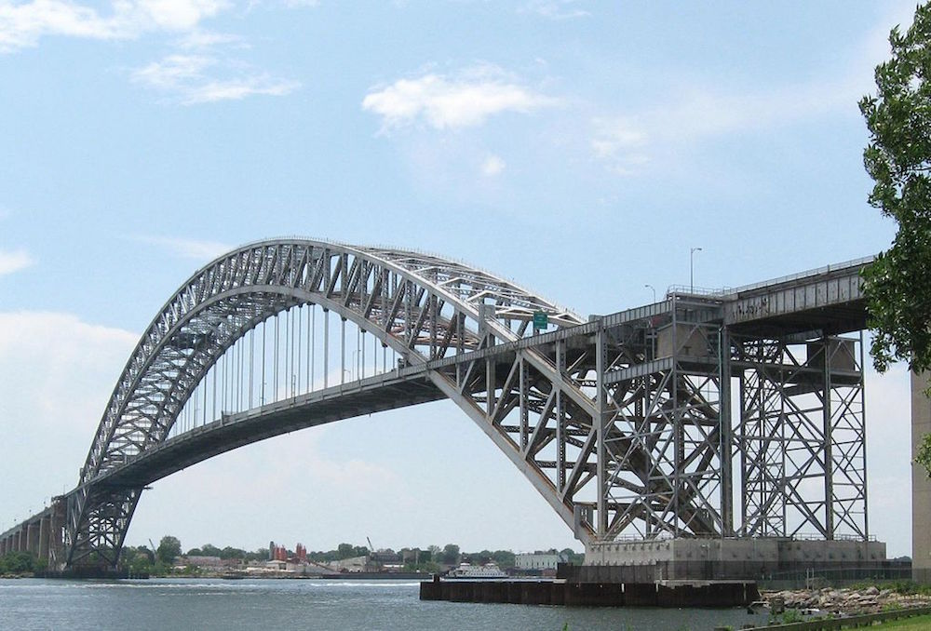
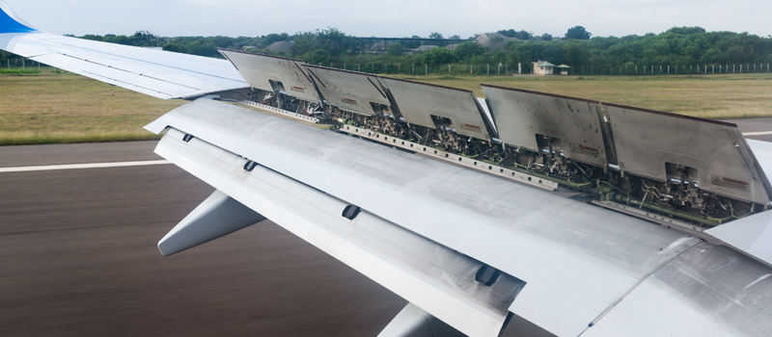
How to create lighter and safer structures ?
How to create optimal designs:
As lightweight as possible
Strong enough to ensure safety
Bridge
Aircraft wings
www.usa.skanska.com
https://pilotinstitute.com/
Notes:
- With that, from perspective view of mechanical designers, one of the main question is that how can you design TPMS structures?
- Right now, we have two methods to design TPMS: Functional grading and topology optimization.
- I will talk more details about the advantages and disadvantages of these methods in Section 3

Slide 3
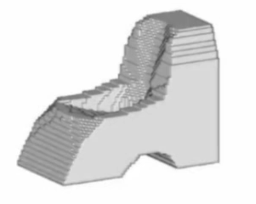
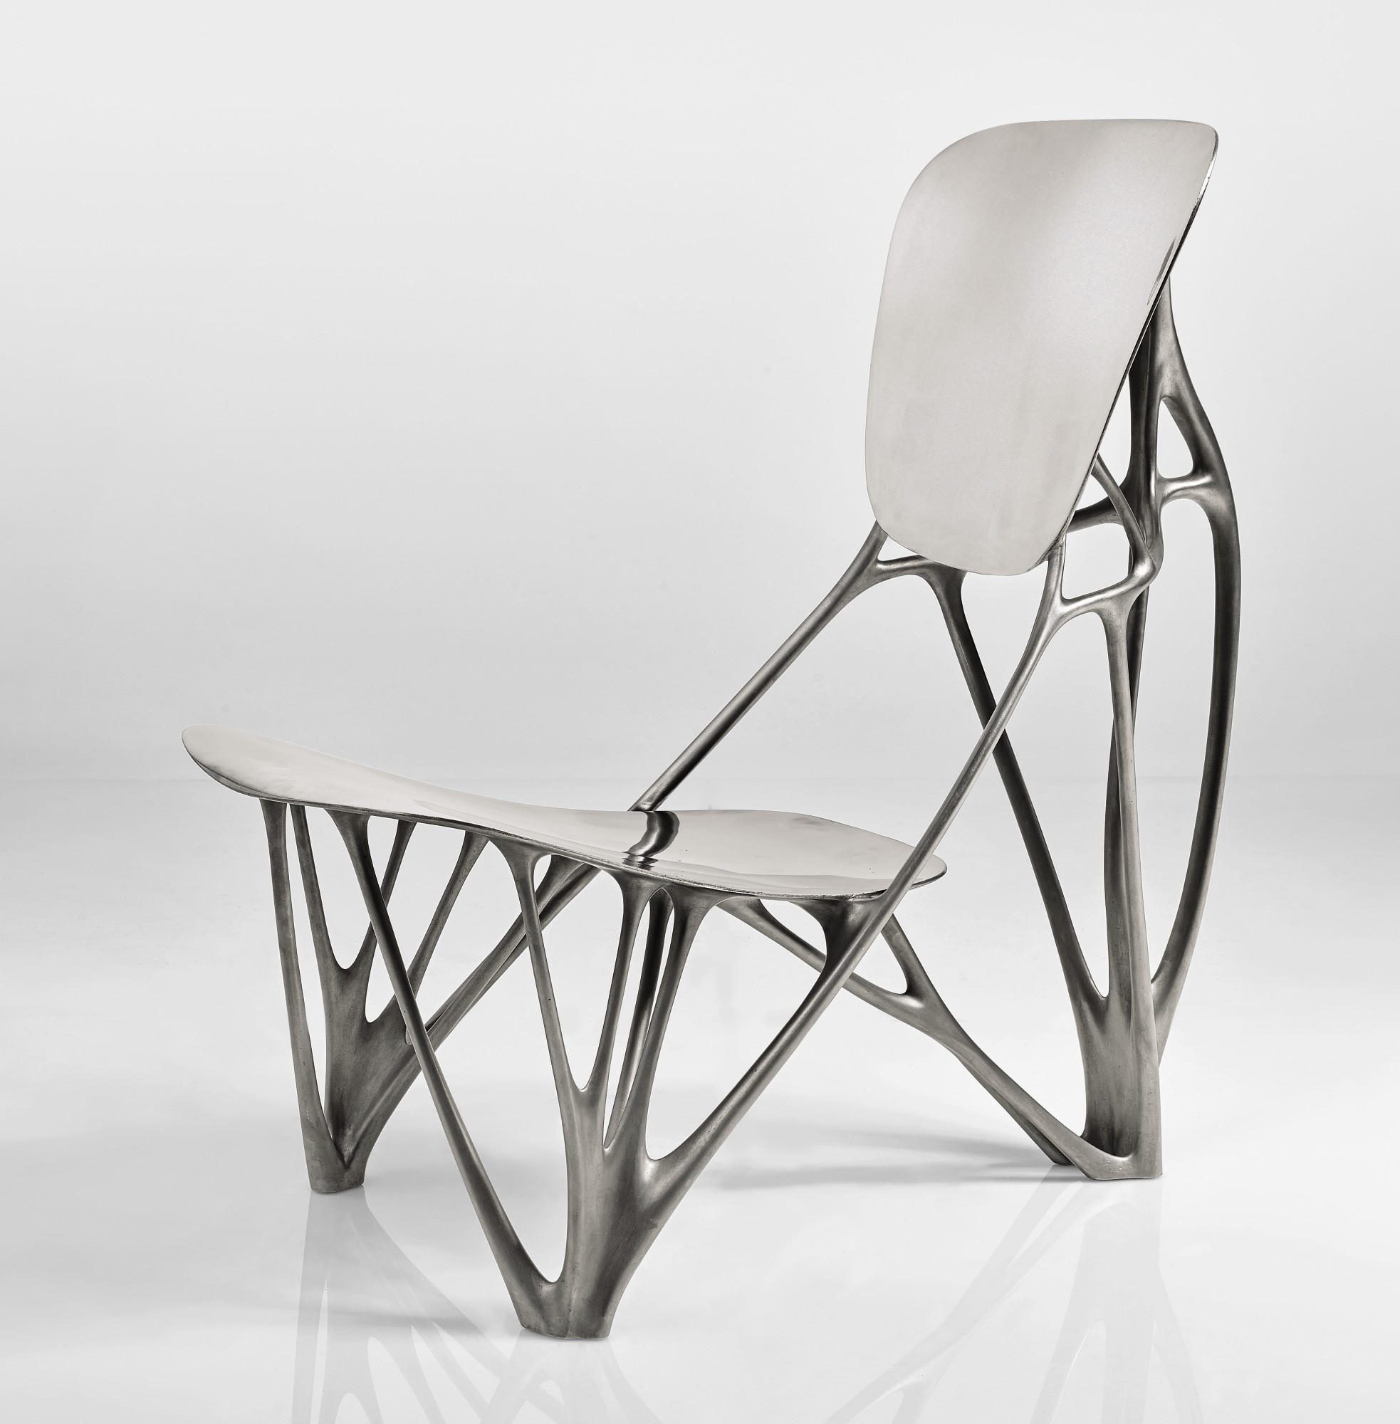
Topology optimization
Topology optimization
Topology optimization process
Optimal design
https://www.jorislaarman.com/

Slide 4
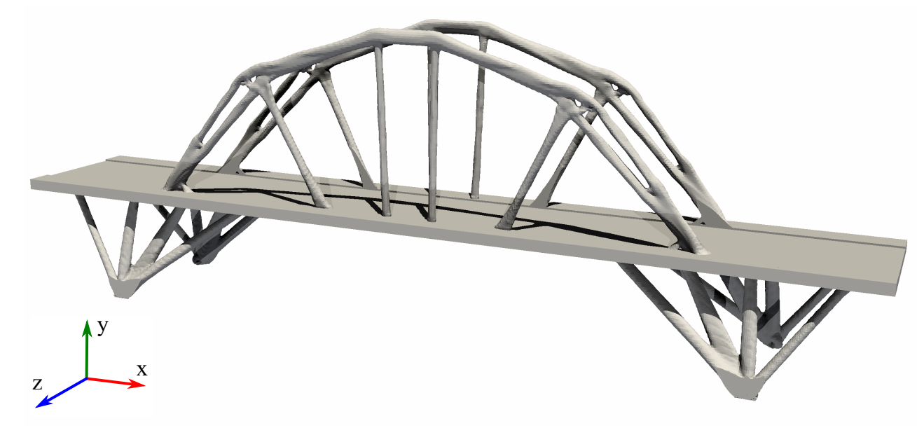
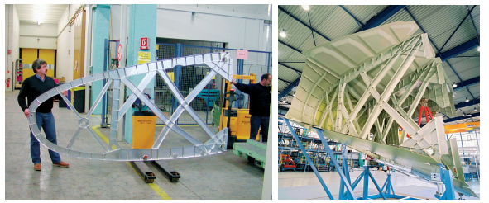
Applications of topology optimization
Airbus uses topology optimization in aircraft wings to save 1000 kg of weight
Optimal bridge design
Javier et al. 2019
altairhyperworks.co.uk
Notes:
- With that, from perspective view of mechanical designers, one of the main question is that how can you design TPMS structures?
- Right now, we have two methods to design TPMS: Functional grading and topology optimization.
- I will talk more details about the advantages and disadvantages of these methods in Section 3

Slide 5
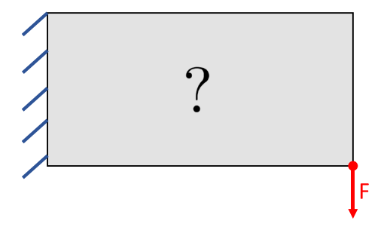
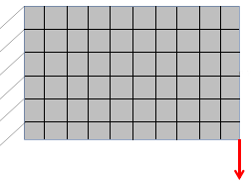
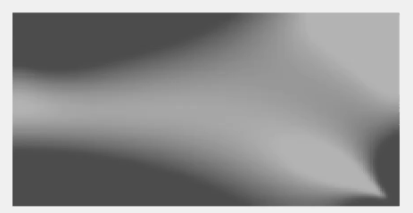
Challenges in Topology Optimization
Challenges in Topology Optimization
Initial domain
Design variables: density (ρ)
Solve PDE using
Finite Element Analysis (FEA)
Discretization
ρ_{e}
Functions
Objective: Stiffness (ρ)
Constraint: Mass (ρ)
Sensitivity
No
Yes
Stopping
Gradient-based
optimizers
Optimal ρ
Update of ρ
03 main challenges in Topology Optimization (TO)
Solving PDE: Expensive
Gradients: Error prones + Time consuming
Iterative process: Expensive

Slide 6
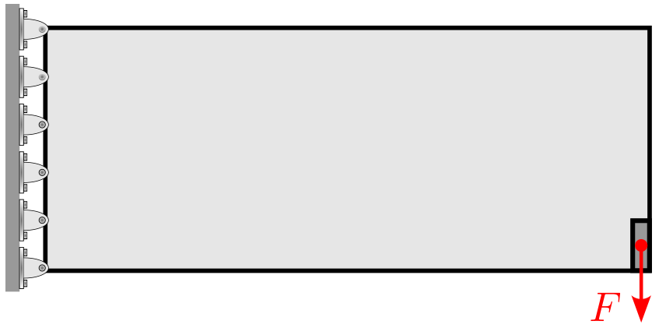
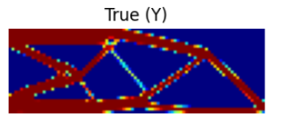
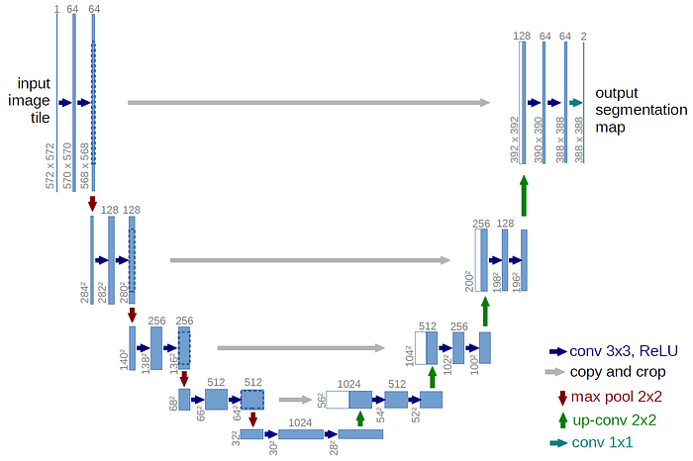
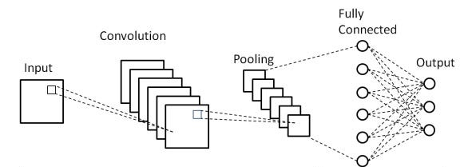
Proposed deep learning
Deep learning
CNN
Unet
https://medium.com/

Slide 7
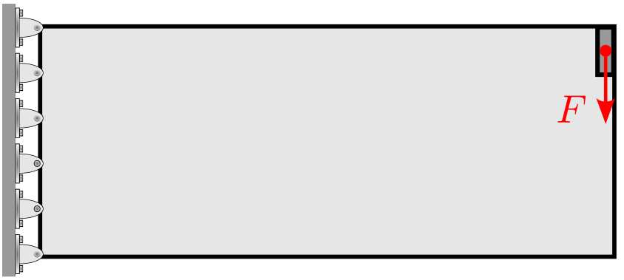
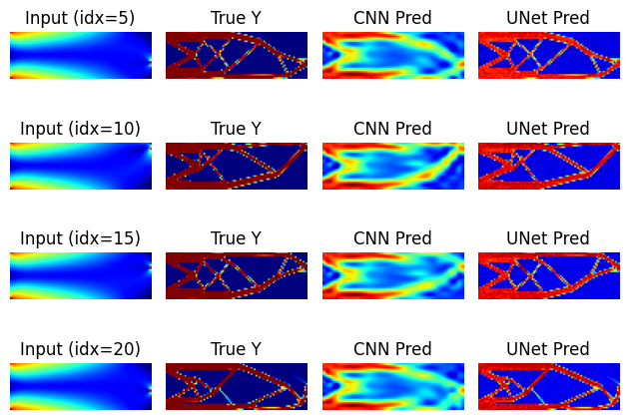
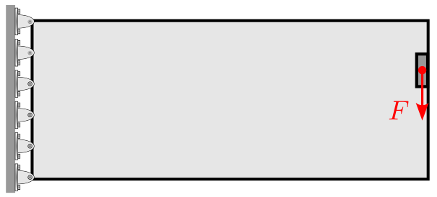
Dataset
Input: Stress of initial domain with changing of location of forces
Output: The optimal design from topology optimization
Topology optimization: Minimize the mass and stress constraint
Boundary conditions
Input: Stress
Output: Optimal design

Slide 8
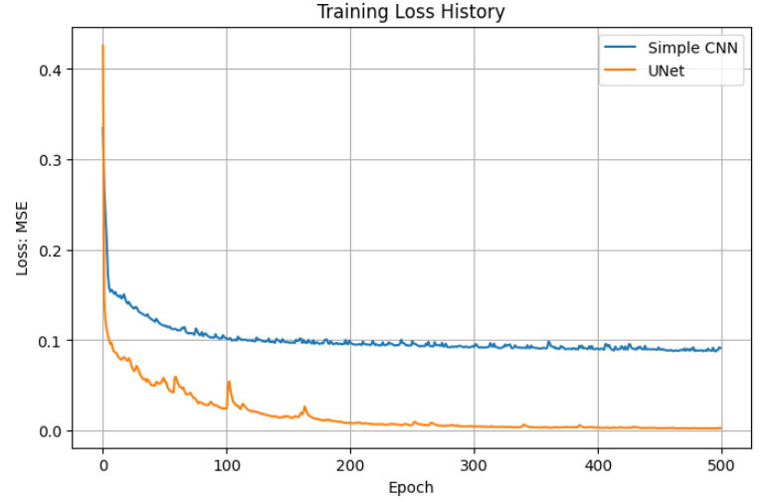
Challenges in Topology Optimization
Dataset and Training
200 training: Latin Hypercube
Input: 01 channel
Output: 01 channel
Parameters:
Stride = 1
Padding = 1
Learning rate = 1e-3
Loss function: MSE
Training time
CNN = 120s
Unet = 945s

Slide 9
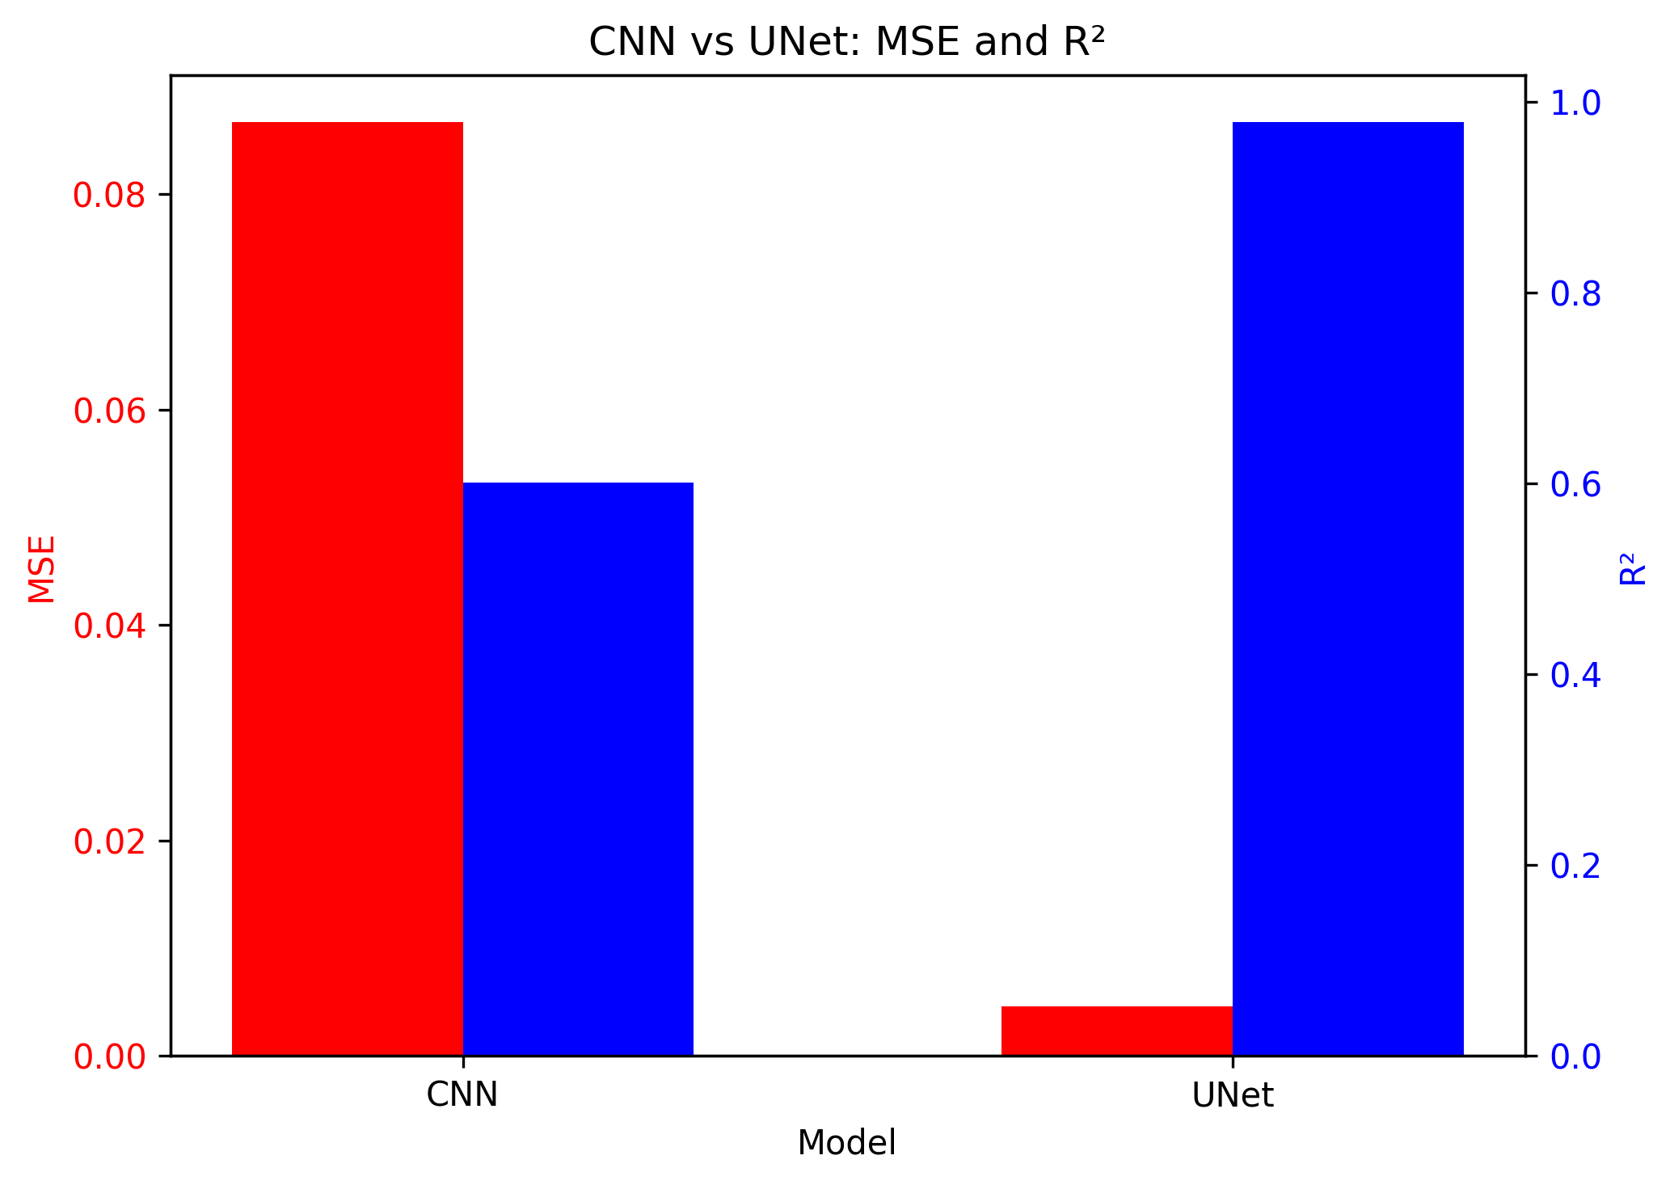
Challenges in Topology Optimization
Testing data
50 dataset
Notes:
COLOR SCALE
R2

Slide 10
Challenges in Topology Optimization
Prediction
Times:
TO = 137 s
CNN = 0.005 s
Unet = 0.001 s
Notes:
COLOR SCALE
R2

Slide 11
Challenges in Topology Optimization
Conclusion and future works
Hyperparameter tunning
Dataset: Increase number of dataset and 3D models
Data augmentation: noise, rotation
Different models: Diffusions
My codes: https://github.com/sy-nguyen-van/Deep_Learning_Sy
My thought:
DL cannot replace topology optimization (TOP)
Because it still requires dataset obtained from TOP
May be in the future, when we have enough data, DL will exceed TOP

