Slide 1
SmartSolver
.

Slide 2
TEAM MEMBERS
>
>
>
>
MEMBER 1
MEMBER 2
MEMBER 3
MEMBER 4
.
.

Slide 3

TABLE OF CONTENTS
01
02
03
04
05
Motivation & Scope
Results And Comparisions
Problem Statement
Limitations
Methodology Diagram
Future Work
Solution/Coding
Conclusion
Evaluation

Slide 4
MOTIVATION AND SCOPE
Addressing the demand for effective and versatile solutions in the digital innovation era.
Aiming to simplify problem-solving in mathematical and computational domains for users.
Emphasizing a user-friendly interface, swift calculating mechanisms, dynamic unit conversion, optimized algorithms, and the handling of complex mathematical expressions.
Unique Feature: Integration of multiple calculators and an algorithm solver into one platform

Slide 5
PROBLEM STATEMENT
Users encounter challenges in finding comprehensive and efficient tools for diverse mathematical problems.
Existing solutions often lack versatility, speed, or user-friendliness.
The Smart Solver resolves these issues by providing a sophisticated platform with a user-friendly interface and efficient calculating mechanisms
Unique Challenge: Seamless integration of multiple calculators and an algorithm solver on one platform.

Slide 6
METHODOLOGY DIAGRAM

Slide 7
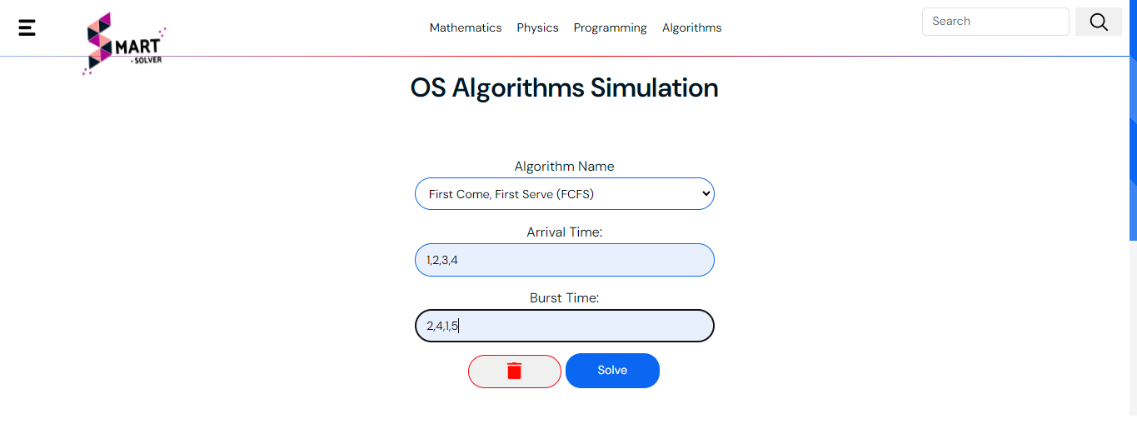
SOLUTION/CODING
Employing HTML, CSS3, and JavaScript for front-end development, ensuring an interactive and responsive user interface.
Utilizing Python, specifically the Django framework, for efficient back-end development.
Managing version control through Git and facilitating collaboration on platforms like GitHub.

Slide 8
KEY IDEAS IN MARKET OPPORTUNITY
RESEARCH NEW MARKETS
INNOVATIVE SOLUTIONS
Analyze existing customer needs and identify gaps in the market to find
new opportunities
Utilize technology and customer feedback to come up with novel solutions that meet your customer’s demands or needs
STAY AHEAD OF TRENDS
SEASONAL SPIKES
Monitor changes in the marketplace, such as shifts in consumer behavior or emerging technologies, to stay competitive and capitalize on new opportunities and trends
Identify times of year when demand for certain products may spike, such as holidays or special occasions, and use these times to target customers or maximize sales

Slide 9
SIX RECOMMENDATIONS
KEEP IT SIMPLE
USE VISUALS
KEEP IT SHORT
Structure your pitch deck clearly and make sure all the important points are easy to understand
Incorporate visuals or graphics to illustrate your message and keep the audience engaged
A good pitch deck should be concise and clear; avoid trying to cram in too much information
LET’S MAKE IT
TEST & ITERATE
MAIN POINTS
Include impactful stories, statistics, or facts that will help your audience remember your
message afterwards
Practice presenting your deck beforehand with friends or colleagues for feedback, then use this input to refine it further
A pitch deck is an overview of your business; focus on key points that get the most important ideas across

Slide 10
333,000
9h 55m 23s
386,000 km
Users bought our product
Estimated delivery time per unit
Avg. distance travelled by logistics team

Slide 11
4,498,300,000
Number of users analyzed in our market research

Slide 12
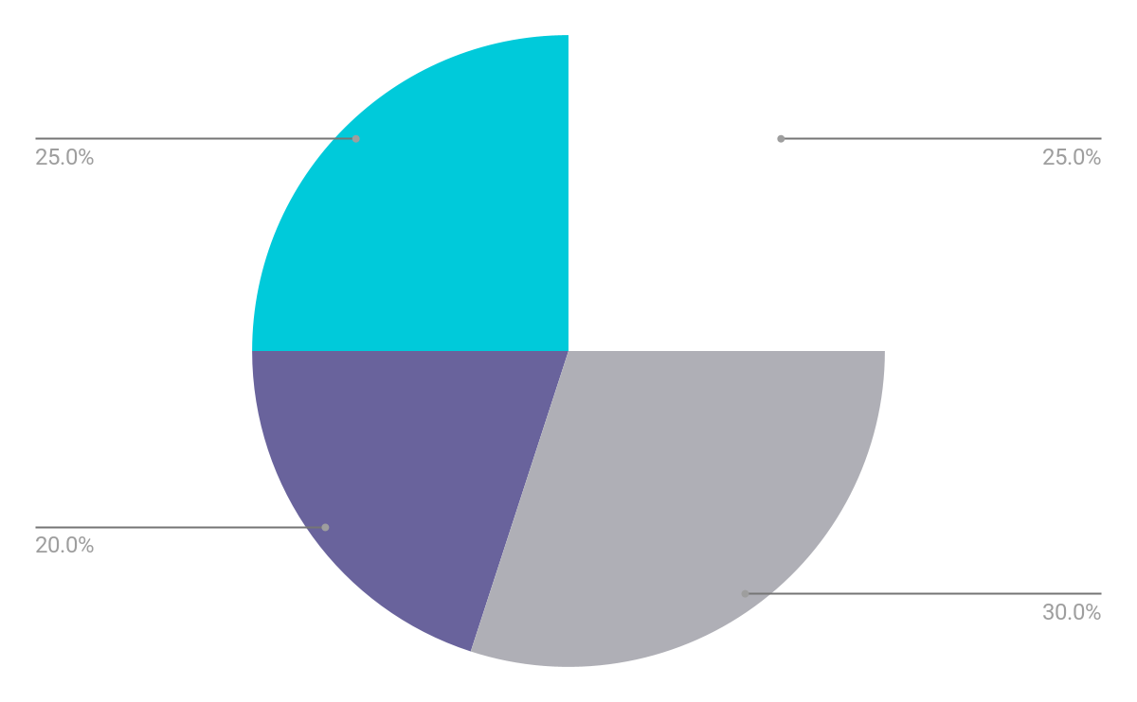
REVENUE BY QUARTER
Q1
Q2
Q3
Q4
January - March
April - June
July - September
October - December
Follow the link in the graph to modify its data and then paste the new one here. For more info, click here

Slide 13
COMPETITION COMPARISON
 | FEATURES | VALUE | PRICING | TRIAL | COMPETENCE | SHARE
Company A | Fuel economy | Special offers | $23,000 | No | Low | 8%
Company B | Design | Reliability | $27,000 | No | Low | 5%
Company C | Performance | Repairs | $30,000 | Yes | High | 20%
Company D | Safety features | Marketing | $24,000 | No | High | 22%
Company E | Technology | Customers | $32,000 | Yes | Low | 10%
Company F | Comfort | Best prices | $15,000 | Yes | High | 30%
Company G | Customization | Brand name | $45,000 | No | Low | 5%

Slide 14
TIMELINE OF YOUR PRESENTATION
Provide a brief overview of the pitch deck's content
Engage the audience with a compelling introduction
Identify the customer's pain points
and challenges
Describe how your product or service can solve the problem
Highlight the unique value proposition and benefits of your specific solution
Analyze the target market size, growth potential, and competition briefly
Explain your financial needs and briefly outline your
funding allocation
End with a clear and concise call to action

Slide 15
ORGANIZATIONAL CHART
Jane Doe
CEO
John Smith
Department Head
Maya Willson
Department Head
Emma Miller
Manager
Richard Taylor
Manager
Sarah Williams
Manager
Steven Ander
Manager
Brian Clark
Employee
Michelle García
Employee
James Scott
Employee
William Young
Employee
Alan Turner
Employee

Slide 16
MARKET SIZE OVERVIEW
OUTER CIRCLE
$100M
Include the total size of the market, which represents the entire potential customer base for the product or service
$20M
MIDDLE CIRCLE
Identify the target market for the product or service, which may be a subset of the total market. This could be based on factors such as demographics, geography, or specific needs
$5M
INNER CIRCLE
Indicate the current market size, which represents the portion of the target market that the company has successfully captured

Slide 17
ROADMAP INFOGRAPHIC
INITIATIVE | OBJECTIVE | JAN | FEB | MAR | APR | MAY | JUN | JUL | AUG | SEP | OCT | NOV | DEC
Understanding | Analyze and understand the needs of your target audience
Conduct research | Research existing products in the industry and analyze them
Brainstorm ideas | Generate ideas based on user feedback and research findings
Develop a prototype | Create a basic version of the product to show investors
Test for usability | Put the prototype through rigorous testing processes
Analyze feedback | Analyze feedback

Slide 18
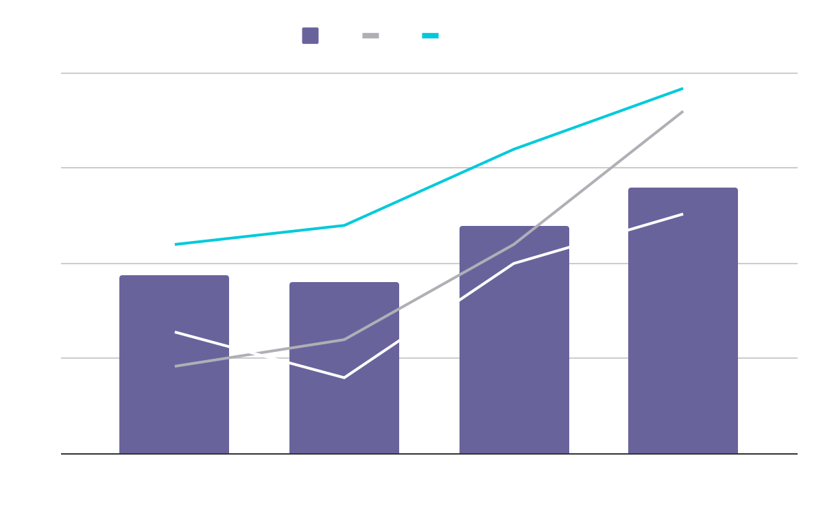
KPI DASHBOARD
PRODUCT | UNITS | REVENUE | RETURNS
Item 1 | 500 | 2,000,000 | 40
Item 2 | 1,000 | 50,750 | 10
Item 3 | 250 | 1,500,000 | 300
Item 4 | 500 | 2,000,000 | 40
Item 5 | 1,000 | 50,750 | 10
Item 6 | 250 | 1,500,000 | 300
Item 7 | 500 | 2,000,000 | 40
Item 8 | 1,000 | 50,750 | 10
$4,000,000
$100,000
$5,000
Revenue
General costs
Benefit
Follow the link in the graph to modify its data and then paste the new one here. For more info, click here

Slide 19
THANKS!
Do you have any questions?
youremail@freepik.com
+34 654 321 432
yourwebsite.com
Please keep this slide for attribution

Slide 20
ICON PACK

Slide 21
ALTERNATIVE RESOURCES
Here’s an assortment of alternative resources whose style fits the one of this template:
White technology design for wallpaper
Gradient cyber futuristic background

Slide 22
RESOURCES
Did you like the resources on this template? Get them for free at our other websites:
VECTORS
Artificial intelligence concept twitter header
Artificial intelligence concept youtube thumbnail
PHOTOS
Woman wearing virtual reality simulator
Medium shot woman holding smartphone
ICONS
Icon Pack: Innovation | Lineal

Slide 23
Instructions for use
If you have a free account, in order to use this template, you must credit Slidesgo by keeping the Thanks slide. Please refer to the next slide to read the instructions for premium users.
As a Free user, you are allowed to:
Modify this template.
Use it for both personal and commercial projects.
You are not allowed to:
Sublicense, sell or rent any of Slidesgo Content (or a modified version of Slidesgo Content).
Distribute Slidesgo Content unless it has been expressly authorized by Slidesgo.
Include Slidesgo Content in an online or offline database or file.
Offer Slidesgo templates (or modified versions of Slidesgo templates) for download.
Acquire the copyright of Slidesgo Content.
For more information about editing slides, please read our FAQs or visit our blog:
https://slidesgo.com/faqs and https://slidesgo.com/slidesgo-school

Slide 24
Instructions for use (premium users)
As a Premium user, you can use this template without attributing Slidesgo or keeping the Thanks slide.
You are allowed to:
Modify this template.
Use it for both personal and commercial purposes.
Hide or delete the “Thanks” slide and the mention to Slidesgo in the credits.
Share this template in an editable format with people who are not part of your team.
You are not allowed to:
Sublicense, sell or rent this Slidesgo Template (or a modified version of this Slidesgo Template).
Distribute this Slidesgo Template (or a modified version of this Slidesgo Template) or include it in a database or in any other product or service that offers downloadable images, icons or presentations that may be subject to distribution or resale.
Use any of the elements that are part of this Slidesgo Template in an isolated and separated way from this Template.
Register any of the elements that are part of this template as a trademark or logo, or register it as a work in an intellectual property registry or similar.
For more information about editing slides, please read our FAQs or visit our blog:
https://slidesgo.com/faqs and https://slidesgo.com/slidesgo-school

Slide 25
Fonts & colors used
This presentation has been made using the following fonts:
Raleway
(https://fonts.google.com/specimen/Raleway)
Hanken Grotesk
(https://fonts.google.com/specimen/Hanken+Grotesk)
#ffffff
#00cada
#110e24
#46406b
#69639c
#afafb6

Slide 26





Storyset
Create your Story with our illustrated concepts. Choose the style you like the most, edit its colors, pick the background and layers you want to show and bring them to life with the animator panel! It will boost your presentation. Check out how it works.
Pana
Amico
Bro
Rafiki
Cuate

Slide 27
Use our editable graphic resources...
You can easily resize these resources without losing quality. To change the color, just ungroup the resource and click on the object you want to change. Then, click on the paint bucket and select the color you want. Group the resource again when you’re done. You can also look for more infographics on Slidesgo.

Slide 30
JANUARY
FEBRUARY
MARCH
APRIL
MAY
JUNE
PHASE 1
Task 1
Task 2
PHASE 2
Task 1
Task 2
JANUARY
FEBRUARY
MARCH
APRIL
PHASE 1
Task 1
Task 2

Slide 33
...and our sets of editable icons
You can resize these icons without losing quality.
You can change the stroke and fill color; just select the icon and click on the paint bucket/pen.
In Google Slides, you can also use Flaticon’s extension, allowing you to customize and add even more icons.

Slide 34
Educational Icons
Medical Icons

Slide 35
Business Icons
Teamwork Icons

Slide 36
Help & Support Icons
Avatar Icons

Slide 37
Creative Process Icons
Performing Arts Icons

Slide 38
Nature Icons

Slide 39
SEO & Marketing Icons

