Slide 1
Yofficial
Capstone Design 1 Class No.4 / Team No.9
민준홍
중앙대학교 컴퓨터공학부
20140006

Slide 2
Content
1. Feedbacks
2. Progression and Trouble Shooting
3. Schedule

Slide 3
Feed Back

Slide 4

FeedBacks
01
How to search using ingredients
in take good care of the fridge.
?
삼겹살, 양파
삼겹살, 양파, 간장, 설탕

Slide 5
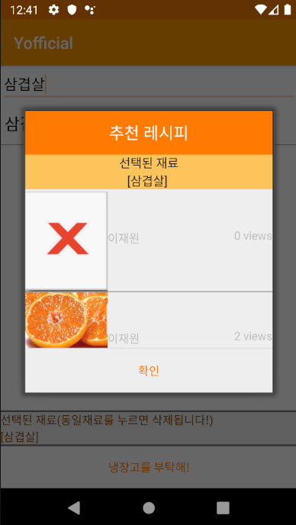
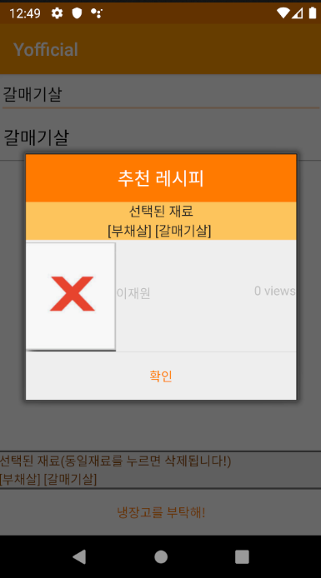
FeedBacks
01
How to search using ingredients
in take good care of the fridge.
Case1: [삼겹살] search
Case2: [부채살] [갈매기살] search

Slide 6

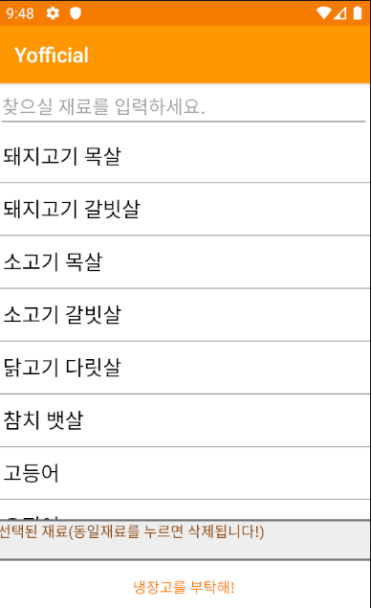
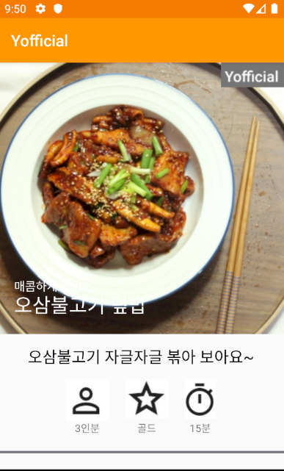
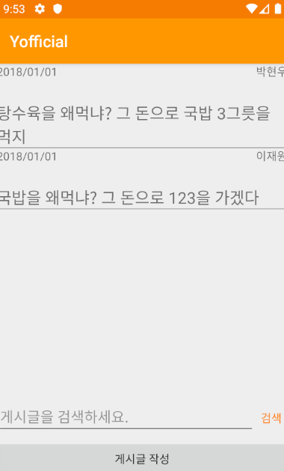
FeedBacks
02
UI is little crude.
etc…

Slide 7
Progression
&
Trouble Shooting

Slide 8
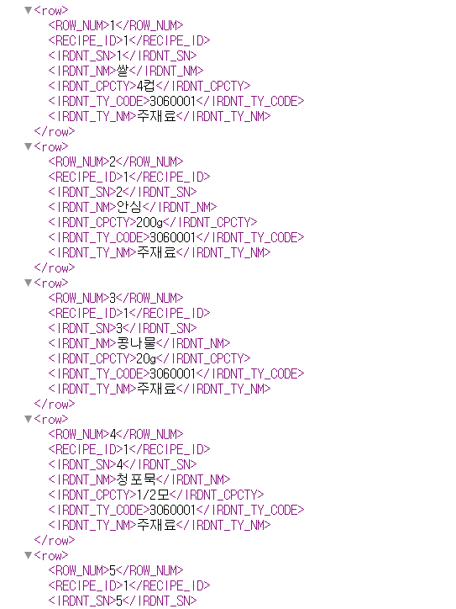
Progression & Trouble Shooting
01
Trouble Shooting 1
We tried to get ingredients list using the recipe API of the public data portal.
Problem:
The recipe is a collection of recipes, not ingredients.
The classification of ingredients in each recipe is not batch.
There is also too much duplication.
Too few actual ingredient values ​​in API!

Slide 9
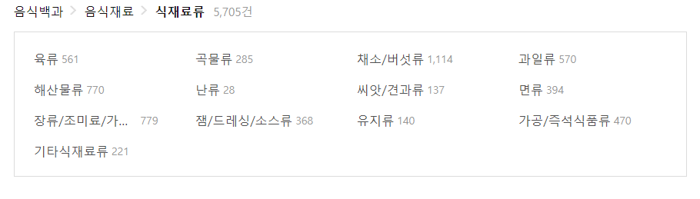
Progression & Trouble Shooting
02
Trouble Shooting 1
Alternative 1: Using the encyclopedia API.
Advantages:
The classification is very good.
Various ingredients can be pulled out.
Problem:
Encyclopedias also have a lot of overlap.
We must call API every time. When we select a ingredient.
There is a limit to the number of API calls.

Slide 10
Progression & Trouble Shooting
03
Trouble Shooting 1
Conclusion: Make our own ingredients data set.
Advantages:
Accurate classification by referring to the encyclopedia.
Can provide clean service without duplication of data.
Fast updating when there is no existing ingredient.
Problem:
The time and cost of creating a data set

Slide 11
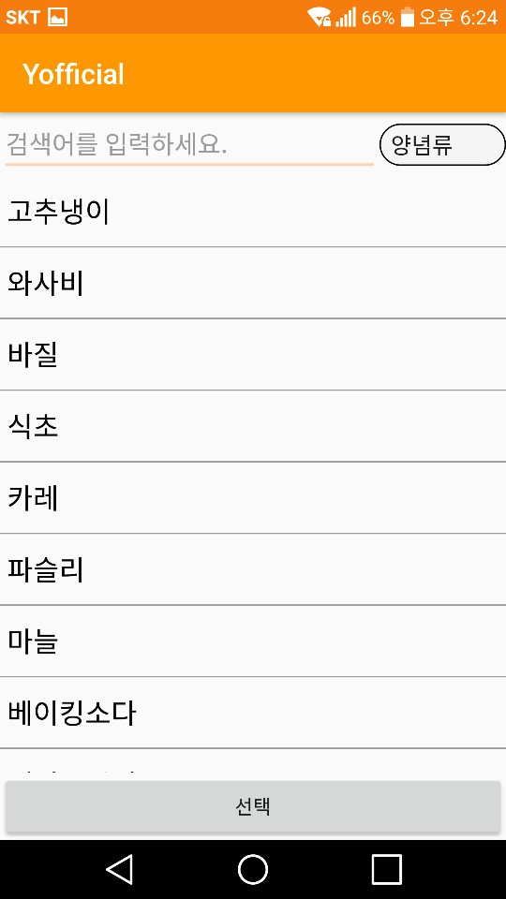
Progression & Trouble Shooting
04
Trouble Shooting 2
ERROR!
Notes:
다른 종류의 검색은 전부 작동하는데 양념류 검색만 작동이 되지 않고 프로그램이 터져버림
-> application 오류인줄 알고 계속 app 내부만 살핌 -> 알고보니 db에 널값이 존재하면 안되는데 널값이 존재했음

Slide 12
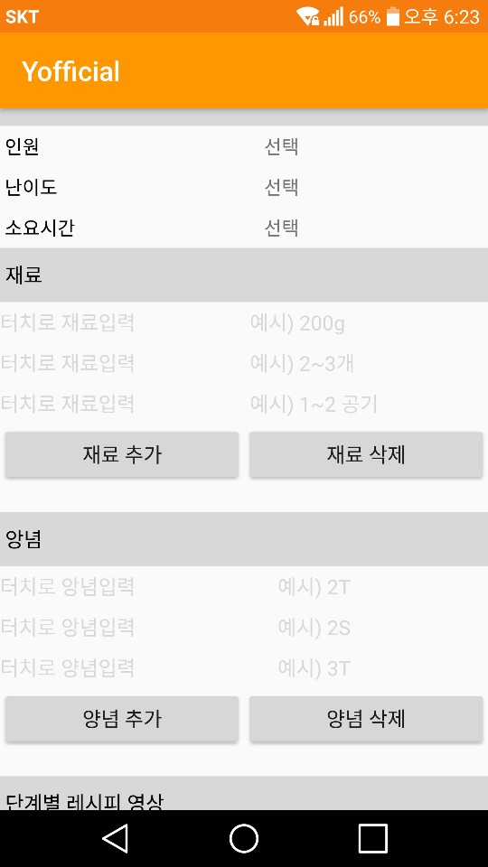
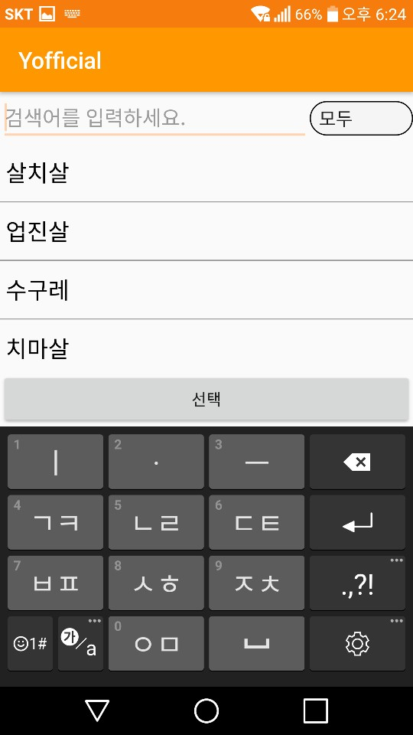
Progression & Trouble Shooting
05
Progression 1

Slide 13
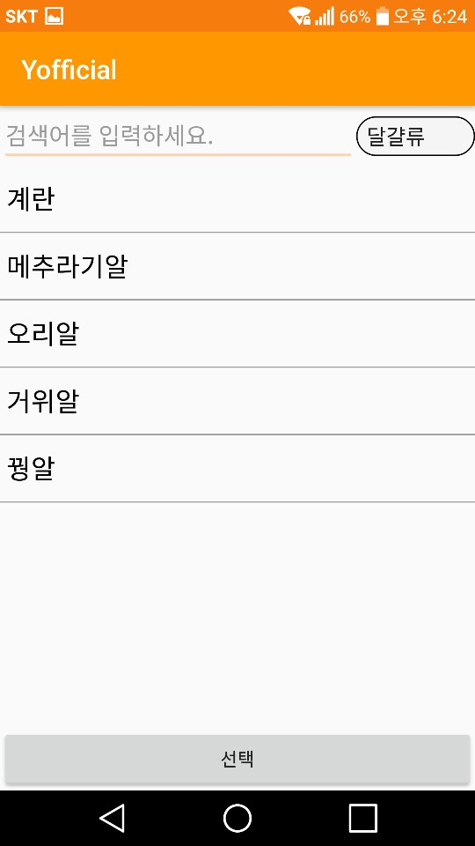
Progression & Trouble Shooting
06
Progression 1

Slide 14
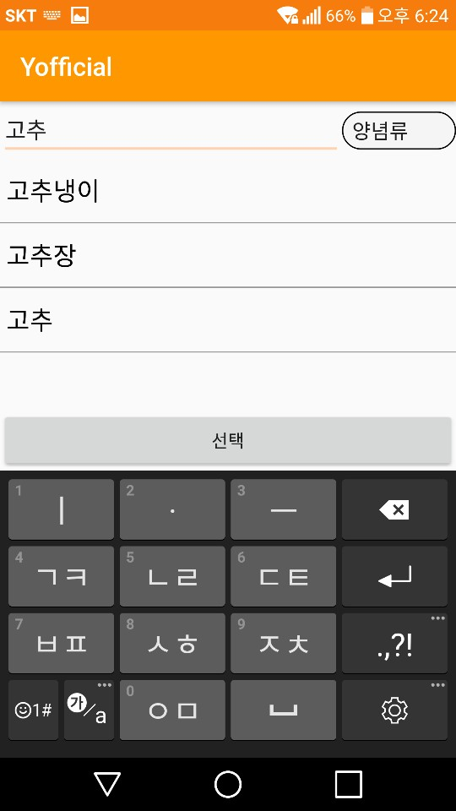
Progression & Trouble Shooting
07
Progression 1
You can also search again within each types.

Slide 15
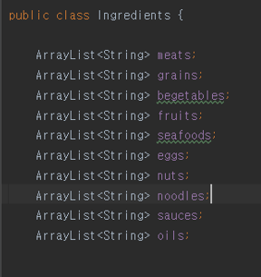
Progression & Trouble Shooting
08
Progression 1
You can also search again within each types.
Ingredient data classification

Slide 16
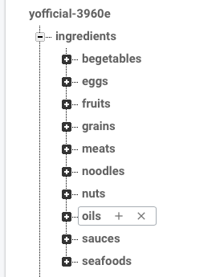
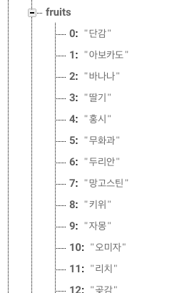
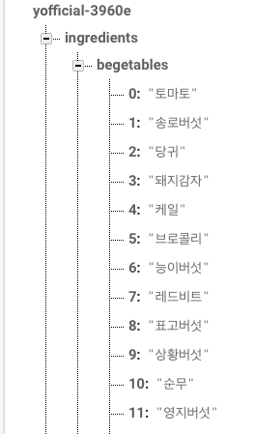
Progression & Trouble Shooting
09
Progression 2

Slide 17
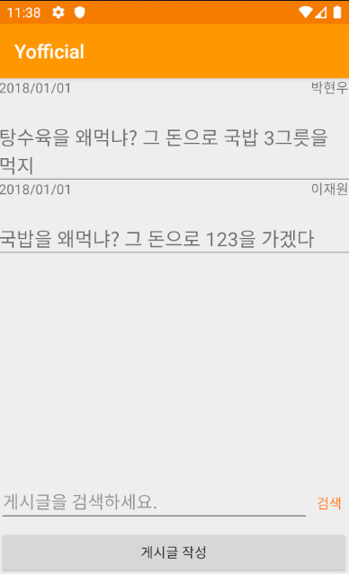
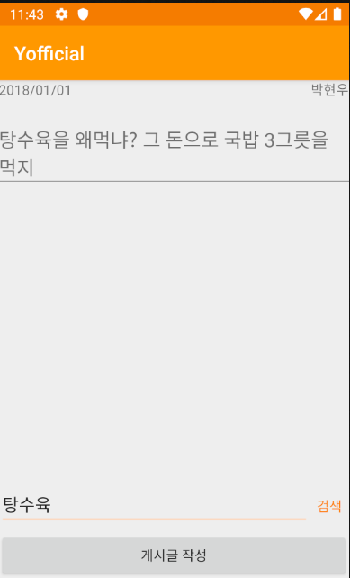
Progression & Trouble Shooting
10
Progression 3

Slide 18
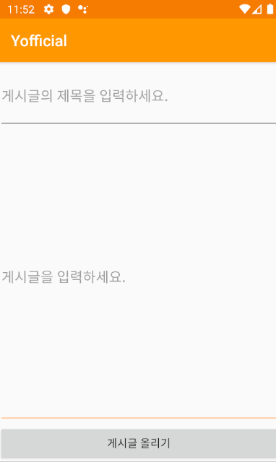
Progression & Trouble Shooting
11
Progression 3

Slide 19
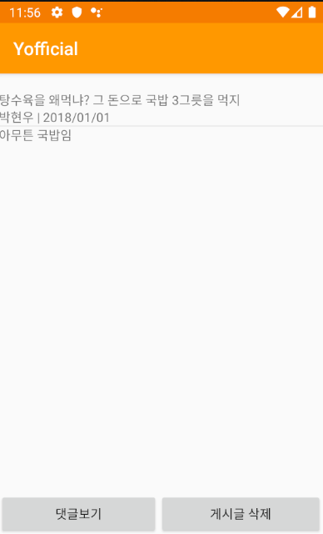
Progression & Trouble Shooting
12
Progression 3

Slide 20
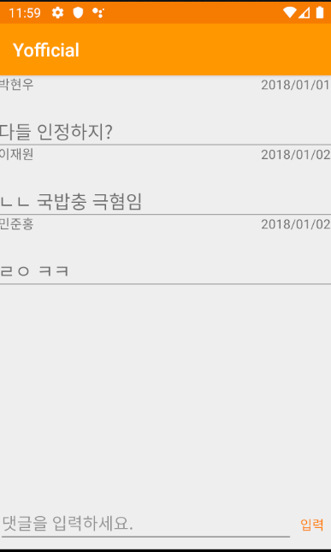
Progression & Trouble Shooting
13
Progression 3

Slide 21
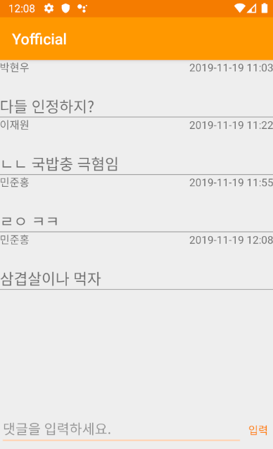
Progression & Trouble Shooting
14
Progression 3

Slide 22
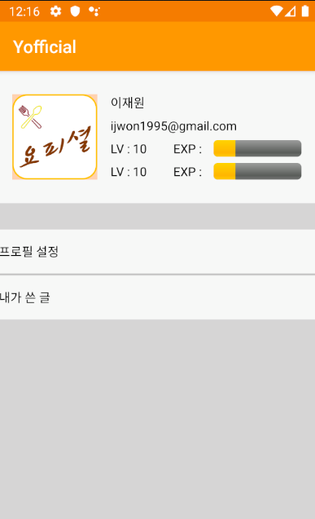
Progression & Trouble Shooting
15
Progression 4

Slide 23
Schedule

Slide 24
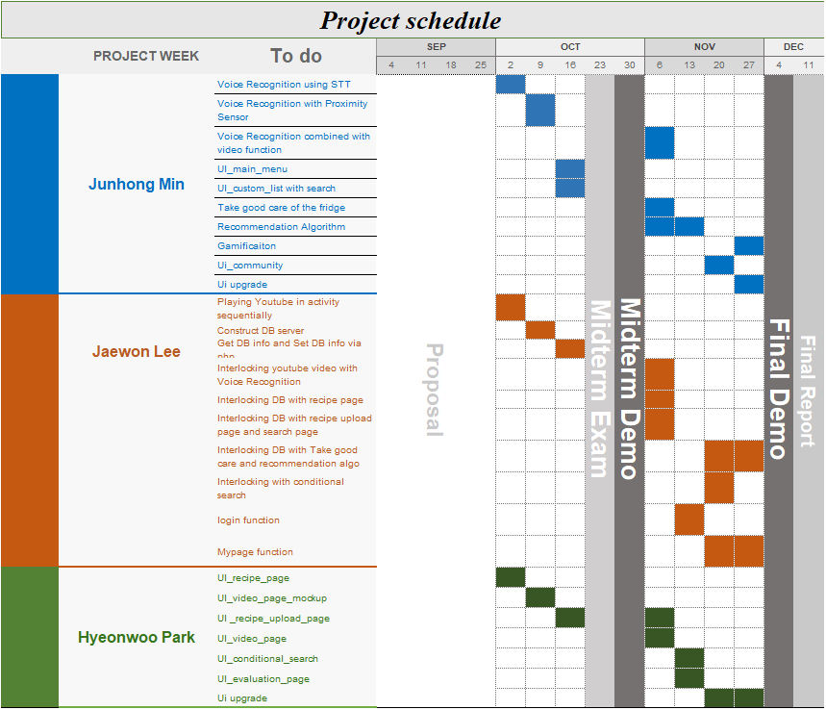
Schedule
01

Slide 25
The end
Thank you

