Slide 1
Yofficial
Capstone Design 1 Class No.4 / Team No.9
이재원
중앙대학교 컴퓨터공학부
20132697

Slide 2
Content
1. Progression
2. Trouble Shooting
3. Schedule

Slide 3
Progression

Slide 4
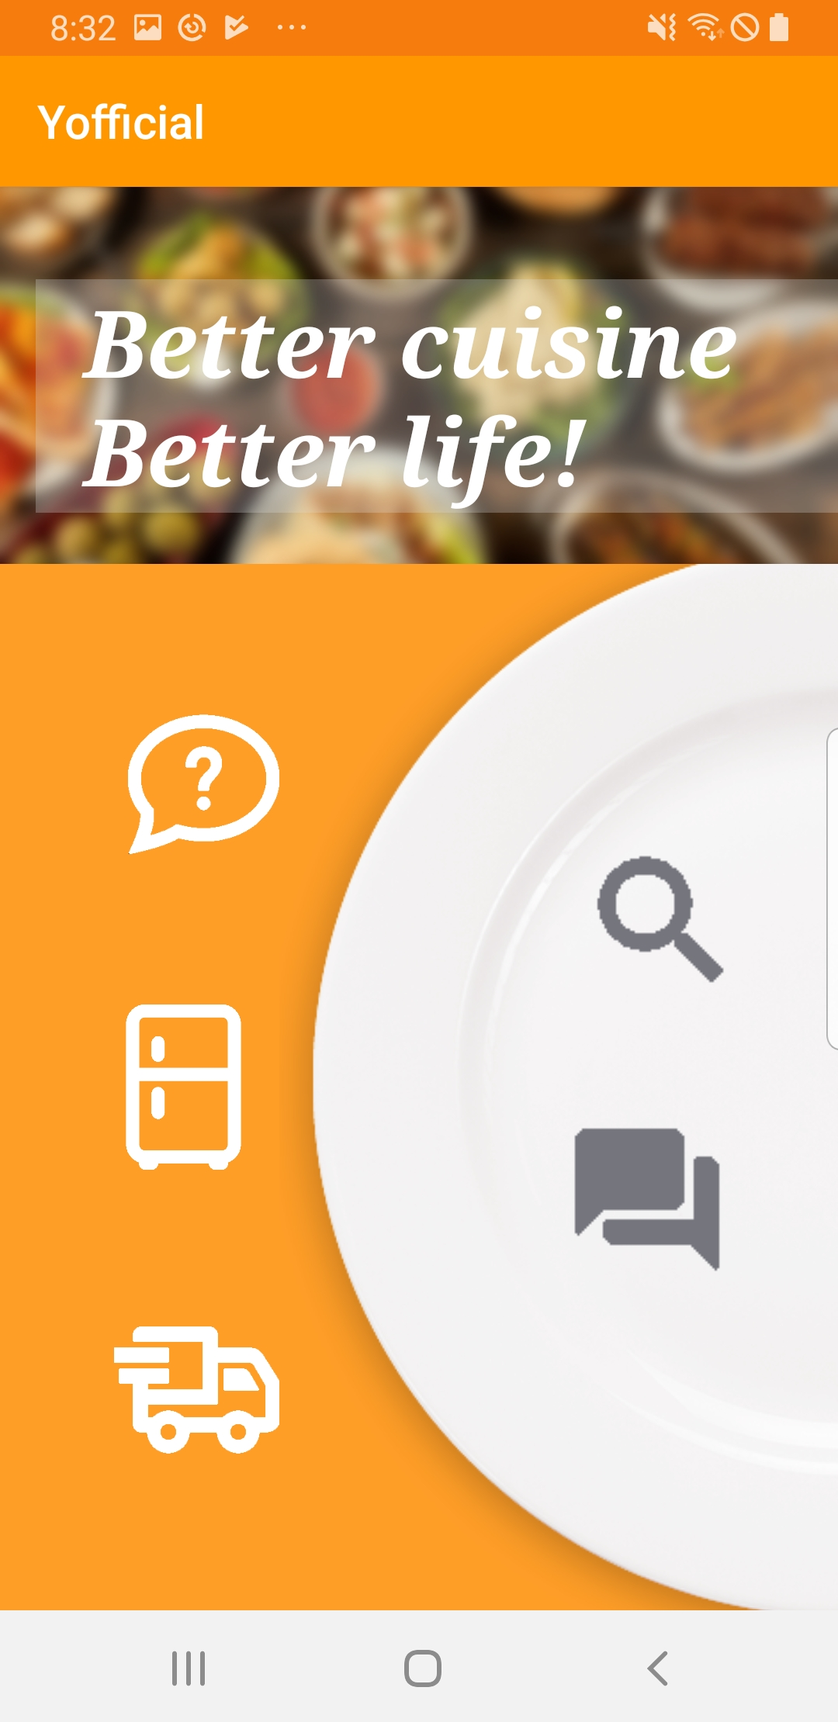
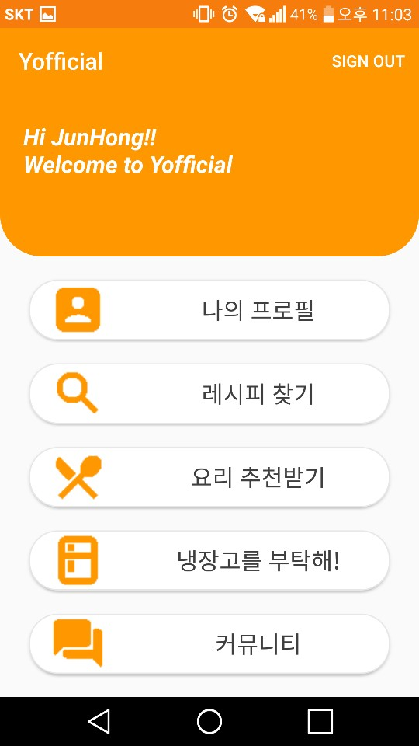
Progression
01
Main UI

Slide 5
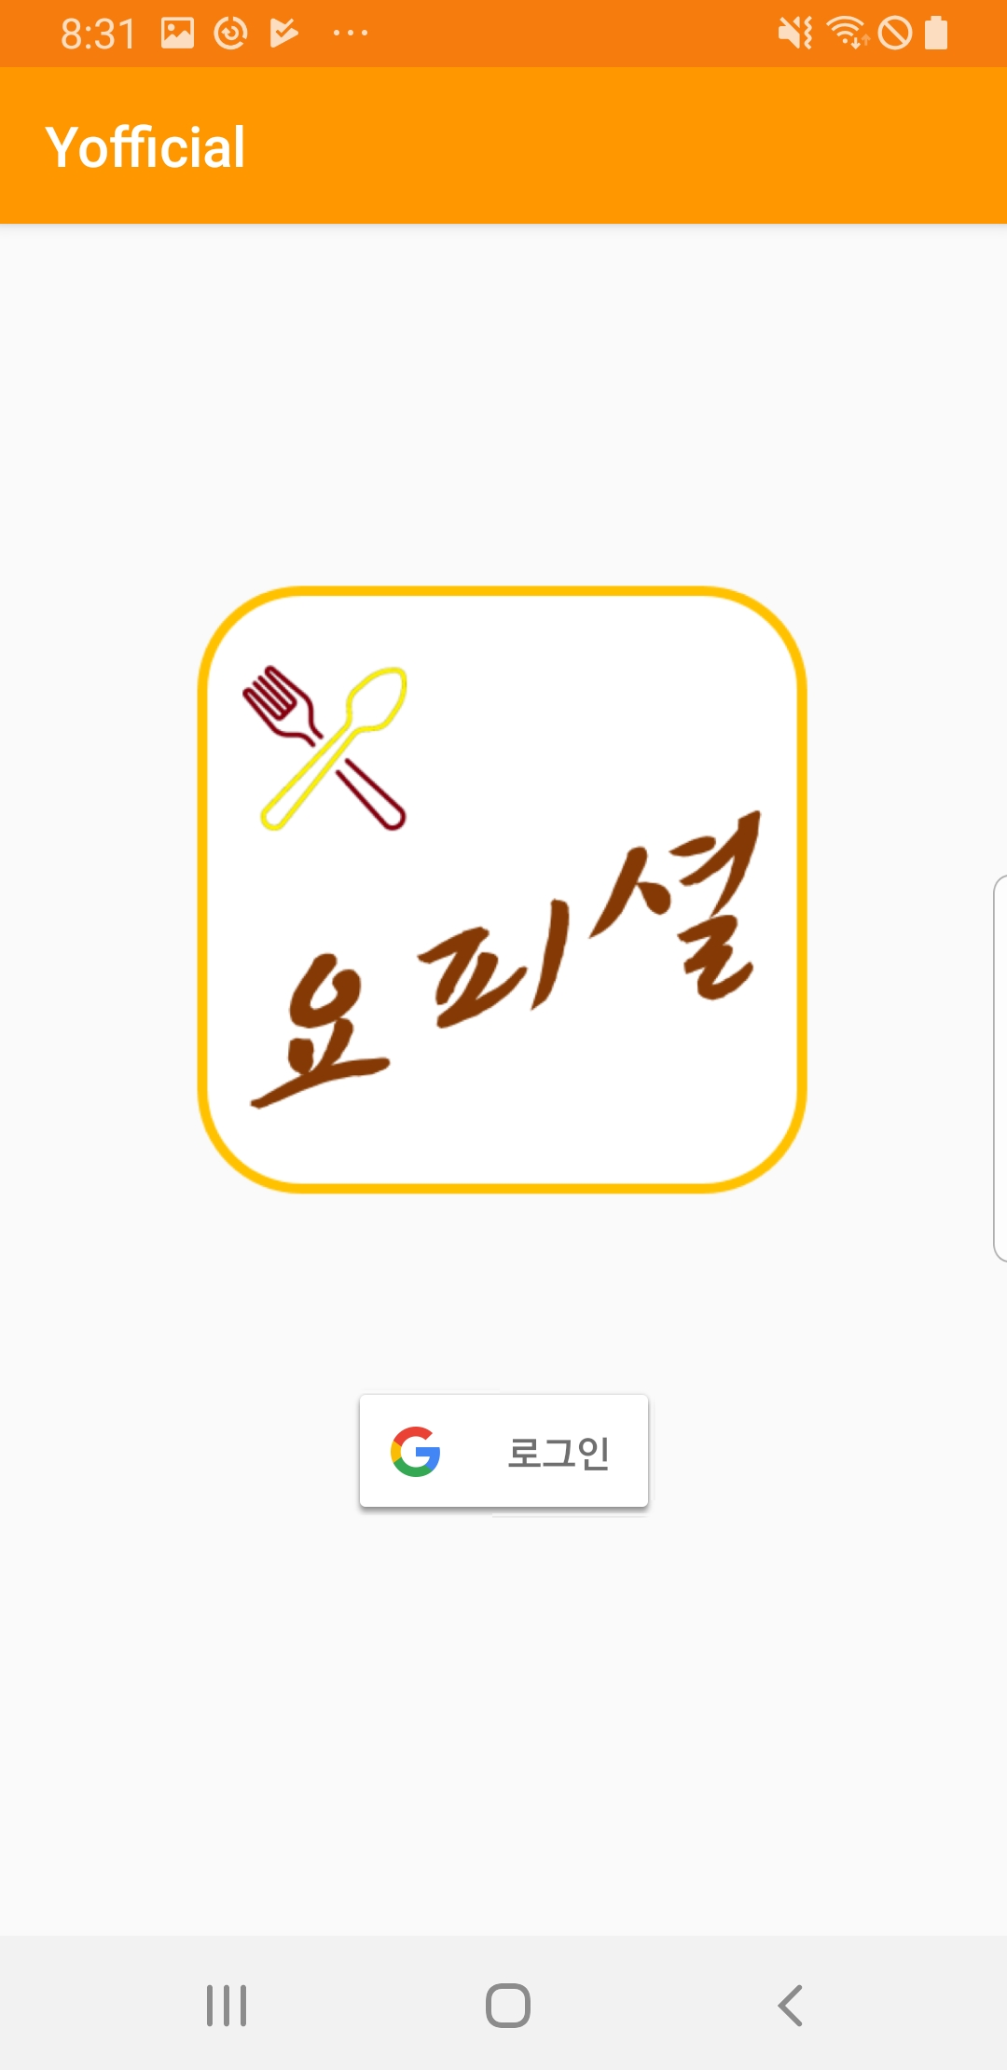
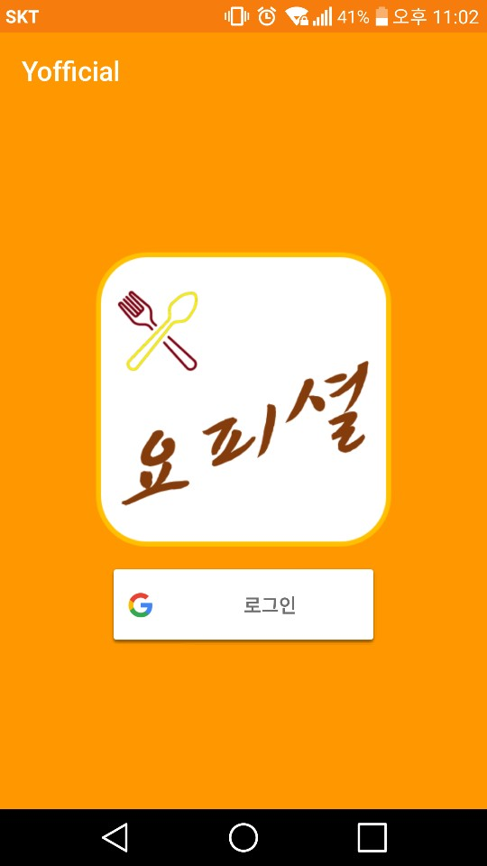
Progression
01
Sign In UI

Slide 6
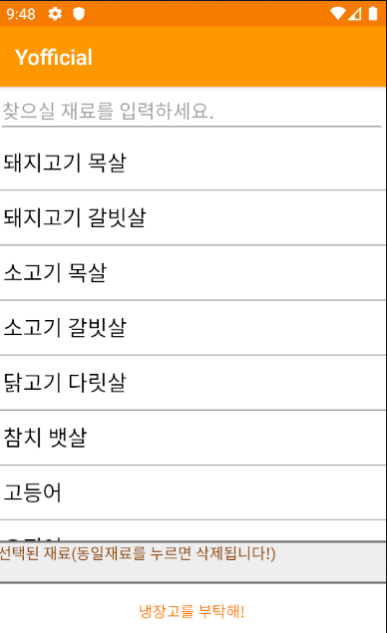
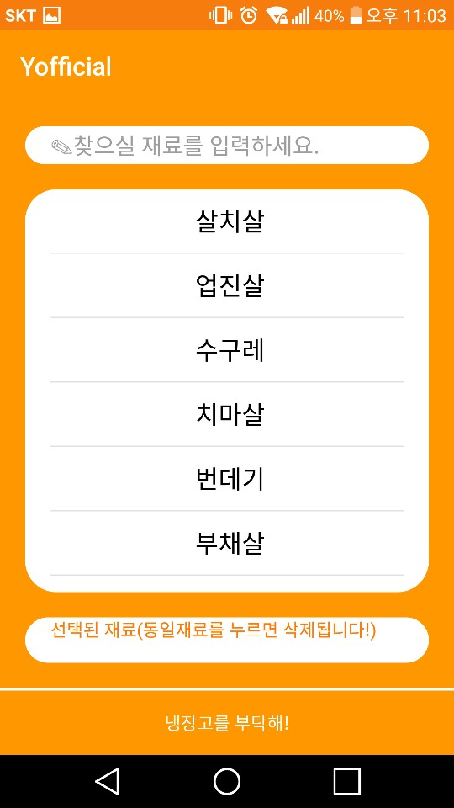
Progression
01
Refreg UI

Slide 7
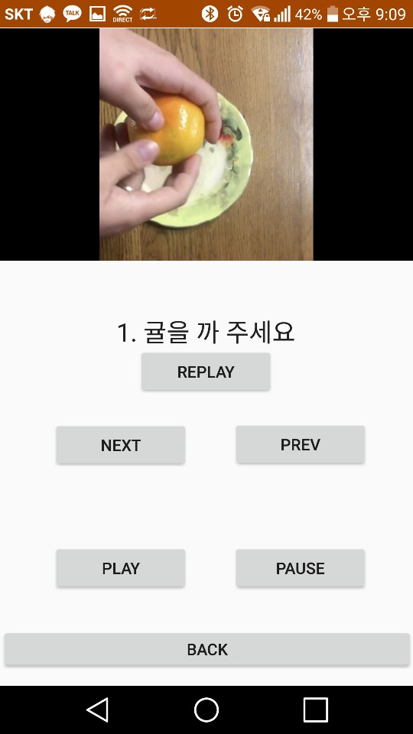
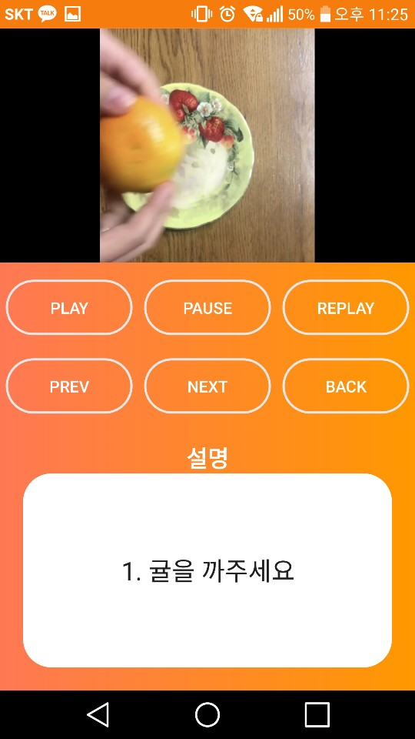
Progression
01
Video UI

Slide 8
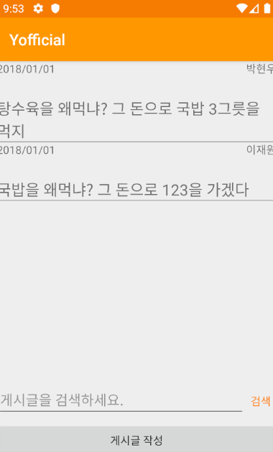
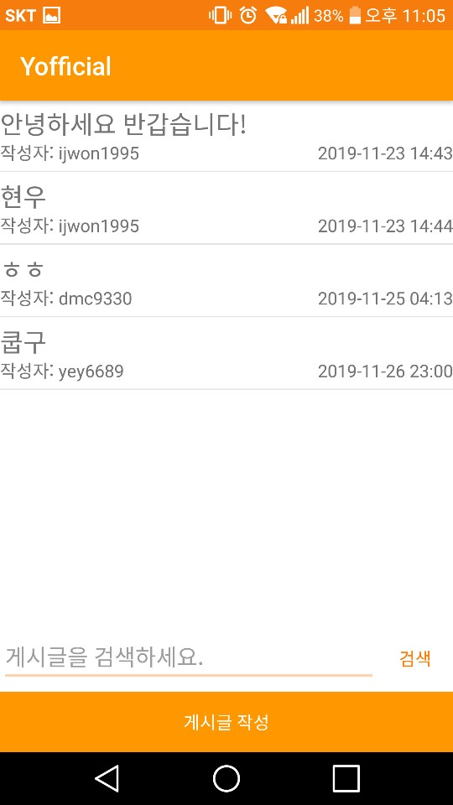
Progression
01
Board UI

Slide 9
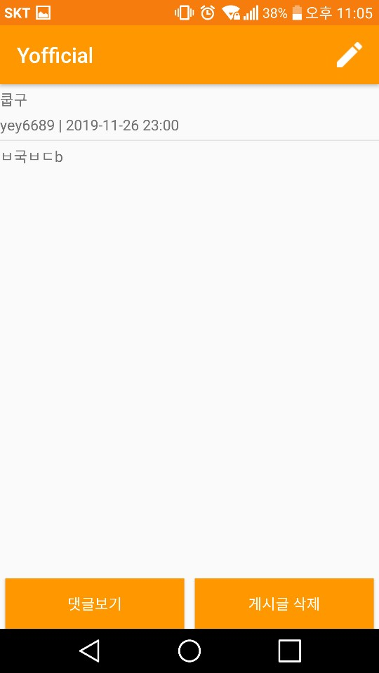
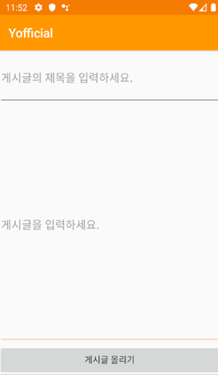
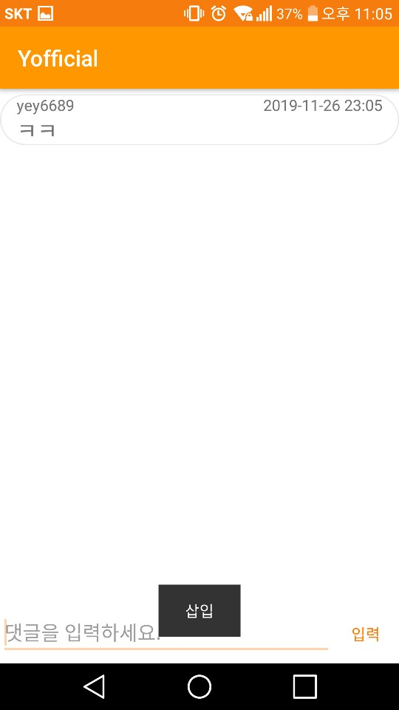
Progression
01
Board UI

Slide 10
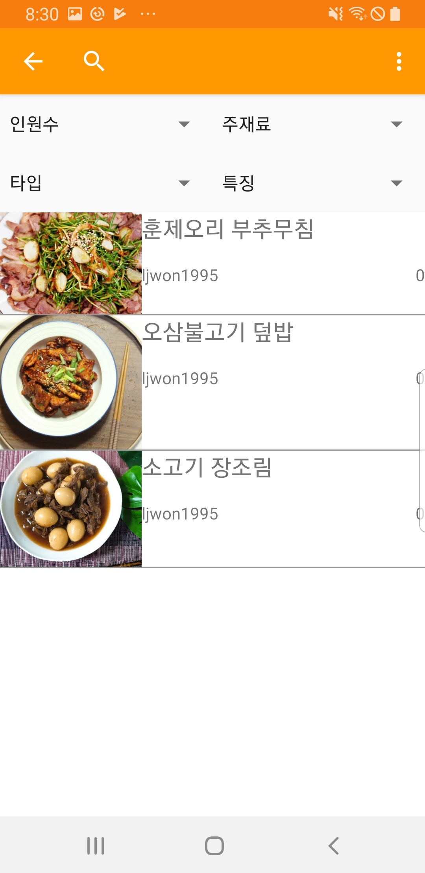
Progression
01
DB Integrated

Slide 11
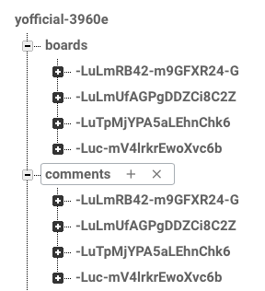
Progression
01
DB Integrated

Slide 12
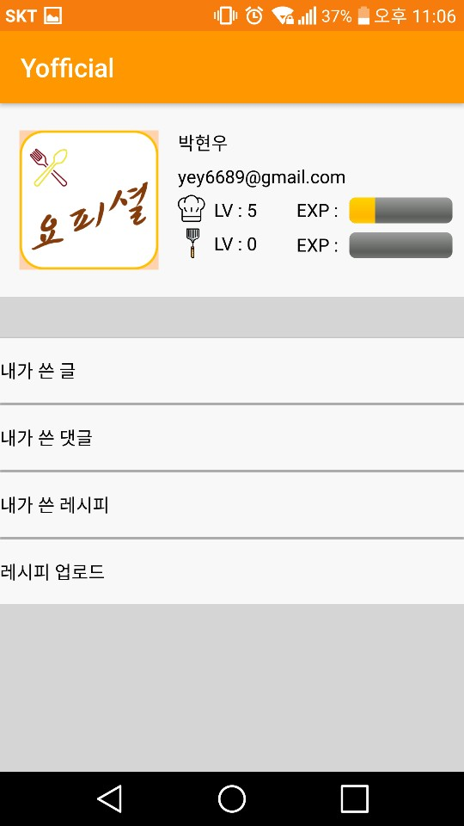
Progression
01
UI design &
DB Integrated

Slide 13
Trouble Shooting

Slide 14






Trouble Shooting
02
Sign In problem
MY
Other

Slide 15


Trouble Shooting
02
Sign In problem
- To make OAuth2 client and API key for app
- Need to give SHA1 key for “each” project

Slide 16
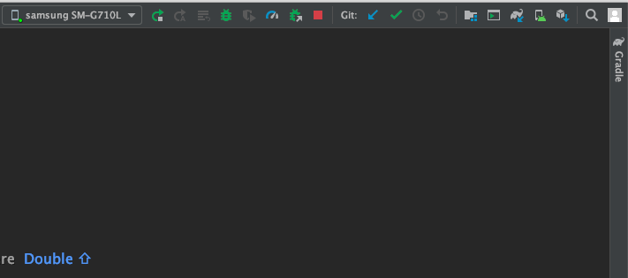
Trouble Shooting
02
Sign In problem

Slide 17
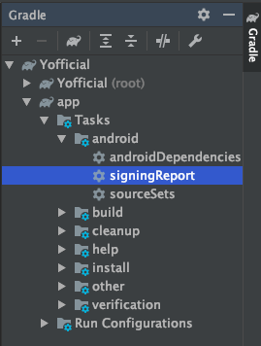
Trouble Shooting
02
Sign In problem

Slide 18
Trouble Shooting
02
Back Button Problem
Sign Out

Slide 19
Trouble Shooting
02
Back Button Problem
Back Button

Slide 20
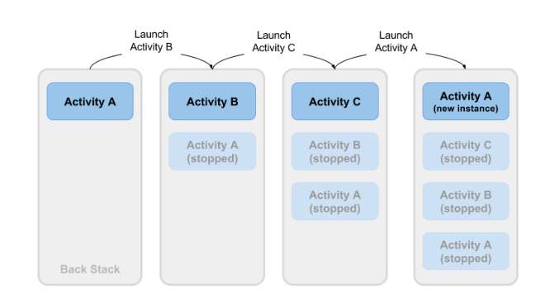
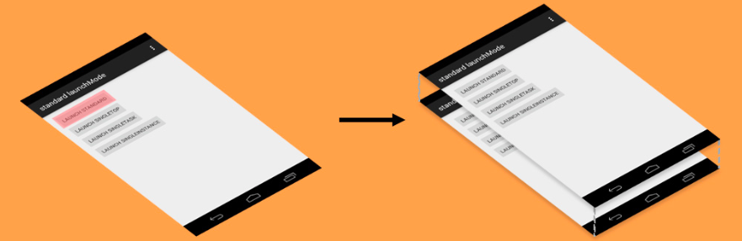
Trouble Shooting
02
Back Button Problem

Slide 21
Trouble Shooting
02
Back Button Problem

Slide 22
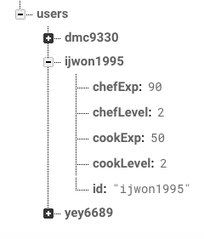
Trouble Shooting
02
Firebase Data Save Error
Email
ijwon1995@naver.com

Slide 23
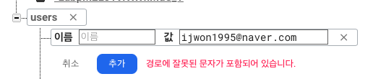
Trouble Shooting
02
Firebase Data Save Error

Slide 24
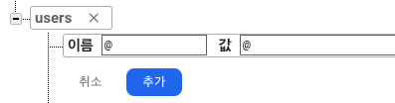


Trouble Shooting
02
Firebase Data Save Error

Slide 25
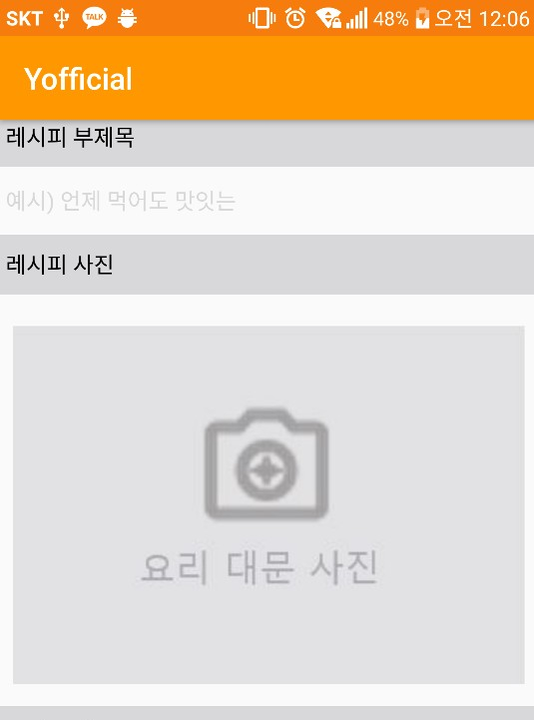
Trouble Shooting
02
Picture Upload Error

Slide 26


Trouble Shooting
02
YouTube Thread Error

Slide 27
Trouble Shooting
02
YouTube Thread Error
>
100ms
Current Time
End Time
Player. pause

Slide 28

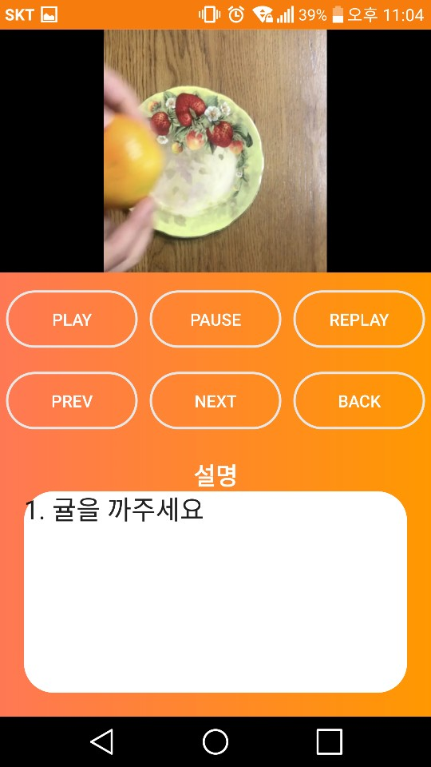
Trouble Shooting
02
YouTube Thread Error
@Override public void run() {
}
Sleep 100ms
>
while (Current Time
End Time)
Player. pause
if(step remained)
onSeekTo

Slide 29

Trouble Shooting
02
YouTube Thread Error
>
while (Current Time
End Time && !flag)

Slide 30
Schedule

Slide 31
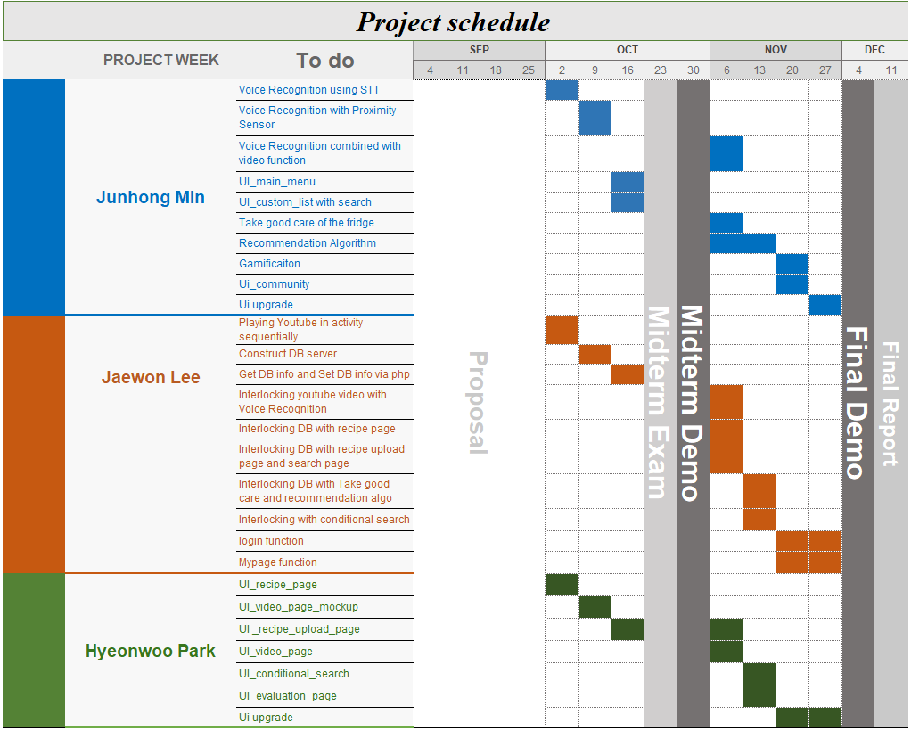
Schedule
03

Slide 32
The end
Thank you

