Slide 1
Yofficial
Team 9 MojaDol

Slide 2
Contents
Team Introduction
Project
Plan

Slide 3
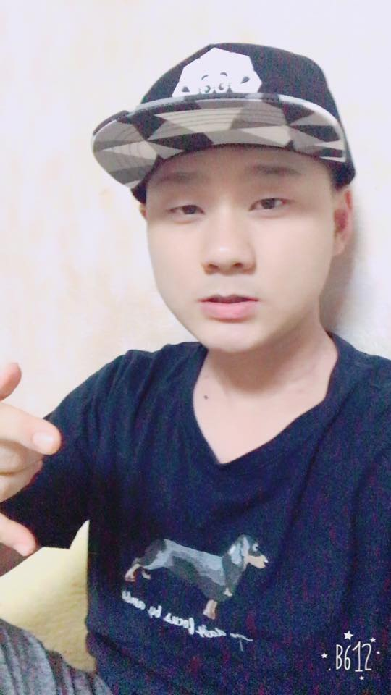
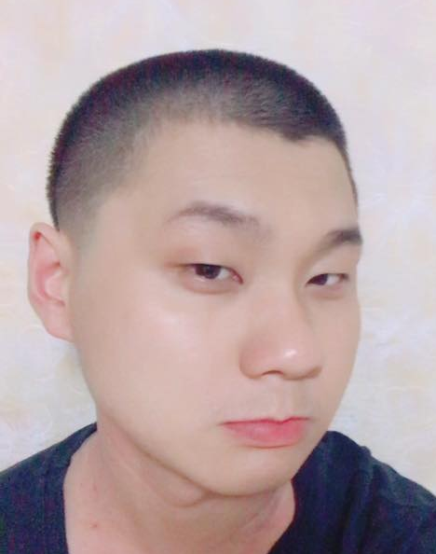

1. Team Introduction
MojaDol
Moja
Dol

Slide 4
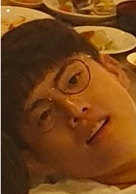
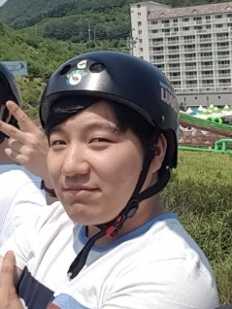
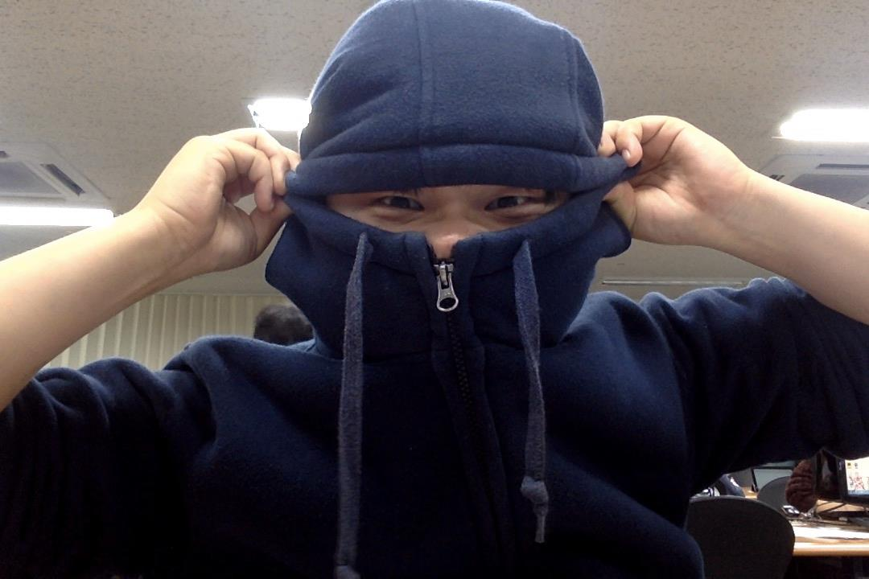
1. Team Introduction
Stupid(Moja) Three Stone(Dol)
Moja(Cap) Dol(Stone)

Slide 5

2. Project Introduction

Slide 6



2. Project motivation
- Three main recipe Apps
- Some problems and inconvenience

Slide 7
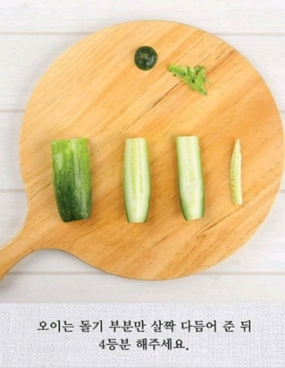
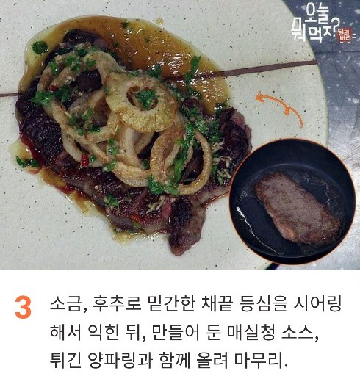
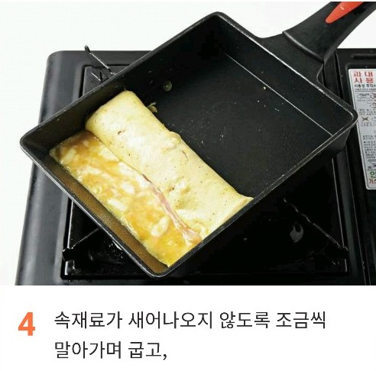
2. Project motivation
Obscure Explanation

Slide 8
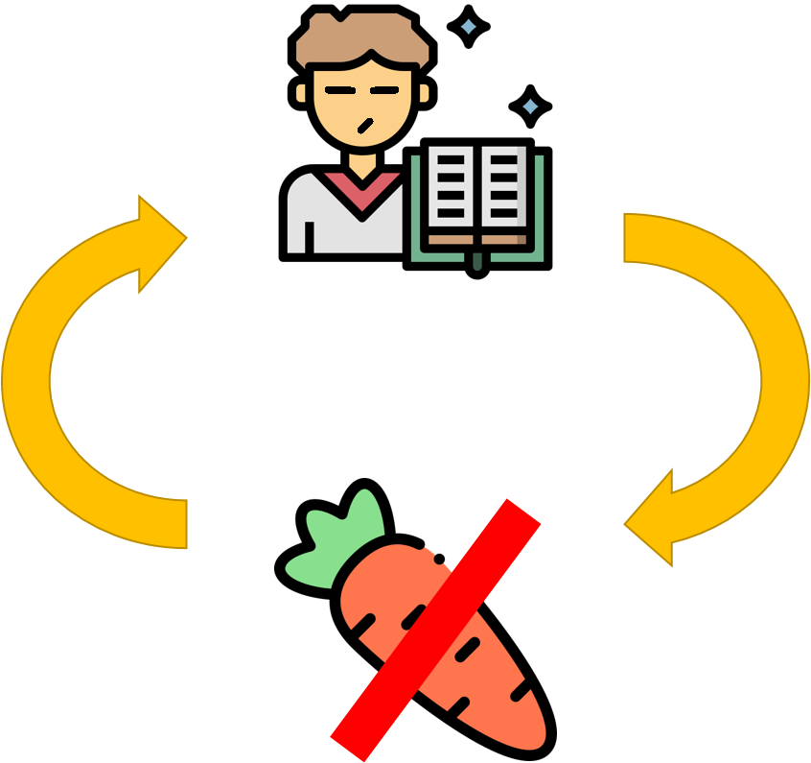

2. Project motivation
Lack of boosting Motivation

Slide 9

2. Project motivation
Extendable Convenient Function

Slide 10
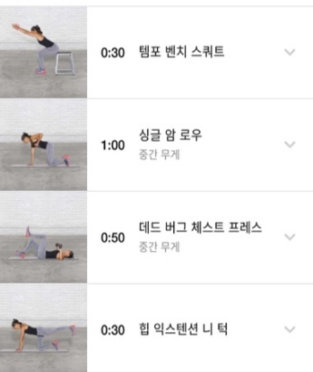
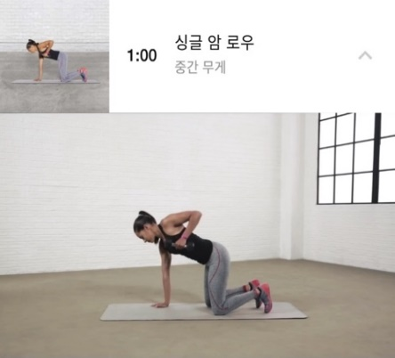
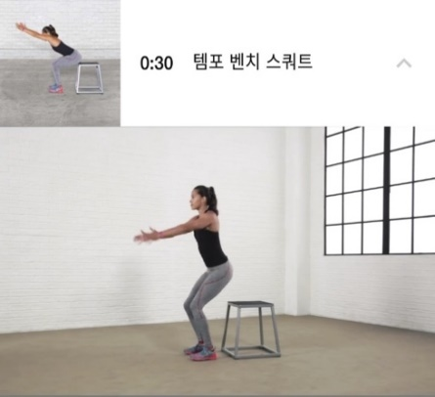
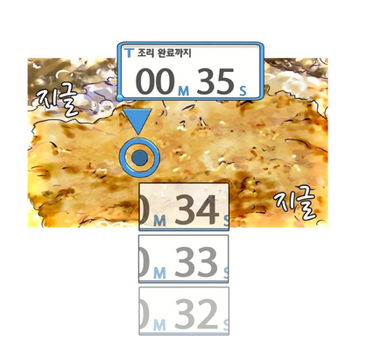
2. Project Goal
So our Yofficial pursue..
Concrete Explanation Using Video

Slide 11
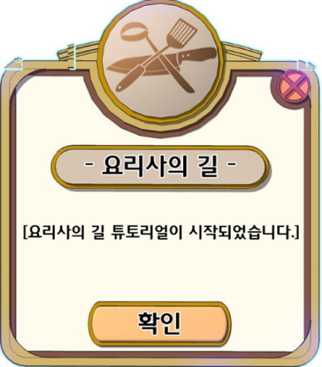

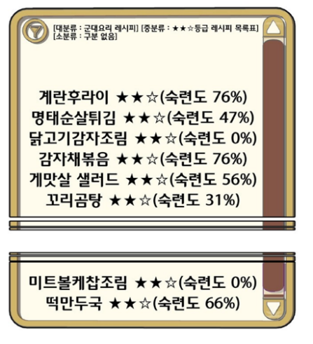
2. Project Goal
So our Yofficial pursue..
Motivate through Gamification
Notes:
쿡과 셰프 모두

Slide 12
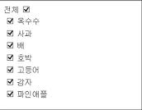

2. Project Goal
So our Yofficial pursue..
Extend convenience

Slide 13

2. Project Goal
So our Yofficial pursue..
Extend convenience

Slide 14


2. Project Goal
So our Yofficial pursue..
Extend convenience

Slide 15
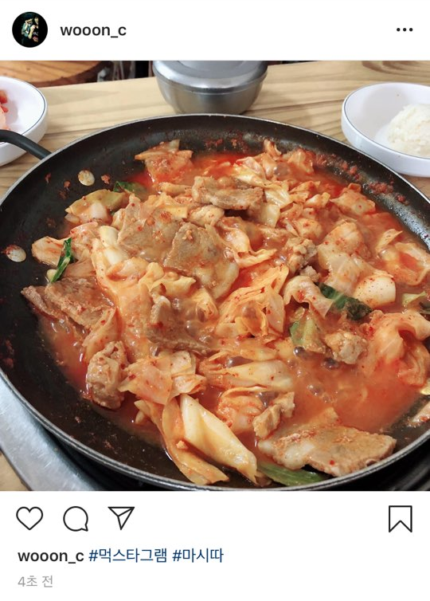

2. Project Goal
So our Yofficial pursue..
Extend convenience

Slide 16


2. Project Goal
So our Yofficial pursue..
Revenue Model For Uploader

Slide 17
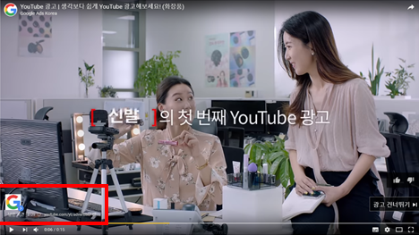
2. Project Goal
So our Yofficial pursue..
Revenue Model For Uploader

Slide 18
2. Project Development and Implementation Contents
Voice Recognition and Processing for a navigation
Change Voice To Text
Interpret text and do a designated action
2) Recommendation Algorithm
Recommend dishes based on ingredients that they currently have and their preference
3) Interlocking with YouTube
Use YouTube clips for making video in our app

Slide 19
2. Project Development and Implementation Contents
4) Overall Android App Programming Knowledge
Gamification
UI Design
5) Interlocking with other Apps
-Automatic order ingredients by out apps

Slide 20
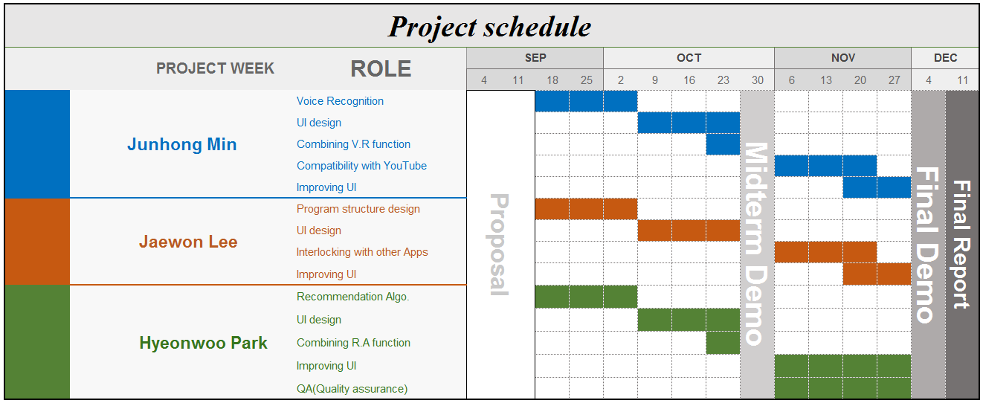
3. Plan

Slide 21
Thank You

