Slide 1
Yofficial ver2.0
Team 9 MojaDol

Slide 2
Contents
Brief Review
Feedbacks & Solutions
Schedule

Slide 3

2. Project Introduction

Slide 4
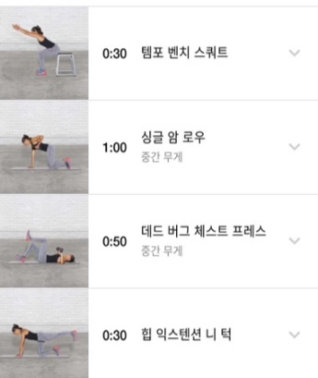
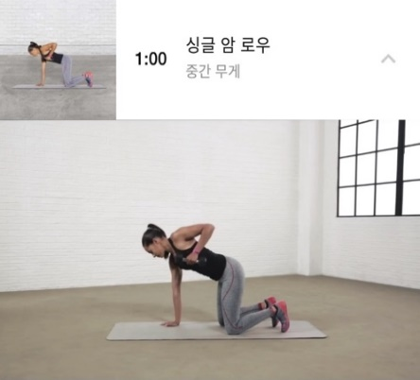
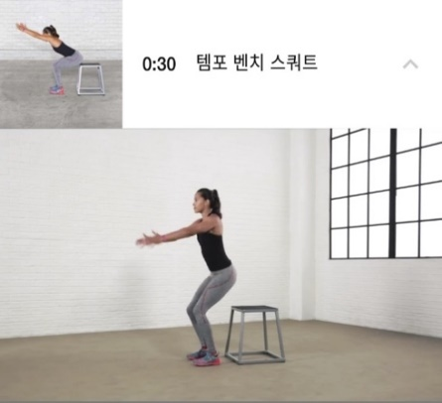
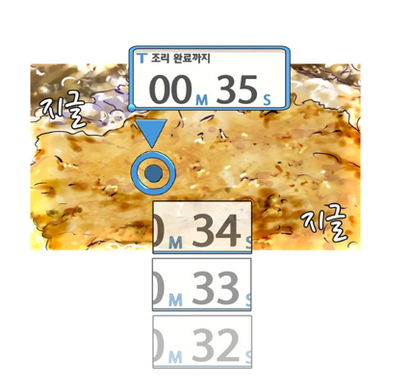
1. Brief Review
So our Yofficial pursue..
Concrete Explanation Using Video

Slide 5


1. Brief Review
So our Yofficial pursue..
Control Video Using Voice Recognition

Slide 6


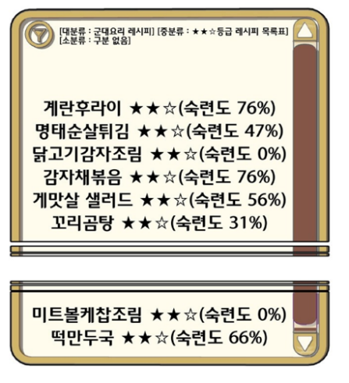
1. Brief Review
So our Yofficial pursue..
Motivate through Gamification
Notes:
쿡과 셰프 모두

Slide 7
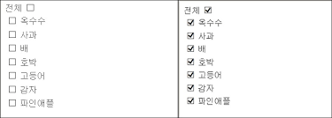


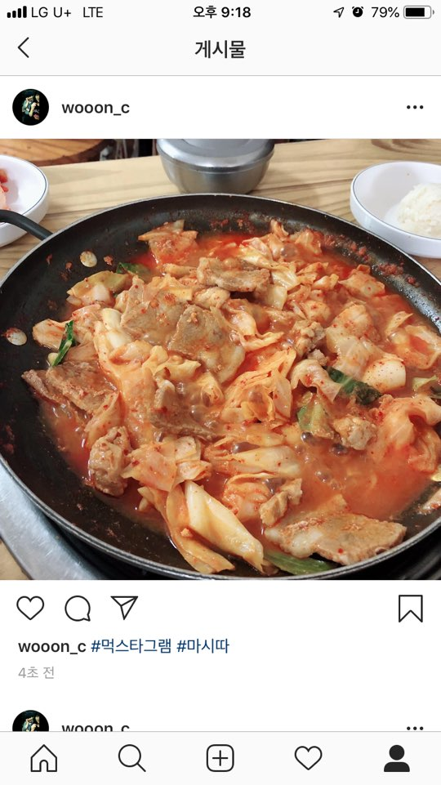



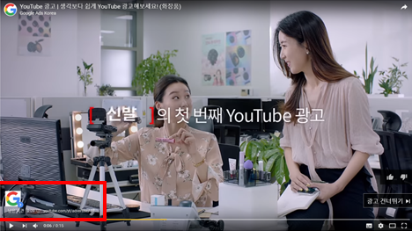
1. Brief Review
And..
Ordering Sys through online mall
Recommendation Functions
Interlocking with SNS application
Boosting Motivation to Chefs

Slide 8







2. Feedbacks & Solutions
Q. Is Yofficial really better than YouTube?
Chefs
Cooks

Slide 9

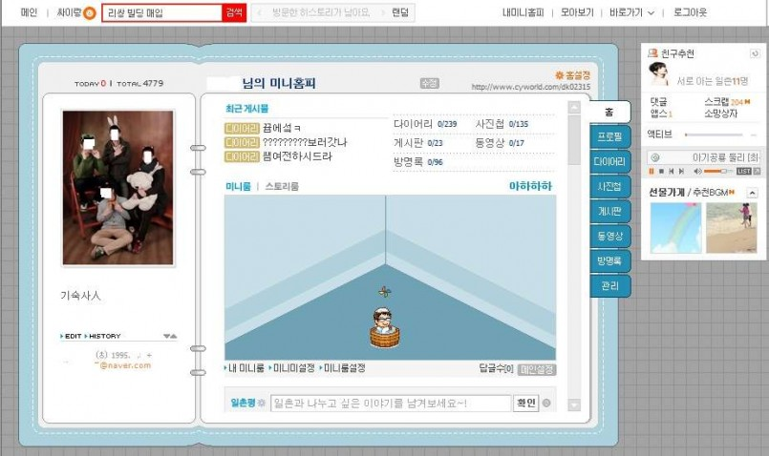

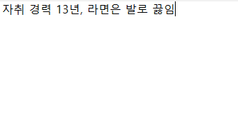

2. Feedbacks & Solutions
Q. Can your app cut out poor chef among good chefs?

Slide 10
2. Feedbacks & Solutions
Q. It seems your app is lack of functions for beginner
Concrete Explanation Using Video
Motivate through Gamification
Ordering Sys through online mall

Slide 11

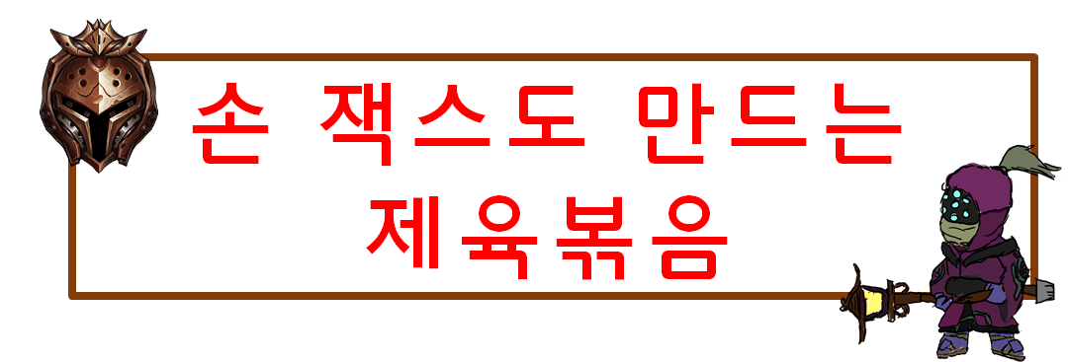



2. Feedbacks & Solutions
Q. It seems your app is lack of functions for beginner(cont’)
Providing suitable video according to cook’s tier

Slide 12
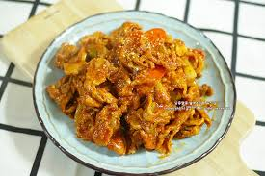

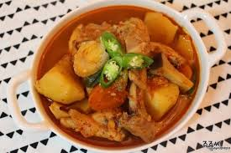
2. Feedbacks & Solutions
Q. It seems your app is lack of functions for beginner(cont’)
1인분
王 초보도 간단! 제육 복음 만들기
for
2인분
너도 할 수 있다! 닭볶음탕 만들기
for
Giving servings tag to cooks

Slide 13
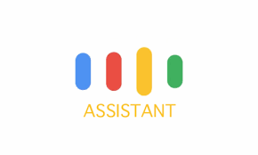






2. Feedbacks & Solutions
Q. Battery issue processing voice recognition while playing video
Voice Recognition API on Application
Google Assistant
Consuming battery quickly, but fast reaction
Relatively less consuming battery, but
slow reaction and can even cause pause

Slide 14

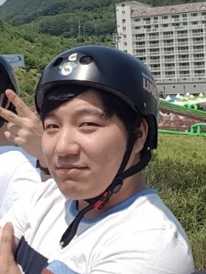

3. Schedule
By next presentation….
Jae Won Lee
Devise parsing videos and Include them into our app
Think out attractive gamification and its details
Hyeon Woo Park
Design entire UI activity,
such as where a button is,
how to show certain screen
of the app, and how to
interlock them.
Jun Hong Min
Investigate two ways of
voice recognition
Think out way of recommendation and
its algorithms

Slide 15
Thank You

