Slide 1
Yofficial
Capstone Design 1 Class No.4 / Team No.9
민준홍
중앙대학교 컴퓨터공학부
20140006

Slide 2
Content
1. Project proposal review
2. Progression and Changes with feedbacks
3. Schedule

Slide 3

Project proposal review
01
[ Yofficial ] is
Android app about recipe
More easy, More kind !

Slide 4
Project proposal review
02
Main
Functions
Sub
Recipe with video
Step by step
With Voice Recognition
Community
Gamification
Interlocking with other apps
Recommendation System

Slide 5

Progression and Changes with feedbacks
01
Changes with Feedbacks
Battery issue
How to change tiers
Money
Tier
\
Recognition
act by motion
using proximity sensor.
Self evaluation system about their results.
Generating revenue
using ad and partnership other service

Slide 6
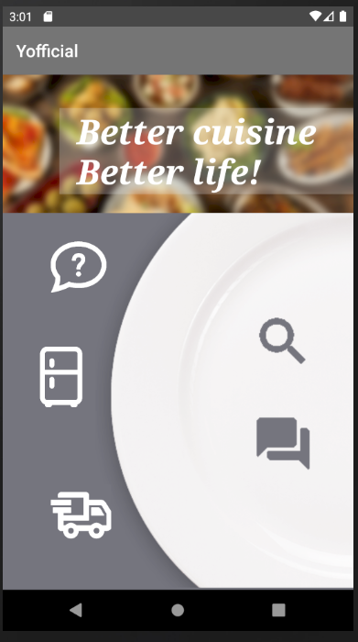
Progression and Changes with feedbacks
01
Progression of UI

Slide 7
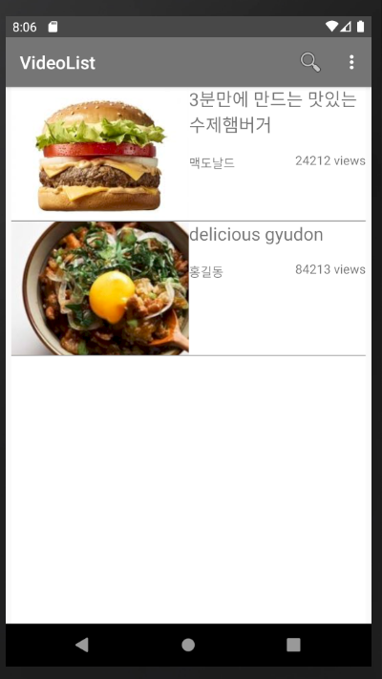
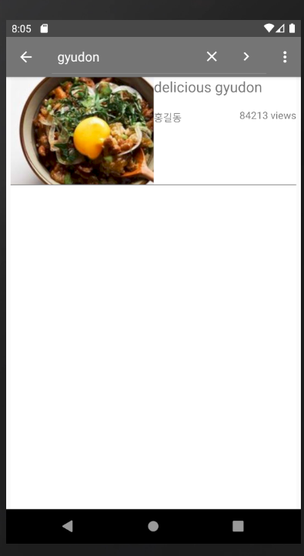
Progression and Changes with feedbacks
02
Progression of UI

Slide 8
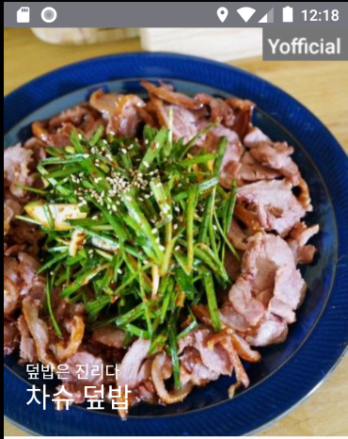
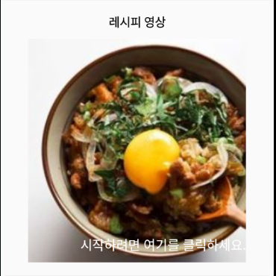
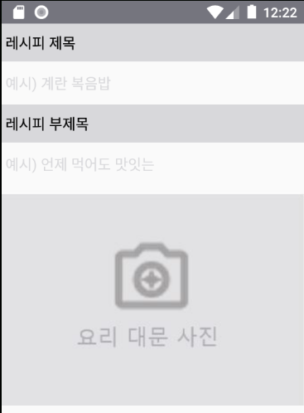
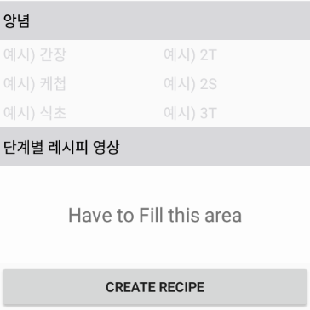
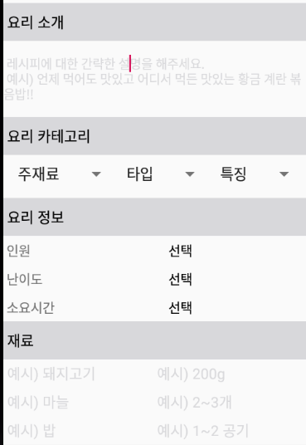
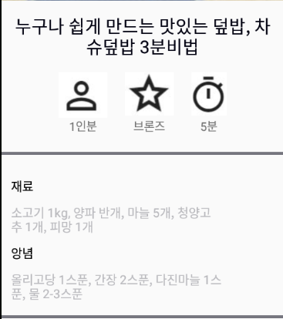
Progression and Changes with feedbacks
03
Progression of UI

Slide 9
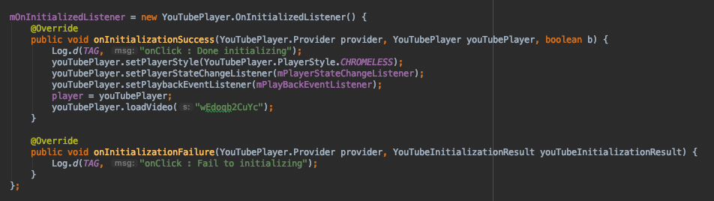

Progression and Changes with feedbacks
04
Progression of functions
Video loading and parsing
Start video playing

Slide 10
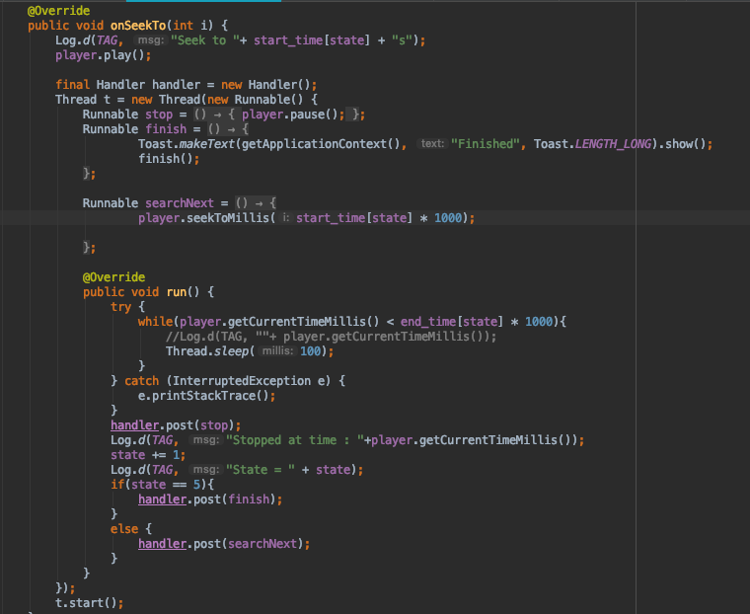
Progression and Changes with feedbacks
05
Progression of functions
Video playing by steps

Slide 11
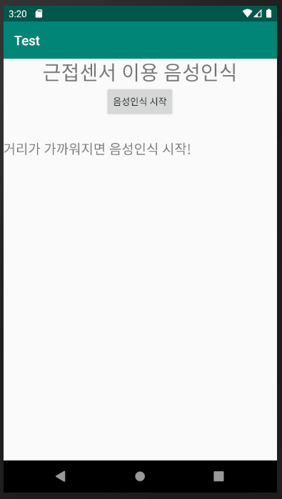
Progression and Changes with feedbacks
06
Progression of functions

Slide 12
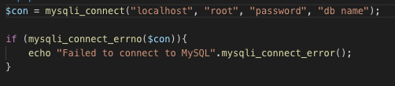
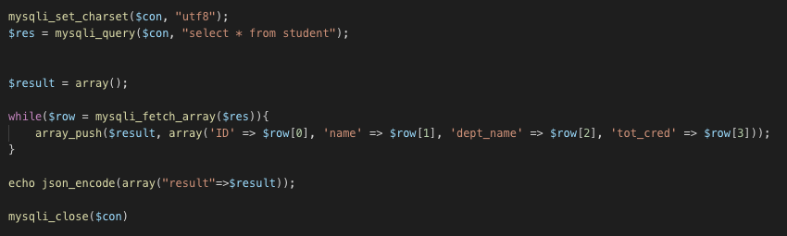
Progression and Changes with feedbacks
07
Progression of Back-End
PHP part
Connecting DB and Encoding to JSON format in server

Slide 13
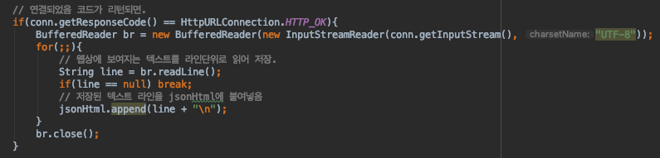
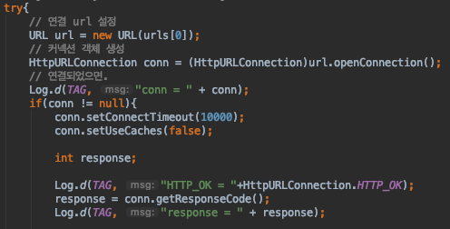
Progression and Changes with feedbacks
08
Progression of Back-End
Connecting PHP in server
Getting a data

Slide 14
Schedule
01
WEEK 10
Prototype of Recommendation
WEEK 12
Completion of main functions
WEEK 14
Completion of Yofficial
WEEK 9
Completion of Video service
Completion of Log-In
WEEK 11
Completion of Recommendation & Gamification
WEEK 13
UI upgrade
Completion of sub functions

Slide 15
The end
Thank you

