Slide 1
Yofficial
Team 9 MojaDol

Slide 2
Contents
Progress
Trouble shooting
Schedule

Slide 3

1. Progress

Slide 4


1. Progress
DB part

Slide 5


1. Progress
DB part

Slide 6
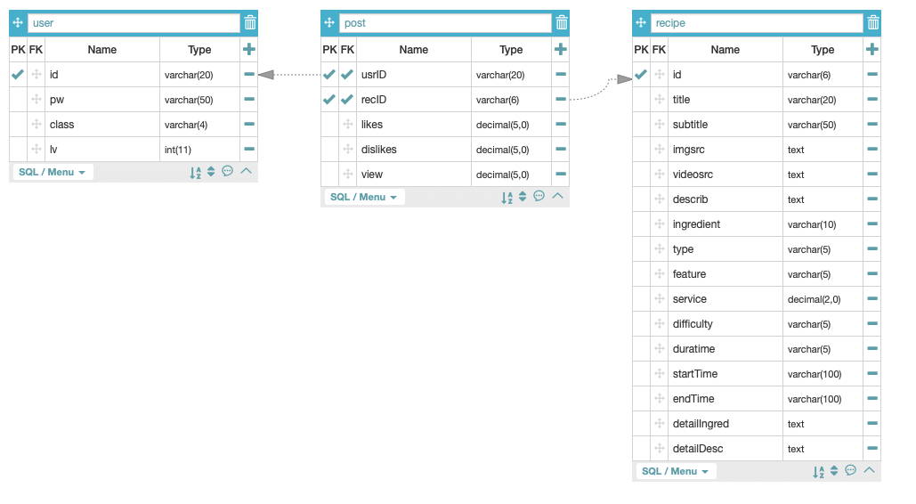
1. Progress
DB part

Slide 7

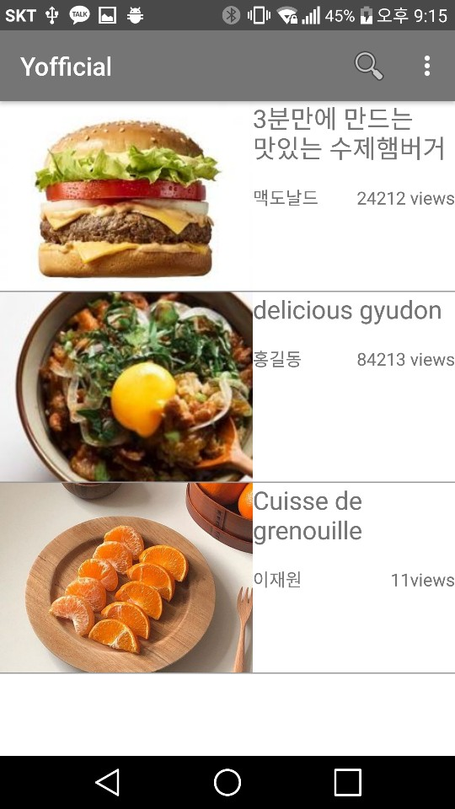
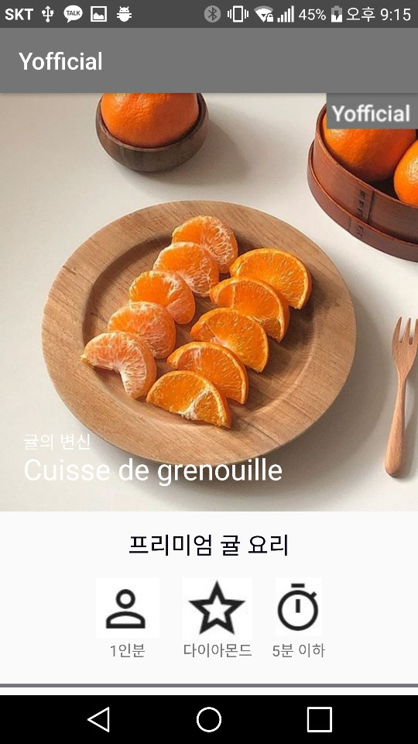
1. Progress
Main
Search
Recipe

Slide 8
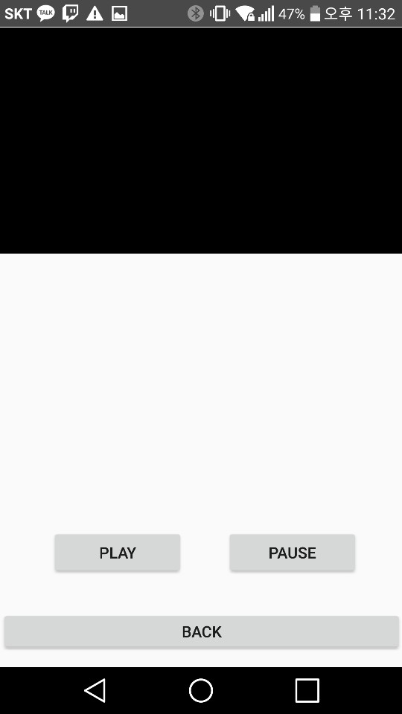
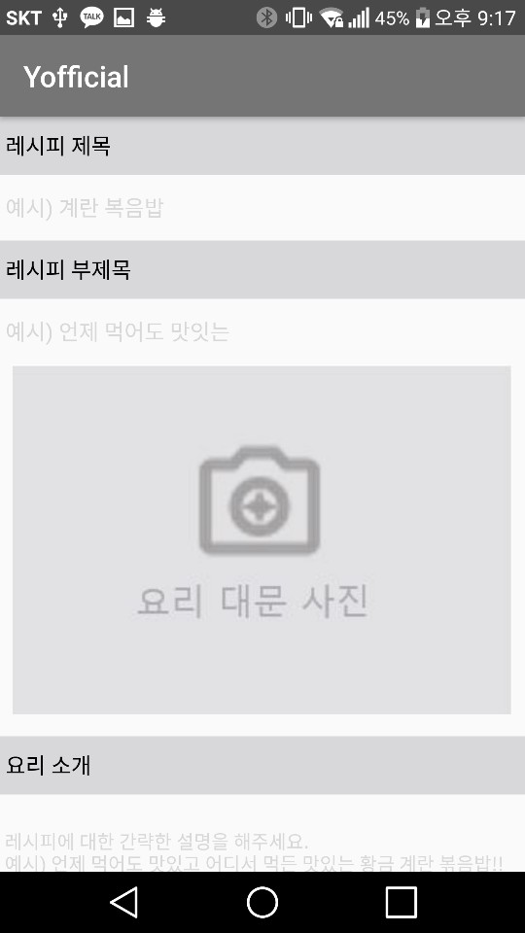
1. Progress
Play
Post

Slide 9



2. Trouble Shooting
Start time
End time

Slide 10
2. Trouble Shooting
Thread
>
100ms
Current Time
End Time
Player. pause

Slide 11
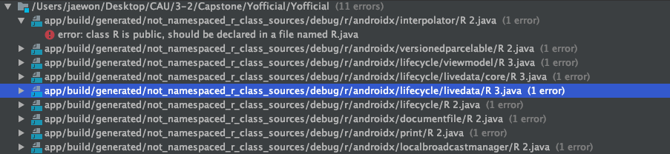
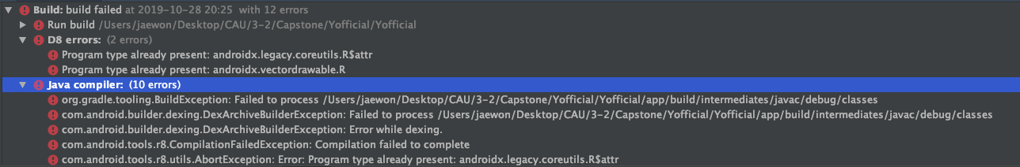
2. Trouble Shooting

Slide 12
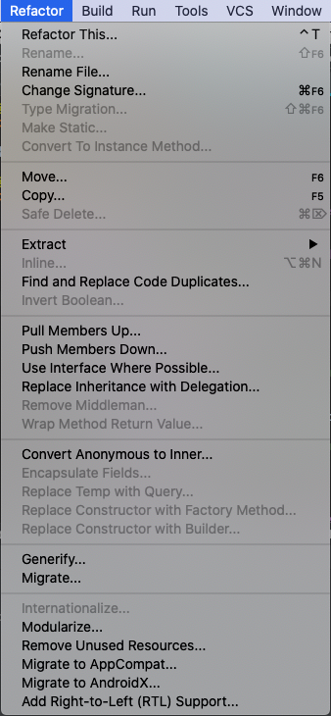
2. Trouble Shooting

Slide 13
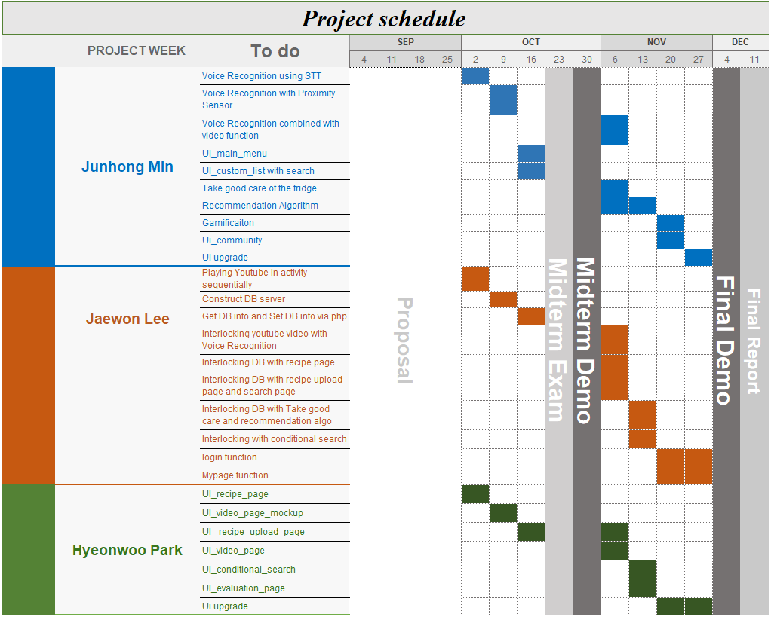
3. Schedule

Slide 14
Thank You

