Slide 1
User SignUp
First Name
Last Name
Mobile no.
Email id
Gender
Address
Password
Create
Sign up as seller

Slide 2
Seller Sign-Up
First Name
Last Name
Mobile no.
Email id
GST no.
Address
Password
Create
Sign up as buyer

Slide 3
Login
UserName/mobile
Password
Login
Forget password!
Create new account

Slide 4
Add Item/ Edit Item
Mobile
Product Id
Item Name
Description
CompanyName
Amount
Category
Add Item/ Update

Slide 5
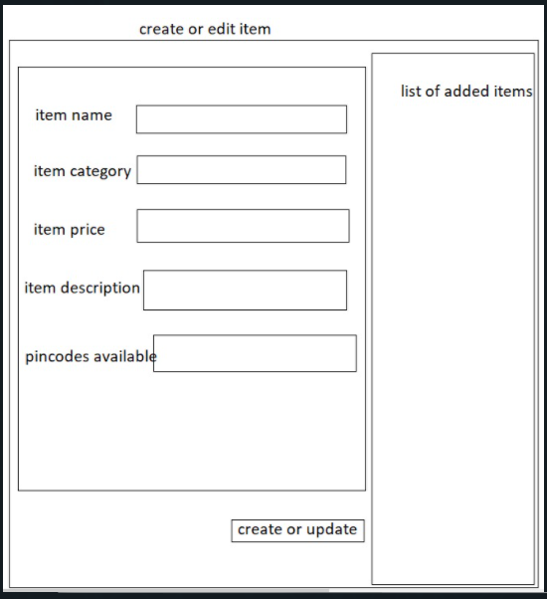

Slide 6
Logo
Search
Login
Cart
AboutUs
Catagory1
Catagory2
Catagory3
Catagory4
Catagory6
Catagory6
Image(SlidShow)
Products
Footer

Slide 7
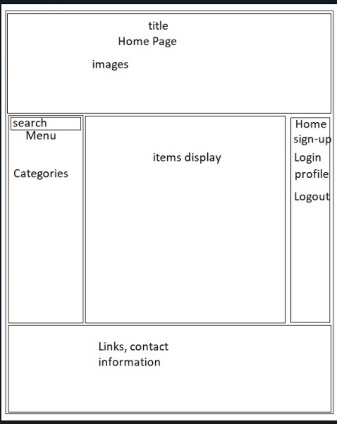
With add to cart option

Slide 8
User Profile
Your Profile
Name
Email
Mobile number
Edit profile
Home
Your order – Track or cancel order
Change password
Deactivate account

Slide 9
Your Order
List of orders
Track
cancel
Home

Slide 10
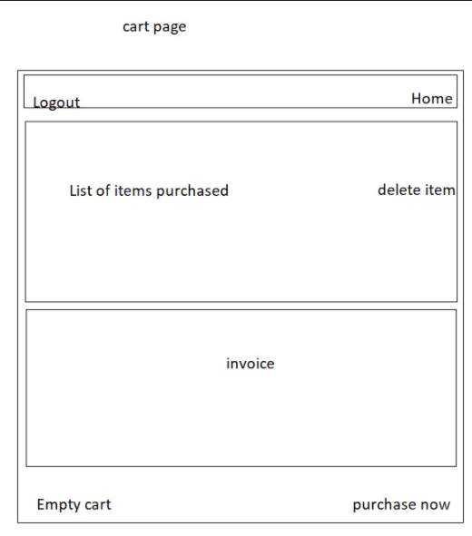

Slide 11
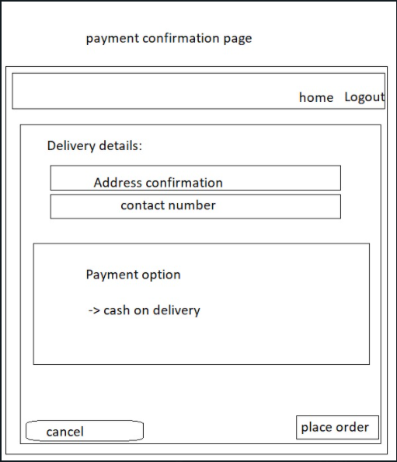

Slide 12
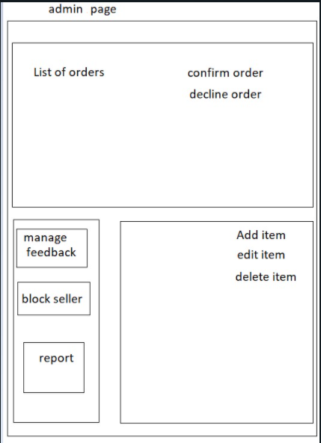
Update order info

Slide 13
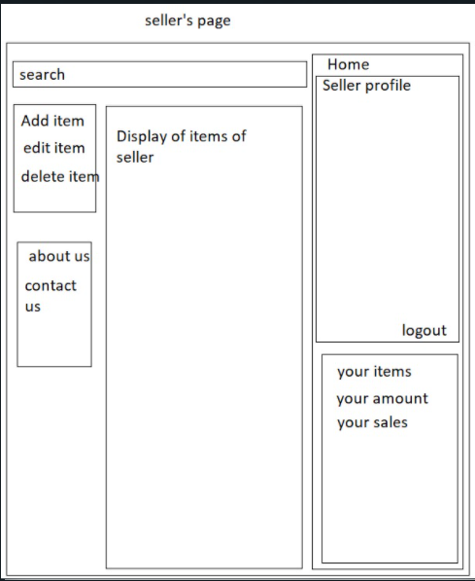

Slide 14
