Slide 1

KHO, YUET HANG HILDA (105110)
TSOI, HIU YUI (105112)
AU, KA CHUN (105113)

Slide 2
CONTENT STRUCTURE
Story Title | TOY BOY
Journey Origin | I'm a wind up toy In an up down world
Journey Destination | Tell him the story of a boy like me
No. of Moments | 6
Text Segments | I'm a wind up toy In an up down world
 | Come to life on a brass spring Such a wonderful plaything
 | But your momma thought There was something wrong Didn't want you sleeping With a boy too long
 | Toys are not sentimental How could i be for rental?
 | I'm the sorest sight Now I feel like trash
 | Tell him the story of a boy like me

Slide 3
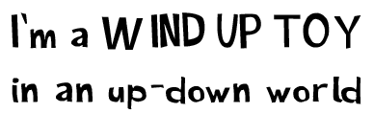




Typography
FONT: Cartoon Toy

Slide 4

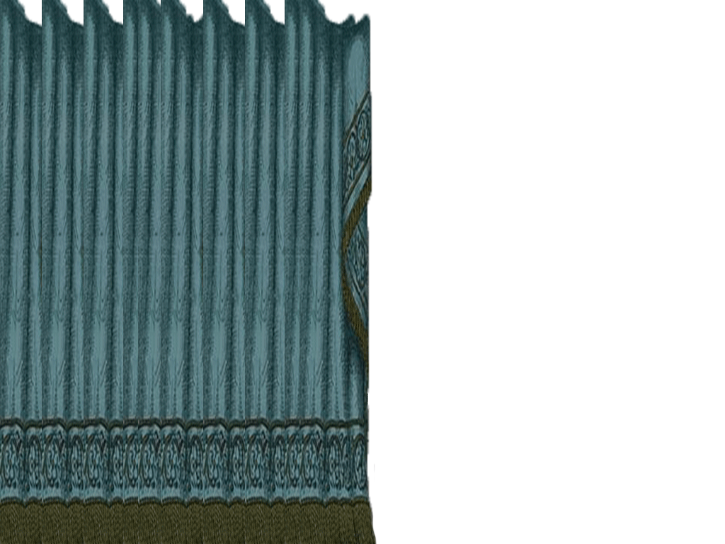
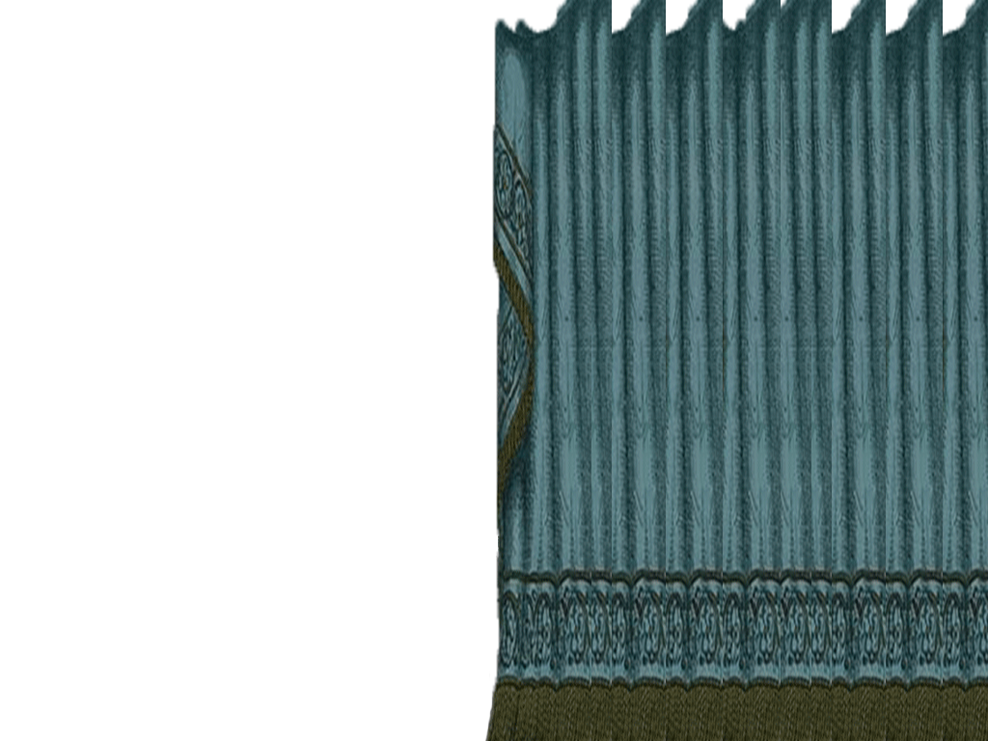
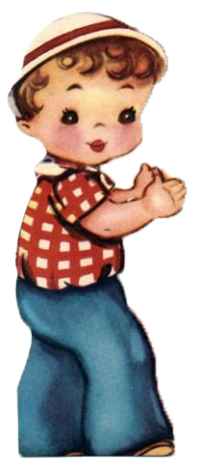
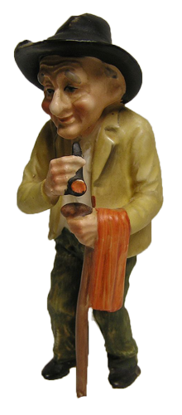
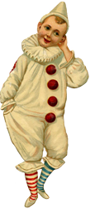
Images

Slide 5
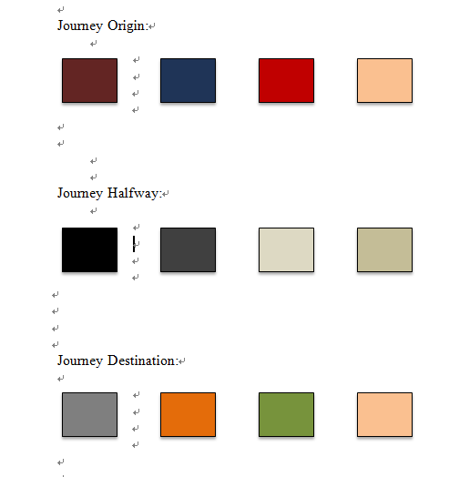
Color script

Slide 6
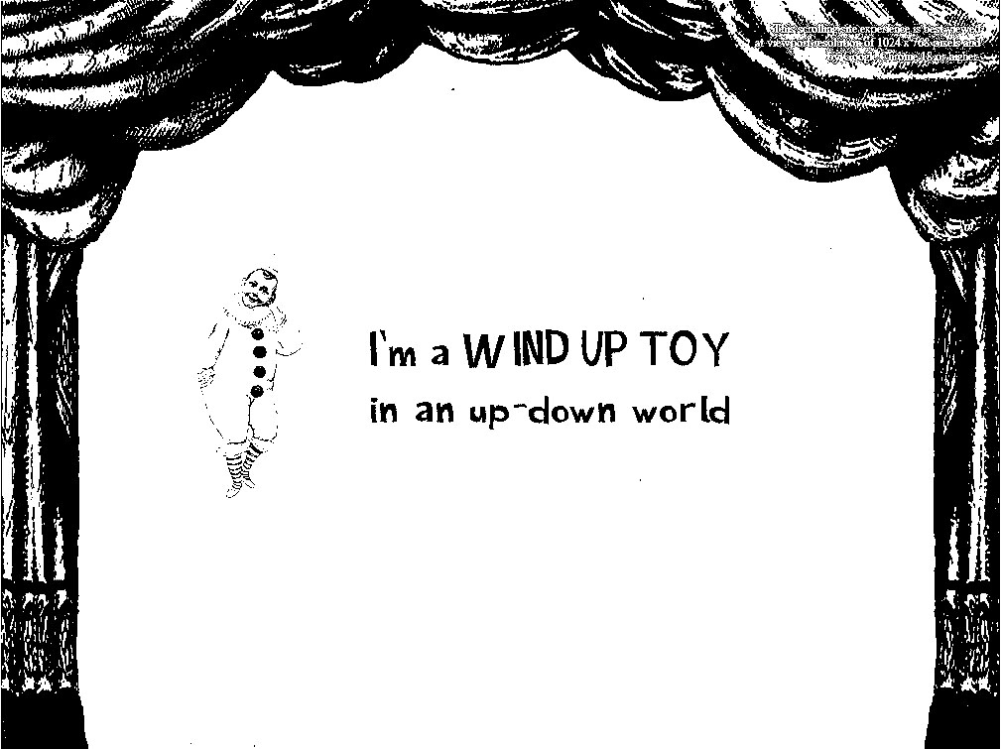
Journey Origin

Slide 7
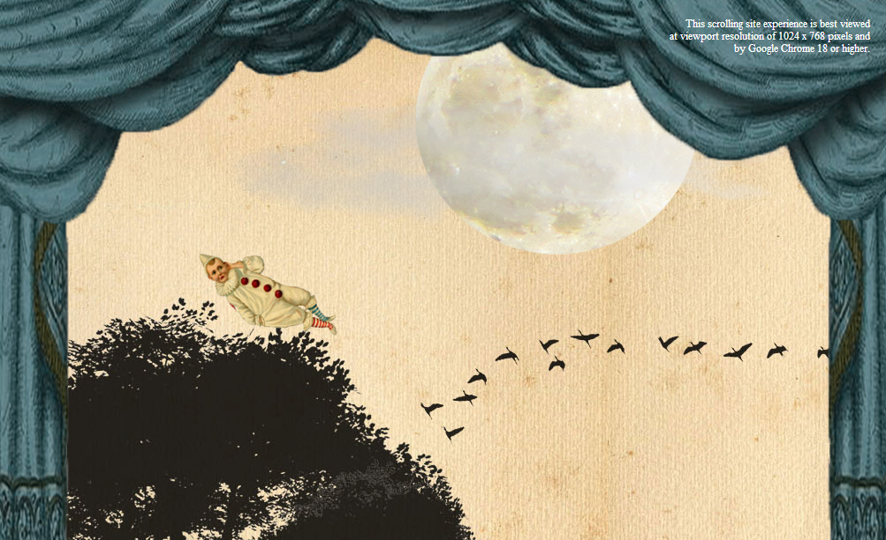
Layers
Foreground
Midground
Midground
Background

Slide 8
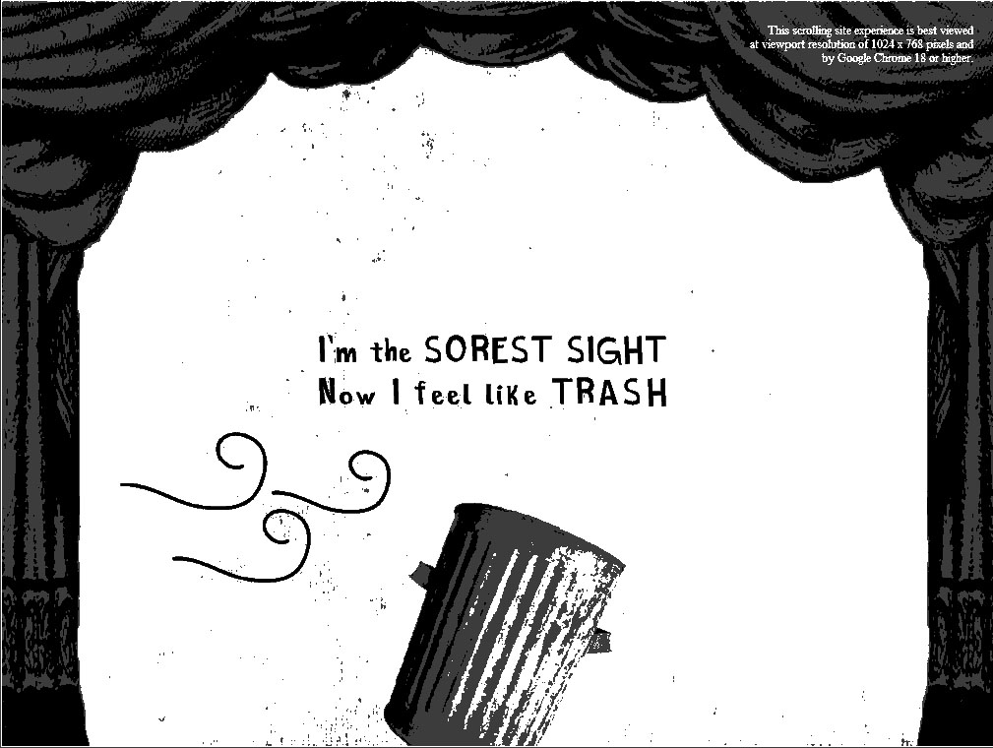
Journey Halfway

Slide 9
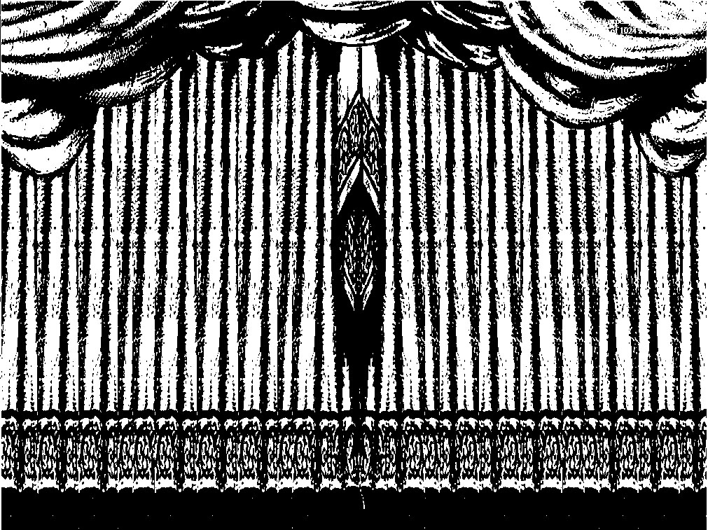
Journey Destination

