Slide 1



360° Digital Transformation Culture Company
Make IT Happen
Prototype Gulf Power International
  GPI Command
  Center.
This document only applies to your collaboration with WIT.ID
Scan QR Code
to see more detail.
And please do not spread and use it for things outside of this collaboration.
www.wit.id
Notes:
Frontend prototype of the Khobar Command Center for the five Yemen plants. All data is simulated.

Slide 2






Summary
WHAT THIS
DECK COVERS.
CONTEXT.
MONITOR.
ALARMS.
Five plants watched
from Khobar
Overview, site
plan, drill-down
Lifecycle,
escalation, filters
SLIDES 3–5
SLIDES 6–9
SLIDES 10–12
INSIGHTS.
ACCESS.
NEXT.
Findings and the
charts behind them
Roles and screens
Status and next steps
SLIDES 15–16
SLIDES 17–18
GPI Command Center
A read-only console for the 300 MW Yemen fleet, built as a clickable prototype.
SLIDES 13–14
#MakeITHappen
GPI Command Center ©2026 www.wit.id Page 2
360° Digital Transformation Culture Company

Slide 3
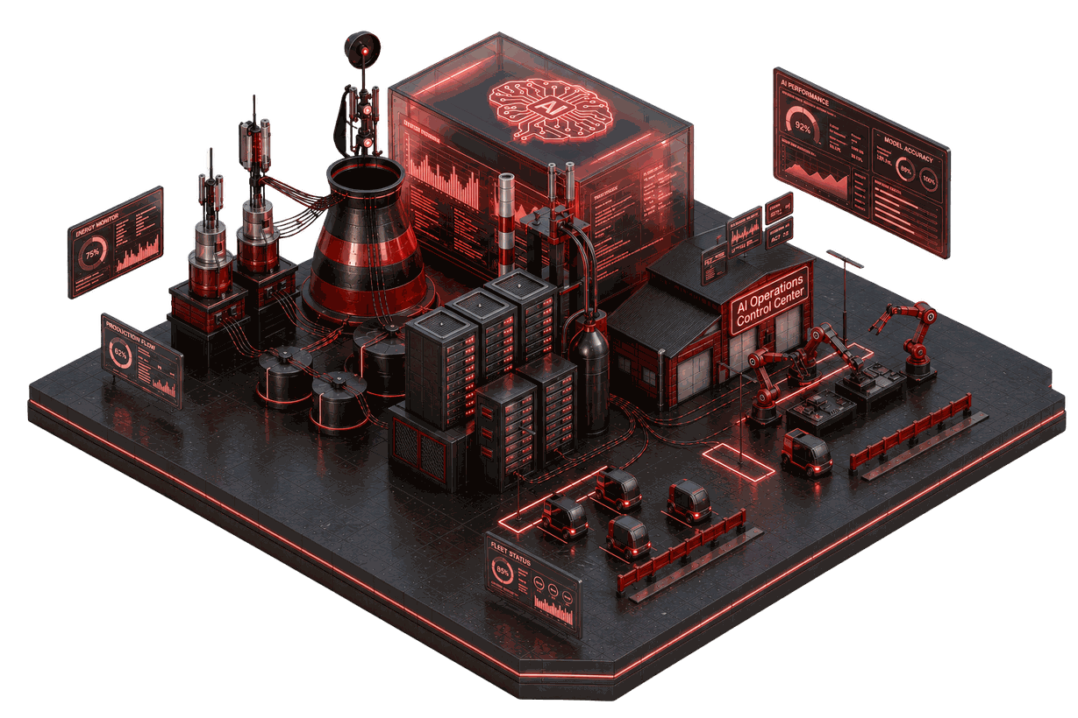

CONTEXT. The GPI fleet
Five plants,
one console.
The fleet
Five HFO plants in Hadramout and Aden, 300 MW planned
Al-Bidrah, Jul Masahah and Umbaikha operate today
Al-Ghurf commissions, Aden is under construction
Each site reaches Khobar over a Starlink link
What the console answers
What each plant generates now, and how old that value is
Which alarm needs whom, and who owns it
How many hours of fuel each site has left
Where construction and commissioning stand
GPI Command Center ©2026 www.wit.id Page 3
360° Digital Transformation Culture Company

Slide 4

NEEDS. Problems and answers
Each operating question gets a screen.
What the Command Center needs
What the console does
01
See every plant live, with honest data age
Values refresh every 5 s and every number shows its age
02
Tell a quiet plant from a lost link
Late after 15 s, stale after 60 s, with a banner naming the age
03
Make sure every alarm gets an owner
Ownerless alarms climb a level at 30, 60 and 120 minutes
04
Know fuel stock before it runs out
Tank level and hours of supply per plant at the current burn
05
Follow sites still being built
Milestones, issues, photos and progress that cannot go backwards
GPI Command Center ©2026 www.wit.id Page 4
360° Digital Transformation Culture Company

Slide 5
CONTEXT. The fleet in numbers
The fleet the prototype models.
300
160
32
5 s
MW planned across five plants
MW commissioned today
engine units on the site plans
sample interval for live values
Plant names and planned capacities come from the discovery answers. Everything else is demo data.
GPI Command Center ©2026 www.wit.id Page 5
360° Digital Transformation Culture Company

Slide 6
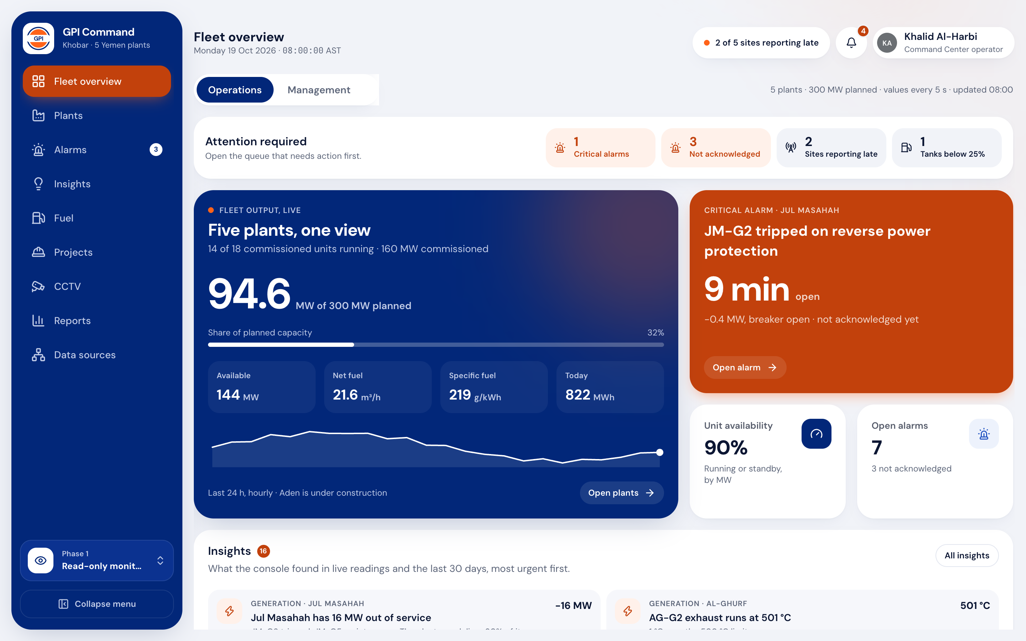
MONITOR. Fleet overview
One screen for the whole fleet.
Operations view
Management view
Attention strip counts critical alarms, unacknowledged alarms and late sites
Live fleet output against the 300 MW plan, with a 24-hour trend
Yemen map with one marker per plant, coloured by alarm and link state
Management view shows energy, billing, project progress and findings
GPI Command Center ©2026 www.wit.id Page 6
360° Digital Transformation Culture Company

Slide 7
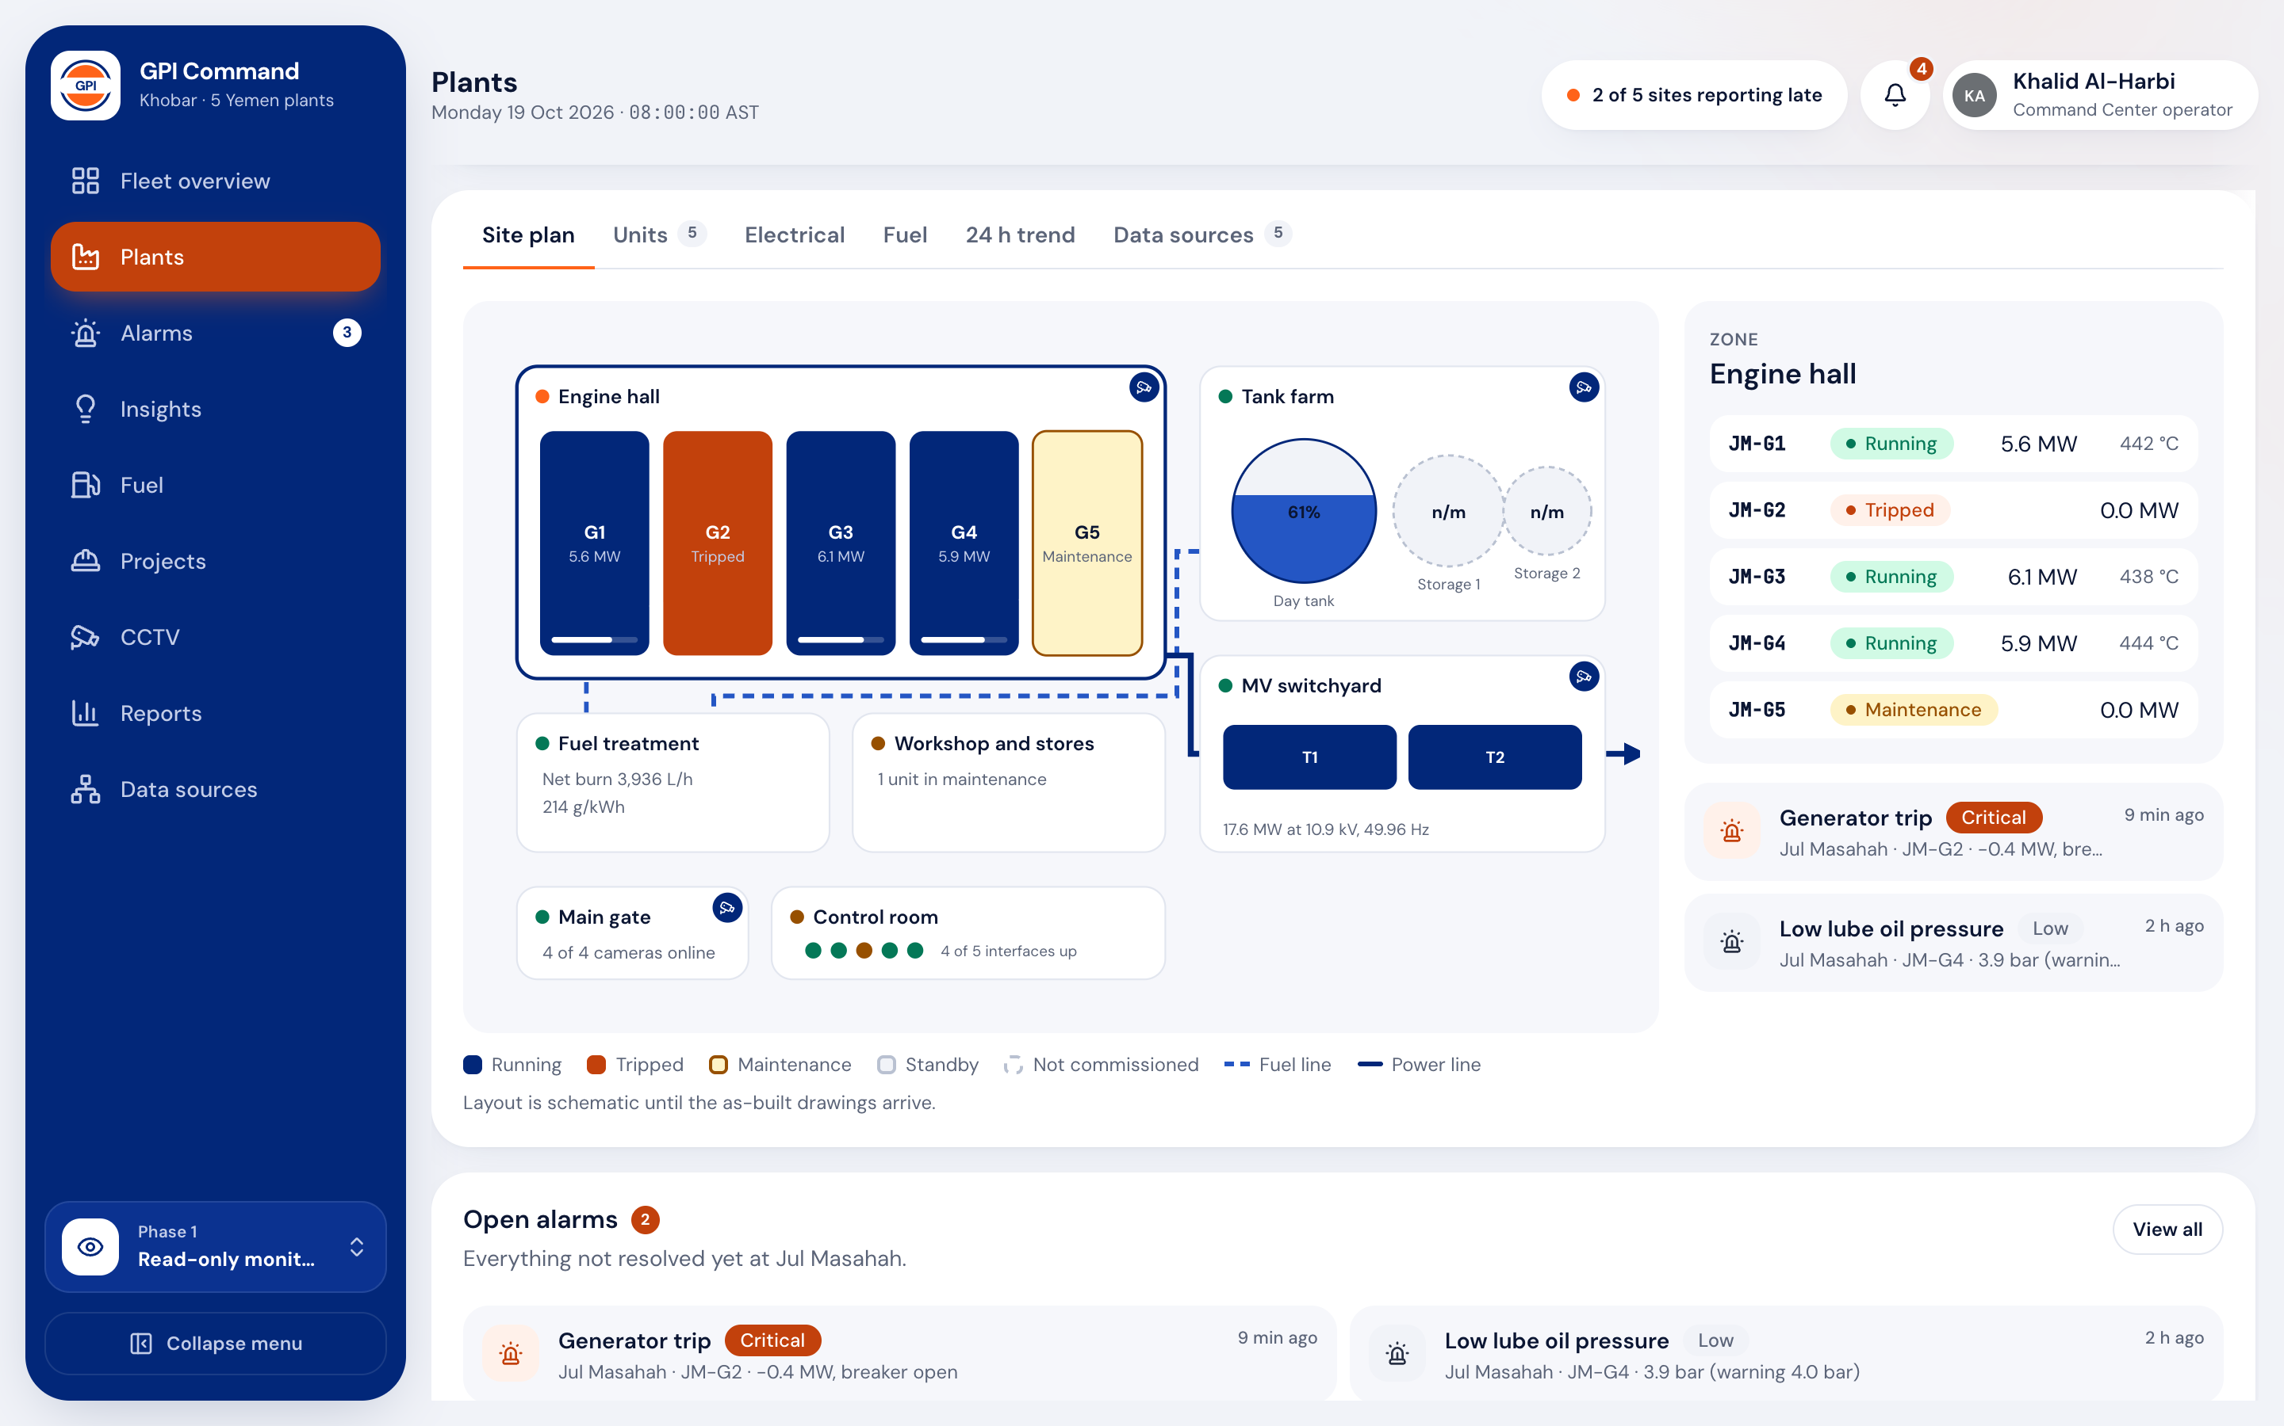
MONITOR. Site plan
Every plant opens on its own site plan.
7 zones
Zone in URL
Engine hall shows each genset coloured by state, with load and exhaust
Tank farm, fuel treatment and switchyard carry live values
Pick a zone to see its readings and open alarms beside the plan
Camera pins open CCTV; a genset block opens the unit page
GPI Command Center ©2026 www.wit.id Page 7
360° Digital Transformation Culture Company

Slide 8
MONITOR. Drill-down
From the fleet map to one alarm in four taps.
01
02
03
04
05
Fleet map
Plant
Zone
Unit
Alarm
Five markers with output, alarm and link state
Site plan, units, electrical, fuel, trend, sources
Live values and open alarms for that area
Exhaust, lube oil and coolant against limits
Next step, escalation path and full history
Back lands where you left. Each level keeps its tab, zone and filters in the URL, so a link opens the same view.
GPI Command Center ©2026 www.wit.id Page 8
360° Digital Transformation Culture Company

Slide 9
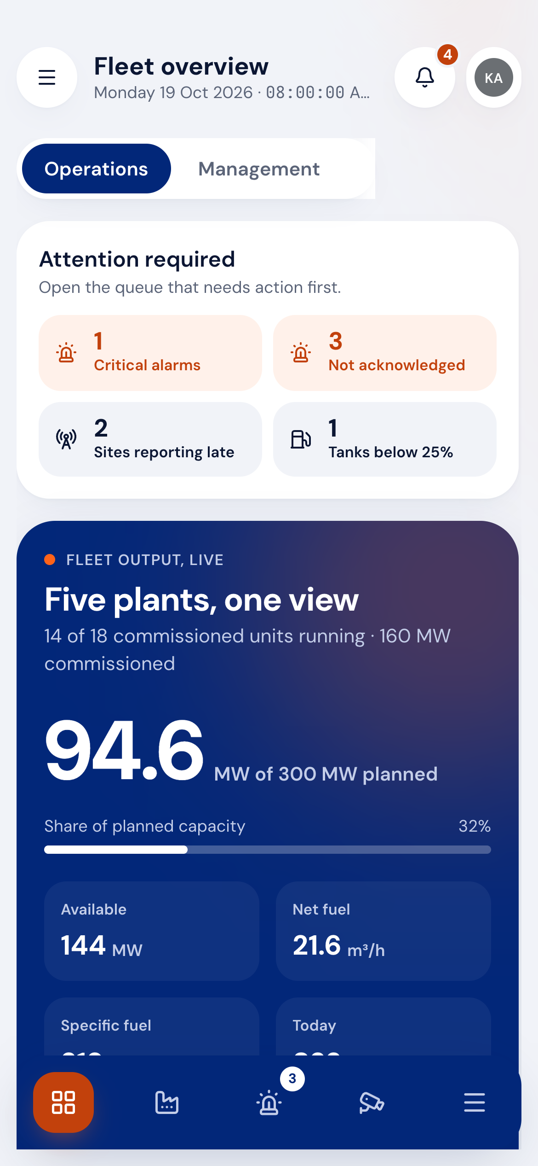
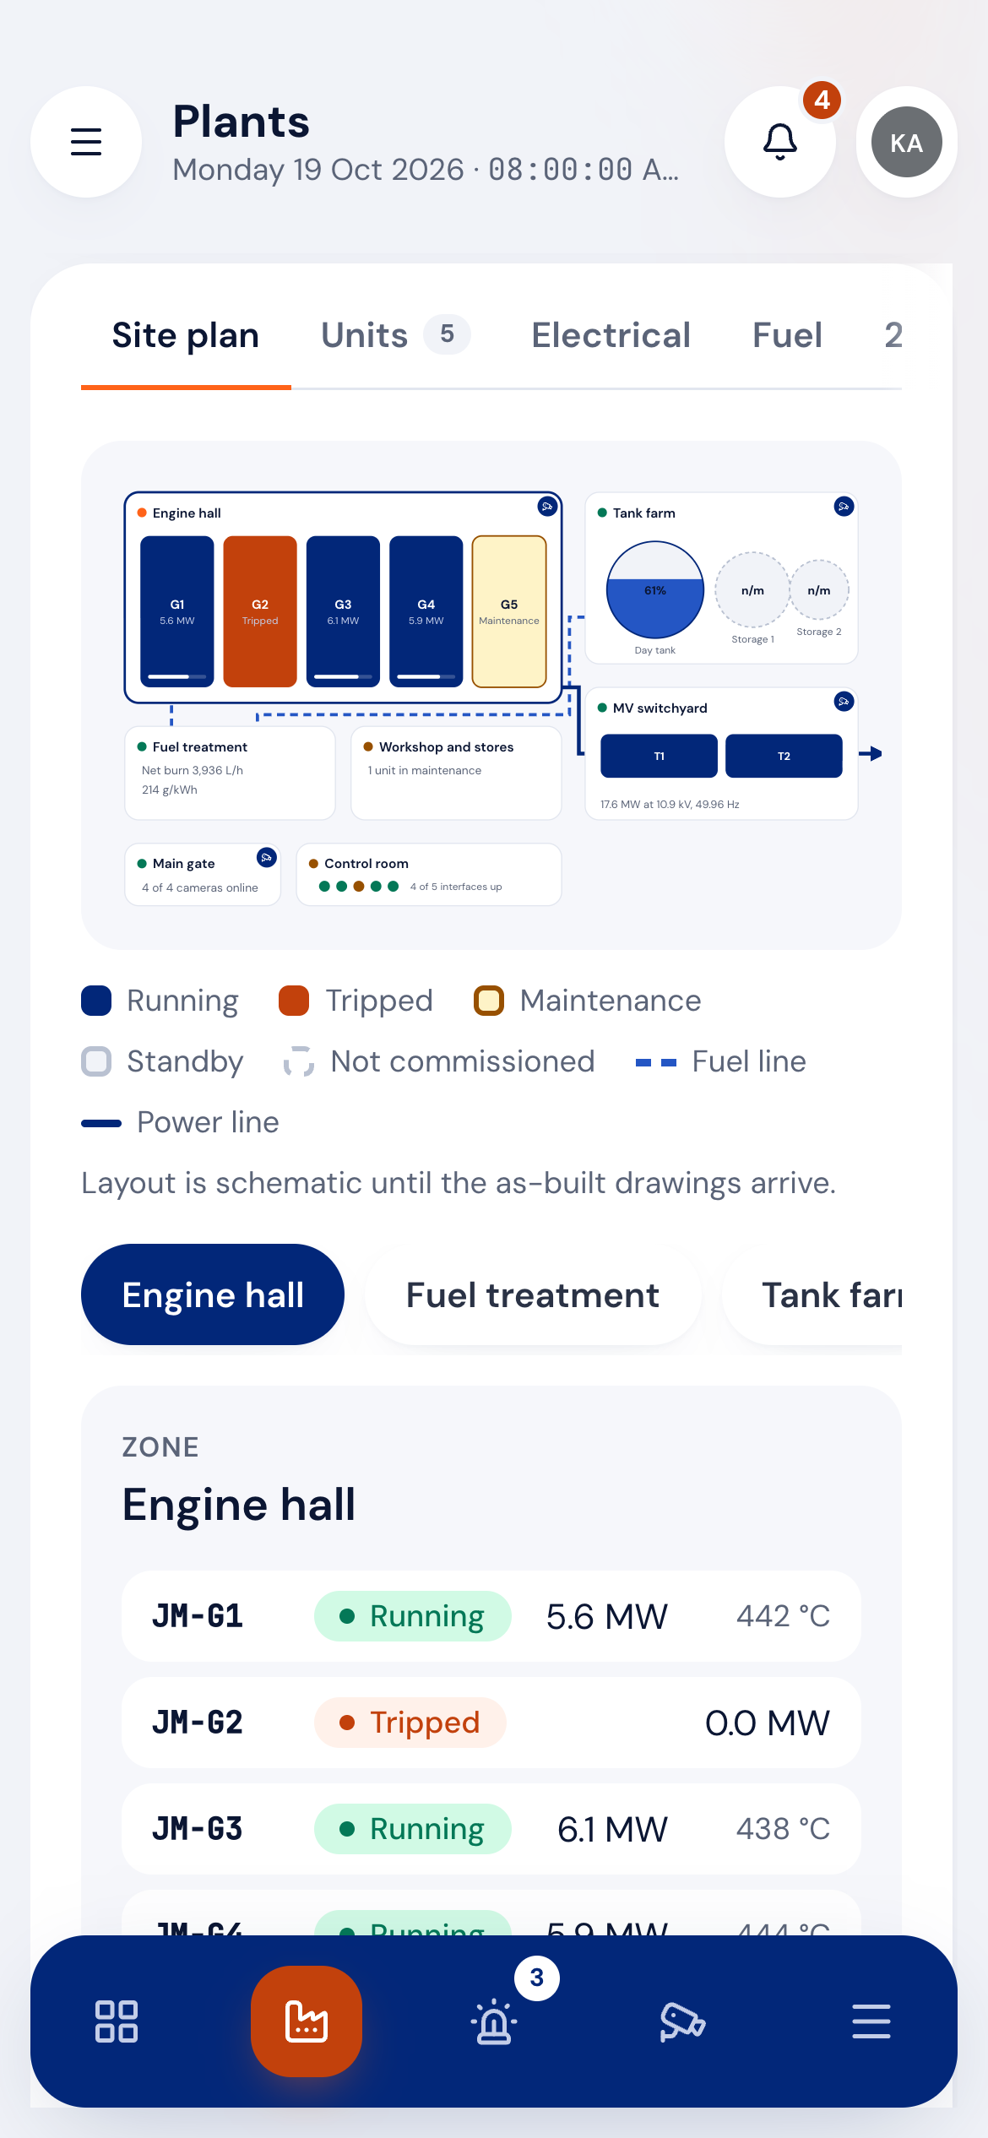
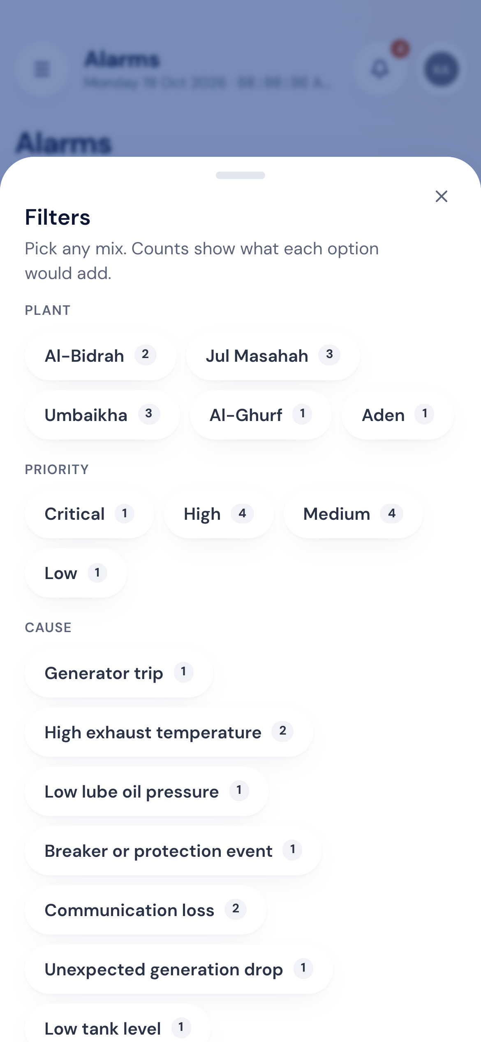
MONITOR. On a phone
The same console runs on a phone.
375 px checked
A bottom bar replaces the side menu below tablet width
The site plan scales down and zone chips take over selection
Filters and menus open as bottom sheets
A phone browser is enough; nothing to install
GPI Command Center ©2026 www.wit.id Page 9
360° Digital Transformation Culture Company

Slide 10
ALARMS. Lifecycle and data age
How an alarm and a reading move.
ALARM LIFECYCLE
Owner
assigned?
Alarm raised
(rule on site data)
Acknowledged in Khobar
Yes
Site crew resolves
Closed with
post-incident note
No
Escalation timer raises level
Level 1 at 30 min → level 2 at 60 → level 3 at 120
DATA FRESHNESS
Older than
15 s?
Sample arrives
(every 5 s)
Age checked
Yes
Late badge on values
Stale banner
after 60 s
No
Offline sites keep their last values, marked stale
Fresh value shown
GPI Command Center ©2026 www.wit.id Page 10
360° Digital Transformation Culture Company

Slide 11
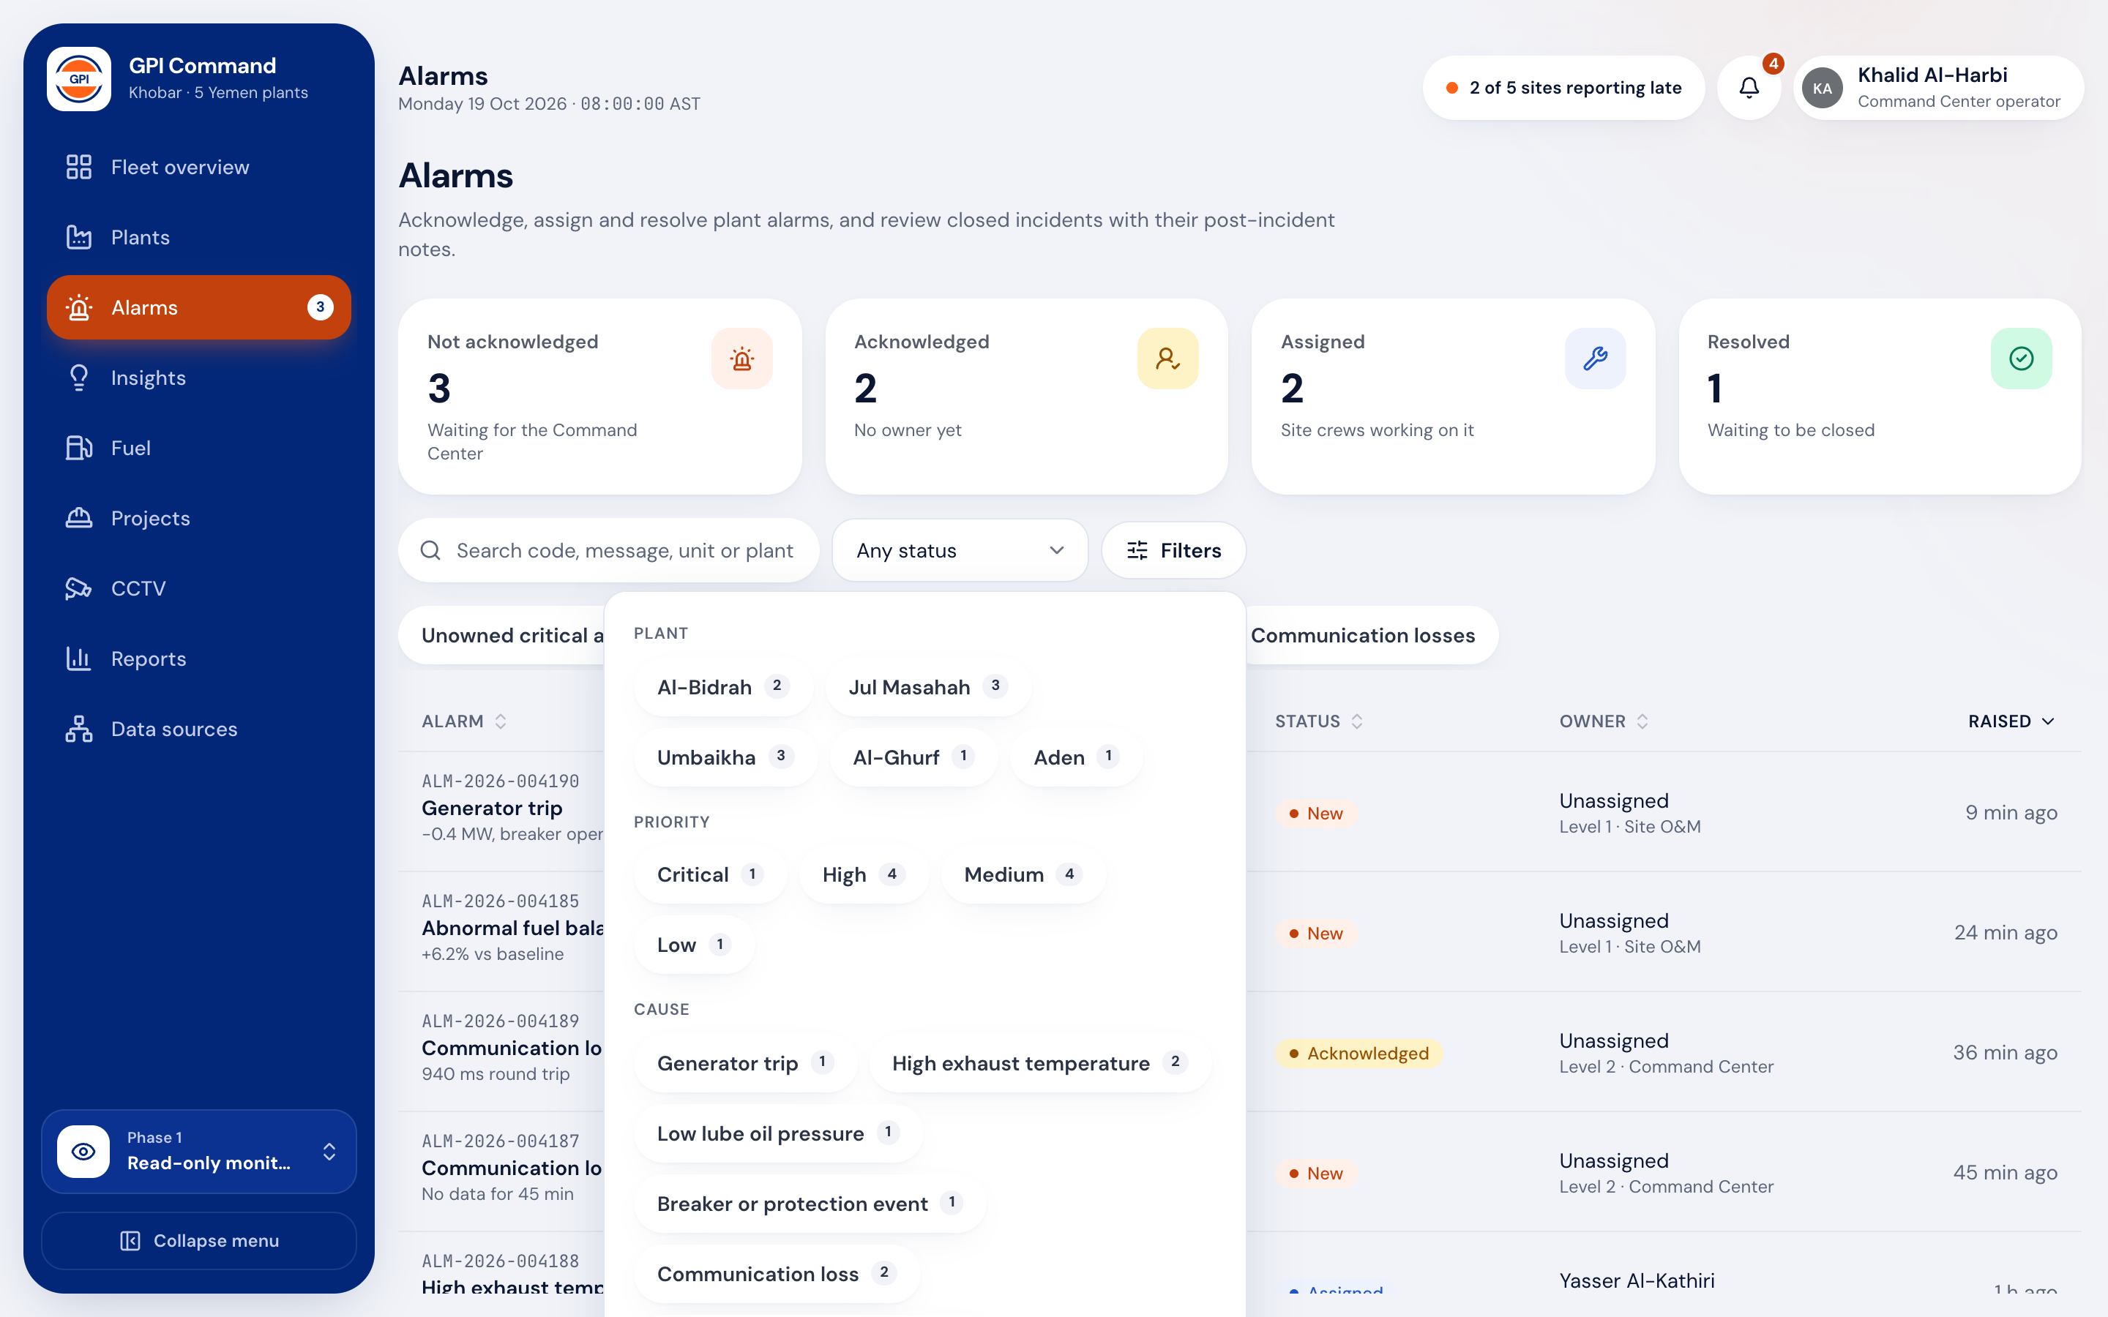
ALARMS. Filtering
Find any alarm in two taps.
Multi-select
Filters in URL
Filter by plant, priority, cause, owner, escalation level and time raised
Each option shows how many alarms it would add before you pick it
Active filters sit as chips you can remove one by one
Quick views: unowned critical and high, assigned to me, escalated
GPI Command Center ©2026 www.wit.id Page 11
360° Digital Transformation Culture Company

Slide 12
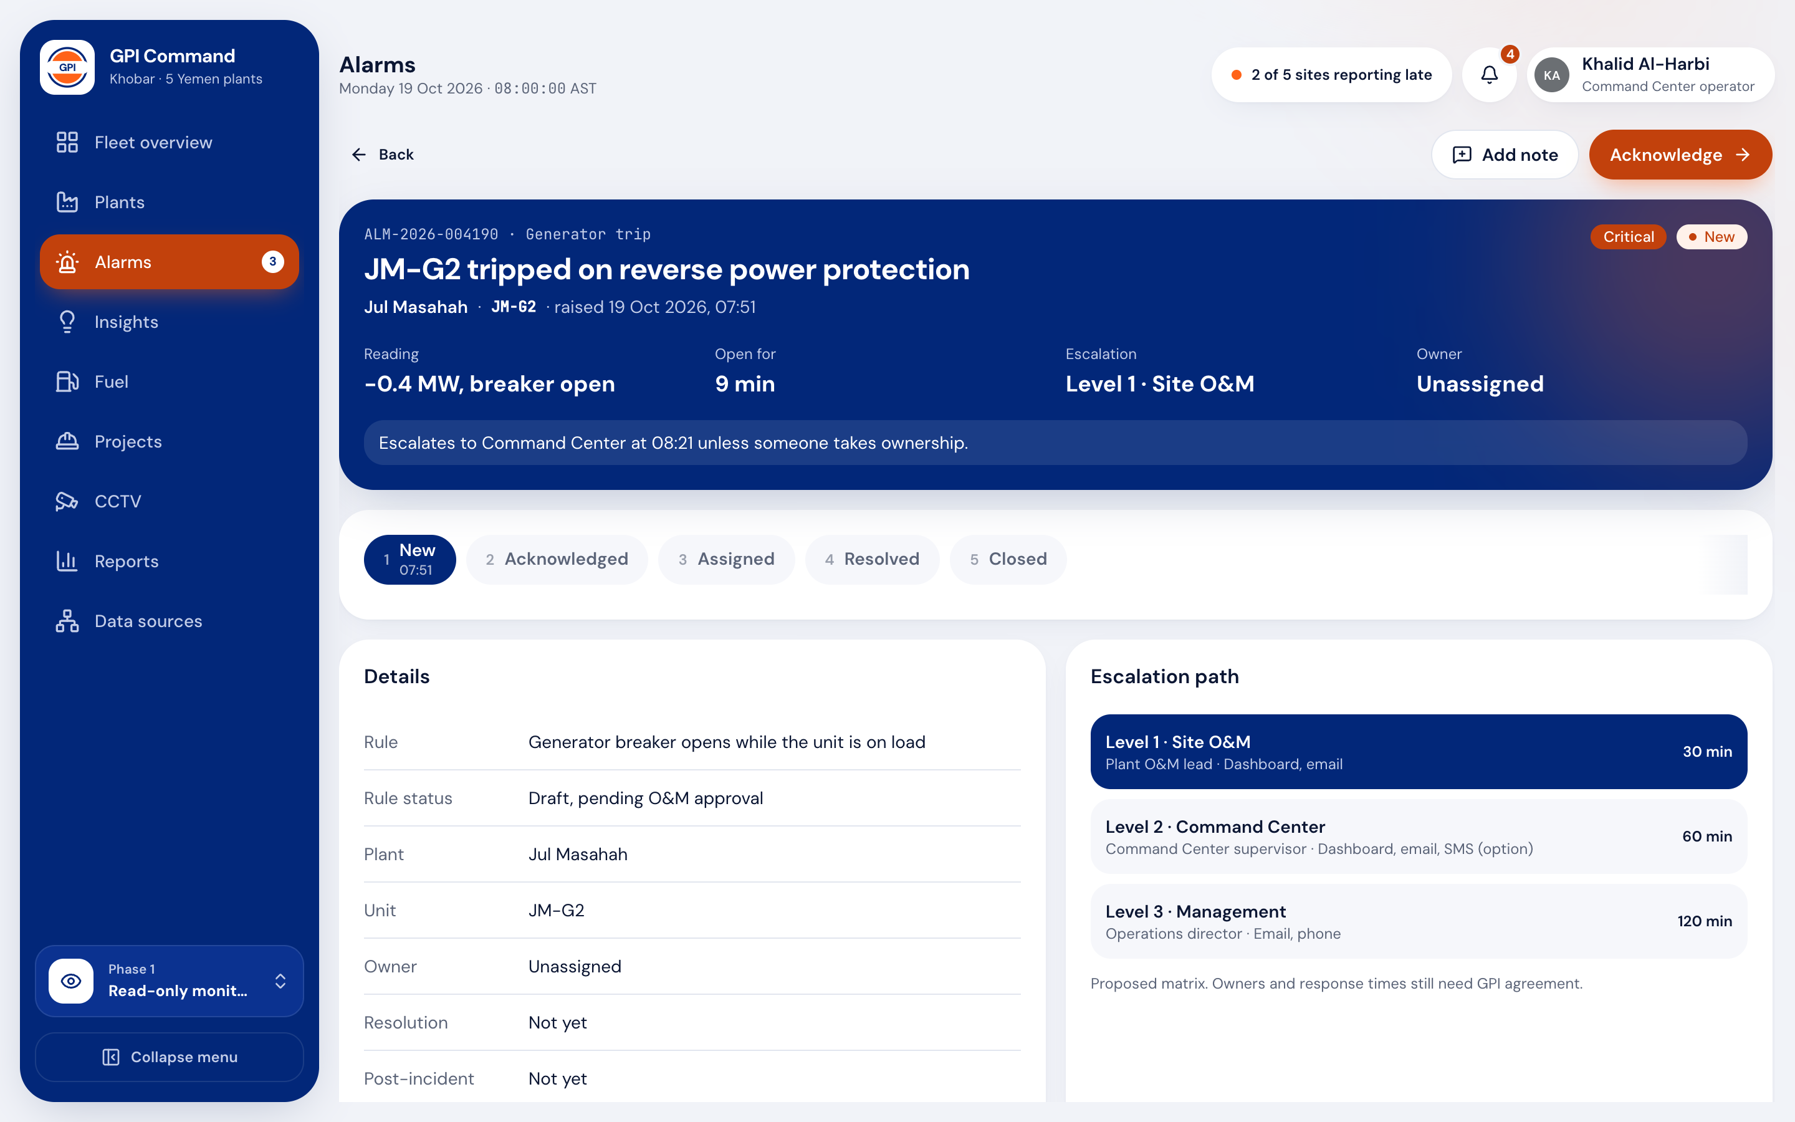
ALARMS. Alarm detail
The next step is always the main button.
4 steps
Blocked actions say why
Acknowledge, assign, resolve and close in order, each with a toast
Critical and high alarms need a post-incident note before closing
Escalation path shows who gets it next and when
History records every action with the person or the timer behind it
GPI Command Center ©2026 www.wit.id Page 12
360° Digital Transformation Culture Company

Slide 13
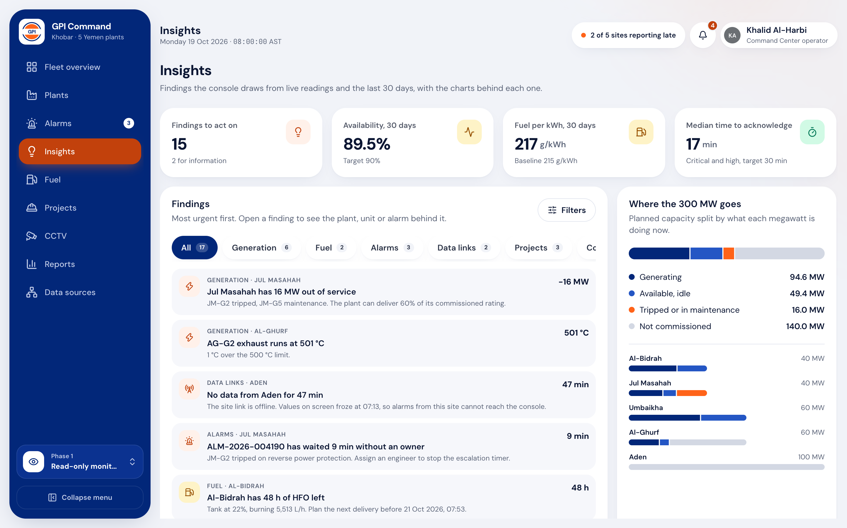
INSIGHTS. Findings
The console points at what to fix first.
17 findings
Most urgent first
Rules turn readings and 30 days of history into ranked findings
Each finding names the plant, the number and the page with the detail
Examples: 16 MW out of service, 48 h of fuel left, comms losses tripled
Overview and plant pages show their top findings too
GPI Command Center ©2026 www.wit.id Page 13
360° Digital Transformation Culture Company

Slide 14
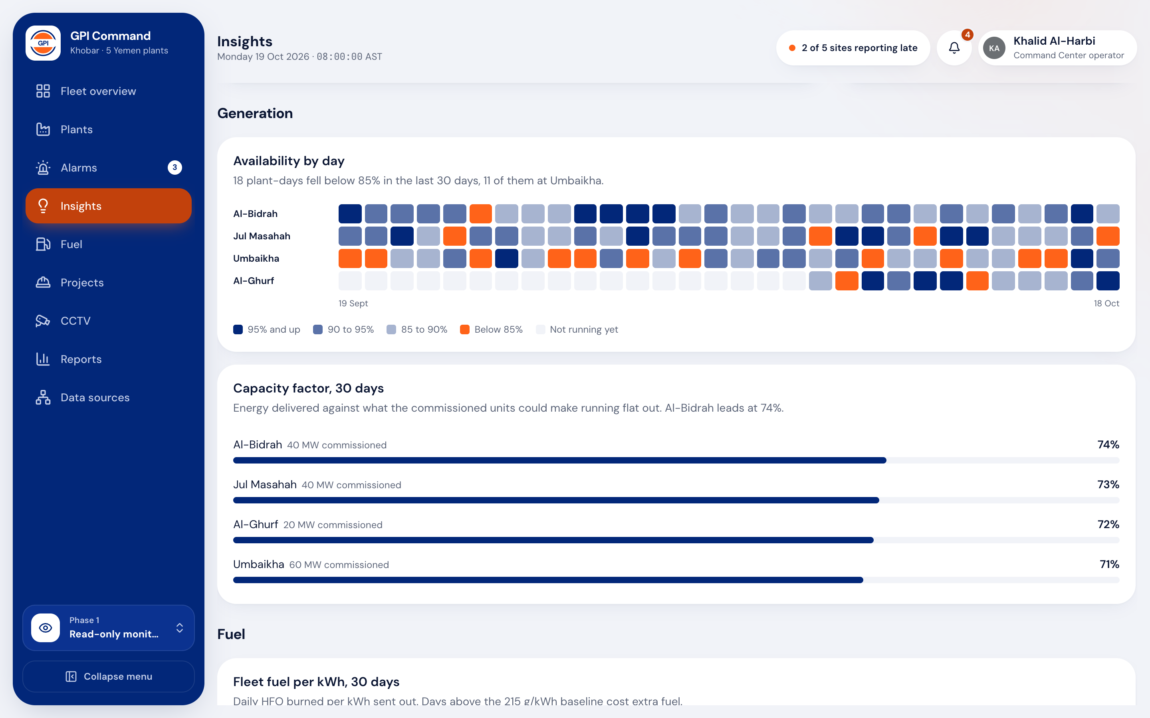
INSIGHTS. Charts
The charts behind each finding.
Generation
Fuel
Alarms
Where the 300 MW goes: generating, idle, out of service, not built
Availability heatmap per plant per day over 30 days
Fuel per kWh against the 215 g/kWh baseline
Alarm causes, share by plant, busiest hour and response times
GPI Command Center ©2026 www.wit.id Page 14
360° Digital Transformation Culture Company

Slide 15
ACCESS. Roles
Each role sees only the actions it can take.
Command Center operator
01
Acknowledges, assigns, resolves and closes alarms
02
Exports reports
Site O&M and project managers
01
O&M acknowledges and resolves alarms
02
Both record site progress with photos
Senior management
01
Reads every screen and exports reports
GPI Command Center ©2026 www.wit.id Page 15
360° Digital Transformation Culture Company

Slide 16
ACCESS. Screens
Thirteen screens in the prototype.
Screen | What it shows
Fleet overview | Operations and management views, map, findings
Plants and plant detail | Site plan, units, electrical, fuel, 24 h trend, data sources
Unit detail | Exhaust, lube oil and coolant gauges, alarm history
Alarms and alarm detail | Filters and quick views, lifecycle, escalation, history
Insights | Findings, capacity split, heatmap, fuel and alarm analytics
Fuel | Tank stock, hours of supply, fuel per kWh, supply and return balance
Projects and project detail | Milestones, issues, site photos, progress entry
CCTV | Camera tiles per plant (placeholders)
Reports | Daily, weekly and monthly summary, plant comparison, billing
Data sources | Interface matrix, alarm register, escalation matrix, platform
GPI Command Center ©2026 www.wit.id Page 16
360° Digital Transformation Culture Company

Slide 17
NEXT. Status
Where the prototype stands.
DONE
WAITING ON GPI
PHASE 2
LATER
Built
Inputs
Backend
AI
Frontend prototype
To replace demo values
Real data
Decision support
Thirteen screens, phone to desktop
Logo file and final palette
Site gateways and buffering
After data-governance approval
Plant coordinates
Ingestion API and storage in Khobar
Advice only, no plant control
Simulated live telemetry
As-built site drawings
Alarm lifecycle and escalation
Approved alarm thresholds
Sign-in with MFA and audit log
Insights, site plan, filters
Fuel and availability targets
Interface survey per site
Role-based views
GPI Command Center ©2026 www.wit.id Page 17
360° Digital Transformation Culture Company

Slide 18
NEXT. Next steps
From prototype to a console on real data.
GPI team
01
Send the logo file, plant coordinates and as-built drawings
02
Approve alarm thresholds, delays and priorities with the owner's engineer
03
Confirm the billing currency and the fuel and availability targets
WIT team
01
Write end-to-end tests and the test reports for the prototype
02
Run the interface survey with each site
03
Design the ingestion API and site buffering for phase 2
GPI Command Center ©2026 www.wit.id Page 18
360° Digital Transformation Culture Company

Slide 19


Make IT Happen.
REVIEW NEXT
CONTACT
The GPI Command Center prototype is ready for review with the Khobar team.
Site plan layouts
business@wit.id
Alarm register
Insight rules
360° Digital Transformation Culture Company

