Slide 1
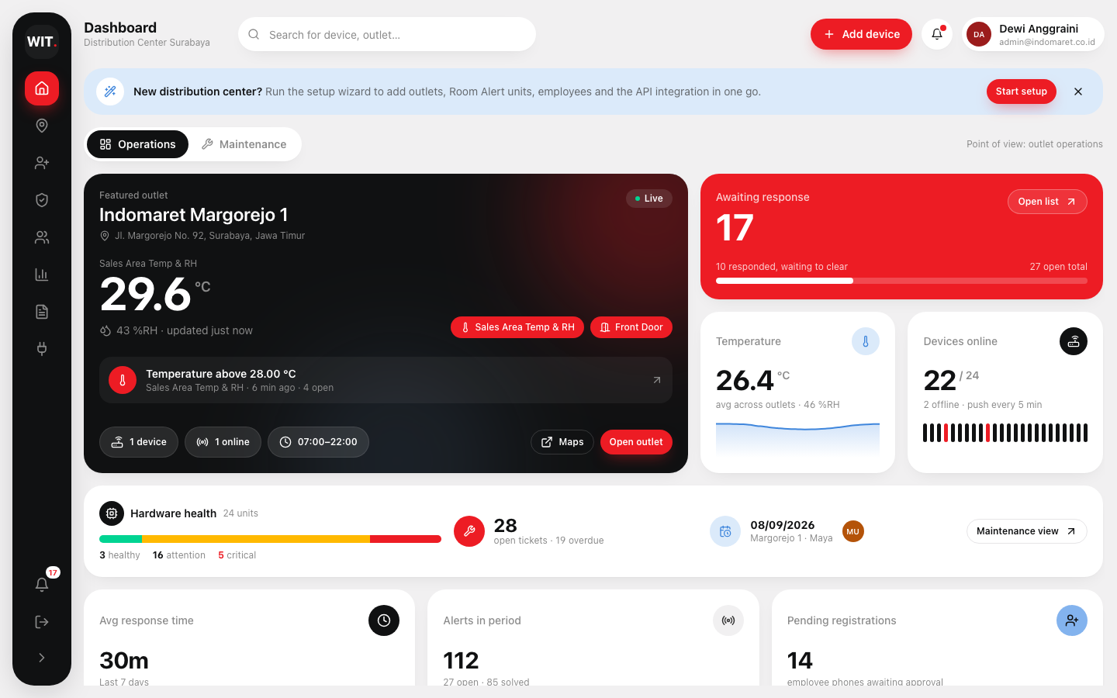
WIT.
PRODUCT DECK · SEPTEMBER 2026
RA Monitor.
Realtime environment & security monitoring for every Indomaret outlet — Room Alert units, admin dashboard, employee mobile app and API blackbox in one product.
Admin dashboard
Mobile PWA
API blackbox
WIT.ID · 360° Digital Transformation Company · Make IT Happen

Slide 2
AGENDA
←
What this deck covers.
# | Section | What you will see
01 | The problem | Environmental downtime, GSM/FWT pain points and why outlets need continuous monitoring
02 | The solution | Room Alert units + WIT blackbox + admin dashboard + employee app + Telegram
03 | Admin dashboard | Operations and maintenance points of view, alerts, analysis, reports
04 | Shopfloor & devices | Outlet map, in-store floor plan, device management and full master data CRUD
05 | Mobile app | Employee response with photo proof, technician tickets, PWA install
06 | API blackbox & setup | Webhook / e-mail ingestion, request log, endpoint contract, setup wizard
07 | Scale & roadmap | 30 distribution centers, 21,000 outlets, delivery phases
WIT.
RA Monitor Product Deck ©2026 · 360° Digital Transformation Company
Page 2

Slide 3
THE PROBLEM
←
30% of all downtime, data loss and damage an organisation faces is caused by environmental factors.
Today at the outlet
Temperature written down by hand, no trend history
Security alarm needs a GSM SIM card per outlet, topped up monthly
Daily arm / disarm passkey — forgotten after hours
Missed calls and Telegram from an FWT box, no field response tracking
No way to see which sensor is abnormal
Every outlet already monitors its network. Almost none monitor temperature, humidity, doors and motion — until the cooler fails, the store is broken into after hours, or the power is cut.
WIT.
RA Monitor Product Deck ©2026 · 360° Digital Transformation Company
Page 3

Slide 4
COMPARISON
←
Existing security system vs RA Monitor
Parameter | Existing system | RA Monitor
Temperature & humidity | Manual log sheet | Realtime online, 24/7 trend history
Server connection | FWT + GSM SIM card per outlet | Building internet only, no SIM card
Arming / disarming | Daily passkey on site | One-time automatic schedule
Alert notification | Missed call + Telegram broadcast | App push with respond system + Telegram
Field response | Not tracked | Notes + photo proof, response time KPI
Hardware maintenance | Reactive | Health score, tickets, technician schedule
Where is it installed? | Unknown | Outlet map + in-store floor plan
Monthly cost | Rp 20–30k SIM per outlet + refills | Decreases as more outlets are connected
WIT.
RA Monitor Product Deck ©2026 · 360° Digital Transformation Company
Page 4

Slide 5
THE SOLUTION
←
One stop solution: sensor to response in seconds.
01
02
03
04
05
06
Room Alert units
Room Alert cloud
WIT blackbox
Alert engine
Admin dashboard
Employee & technician app
AVTECH 3S / 12S in every outlet. Temp & RH, door, motion, power, panic button on independent ports.
›
Units push status every 5 min. Alert actions fire an HTTP POST or an alert e-mail.
›
Webhook receiver, IMAP parser and a single adapter contract. Normalises every event.
›
Matches device & sensor, opens / clears alerts, fans out to app push and Telegram, tracks KPI.
›
Per distribution center: notifications, respond list, history, shopfloor, maintenance, master data.
›
PWA on any Android. Respond with photo proof, work tickets, see the floor plan.
Frontend delivered first, backend swapped in behind the blackbox
The dashboard and app run today on a seeded data set through the same adapter interface the backend will implement. Switching from mock to HTTP is a single toggle on the Integration page — no UI rewrite.
WIT.
RA Monitor Product Deck ©2026 · 360° Digital Transformation Company
Page 5

Slide 6
ADMIN DASHBOARD
←
Everything a distribution center admin needs on one screen.
Featured outlet with live temperature, humidity and sensor chips
Awaiting-response counter with responded / open progress
Fleet temperature trend and devices-online strip
Open and solved alert lists with category filter, analysis donut and date range
Hardware-health strip so maintenance is never out of sight
Switchable point of view: Operations or Maintenance
WIT.ID design system
Expandable sidebar
WIT.
RA Monitor Product Deck ©2026 · 360° Digital Transformation Company
Page 6

Slide 7
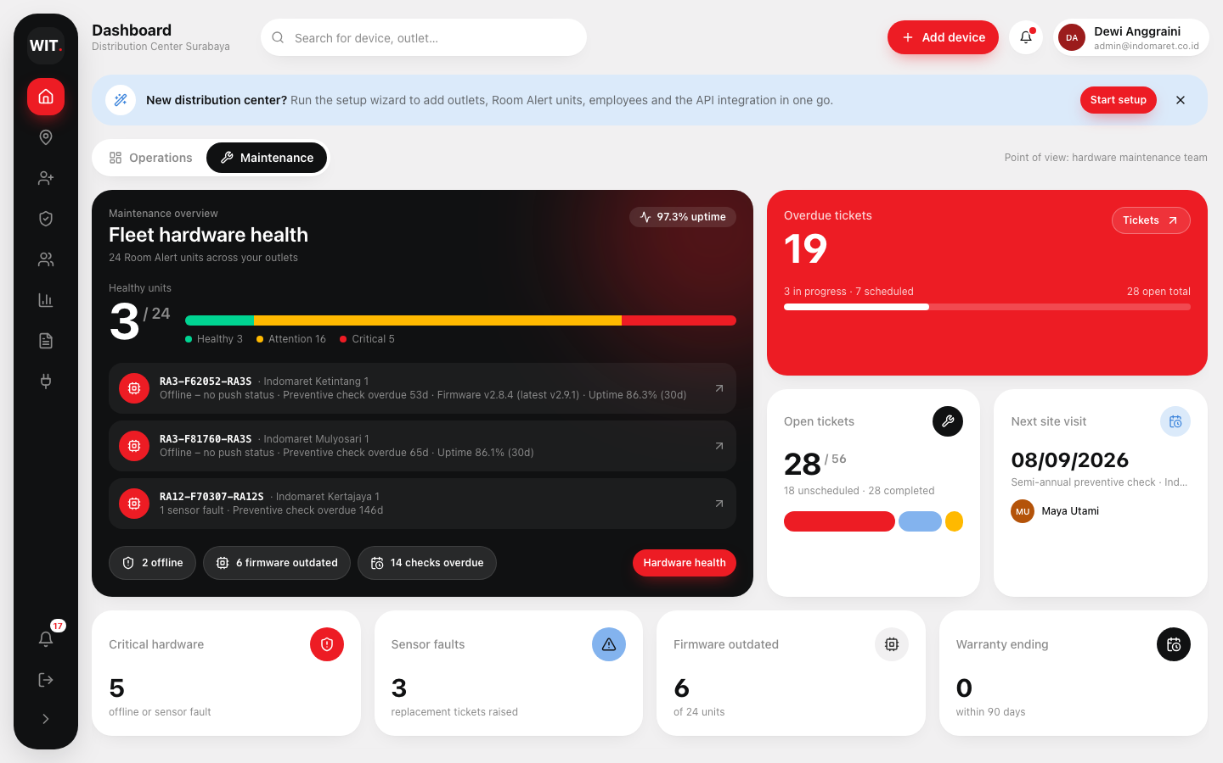
MAINTENANCE POINT OF VIEW
←
Hardware health, tickets and technicians — built in.
Health per unit derived from offline status, sensor faults, firmware, overdue checks, warranty and uptime
Service tickets: preventive, corrective, replacement, firmware — with priority, schedule and status flow
Technician assignment and workload, overdue visits highlighted
Same view exists in the mobile app: technicians start and complete tickets with notes and photos
Device Maintenance page: hardware health table, tickets, schedule by day, technician cards
WIT.
RA Monitor Product Deck ©2026 · 360° Digital Transformation Company
Page 7

Slide 8
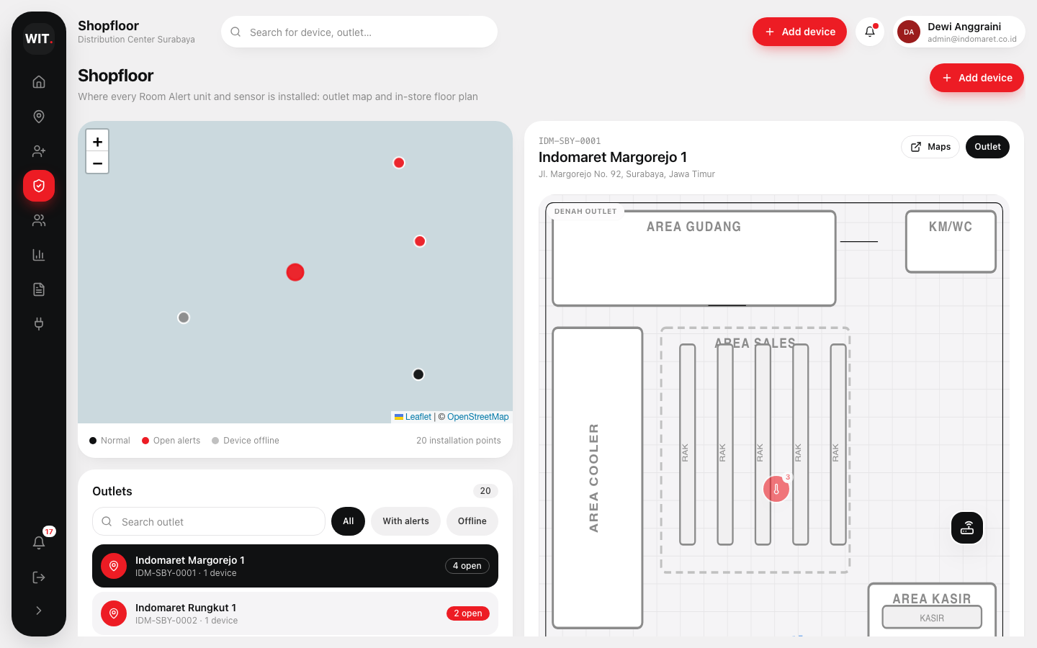
SHOPFLOOR VIEW
←
Know exactly where every unit and sensor is installed.
Outlet map (OpenStreetMap) with every installation point, coloured by open alerts and offline devices
In-store floor plan drawn from the outlet layout: gudang, cooler area, racks, kasir, teras
Markers for the Room Alert unit and each sensor, pulsing when an alert is open
Click any point: readings, thresholds, alert history, parent device, raise a ticket
Positions editable from Device master data; the same plan is shown in the mobile app
WIT.
RA Monitor Product Deck ©2026 · 360° Digital Transformation Company
Page 8

Slide 9
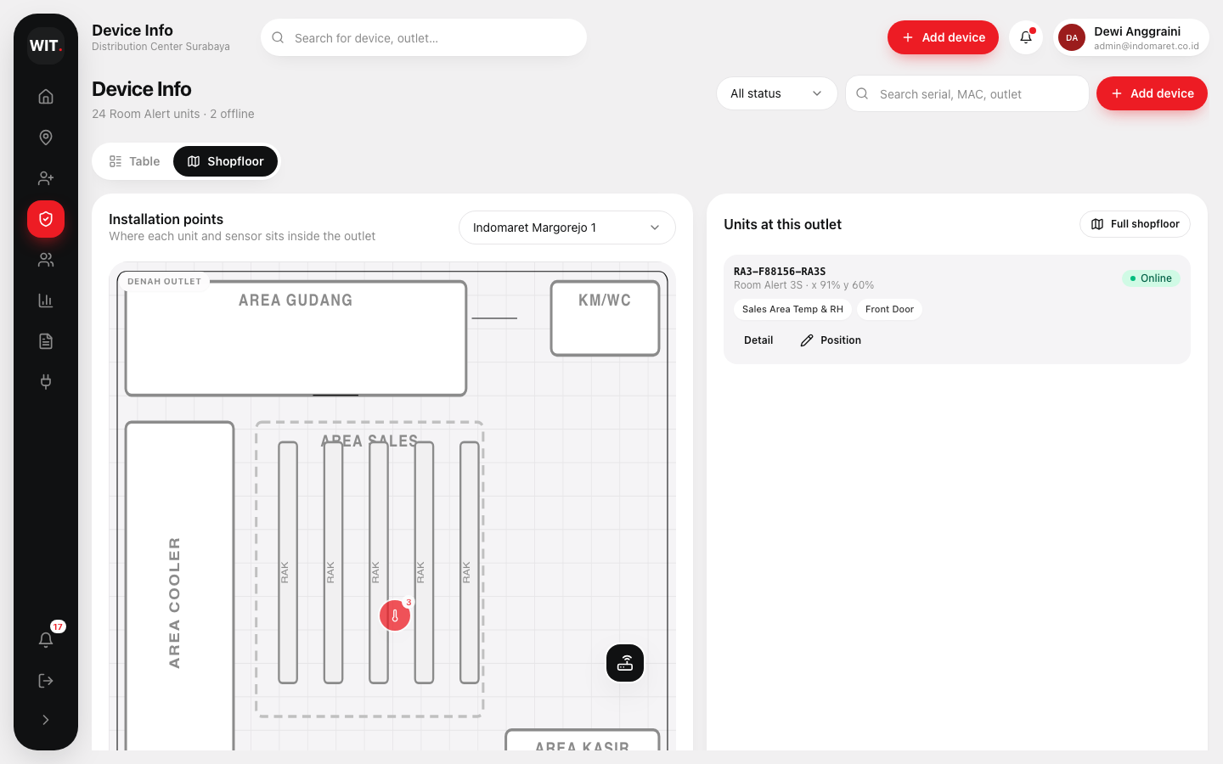
DEVICE MANAGEMENT & MASTER DATA
←
Full master data CRUD — outlets, units, sensors, people
Outlets
Device types
Code, address, GPS, hours, time zone
Ports, built-in sensors, firmware, service interval
Devices
Sensors
Register with default sensors, edit network & position, remove
Type, port, thresholds, floor position
Employees
Technicians
Roles, outlets, tokens, approval
Specialty, mobile app token
Contact persons
Tickets
Primary contact, Telegram channel
Create, assign, schedule, complete
WIT.
RA Monitor Product Deck ©2026 · 360° Digital Transformation Company
Page 9

Slide 10
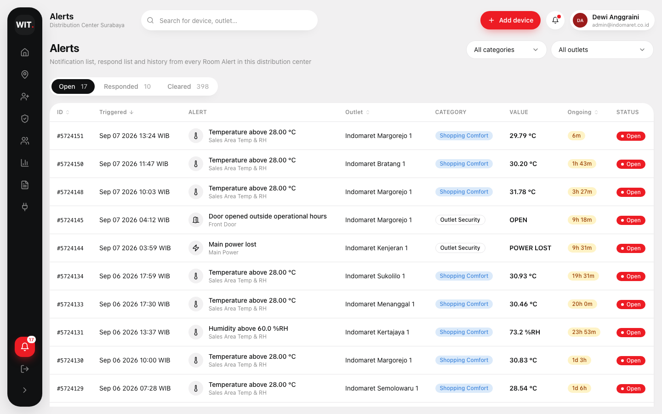
ALERT LIFECYCLE
←
From trigger to KPI, no double response.
01
02
03
04
05
Triggered
Notified
Responded
Cleared
Measured
Sensor exceeds its limit during operational hours (comfort) or after hours (security). Alert opens with ID, value and time.
›
Every registered employee at that outlet gets an app push; Telegram broadcast to contact persons; admin list updates.
›
First employee on site adds notes and photo proof. Others see the status — nobody responds twice.
›
Room Alert reports the clear value, or an admin marks it cleared. Clear time recorded.
›
Response time per employee and outlet becomes a KPI in Analysis and the CSV report.
Alert list with Open / Responded / Cleared tabs, category and outlet filters, and a detail drawer with the field response and photo proof.
WIT.
RA Monitor Product Deck ©2026 · 360° Digital Transformation Company
Page 10

Slide 11
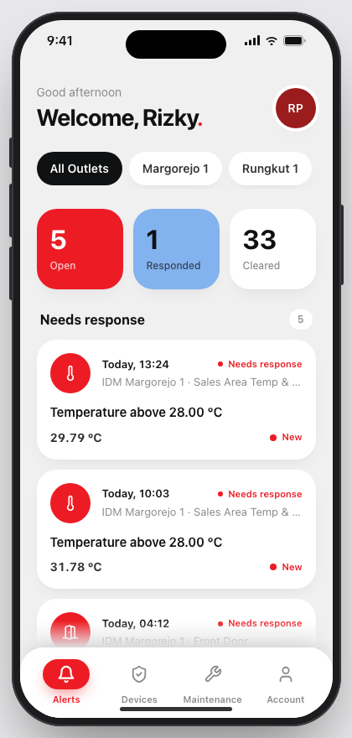
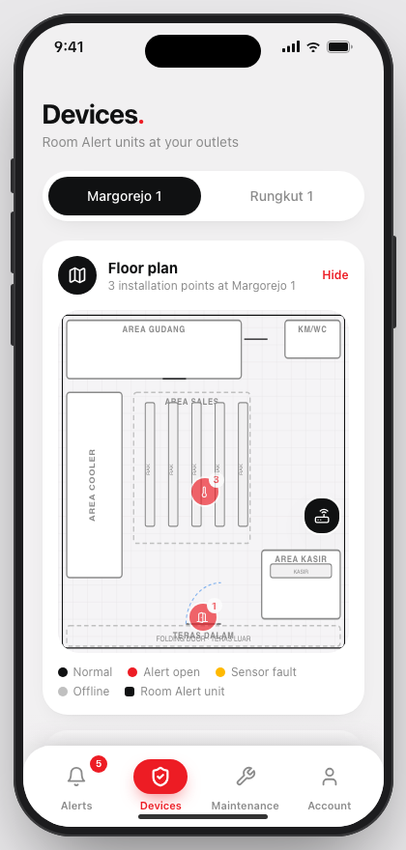
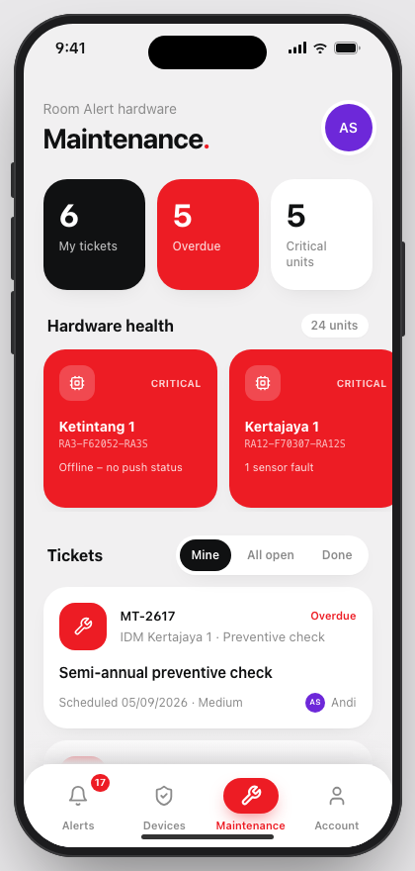
EMPLOYEE & TECHNICIAN APP
←
A PWA that feels native — installs from the browser.
Login with e-mail + admin-issued token; employee or technician role
Alerts: outlet filter, needs-response / responded / cleared, lazy-loading lists
Alert detail: location, device, sensor, latest reading, ongoing time; respond with notes and camera photo
Devices per outlet with health badge and the same floor plan
Maintenance tab: hardware health, tickets, report an issue; technicians start and complete work with photos
Installable, offline-ready shell, no app store needed
WIT.
RA Monitor Product Deck ©2026 · 360° Digital Transformation Company
Page 11

Slide 12
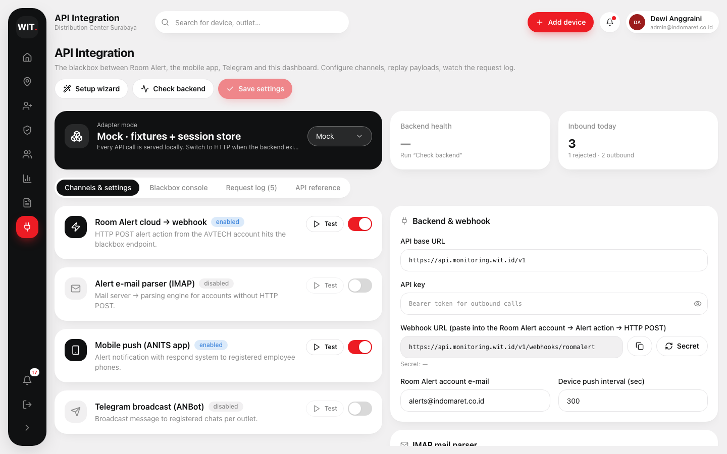
API INTEGRATION BLACKBOX
←
The blackbox between Room Alert, the app, Telegram and the dashboard
Method | Endpoint | Purpose
POST | /webhooks/roomalert | Room Alert HTTP POST action
POST | /webhooks/email | Parsed alert e-mail (IMAP)
GET | /distributors/{id}/alerts | Notification / respond / history
POST | /alerts/{id}/respond | Field response + photo
POST | /integrations/telegram/broadcast | ANBot broadcast
POST | /integrations/push/send | Employee push
Channel cards with enable toggles and Test buttons
Console: paste a webhook JSON or alert e-mail, parse, ingest into the live dashboard
Request log of inbound and outbound calls
Mock and HTTP adapters share one contract
WIT.
RA Monitor Product Deck ©2026 · 360° Digital Transformation Company
Page 12

Slide 13
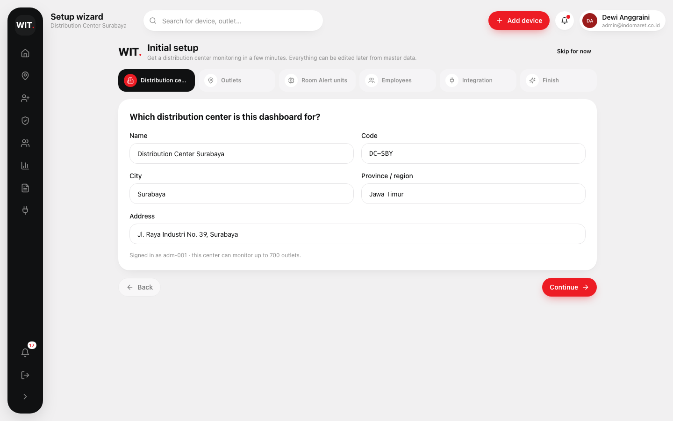
INITIAL SETUP
←
A new distribution center is monitoring in minutes.
01
Distribution center
Name, code, city, region
02
Outlets
Quick rows: code, name, address
03
Room Alert units
Model and sensors per outlet with port-capacity check
04
Employees
Tokens generated for the mobile app
05
Integration
API URL, key, webhook secret, Telegram / IMAP
06
Finish
Records created — go to dashboard or floor plans
WIT.
RA Monitor Product Deck ©2026 · 360° Digital Transformation Company
Page 13

Slide 14
SCALE
←
Designed for the whole network.
30
700
distribution centers across Indonesia, one admin dashboard each
outlets per distribution center, ~21,000 nationwide
5
5 min
employees per outlet notified on the app — first to respond closes the loop
push status interval; offline units flagged, power loss detected immediately with a power sensor
WIT.
RA Monitor Product Deck ©2026 · 360° Digital Transformation Company
Page 14

Slide 15
TECHNOLOGY
←
Modern, maintainable, ready for the backend phase.
Admin dashboard
Mobile PWA
Shared packages
Next: backend
Vite + React + TypeScript
Tailwind v4, WIT.ID tokens
Recharts analysis
Leaflet outlet map
CSV export
Same React stack
vite-plugin-pwa (installable, offline shell)
Camera photo proof
Lazy-loading lists
iPhone demo frame on desktop
types — domain model
fixtures — seeded data + session reducer
ui — component kit
integration — API blackbox
tailwind-config — theme
Implements the blackbox contract
Webhook + IMAP ingestion
Push (FCM) and Telegram bot
Auth, tokens, RBAC
PostgreSQL + reporting
WIT.
RA Monitor Product Deck ©2026 · 360° Digital Transformation Company
Page 15

Slide 16
ROADMAP
←
Delivery phases.
DONE
NEXT
Q1 2027
2027+
Phase 1 · UI & data model
Phase 2 · Backend & pilot
Phase 3 · Broadcast & rollout
Phase 4 · National scale
Admin dashboard, mobile PWA, maintenance, shopfloor, master data CRUD, blackbox console, setup wizard. Delivered on seeded data.
API behind the blackbox contract, webhook + IMAP ingestion, auth and tokens, push notifications. Pilot in 1 distribution center (100 outlets).
Telegram ANBot broadcast, reporting exports, KPI dashboards. Roll out to 7 distribution centers.
Remaining 23 distribution centers, light tower / CCTV integrations, predictive maintenance from uptime and sensor data.
WIT.
RA Monitor Product Deck ©2026 · 360° Digital Transformation Company
Page 16

Slide 17
WIT.
Make IT Happen.
Let your outlets tell you before something goes wrong. RA Monitor — realtime environment & security monitoring, delivered by WIT.ID.
github.com/syabanf/device-monitoring-system · demo: admin@indomaret.co.id / admin123 · user123@indomaret.co.id / 9634871231
RA Monitor Product Deck ©2026 · 360° Digital Transformation Company

