Slide 1


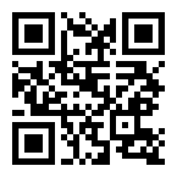
360° Digital Transformation Culture Company
Make IT Happen
Product walkthrough October 2026
  Satona ERP
  Group Console.
This document only applies to your collaboration with WIT.ID
Scan QR Code
to see more detail.
And please do not spread and use it for things outside of this collaboration.
www.wit.id

Slide 2






Summary
WHAT THIS
DECK COVERS.
CONTEXT.
EASE.
OPERATIONS.
SERVICES.
One ERP for a
logistics, fertiliser
and chemicals group
Search, drawer and
charts that open records
Fleet, plants, tank
farm and SHE / K3
HRIS, finance and
approval control
SLIDES 5-9
SLIDES 10-17
SLIDES 18-22
SLIDES 3-4
DELIVERY.
ARCHITECTURE.
PLANNING.
Scrum SDLC from
backlog to release
Ready to split into
microservices
Releases, sprints
and squads
SLIDES 23-25
SLIDES 26-27
SLIDES 28-29
Satona ERP ©2026 www.wit.id Page 2
360° Digital Transformation Culture Company

Slide 3
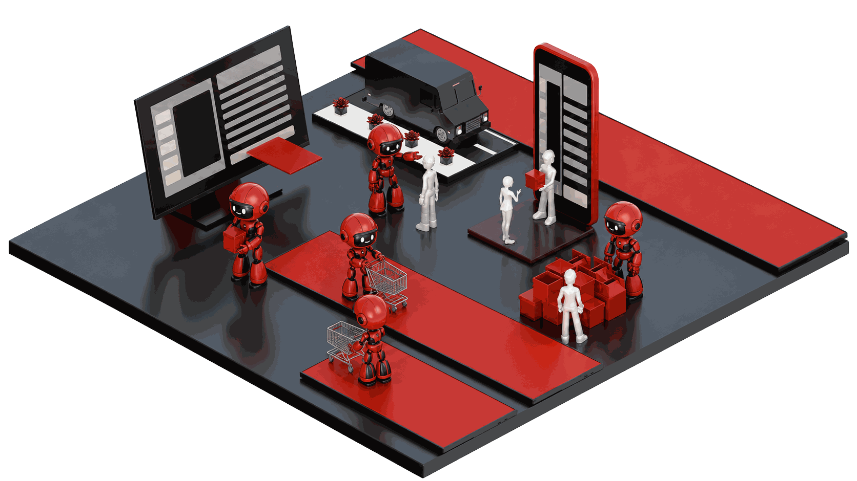

CONTEXT. The group
One ERP for a
chemical group.
Four companies, one console
Satona Holding: master data, finance, procurement, governance, BI
Rotama: tanker fleet, warehouses and dangerous-goods transport
Rodame: NPK and urea plants, MES, maintenance, distributors
Roasi: continuous chemical process, tank farm, genealogy
Shared services across the group
HRIS, finance and accounting, purchasing and inventory
SHE / K3 management for every plant and depot
System administration with a multilevel approval matrix
Satona ERP ©2026 www.wit.id Page 3
360° Digital Transformation Culture Company

Slide 4
PLATFORM. In numbers
Built from the scope and user matrix.
4
26
162
80
Record types with forms and workflows
Companies in the group
Modules
Master data types
78
515
2,562
188
Roles from the user matrix
Transaction codes in the menu
Employees across the group
Automated tests passing
Frontend demo with in-memory data: every screen works, data resets on reload.
Satona ERP ©2026 www.wit.id Page 4
360° Digital Transformation Culture Company

Slide 5
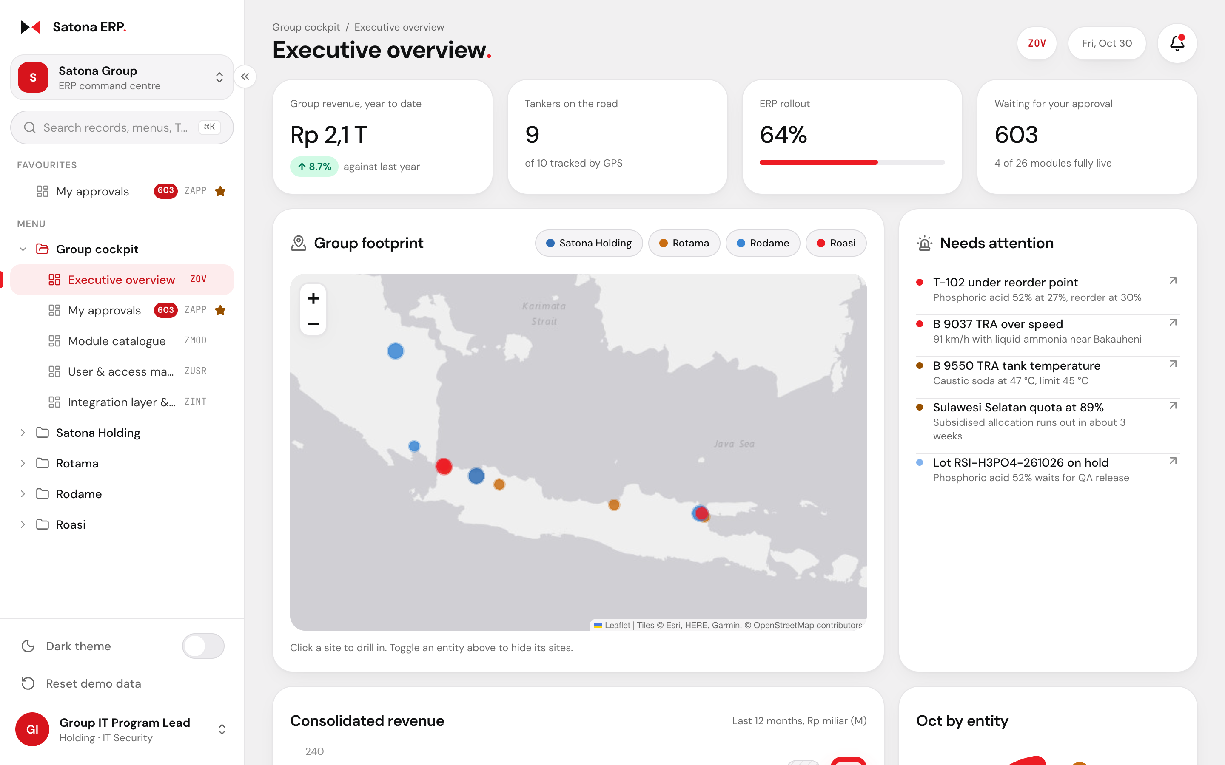
EASE. Executive overview
Each role lands on its own home screen.
Role-based
Light and dark
Quick login for 24 personas, from CFO to driver and contractor
Menus, buttons and approvals follow the signed-in role
Group map, revenue by entity and items that need attention
Phones get a bottom tab bar instead of a hamburger menu
Satona ERP ©2026 www.wit.id Page 5
360° Digital Transformation Culture Company

Slide 6

EASE. Compared with SAP
Familiar for SAP users, simpler for everyone else.
The SAP habit
In Satona ERP
01
Memorise a T-code for every screen
Type a record number, a name or "new permit"; T-codes still work
02
Separate create, change and display transactions
One drawer creates, views, edits, approves and deletes in place
03
Reports exported, then filtered in Excel
Every chart opens the records behind it; any table exports CSV
04
Approvals hidden in a workflow inbox
The record shows each approval level, who signed and who is next
05
Generic menus for every user
The menu, buttons and home screen follow the role
Satona ERP ©2026 www.wit.id Page 6
360° Digital Transformation Culture Company

Slide 7
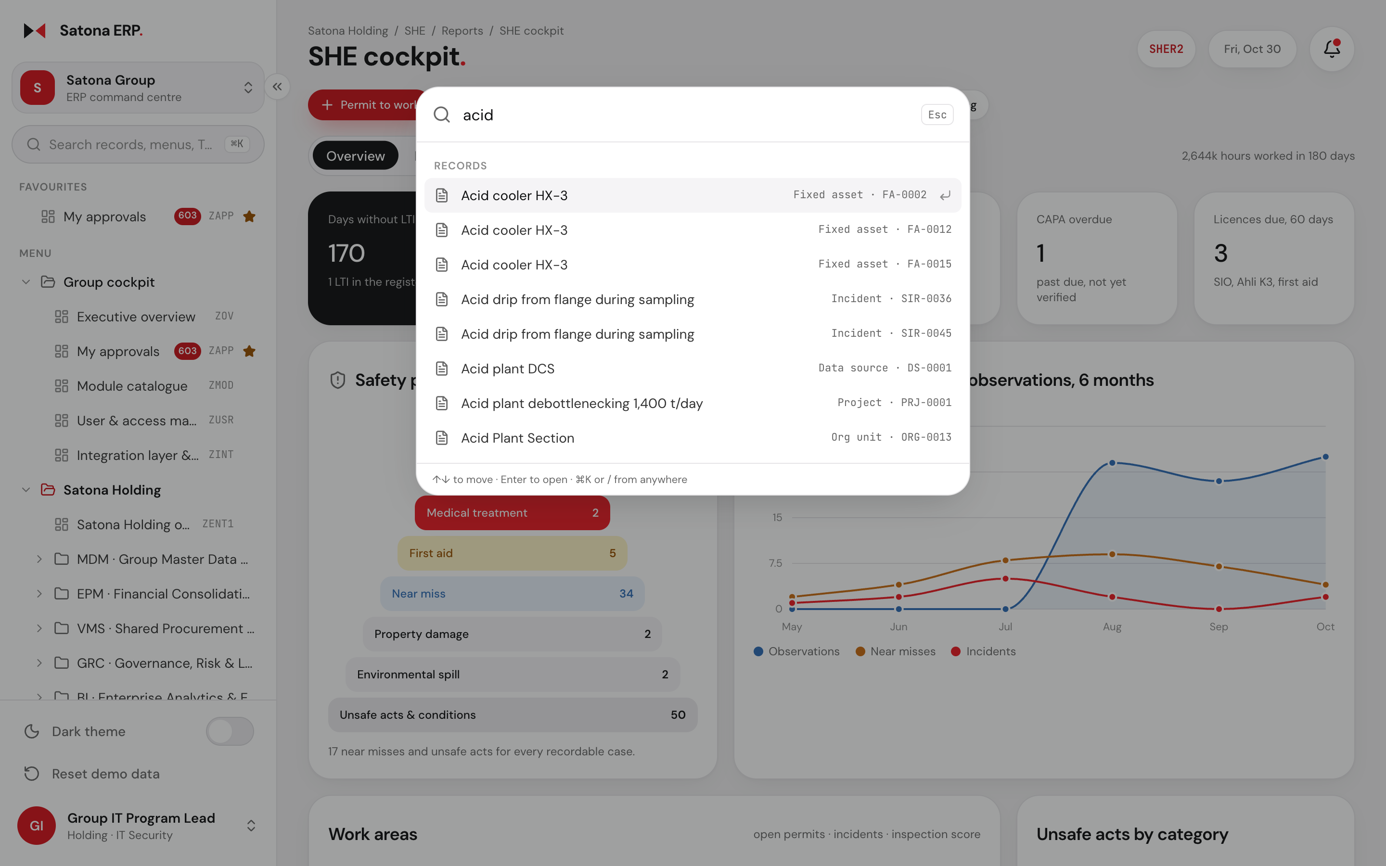
EASE. Global search
One search box finds any record.
Cmd+K
Records + menus
Cmd+K, Ctrl+K or / opens it from any screen
Finds records by number or by words in any field
"new permit" offers the create form for that record
Transaction codes such as PTW01 jump straight to their screen
Recent records and pending approvals show before you type
Satona ERP ©2026 www.wit.id Page 7
360° Digital Transformation Culture Company

Slide 8
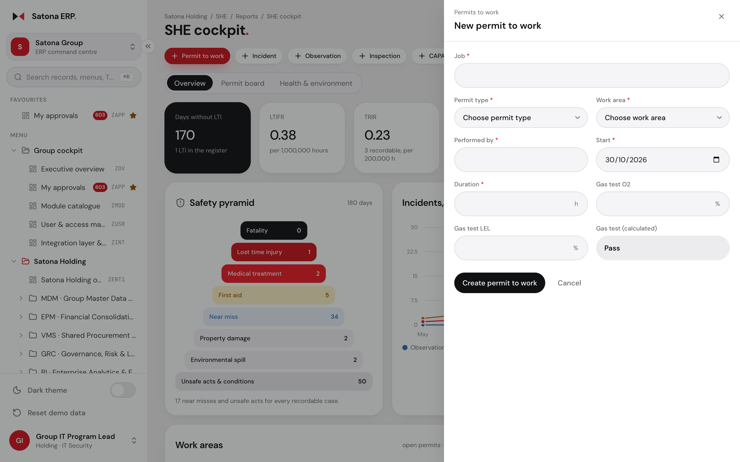
EASE. Work in place
Create and edit without leaving the page.
Drawer
Smart defaults
A side drawer opens any record for view, edit, approve or delete
New forms prefill today and the user's company
Operational pages carry New buttons for the records they use
Press N on a list to start a new record
Satona ERP ©2026 www.wit.id Page 8
360° Digital Transformation Culture Company

Slide 9
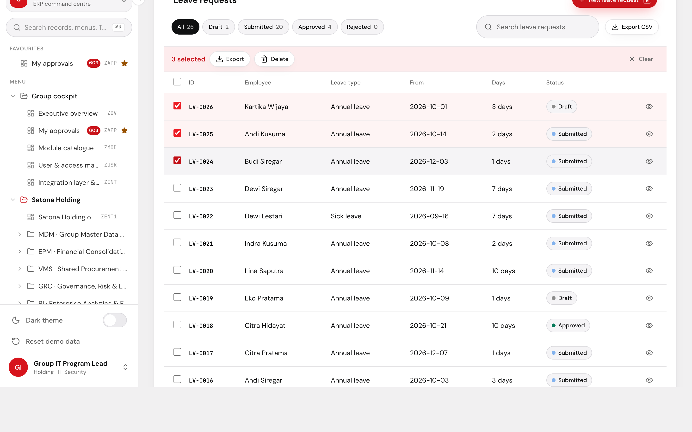
EASE. Lists and drill-down
Every chart opens the records behind it.
Bulk actions
CSV export
Click a month, a status slice or a day to filter the table
Period filter stays in the URL, so links and Back keep it
Select rows to approve, move or delete them in bulk
Export any filtered list to CSV for Excel
Satona ERP ©2026 www.wit.id Page 9
360° Digital Transformation Culture Company

Slide 10
OPERATIONS. Fleet check-in
A driver is cleared to drive in four checks.
01
02
03
04
P2H checklist
Fatigue scan
Breath test
Gate decision
16 pre-trip checks in 6 groups; a failed critical item blocks departure
The DSM camera scans the driver's face for signs of fatigue
Alcohol result recorded with the check-in
Fit to drive or Hold; the approver clears or blocks at the gate
Drivers file their own check-in. The driver app shows only check-in, its history and the gate decision.
Satona ERP ©2026 www.wit.id Page 10
360° Digital Transformation Culture Company

Slide 11
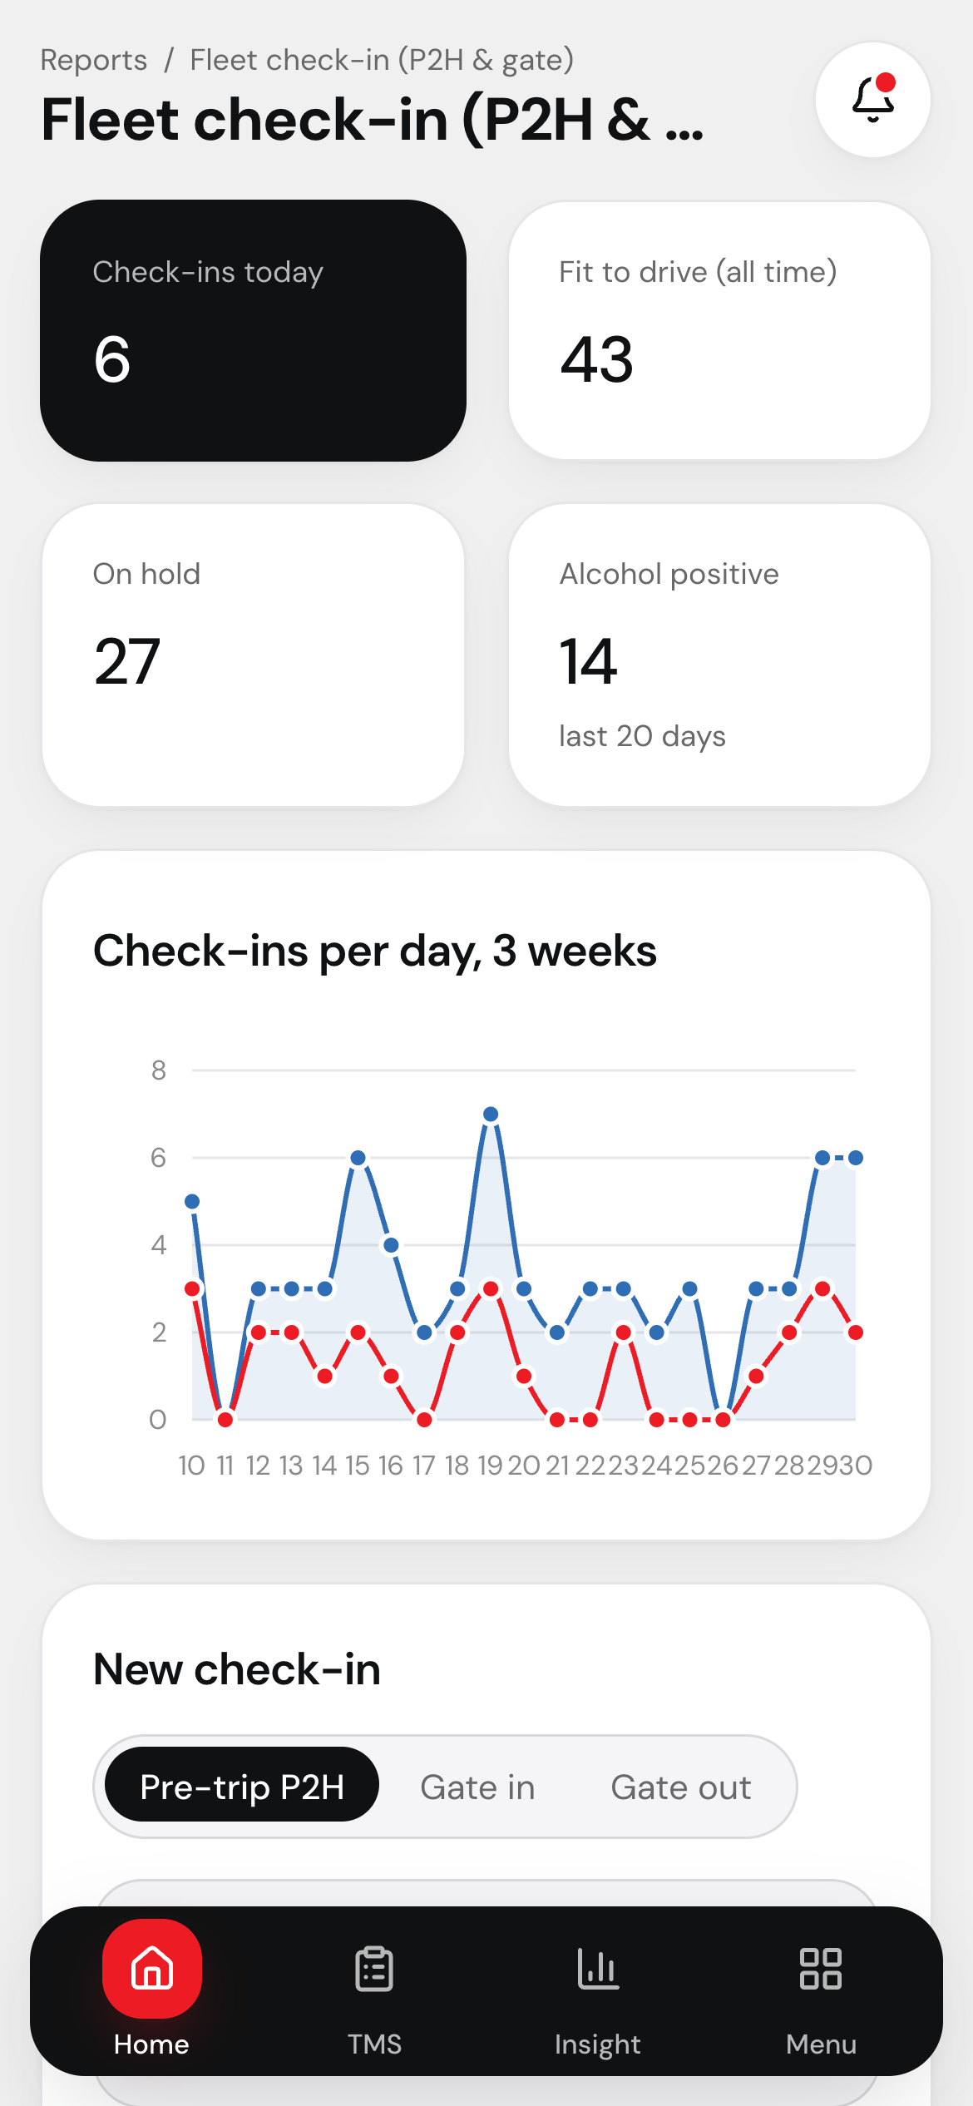
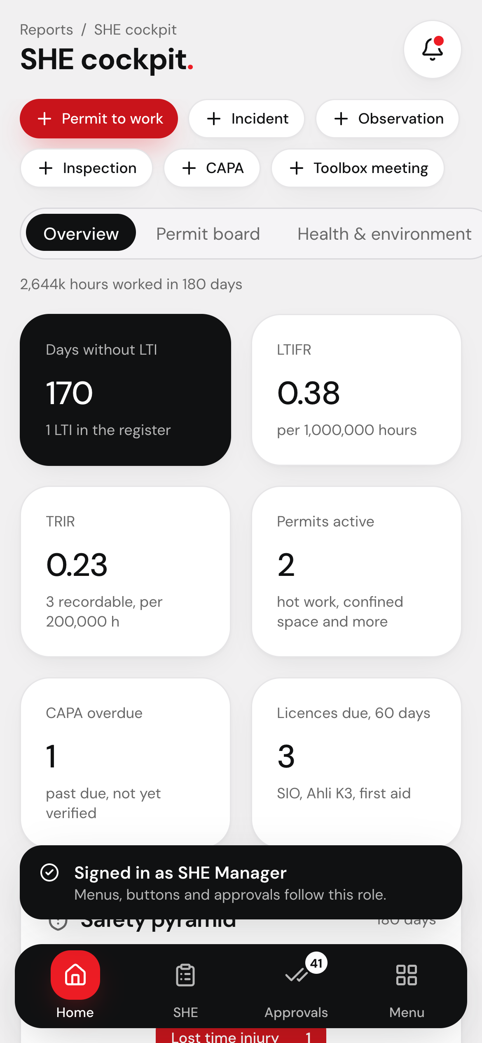
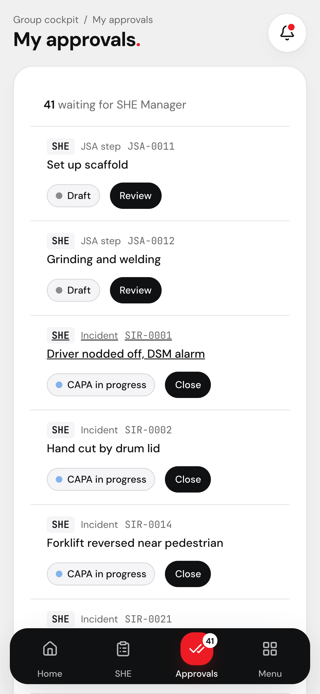
OPERATIONS. On the phone
Field roles work from a phone-sized console.
Driver
SHE Manager
Bottom tab bar: home, worklist, approvals and the full menu
Drivers land on check-in; SHE managers on the SHE cockpit
Approvers sign their level from the approvals tab
Satona ERP ©2026 www.wit.id Page 11
360° Digital Transformation Culture Company

Slide 12
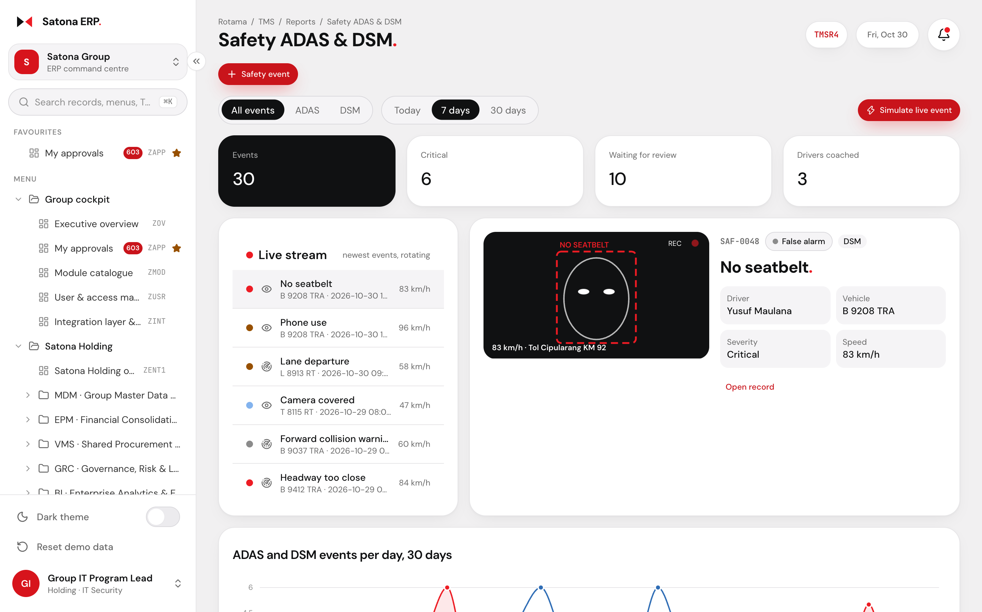
OPERATIONS. Safety ADAS and DSM
Driver safety events reviewed as they arrive.
ADAS
DSM
Live stream of ADAS road events and DSM cabin events
Camera frame per event, hour-of-day heat strip and event types
Driver safety scores rank who needs coaching
Review, coach and close each event in its workflow
Satona ERP ©2026 www.wit.id Page 12
360° Digital Transformation Culture Company

Slide 13
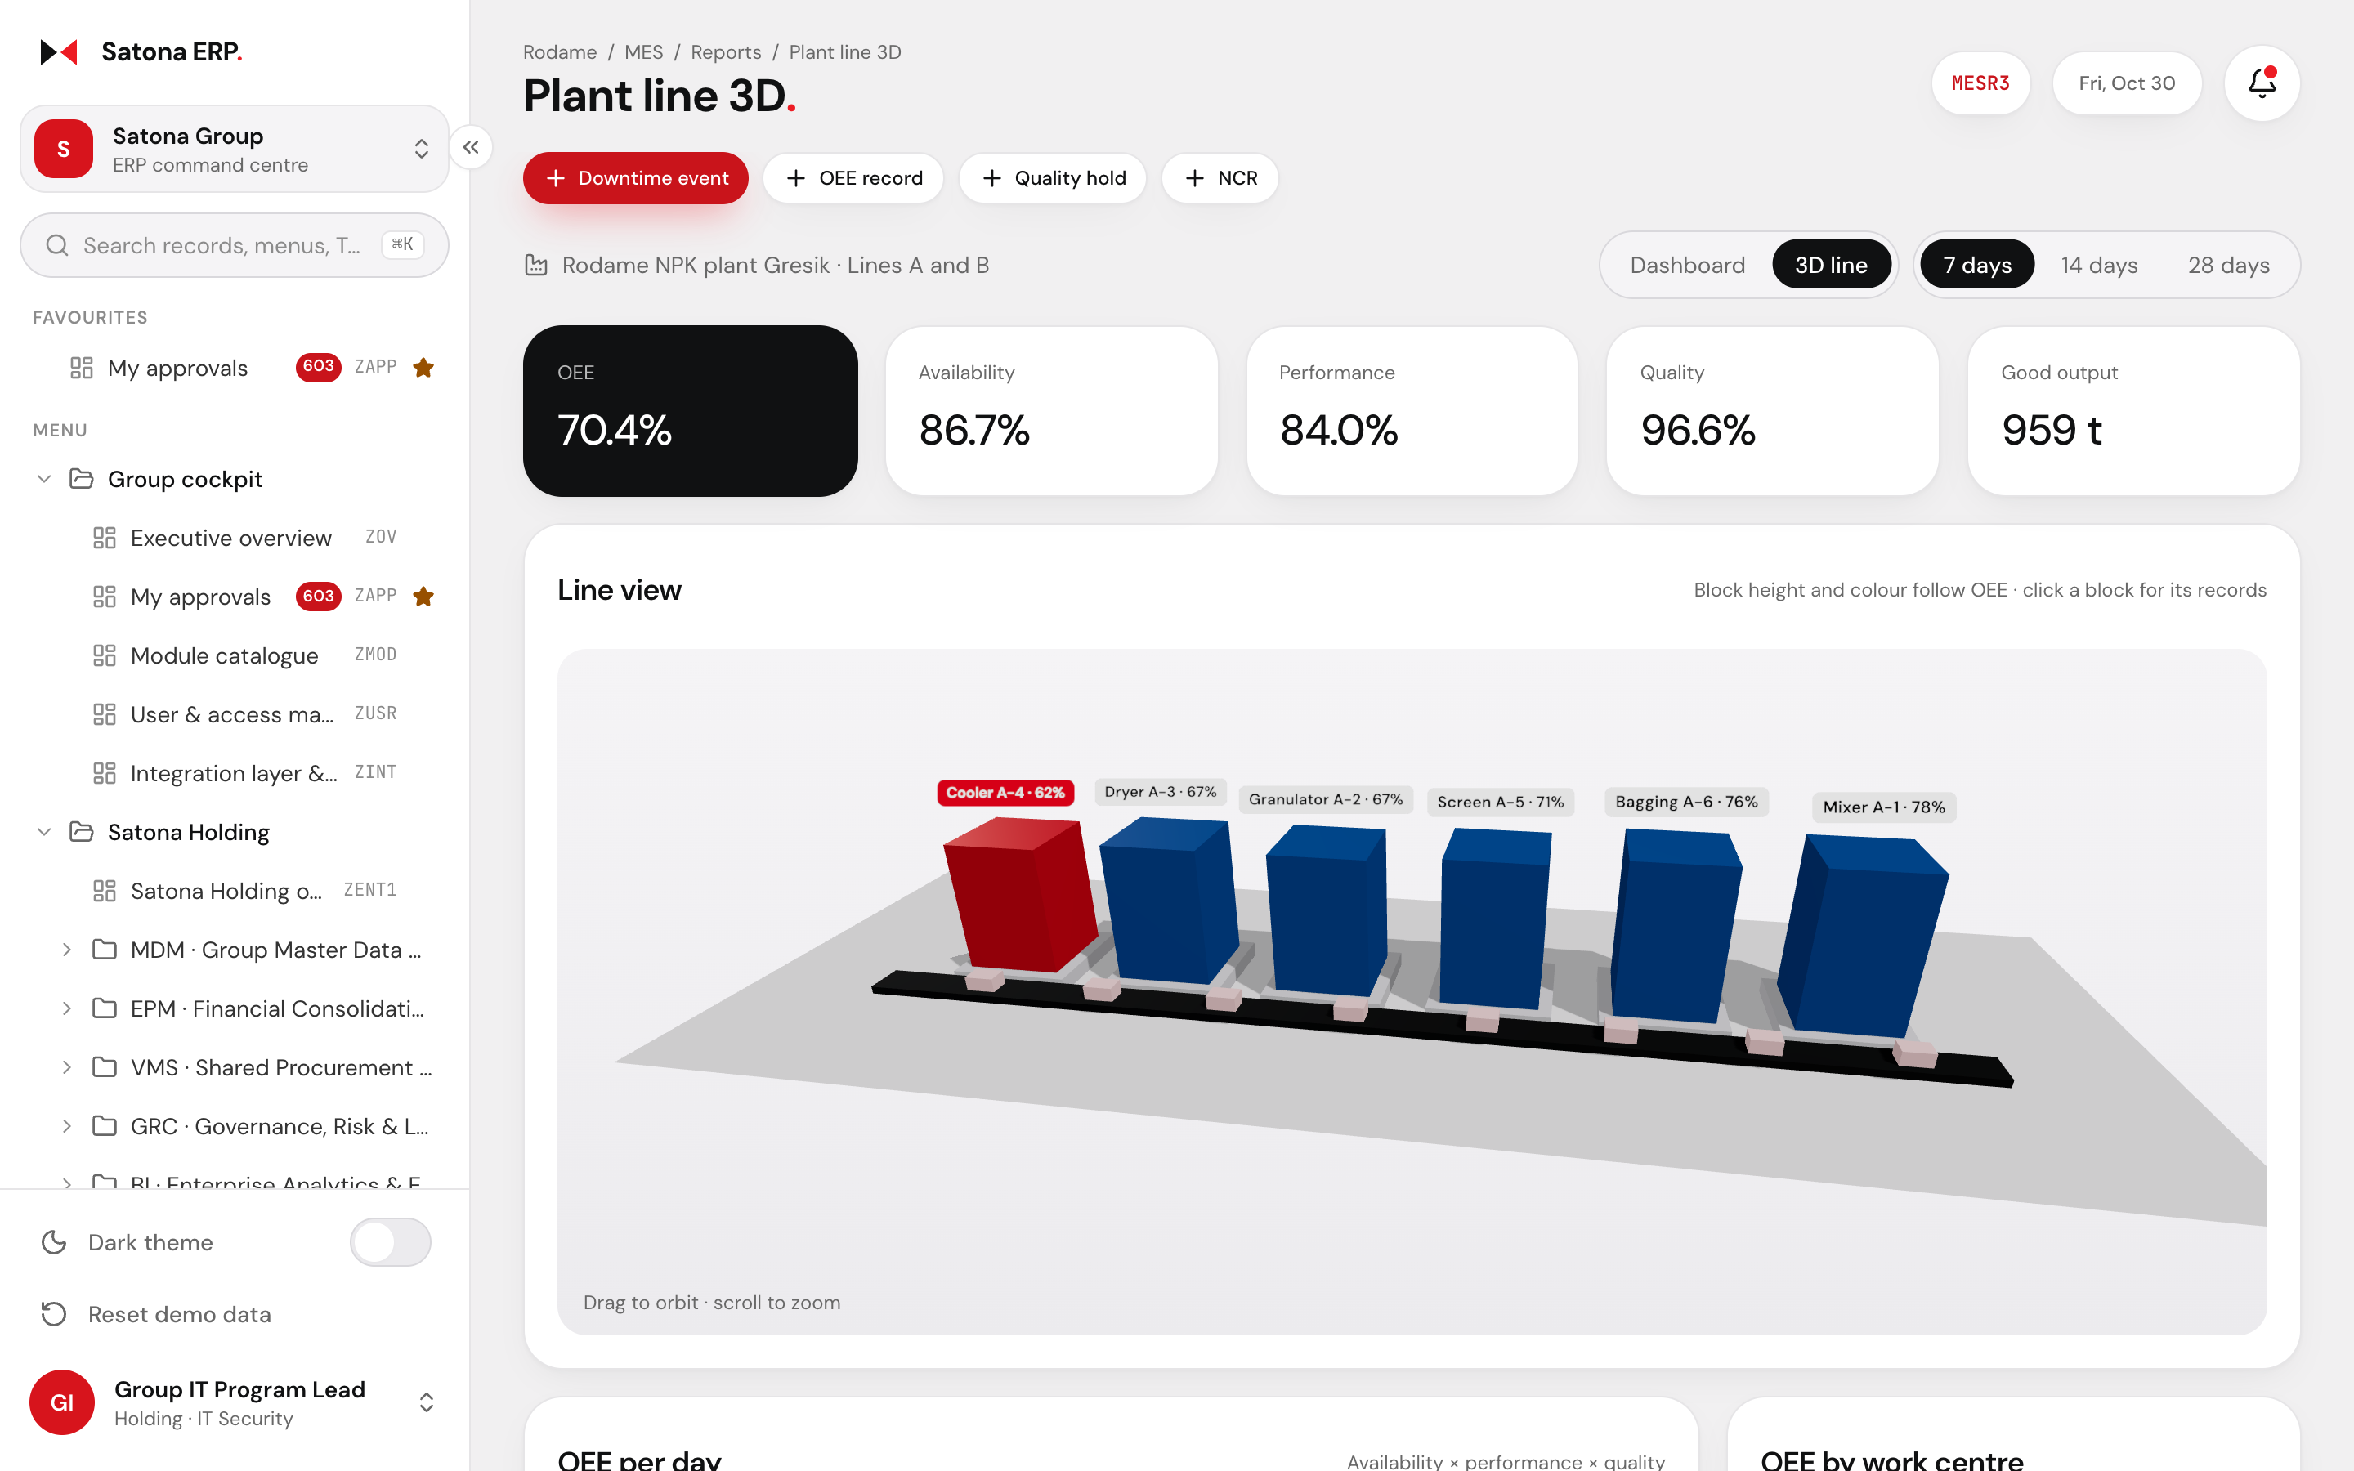
OPERATIONS. Production in 3D
The plant line in 3D, coloured by OEE.
MES
three.js
Block height and colour follow each work centre's OEE
Click a block to open its shift records
Dashboard tab: OEE per day, downtime Pareto and the shop floor
Satona ERP ©2026 www.wit.id Page 13
360° Digital Transformation Culture Company

Slide 14
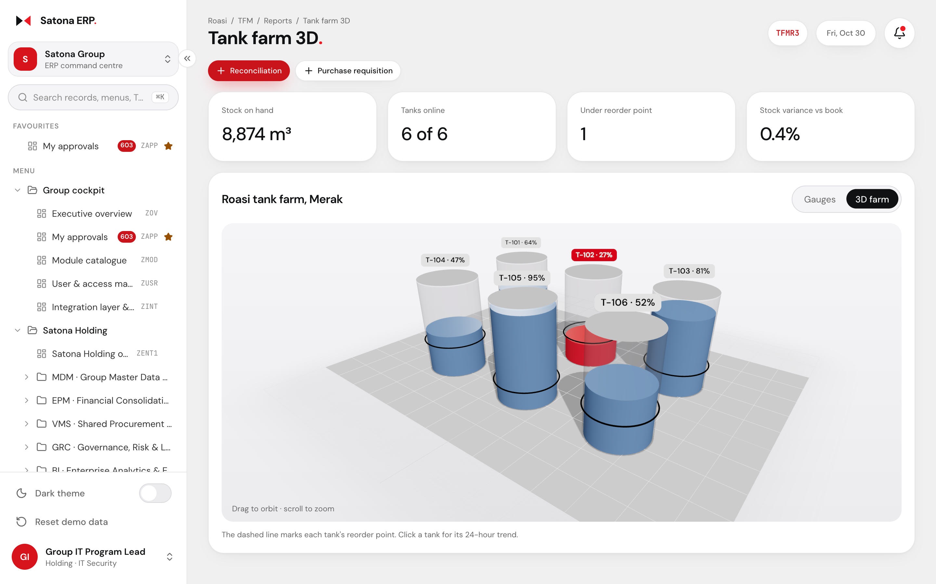
OPERATIONS. Tank farm
Tank levels and reorder points at a glance.
TFM
Auto reorder
Glass tanks show the live level; red marks a tank under its reorder point
A low tank raises a purchase requisition from the same screen
Gauges tab adds level trends and stock reconciliation
Satona ERP ©2026 www.wit.id Page 14
360° Digital Transformation Culture Company

Slide 15
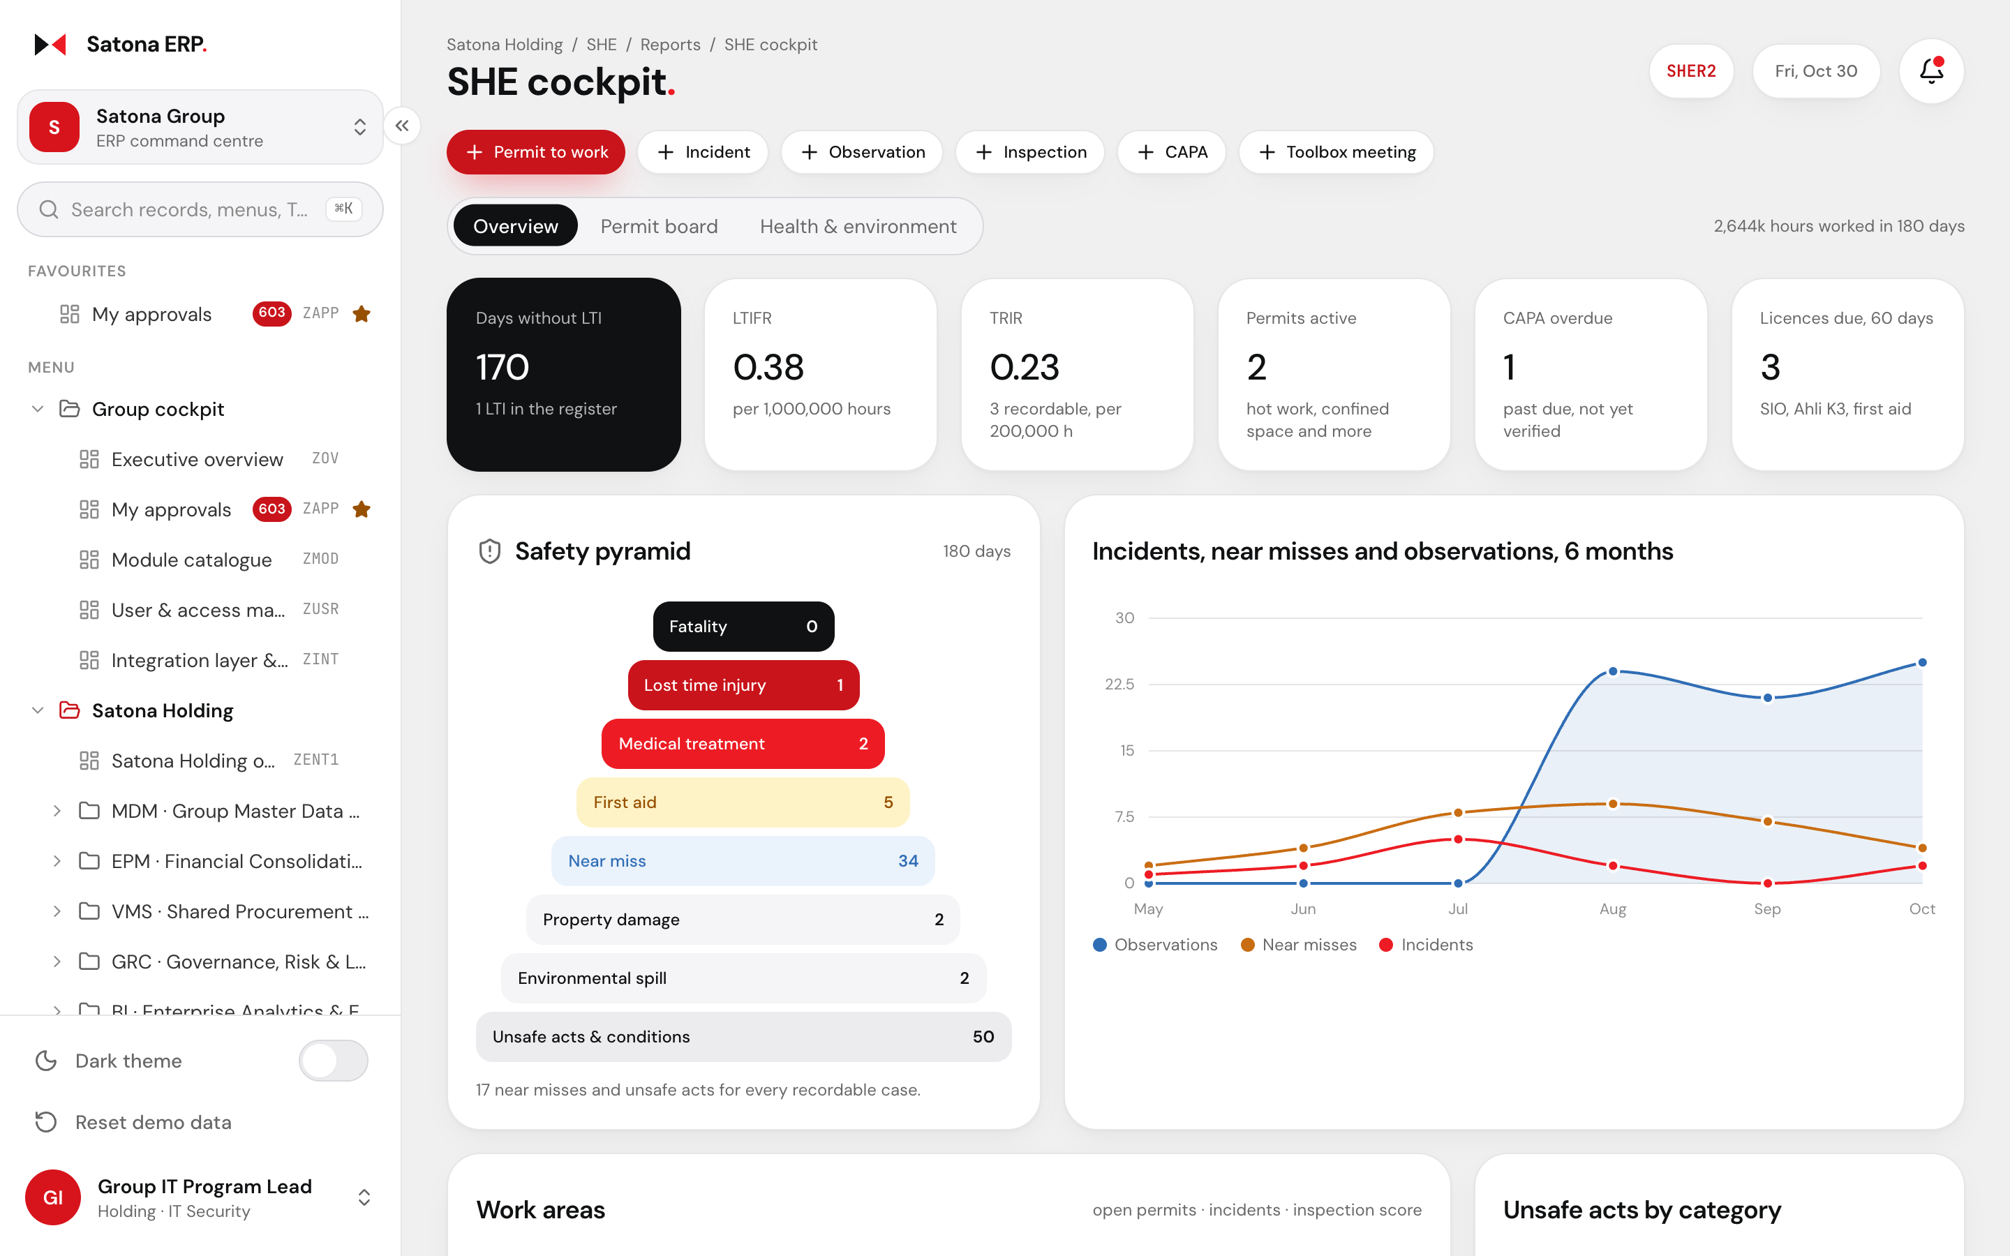
SHE / K3. Cockpit
Lagging and leading indicators on one screen.
K3
Clickable charts
Days without LTI, LTIFR and TRIR from the incident register
Safety pyramid from fatalities down to unsafe acts
Work areas with open permits, incidents and inspection scores
Each chart opens the incidents or observations behind it
Satona ERP ©2026 www.wit.id Page 15
360° Digital Transformation Culture Company

Slide 16
SHE / K3. Permit to work
No permit is approved on a failed gas test.
PERMIT TO WORK
Gas test pass?
Permit request
(K3 or contractor)
Gas test
(O2 and LEL)
Yes
Safety Inspector
level 1
K3 Officer, then
SHE Manager
No
Ventilate and re-test
Approve stays blocked → re-test
Satona ERP ©2026 www.wit.id Page 16
360° Digital Transformation Culture Company

Slide 17
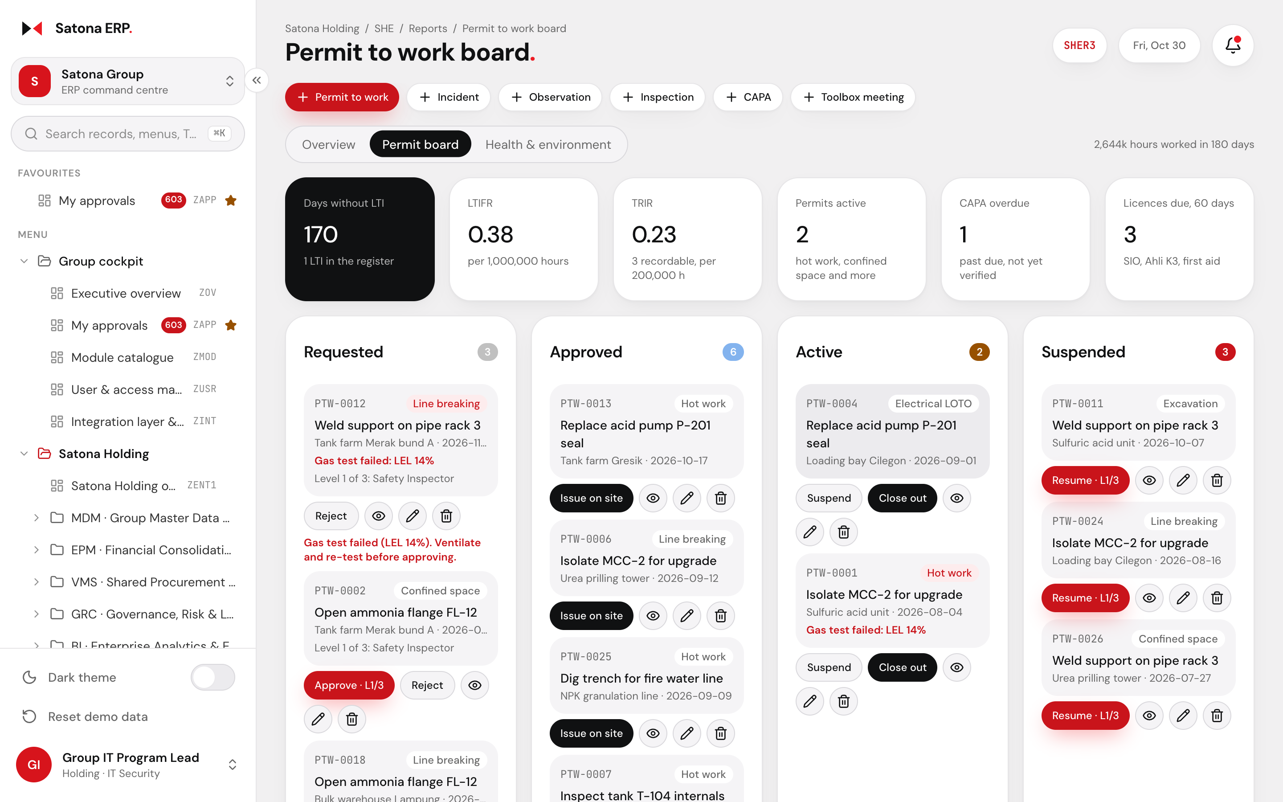
SHE / K3. Permit board
Every permit by state, with its next approver.
PTW
JSA
Requested, approved, active and suspended permits side by side
Failed gas tests flagged in red on the card
Approve, issue, suspend or close from the board
Health tab: MCU fitness, licences due, B3 waste and fire equipment
Satona ERP ©2026 www.wit.id Page 17
360° Digital Transformation Culture Company

Slide 18
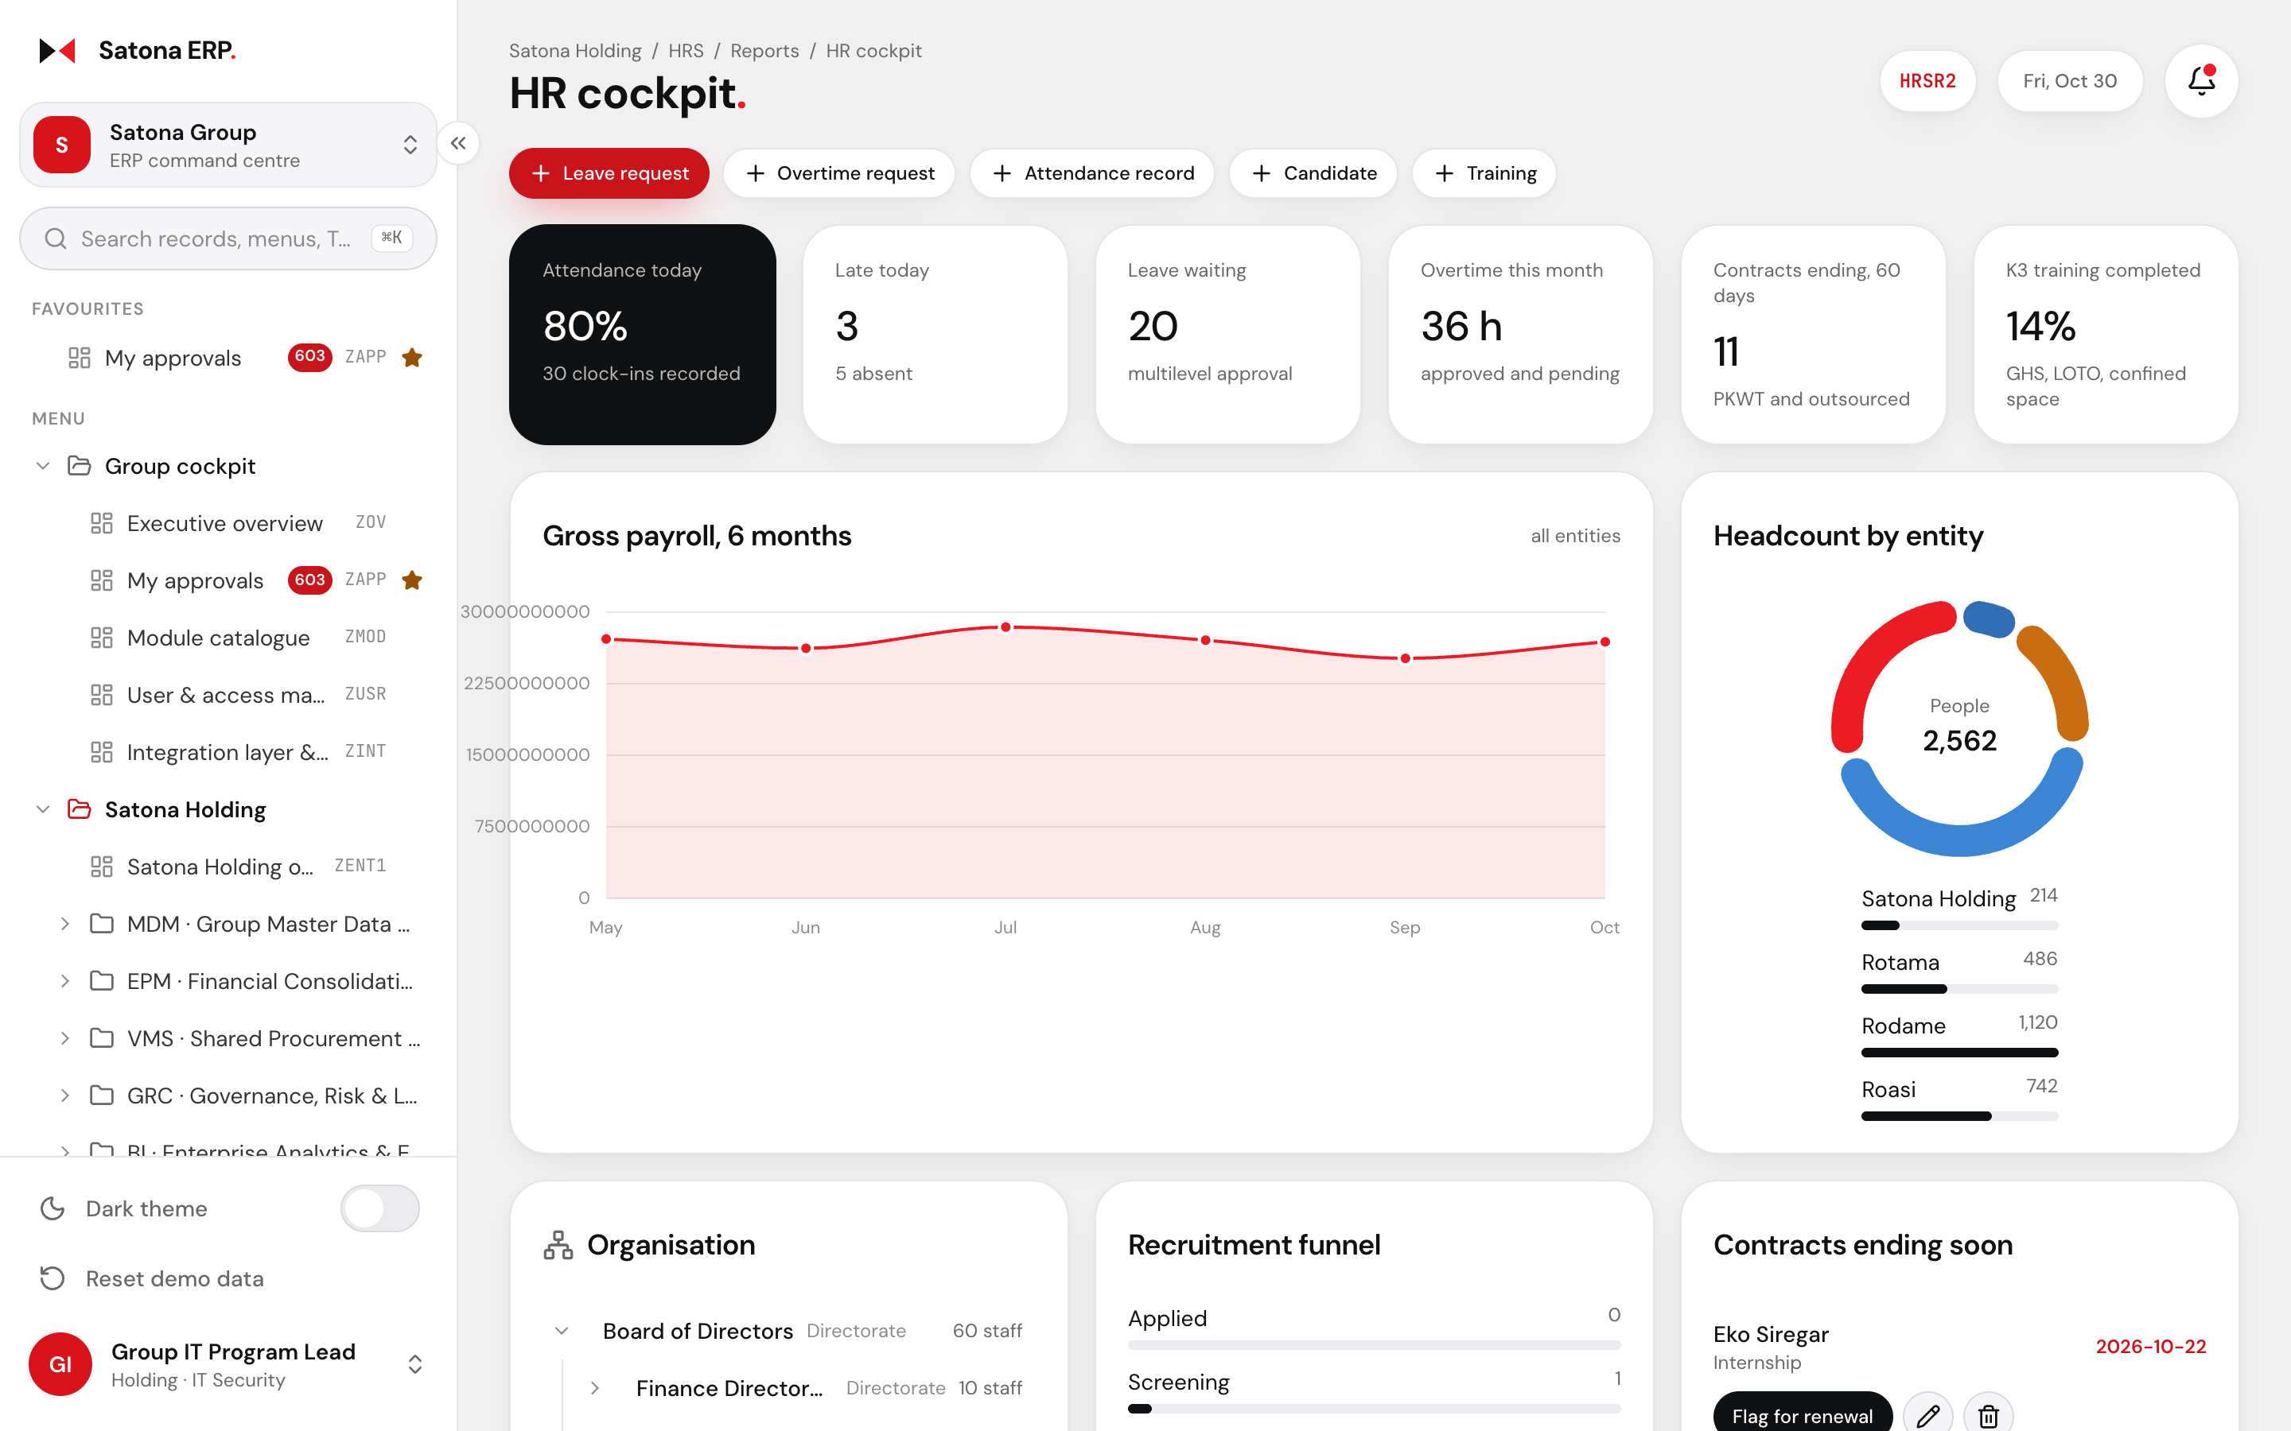
SERVICES. Human capital
HRIS for 2,562 people across four companies.
HRIS
ESS
Attendance, leave, overtime, payroll, contracts and recruitment
Org chart counts staff in every unit and the units below it
Employees file leave and overtime from the ESS portal
K3 training completion tracked with the HR records
Satona ERP ©2026 www.wit.id Page 18
360° Digital Transformation Culture Company

Slide 19
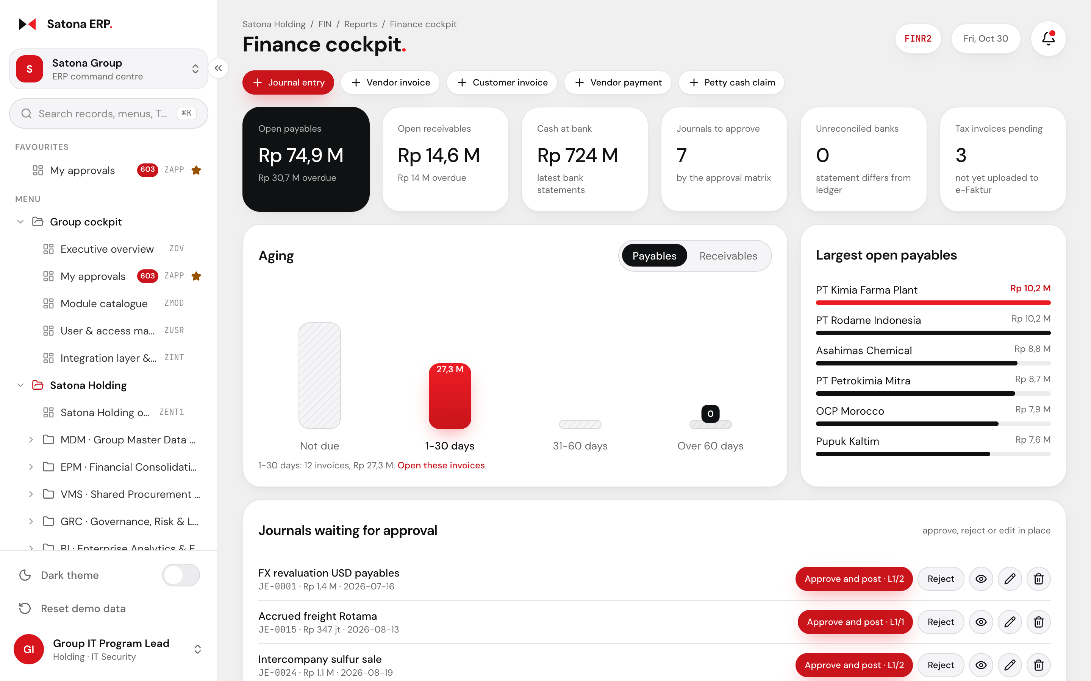
SERVICES. Finance and accounting
Payables, receivables and the close in one place.
FIN
e-Faktur
Journals, AP with 3-way match, AR, e-Faktur and vendor payments
AP and AR aging; each bucket opens exactly its invoices
Journals waiting for approval with approve and reject in the row
Bank reconciliation, petty cash, cash advances and period close
Satona ERP ©2026 www.wit.id Page 19
360° Digital Transformation Culture Company

Slide 20
SERVICES. Approval matrix
Approval levels set by document, company and amount.
Document | Amount band | Level 1 | Level 2 | Level 3
Purchase order | Up to Rp 500 M | Head of Procurement
Purchase order | Above Rp 500 M | Head of Procurement | Finance Controller | CFO
Requisition | Above Rp 1 B | Head of Procurement | CFO
Leave request | Above 5 days | HR Manager | HR Director
Payroll run | Any | HR Director | Finance Controller | CFO
Permit to work | Any | Safety Inspector | K3 Officer | SHE Manager
Journal entry | Above Rp 1 B | Chief Accountant | Finance Controller
Vendor payment | Any | Finance Controller | CFO
Scrap and disposal | Any | Inventory Controller | SHE Manager
Rules, levels, delegations and permission overrides are master data in System Administration.
Satona ERP ©2026 www.wit.id Page 20
360° Digital Transformation Culture Company

Slide 21
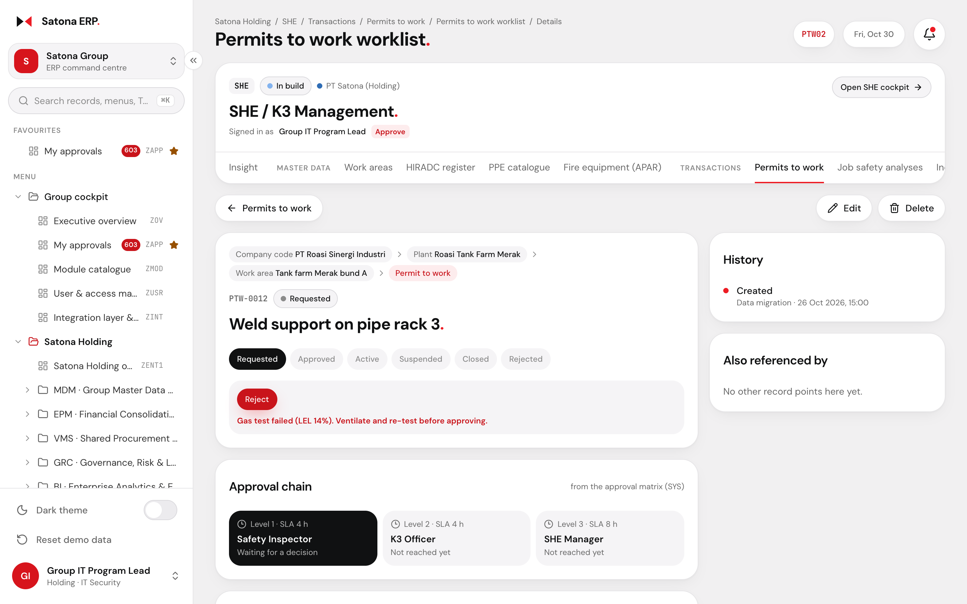
SERVICES. Approval on the record
Each record shows who signed and who is next.
Multilevel
Delegation
Approval chain card: signed levels, the current level and the rest
The approve button names the level: "Approve, level 2 of 3"
Delegations let a deputy sign while the approver is away
A rejection clears the signatures and starts the round again
Satona ERP ©2026 www.wit.id Page 21
360° Digital Transformation Culture Company

Slide 22
SERVICES. Administration
Settings are records, so admins change them without code.
Roles and approval
01
Roles from the user matrix, with permission overrides per module
02
Approval matrix by document, company and amount, with SLA hours
03
Delegations with start and end dates for approvers on leave
General setup
01
Number ranges, holiday calendar and notification templates
02
Currencies, tax codes, company codes, plants and cost centres
03
Every change keeps its history on the record
Satona ERP ©2026 www.wit.id Page 22
360° Digital Transformation Culture Company

Slide 23
DELIVERY. Scrum SDLC
Working software every two weeks.
01
02
03
04
05
06
Backlog
Planning
Build
Test
Review
Retro
Product Owner orders features from the scope and user matrix
The team commits to a sprint goal and the stories that meet it
Daily stand-up; code review and automated tests on every merge
QA in staging; key users run UAT on finished stories
The team demos working software to Satona each sprint
The team agrees one or two improvements for the next sprint
Two-week sprints. Each sprint ends with a release candidate in staging; production gets it at the next release.
Satona ERP ©2026 www.wit.id Page 23
360° Digital Transformation Culture Company

Slide 24
DELIVERY. Ceremonies
Every ceremony has an owner and an output.
Ceremony | When | Who | Output
Sprint planning | Day 1, 2 hours | Product Owner, Scrum Master, team | Sprint goal and sprint backlog
Daily stand-up | Every day, 15 minutes | Development team | Blockers raised and owned
Backlog refinement | Mid-sprint, 1 hour | Product Owner, team | Ready stories for the next sprint
Sprint review | Last day, 1 hour | Team and Satona stakeholders | Accepted increment and feedback
Retrospective | Last day, 1 hour | Team and Scrum Master | Improvement actions
Release and UAT | Each release | Key users and QA | Sign-off to go live
Satona ERP ©2026 www.wit.id Page 24
360° Digital Transformation Culture Company

Slide 25
DELIVERY. Quality gates
A story enters a sprint ready and leaves it done.
Definition of ready
Acceptance criteria and the role that uses the story
Record types, fields and workflow states agreed
Designs and test data available
Definition of done
Code reviewed; unit and API tests pass in CI
Deployed to staging and passes the UI checks: no overflow, both themes
Product Owner accepts it in the sprint review
Satona ERP ©2026 www.wit.id Page 25
360° Digital Transformation Culture Company

Slide 26
ARCHITECTURE. Microservice-ready
One service per business domain, behind one gateway.
Web console
React, role-based menus
Phone and driver app
Check-in, ESS, approvals
Partner portals
Vendors, distributors, contractors
API gateway · Keycloak SSO and role tokens · audit log
Identity and access
SYS roles, permissions
Master data
MDM, company codes, plants
Workflow and approval
Matrix, levels, delegations
Finance
FIN, EPM, FBL, GRC
Procurement and stock
VMS, INV, WMS
Human capital
HRS, ESS, GAS
SHE / K3
Permits, incidents, MCU
Logistics
TMS, HAZ, DMS, devices
Plant operations
MES, EAM, QC, BPF, MRP
Process and storage
CFP, TFM, GTR, EHS
Event bus · RecordCreated, StatusChanged, ApprovalSigned, AlarmRaised
Database per service
Each service owns its tables
Reporting and command centre
BI and OCC read from events
Notifications
Email, WhatsApp, in-app
Satona ERP ©2026 www.wit.id Page 26
360° Digital Transformation Culture Company
Notes:
Service boundaries follow the module catalogue; the workflow service is shared because every module uses the approval matrix.

Slide 27
ARCHITECTURE. From demo to services
The demo already splits along the same seams.
In the demo today
In production
01
Clean architecture: domain and use cases carry no React
Domain and use-case code moves into each service unchanged
02
Pages call ports in application/ports.ts
HTTP adapters call the service APIs behind the same ports
03
Mock adapters; VITE_API_URL picks the source
Point VITE_API_URL at the gateway; no page changes
04
Records live in memory and reset on reload
Each service owns a database and publishes events
05
Access and approval rules run in the browser
Services enforce them; Keycloak tokens carry the role
Satona ERP ©2026 www.wit.id Page 27
360° Digital Transformation Culture Company

Slide 28
PLANNING. Release plan
Six releases in sixteen two-week sprints.
Release | Sprints | Scope | Exit criteria
Sprint 0: foundation | 1 | Repositories, CI/CD, environments, Keycloak, gateway, event bus | Pipeline deploys to staging
R1: core platform | 3 | Identity, master data, workflow and approval, finance | Approval matrix live for real users
R2: logistics | 3 | TMS, WMS, HAZ, fleet devices, check-in, ADAS and DSM | Rotama runs trips in the ERP
R3: plants | 4 | MES, EAM, QC, BPF, MRP, tank farm, process, genealogy | Rodame and Roasi shifts recorded
R4: shared services | 3 | HRIS, SHE / K3, inventory, purchasing, service desk | Payroll and permits run live
R5: insight and go-live | 2 | BI, command centre, data migration, training, hypercare | Go-live sign-off
Total | 16 | About 32 weeks of build
Proposed plan; the team confirms sprint counts and velocity in Sprint 0.
Satona ERP ©2026 www.wit.id Page 28
360° Digital Transformation Culture Company

Slide 29
PLANNING. Squads
Four squads, each owning its services end to end.
SQUAD 1
SQUAD 2
SQUAD 3
SQUAD 4
Platform
Logistics
Plants
Business
Core services
Rotama
Rodame and Roasi
Shared services
Identity and access
TMS and fleet devices
MES and EAM
Finance and accounting
Master data
WMS and HAZ
QC, BPF and MRP
HRIS and ESS
Workflow and approval
Check-in, ADAS and DSM
Tank farm and process
SHE / K3
Gateway and CI/CD
Distribution (DMS)
Genealogy and recall
Procurement and inventory
Satona ERP ©2026 www.wit.id Page 29
360° Digital Transformation Culture Company

Slide 30


Make IT Happen.
TRY IT WITH
REPOSITORY
A working walkthrough of the whole group, ready for review with Satona.
Any of 24 personas
github.com/syabanf/satona-erp
Cmd+K search
WEB
Click any chart
www.wit.id
360° Digital Transformation Culture Company

