Slide 1



360° Digital Transformation Culture Company
Make IT Happen
Bak 1 SCADA trial October 2026
  Electroforming
  Console.
This document only applies to your collaboration with WIT.ID
Scan QR Code
to see more detail.
And please do not spread and use it for things outside of this collaboration.
www.wit.id

Slide 2






Summary
WHAT THIS
DECK COVERS.
WHY.
STEPS.
LOG.
Two Excel files
become one app
How one batch runs
Recording the
tank every hour
SLIDES 4–5
SLIDE 3
SLIDES 6–8
3D.
REPORTS.
DEVICE.
See the rack
and the room
Ten reports, checked
The sensor box
that sends data
SLIDES 11–12
Electroforming Console
What the app does today, and the device that will send it live data.
SLIDES 9–10
SLIDES 13–17
#MakeITHappen
Electroforming Console ©2026 www.wit.id Page 2
360° Digital Transformation Culture Company

Slide 3
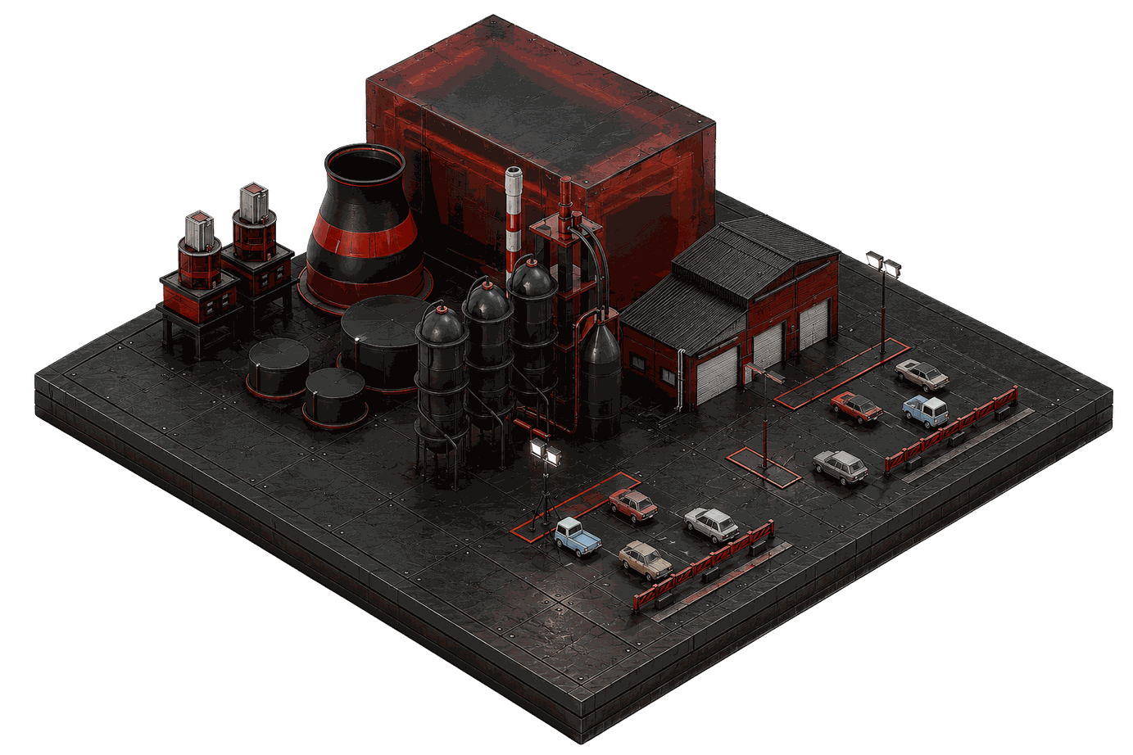

WHY. What the app replaces
Two Excel files,
now one app.
File 1: the batch log
One sheet per batch: time, volt, ampere, meter reading, gold %, plate thickness
Works out how thick the gold is and how fast it grows
Tells the operator to raise, lower or keep the volt
File 2: the surface-area list
Surface area of every product model
How much gold and chemicals each rack load needs
Tank chemistry, top-ups, cleaning tanks and the gold salt log
Electroforming Console ©2026 www.wit.id Page 3
360° Digital Transformation Culture Company

Slide 4
STEPS. One batch, three steps
Each batch goes through three steps on one page.
01
02
03
Prepare
Record
Finish
Hang the products on the rack and enter the lab results
Every 1–2 hours, record pH, temperature, volt and current
Weigh the products and enter the final gold test
One clear next step. The home page tells the operator what each tank needs right now.
Electroforming Console ©2026 www.wit.id Page 4
360° Digital Transformation Culture Company

Slide 5
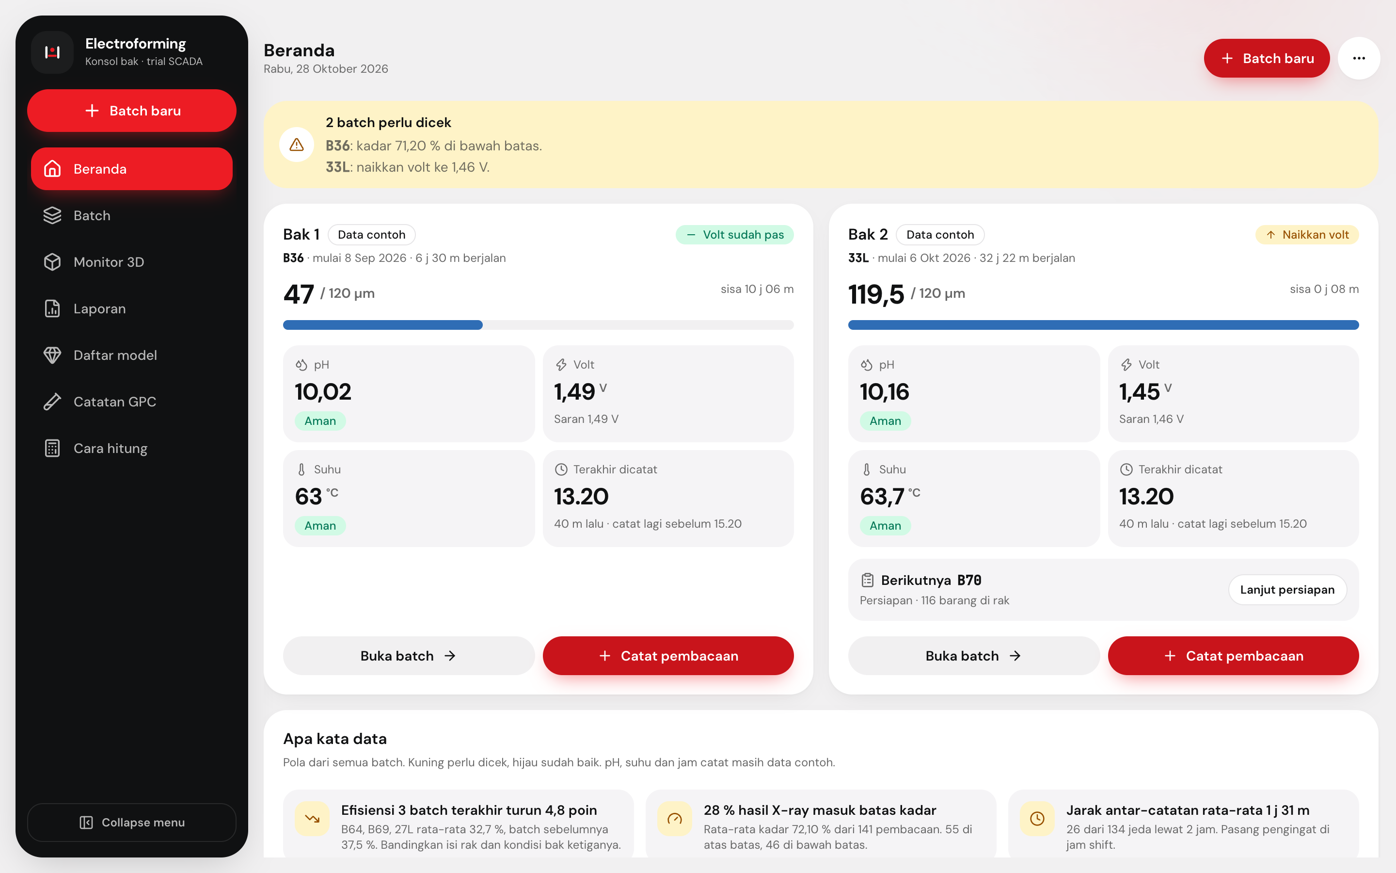
STEPS. Home page
The home page shows what each tank needs now.
Tank 1
Tank 2
A yellow banner lists the batches that need attention, and why
Each tank card shows gold thickness against target, pH, volt and temperature
One button on the card opens the reading form
A short summary points out patterns in the data
Electroforming Console ©2026 www.wit.id Page 5
360° Digital Transformation Culture Company

Slide 6
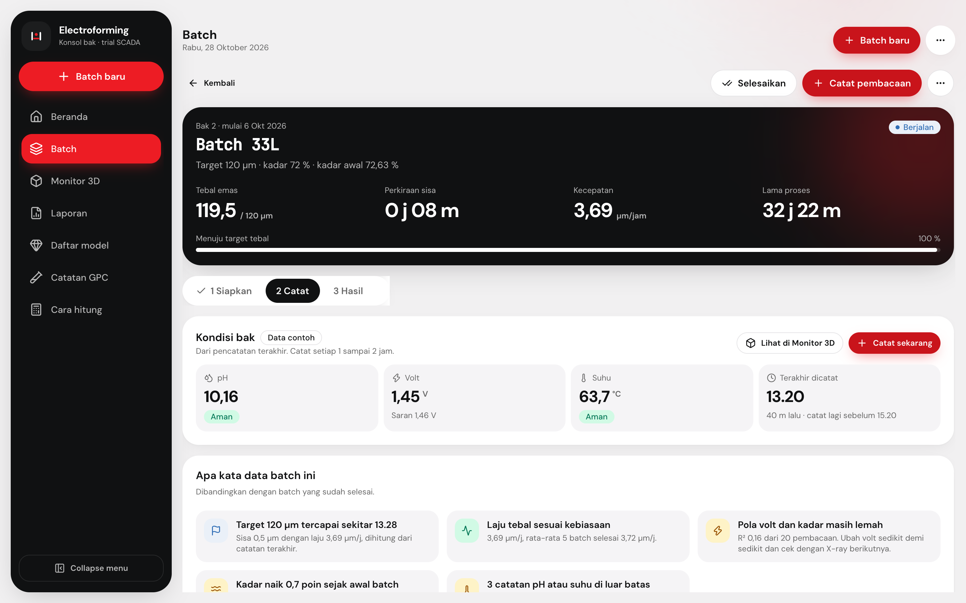
LOG. Tank condition
The app reminds the operator when to record.
Every 1–2 hours
Shows the latest pH, volt, temperature and when they were recorded
Turns to "time to record" after 1 hour and "late" after 2 hours
The form fills in the current time and suggests a volt
pH and temperature limits are samples until the plant sets its own
Electroforming Console ©2026 www.wit.id Page 6
360° Digital Transformation Culture Company

Slide 7
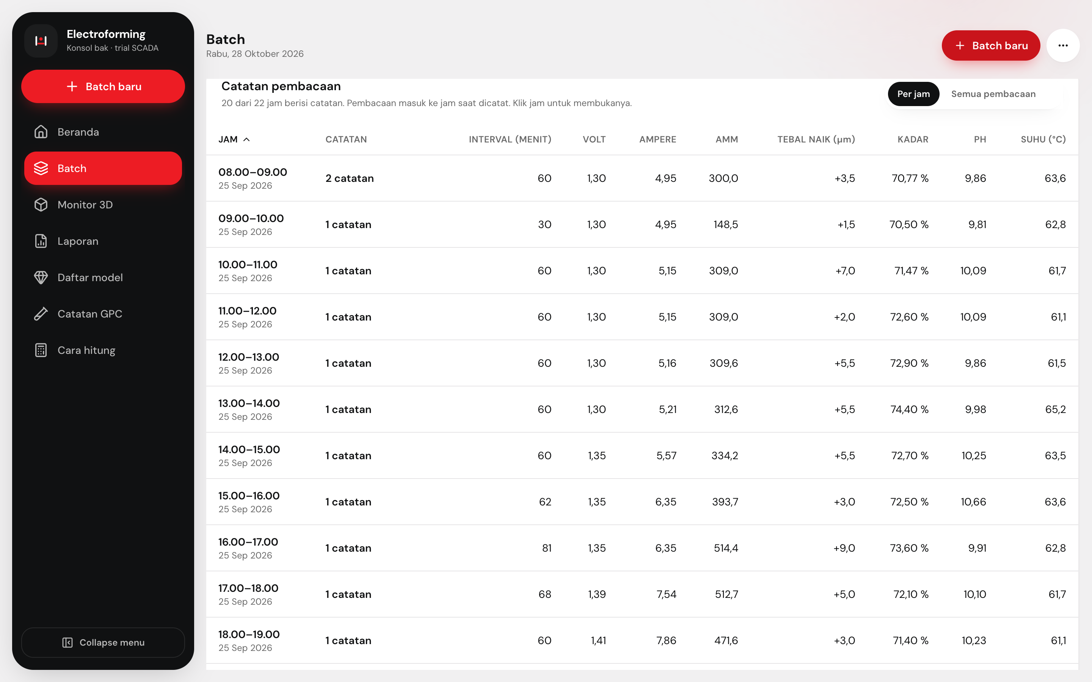
LOG. Hour by hour
The log shows one row for every hour.
Click to open
Each row shows the readings of that hour and how much the gold grew
Hours with no reading stay in the list, marked "late" after 2 hours
For a running batch, the list continues up to now
Click an hour to see its readings; a switch shows the full list
Electroforming Console ©2026 www.wit.id Page 7
360° Digital Transformation Culture Company

Slide 8
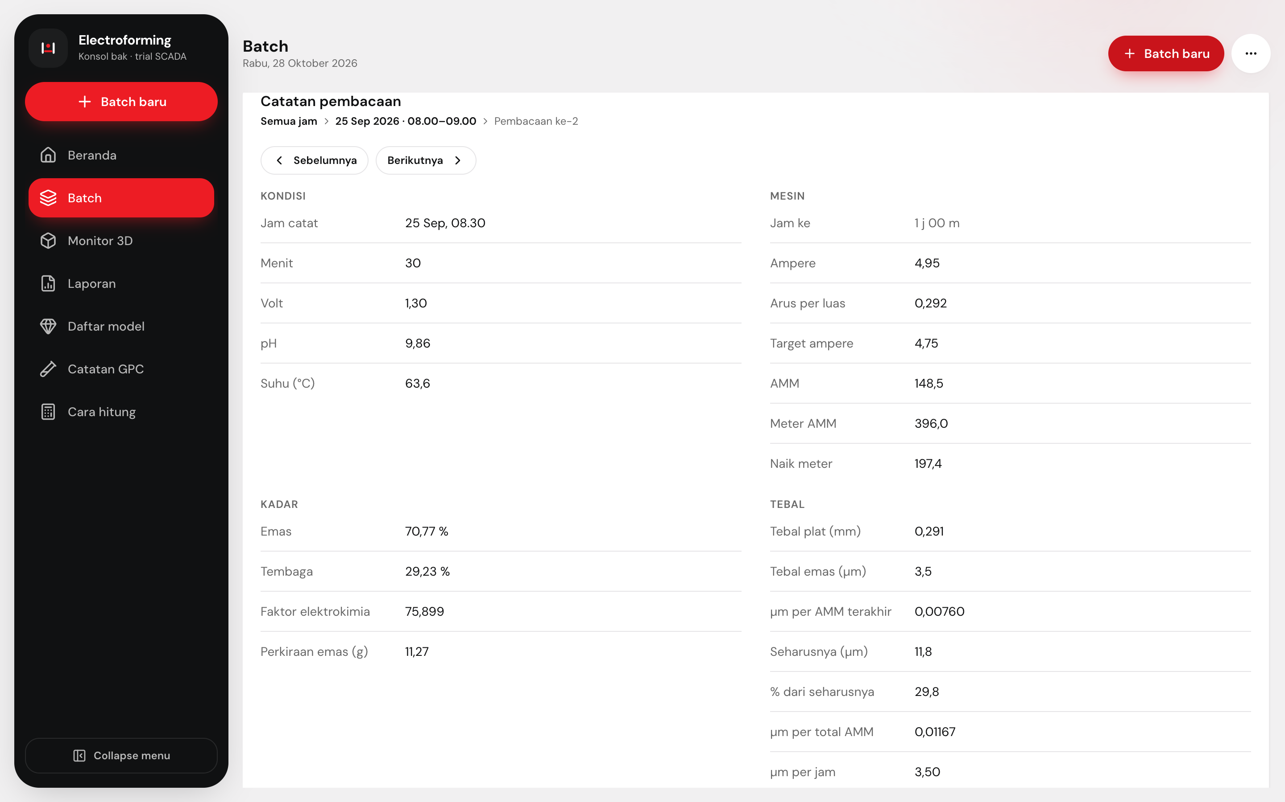
LOG. One reading
Open a reading to see every number behind it.
Hour, then reading
Numbers are grouped like the Excel file: tank, machine, gold %, thickness, volt tip
Previous and next buttons move through the log
While the batch runs, a reading can be edited or deleted
A help page explains every formula and its Excel cell
Electroforming Console ©2026 www.wit.id Page 8
360° Digital Transformation Culture Company

Slide 9
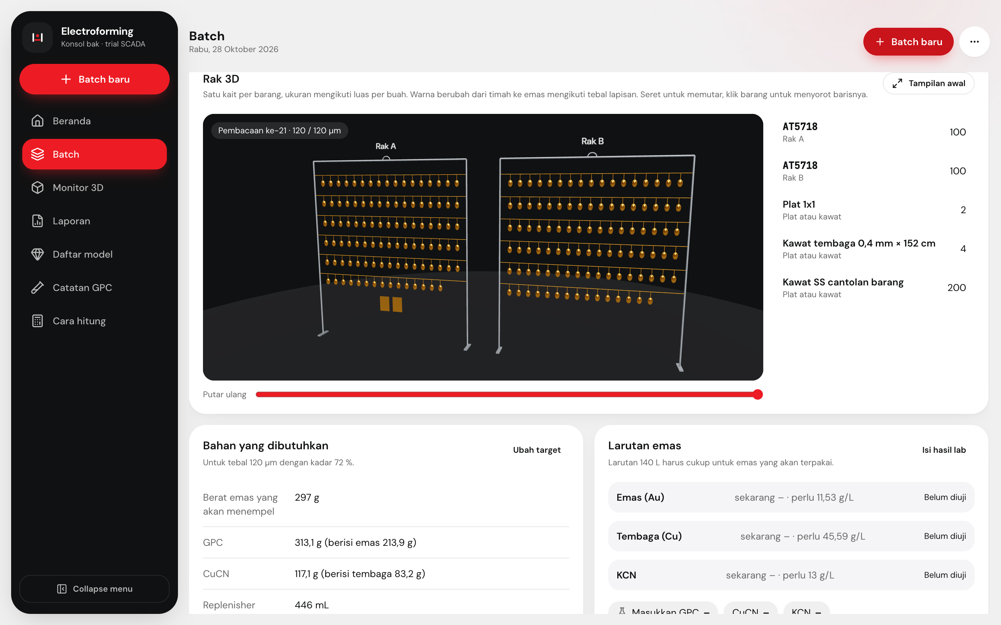
3D. Rack view
The rack turns from grey to gold as plating goes on.
3D
Each batch
Shows every product hanging on the rack
Bigger products are drawn bigger
A slider replays the batch from start to now
Click a product to highlight all pieces of that model
Electroforming Console ©2026 www.wit.id Page 9
360° Digital Transformation Culture Company

Slide 10
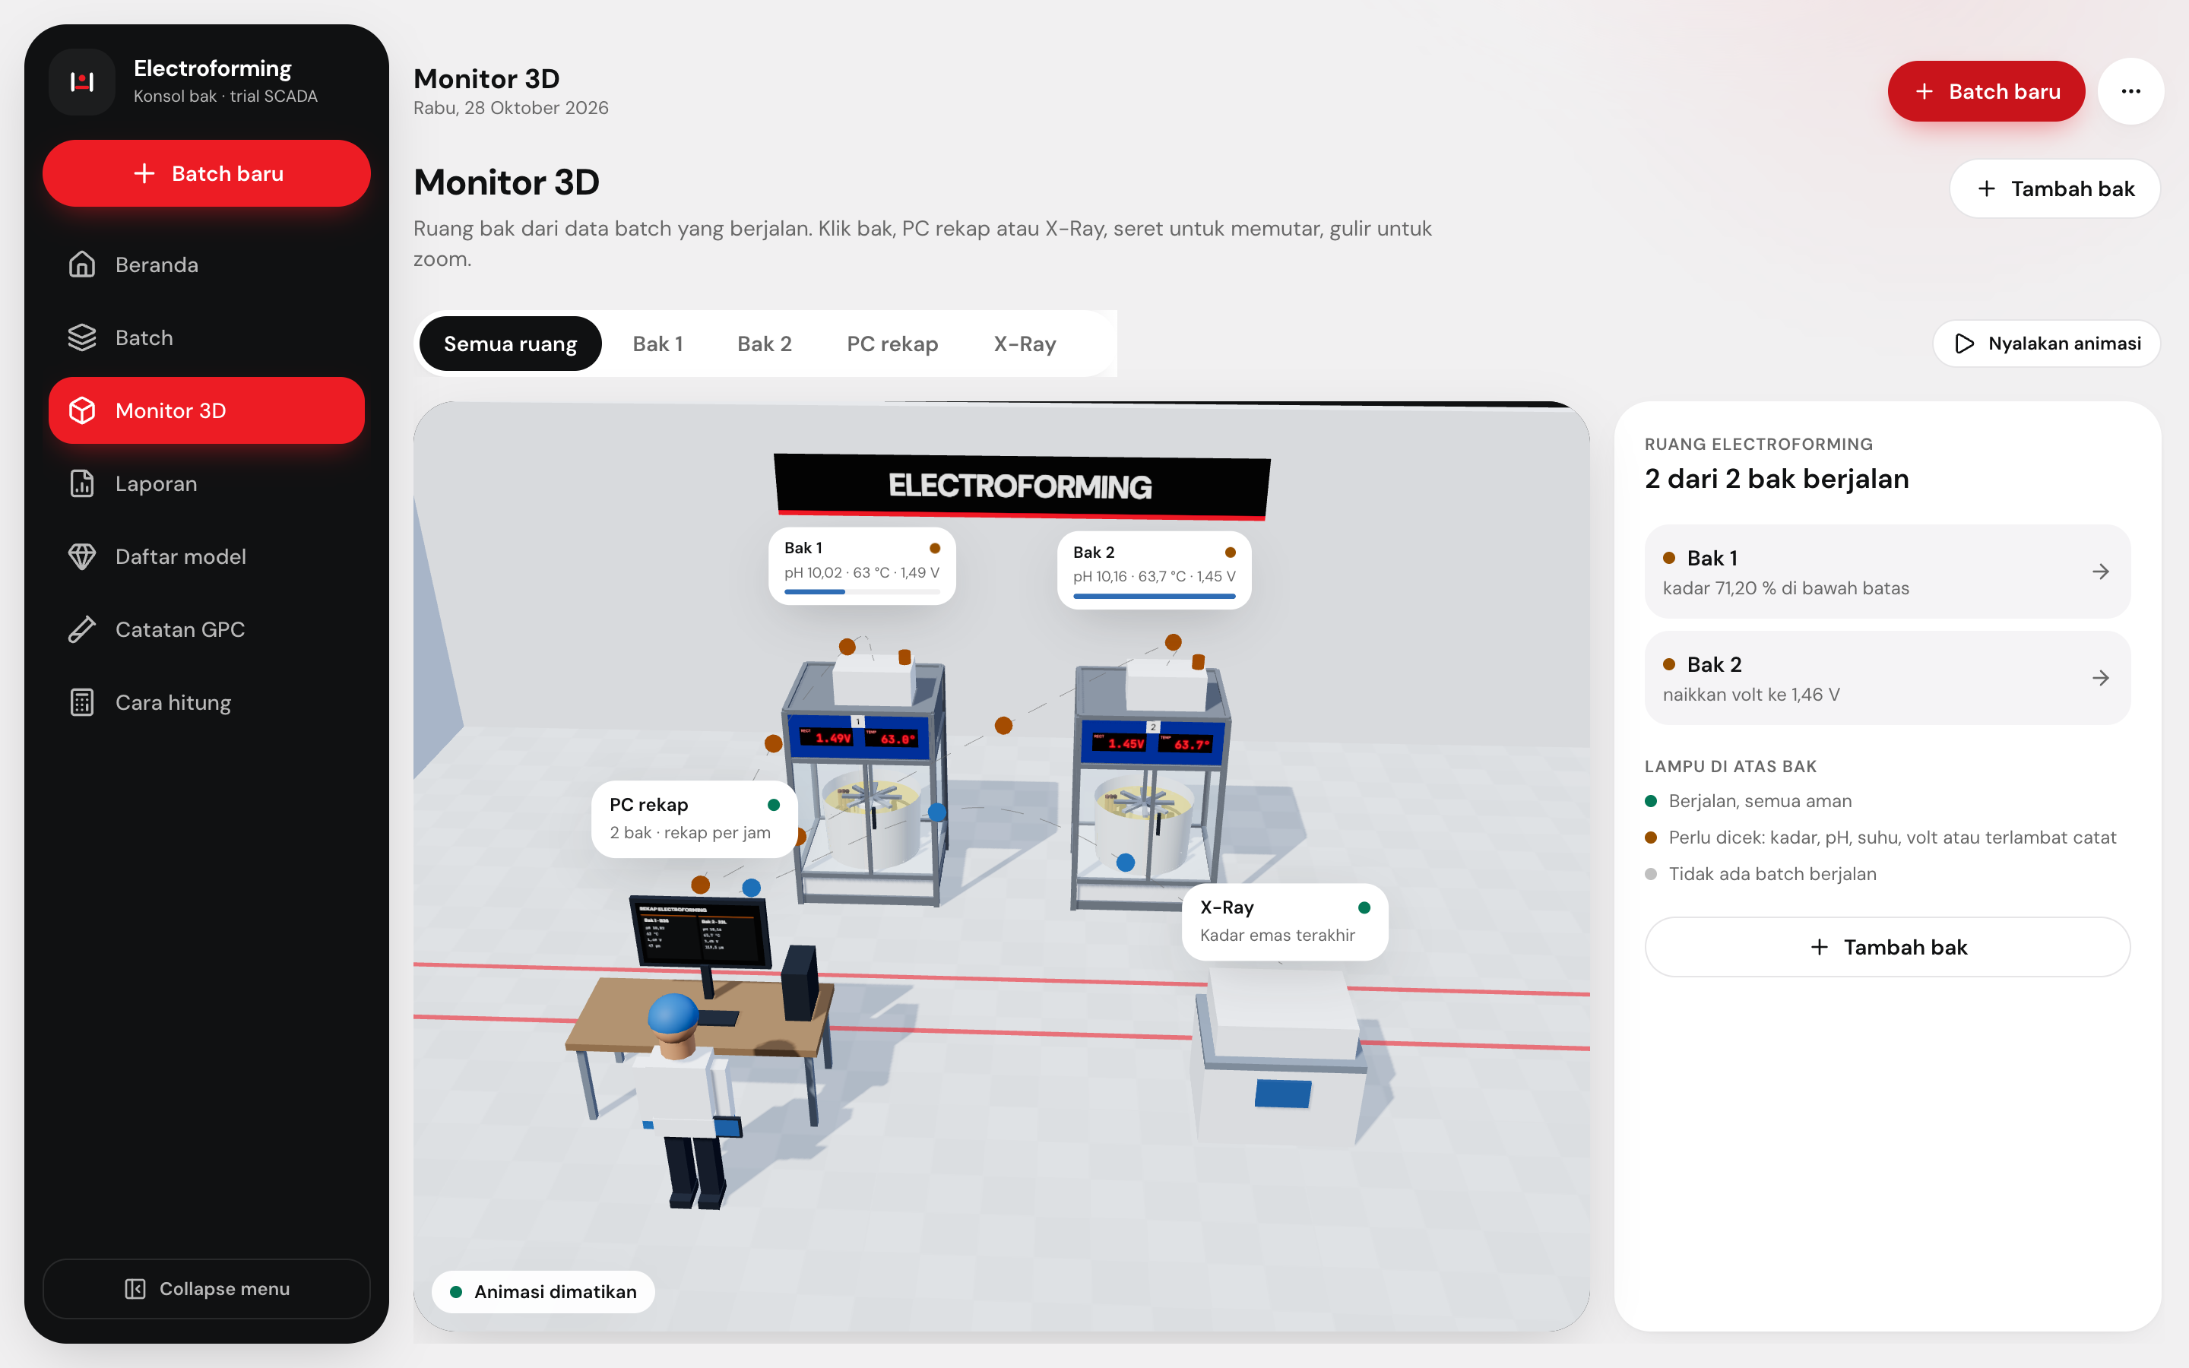
3D. Monitor room
A 3D view of the plating room, live from the log.
Monitor 3D
One tank per bath, with its volt and temperature on display
A lamp turns orange when a batch needs attention
Click a tank, the PC or the X-ray machine to zoom in
Each new reading shows the operator walking the round
Electroforming Console ©2026 www.wit.id Page 10
360° Digital Transformation Culture Company

Slide 11
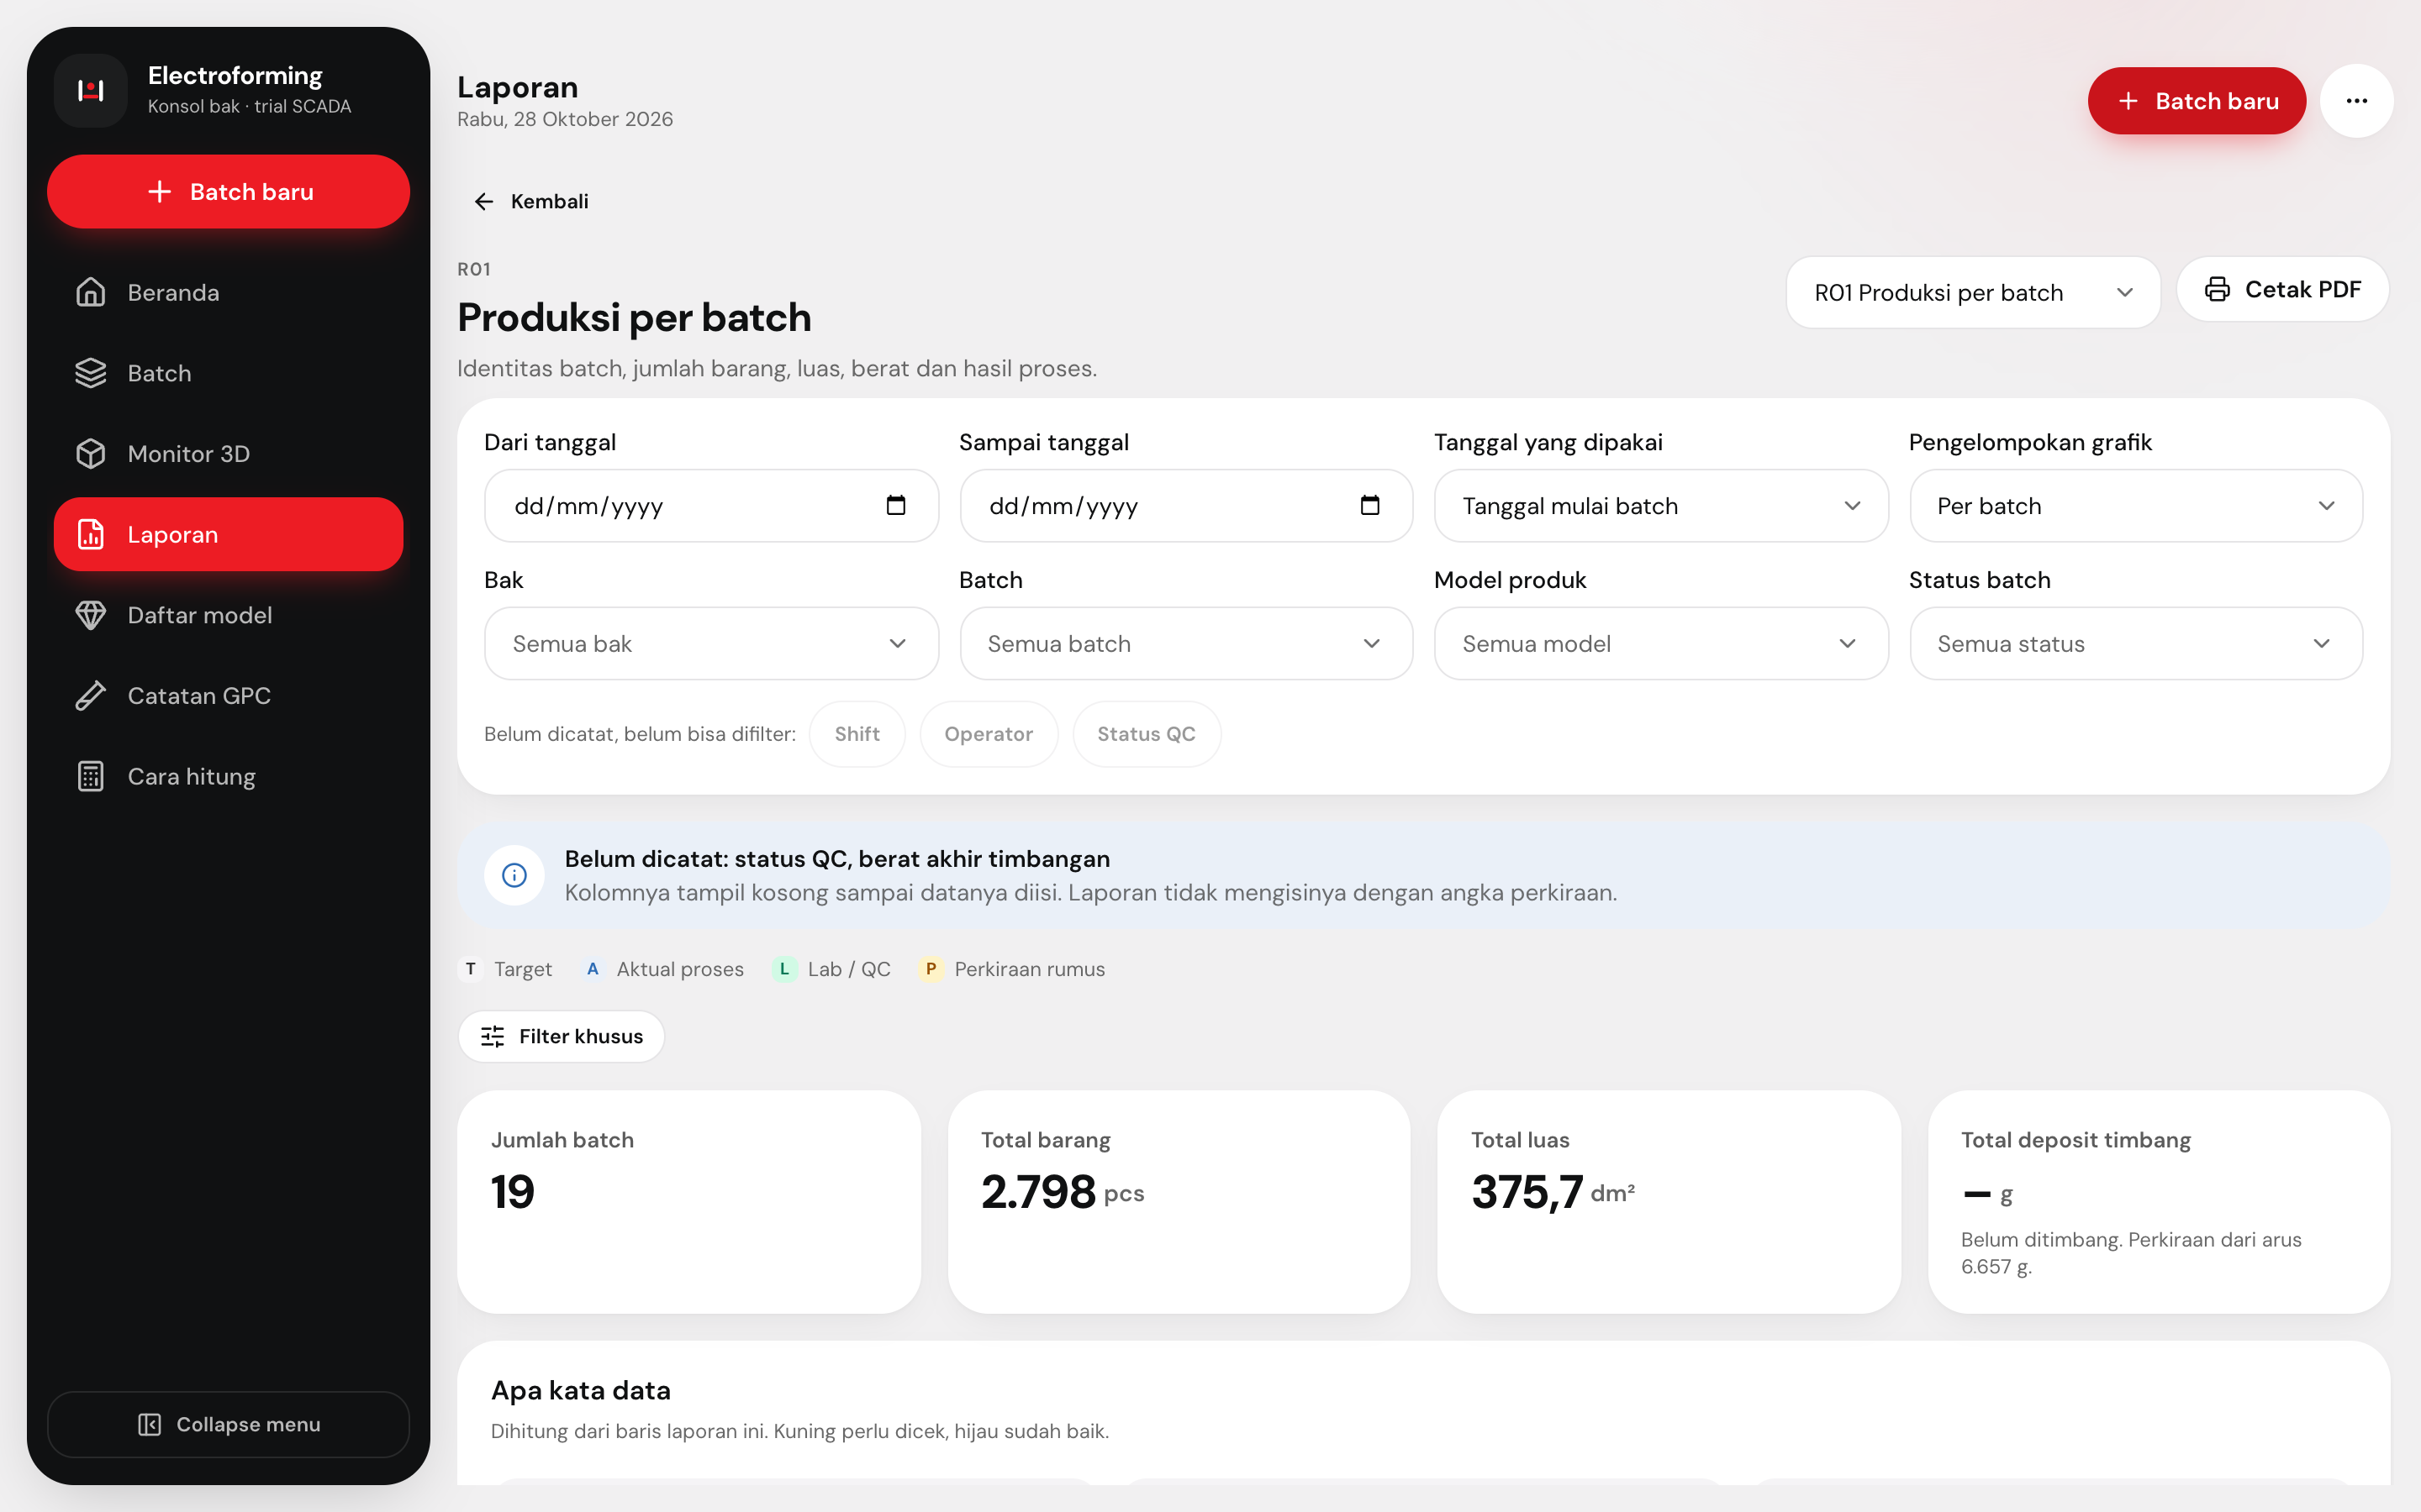
REPORTS. Ten reports
All ten reports use the same filters.
R01–R10
CSV
PDF
Ten standard reports, R01 to R10
Filter by date, tank, batch, product model or status
Share a filtered report by copying its link
Download as a spreadsheet (CSV) or print to PDF
Electroforming Console ©2026 www.wit.id Page 11
360° Digital Transformation Culture Company

Slide 12
REPORTS. Checked against Excel
The app gives the same numbers as the Excel files.
7
13
31
62
batch logs checked against Excel
automatic tests run on every change
surface-area sheets checked
product models in the list
When the plant does not record a value yet, the report leaves it empty instead of guessing.
Electroforming Console ©2026 www.wit.id Page 12
360° Digital Transformation Culture Company

Slide 13
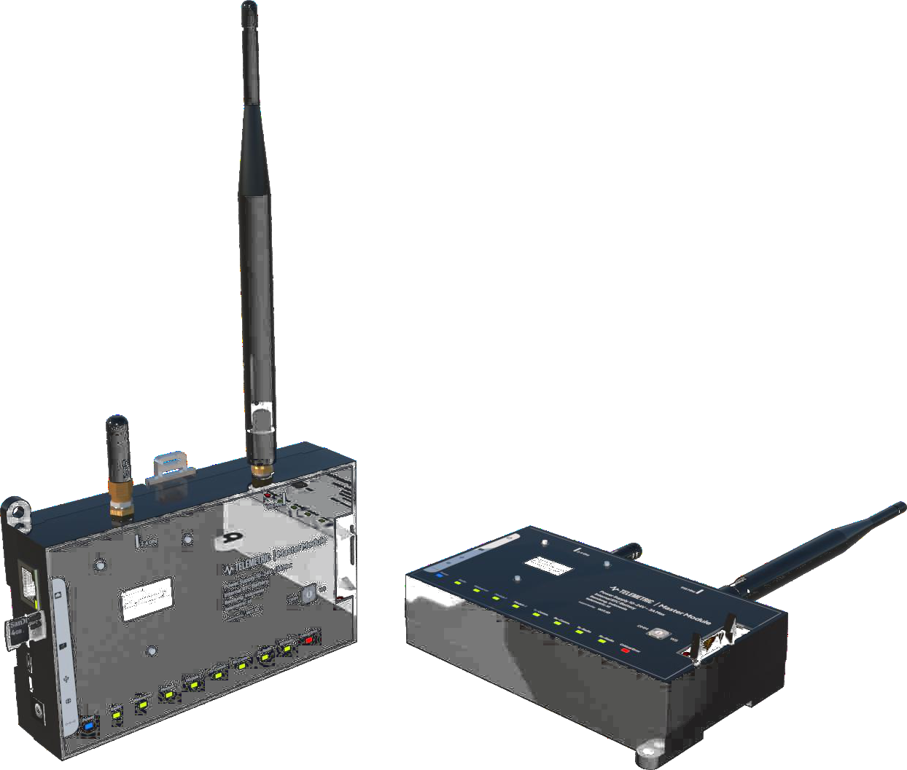
DEVICE. Telemetric
Telemetric collects data so people can decide faster.
Sensors
Smart sensors read the values you choose to watch
Cloud
Data goes to an online server, so you can check it anywhere, any time
Dashboard
A screen to watch and control the devices, and share the data fast
Electroforming Console ©2026 www.wit.id Page 13
360° Digital Transformation Culture Company

Slide 14
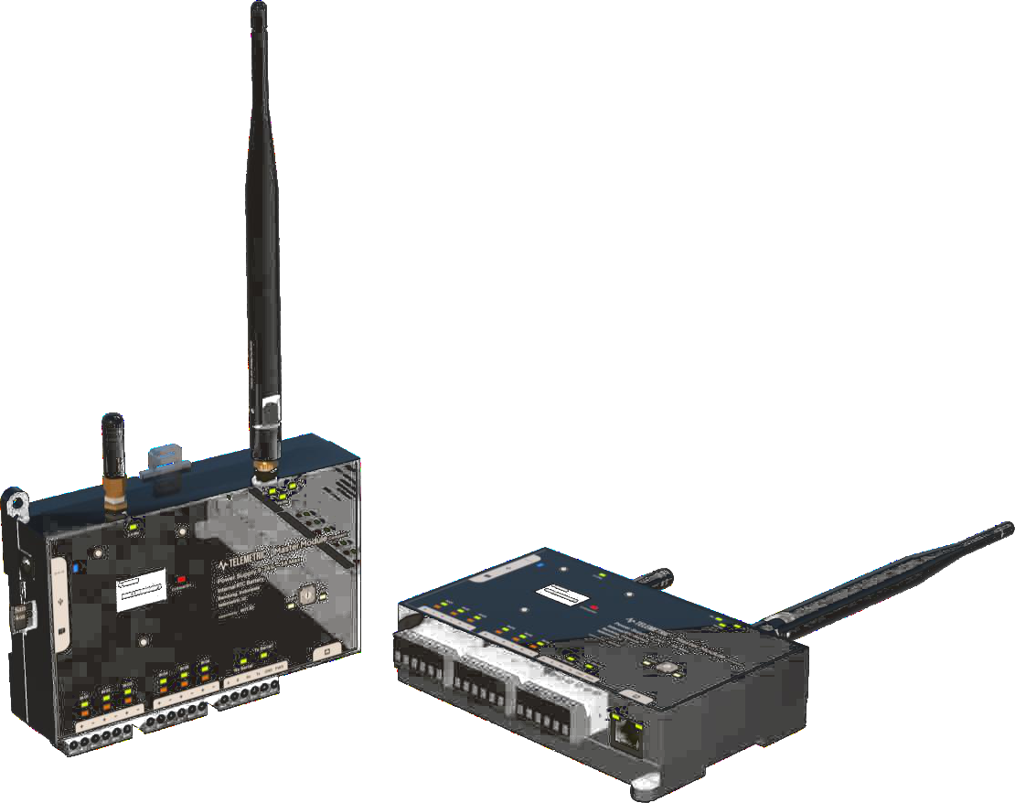
DEVICE. Indoor sensor box
One device family, two sizes.
Telemetric MMA
Telemetric TMC
Module Master
Module Compact
The flexible one. Add extra modules to fit different jobs in the factory.
The small one. Inputs and outputs are built in, ready for a specific job.
Real-time data
Wi-Fi or cable
Sends to the cloud
Easy to install
Set up from a browser
Add more as you grow
Electroforming Console ©2026 www.wit.id Page 14
360° Digital Transformation Culture Company

Slide 15
DEVICE. Technical details
Same base, different inputs and outputs.
Item | MMA Module Master | TMC Module Compact
Works in temperature | -10° to 85°C | -10° to 85°C
Works in humidity | 10% to 70%, no condensation | 10% to 70%, no condensation
Power | 12–30 V DC, 6.4 mm plug | 12–30 V DC, 6.4 mm plug
Sends data by | MQTT, radio (908.2–920.8 MHz), ESP NOW | MQTT, radio (908.2–920.8 MHz), ESP NOW
Connects through | 2.4 GHz Wi-Fi or network cable (RJ45) | 2.4 GHz Wi-Fi or network cable (RJ45)
Built-in sensors | Temperature, humidity, current, voltage | Temperature, humidity, current, voltage
Inputs and outputs | Add up to 2 modules: digital input or Modbus | 4 inputs, 2 outputs, 2 Modbus RTU ports (RS485/RS232)
Setup and updates | From a browser; updates over the local network | From a browser; updates over the local network
Case | ABS plastic, IP60 (dust-proof) | ABS plastic, IP60 (dust-proof)
Size | 110 × 150 × 43 mm | 110 × 150 × 43 mm
Mounting | DIN rail or bolts | DIN rail or bolts
Both are digital devices with dynamic or static IP. Source: Telemetric Indoor Remote I/O brochure, ©2025.
Electroforming Console ©2026 www.wit.id Page 15
360° Digital Transformation Culture Company

Slide 16
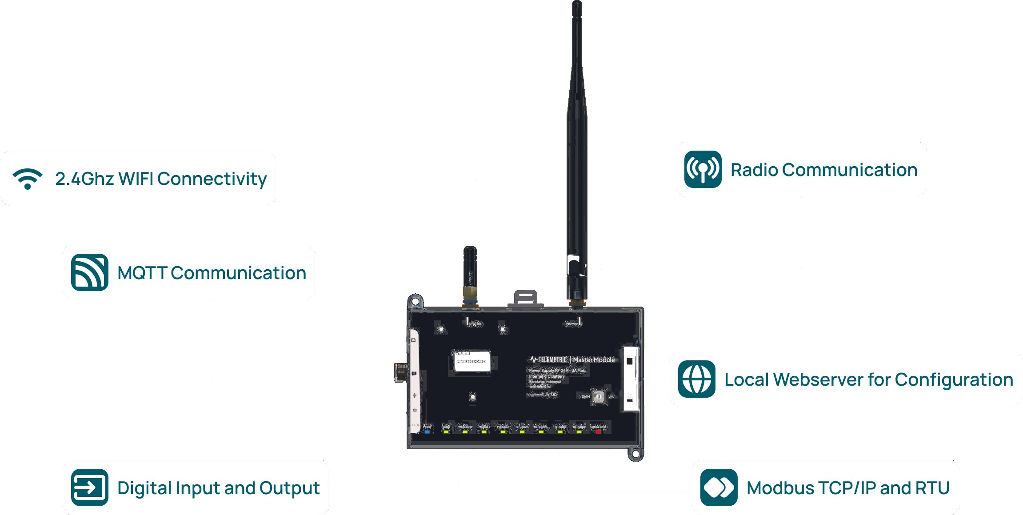
DEVICE. What it can connect to
Six ways the device connects.
Electroforming Console ©2026 www.wit.id Page 16
360° Digital Transformation Culture Company

Slide 17


DEVICE. How data travels
From the sensor to your screen.
Meters and sensors plug into the device by cable. The device sends the data over Wi-Fi or a network cable, or by radio through a gateway. The data is stored and shown on the dashboard.
Electroforming Console ©2026 www.wit.id Page 17
360° Digital Transformation Culture Company

Slide 18

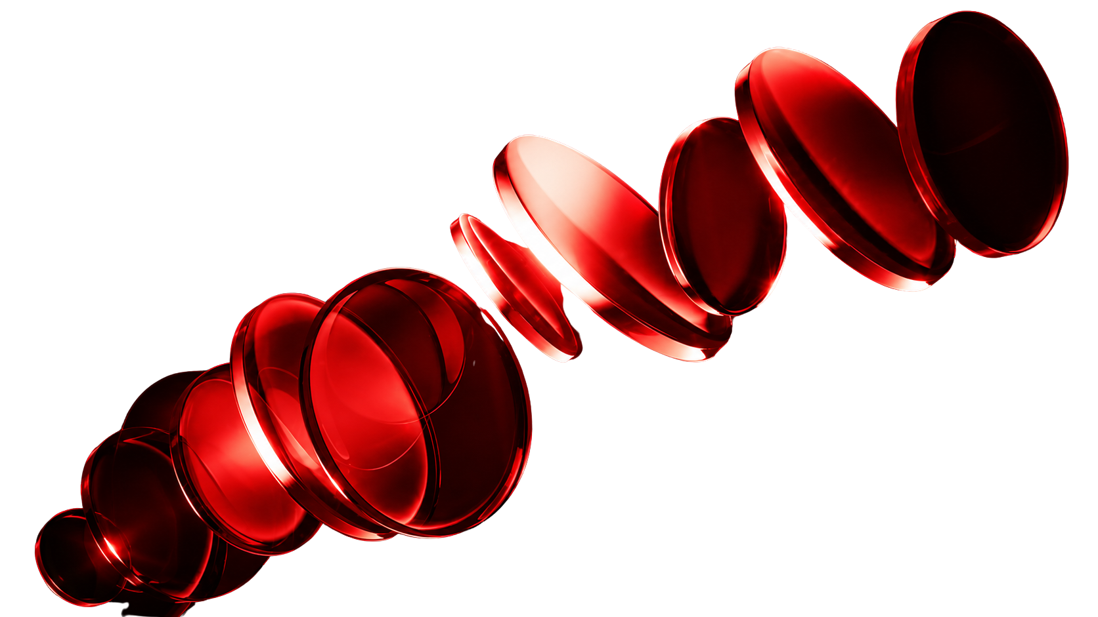
Make IT Happen.
NEXT STEPS
REPO
The app already runs on the trial data from Tank 1 and Tank 2. Next, it can take live data from the Telemetric device.
Server and database
Electroforming-UBS
Live data from device
WEB
Plant pH and temp limits
www.wit.id
360° Digital Transformation Culture Company

