Slide 1
Grape
Group: Undefined
3th July 2015

Slide 2

A very useful website for you to form a group where you can vote, discuss …
Introduction
A Leader-Member-Interaction Group
Useful in classes, lectures, meetings and so on.
In the group, we votes to decide the question, we discuss to solve the problem.

Slide 3
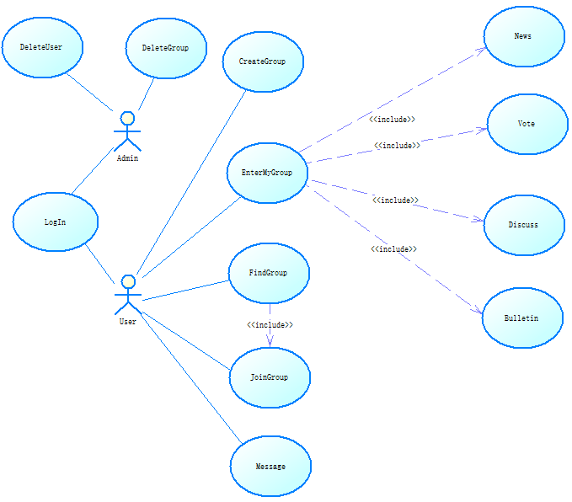
Request Analysis

Slide 4
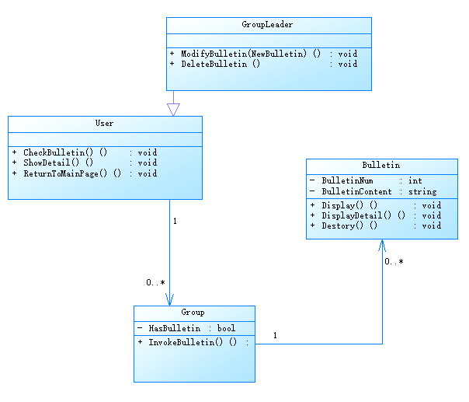
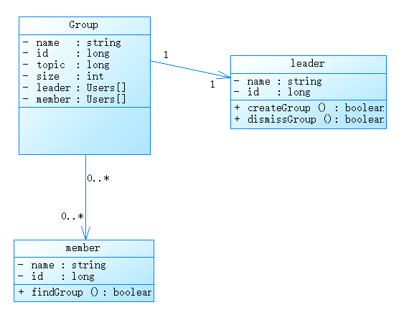
Class Diagram

Slide 5
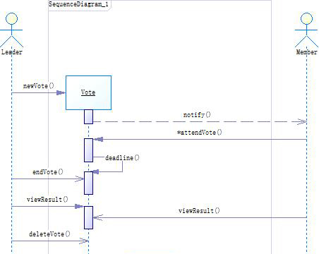
Sequence Diagram

Slide 6
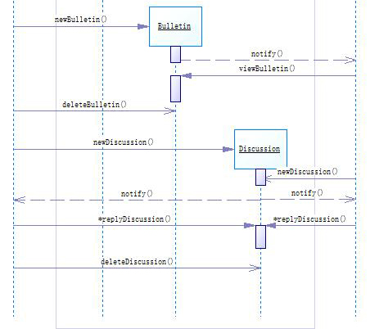
Sequence Diagram

Slide 7
Problem 1- Voting
When time is up
How many votes have I got?
How to display?

Slide 8
Problem 2 - Server
Description:
How to get a server?
How can we visit this web from outside?
Two Level Router
IIS

Slide 9
Distribution
林弘韬
崔景育
毛宇宁
吴力胜
周 畅

Slide 10
Grape
Thanks for listening
Our Website:
202.120.39.158 :2333
Account:
学号@sjtu.edu.cn
Password
学号(5130309732 –
5130309799)

