Slide 1

End-to-End Stock Analytics Dashboard
(Part 1: Stock Analysis)
In this session, we will guide you through the first part of building an end-to-end stock analytics dashboard, focusing on Stock Analysis. Our goal is to help you understand how to perform simple stock analysis using data science techniques.

Slide 2
Table of Contents
01. About Me
02. About Project
03. Stock Dashboard Analytics Overview
04. Stock Analysis (1st Part)
05. Dashboard Visualization with Automation (2nd Part)

Slide 3

Speaker
Syachrul Qolbi Nur Septi
Data Scientist
I am a Data Scientist with two years of experience at Telkom Indonesia and hold a Master’s degree in Data Science from the University of Technology Sydney. My core skills include data mining, machine learning, and predictive modeling. I excel at creating end-to-end analytics solutions that turn raw data into valuable insights.
www.sqnsportfolio.com
syachrulqolbinursepti@gmail.com

Slide 4
About Project
This project provides students with hands-on experience in building an end-to-end Stock Analytics Dashboard, covering data collection, analysis, automation and visualization. It is designed to bridge the gap between theoretical knowledge and practical skills, allowing students to apply data science techniques to a real-world scenario.
▲
▲
▲
Knowledge
Master data science concepts like data collection, analysis, and automation.
Practical Experience
Gain hands-on skills with real stock data, from analysis to visualization.
Portfolio
Build a complete stock analytics dashboard to showcase in your portfolio.

Slide 5
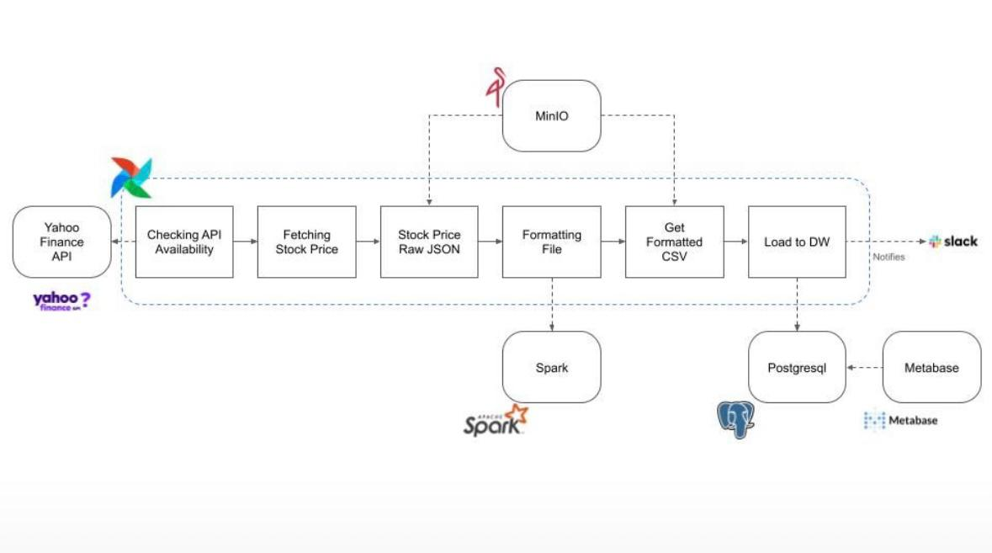
Project Overview
This flowchart illustrates the typical workflow of an automated stock analytics dashboard using the latest technologies
To keep things simple and cost-effective, we will continue using Yahoo Finance API, but we will replace Apache Airflow with GitHub Actions for automation, switch PostgreSQL to Google Sheets for data storage, and deliver the final product through a Tableau dashboard.

Slide 6
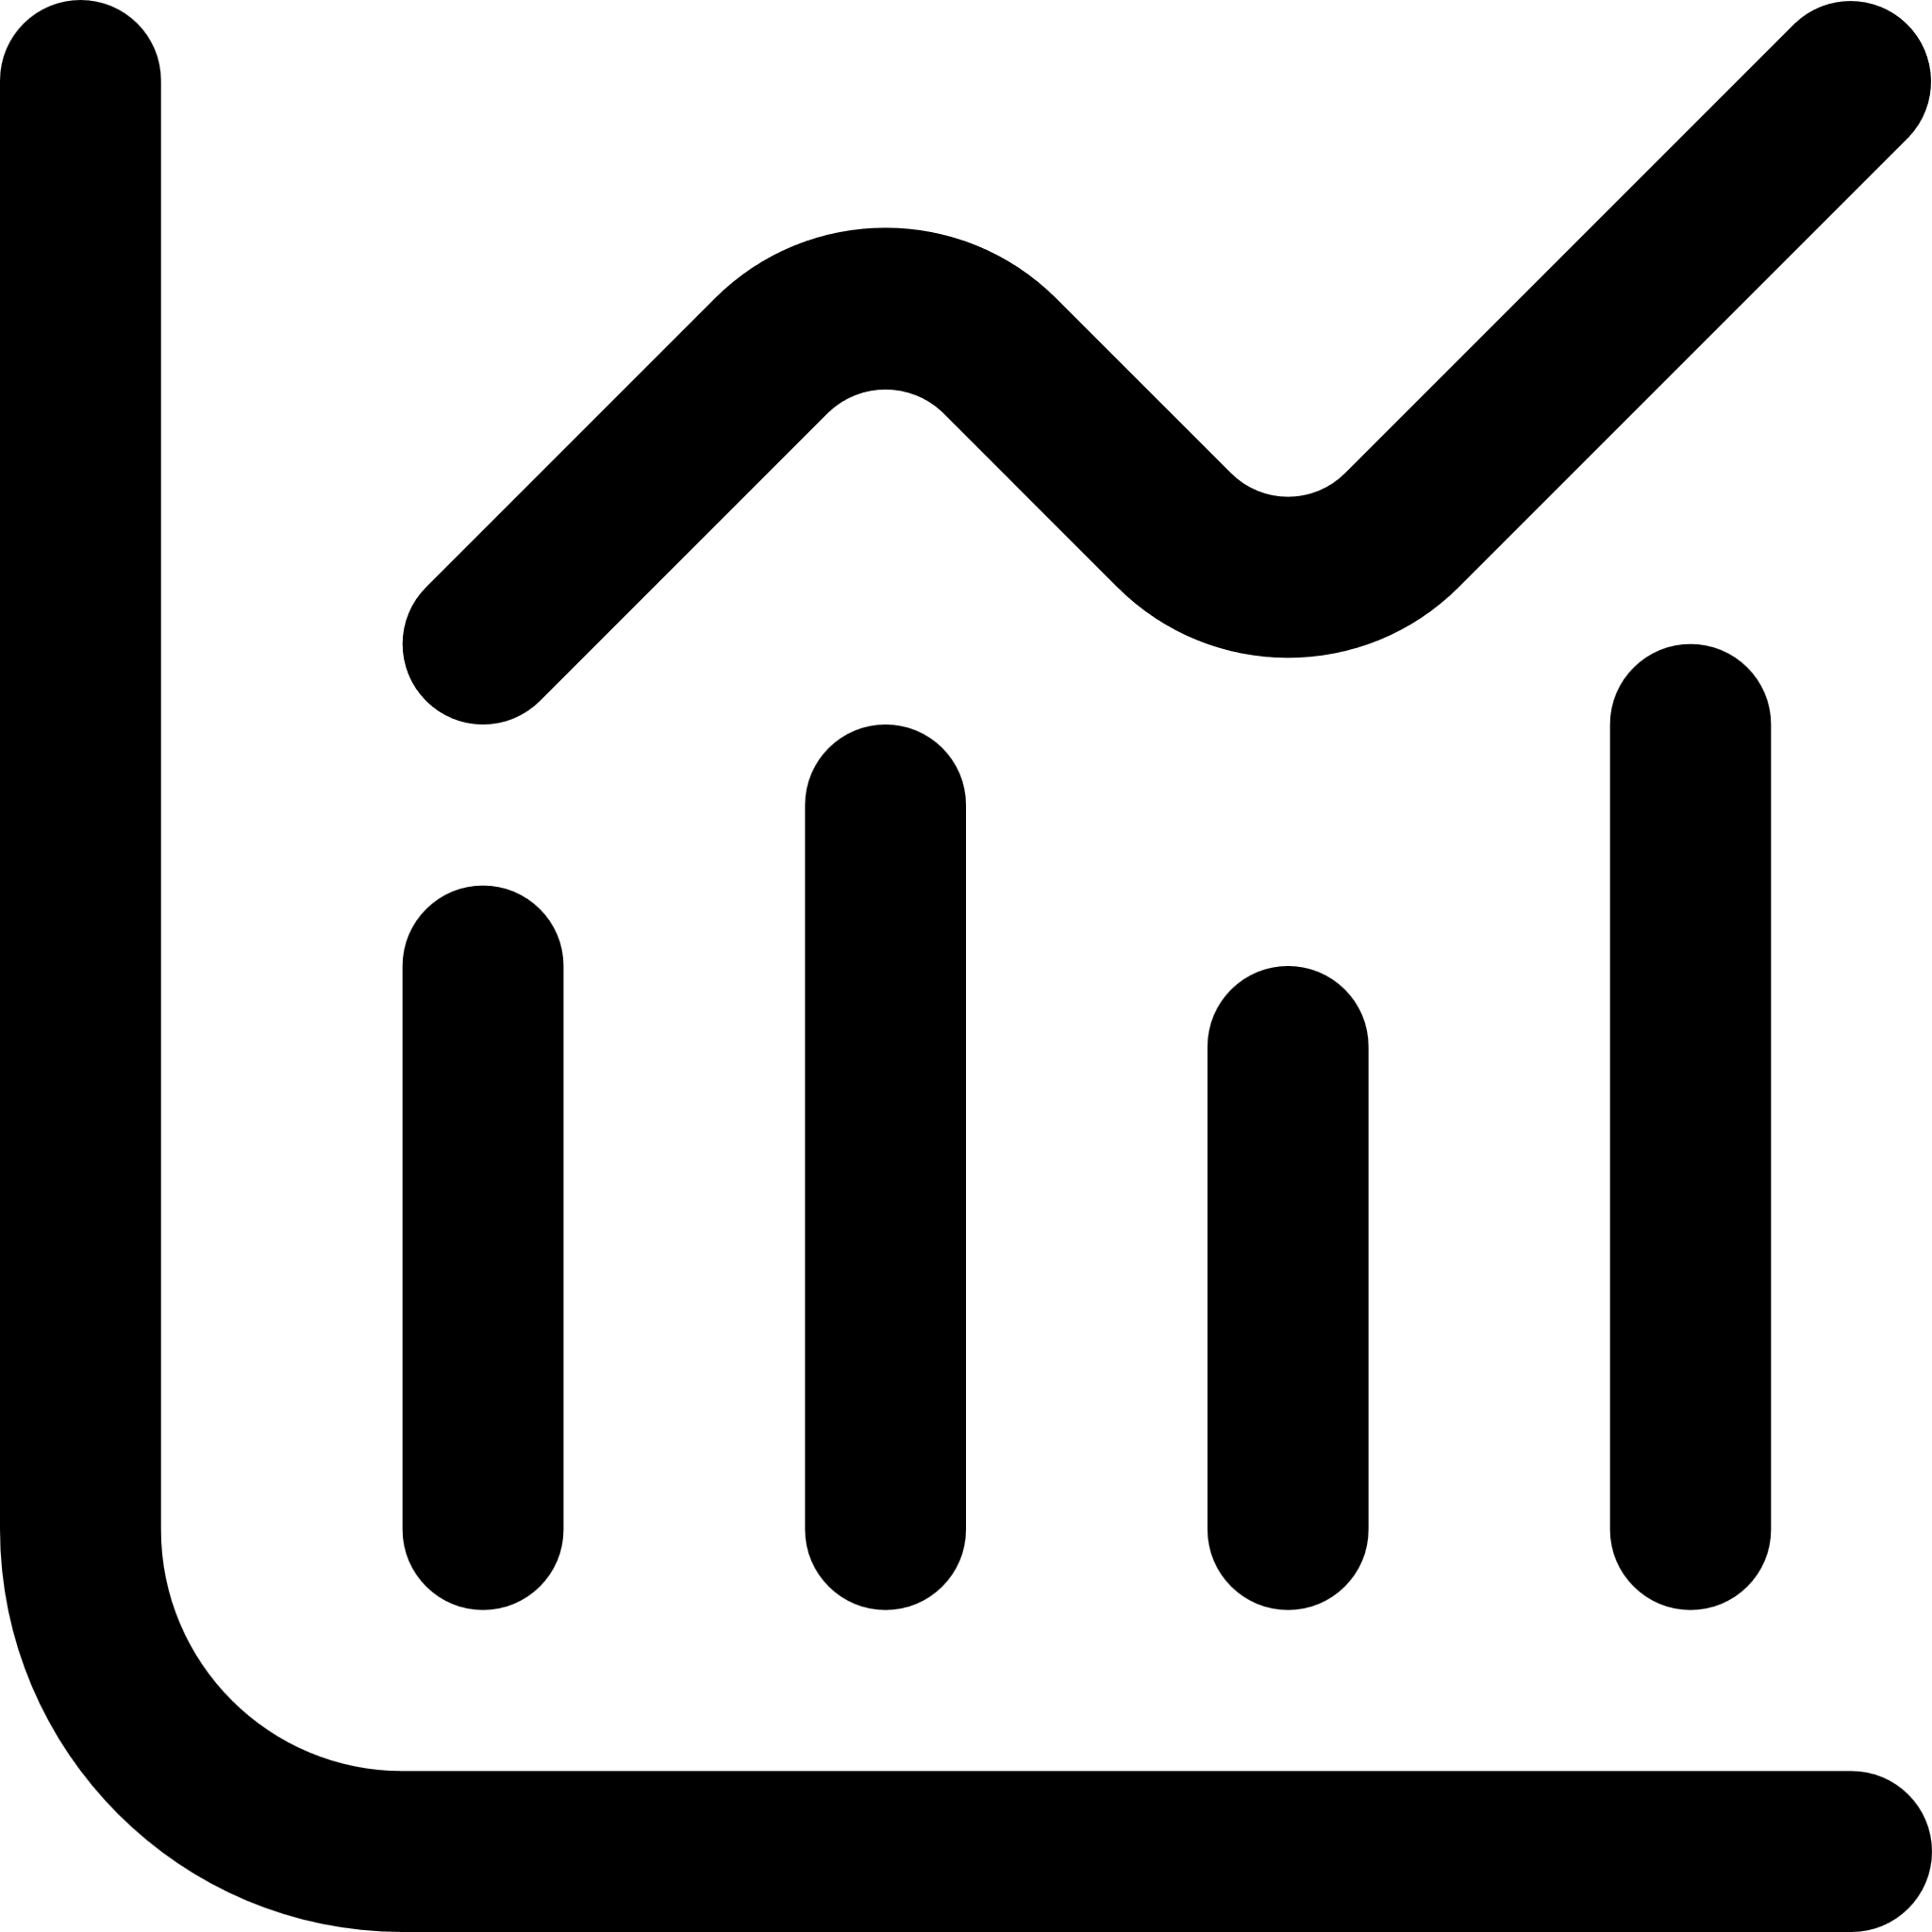



What We Do on Stock Analysis (1st Part)
Fetching Stock Price from Yahoo Finance API
We automate stock price retrieval using the Yahoo Finance API, ensuring accurate and up-to-date data for analysis and forecasting. This allows for continuous monitoring of stock performance.
Backtesting
We implement backtesting strategies to evaluate the effectiveness of our trading models. This process simulates past trading conditions to measure potential profits and risks.
Analysing and Forecasting using Polynomial Regression
We use polynomial regression to analyze stock price trends and forecast future prices, providing insights into market movements and helping make informed investment decisions.
Export Data to Google Sheet using Google Cloud API
Our analysis results are automatically exported to Google Sheets via Google Cloud API, ensuring that data is securely stored, easily accessible, and shareable.

Slide 7
What We Do on Dashboard Visualization with Automation (2nd Part)
News Scraping and Summarize using Gemini API
We automate the extraction of financial news using the Gemini API, summarizing key insights to keep you informed with real-time market updates without manual effort.
Tableau Visualization
We leverage Tableau to transform raw data into interactive dashboards, making it easy to explore trends, monitor stock performance, and derive actionable insights visually.
Automation using Github Action
Our data analysis and visualization workflows are automated using GitHub Actions, ensuring that the dashboards are always up to date with the latest data without manual intervention.
Share your work
Easy sharing through Tableau Public, enabling you to showcase your analysis and dashboards to your audience effortlessly, promoting data-driven decision-making.

Slide 8

Thank you
www.sqnsportfolio.com syachrulqolbinursepti@gmail.com

