Slide 2

Hosting Static Omni CMS Websites with AWS
Learn how to convert and migrate websites running on PHP/Apache to run as static websites on Amazon S3 or AWS Amplify.

Slide 3
Don’t let the pandemic ruin your user experience!

Slide 5

Problem: Pandemic and Quarantine
Events, which had been hosted in-person, hosted exclusively online
Server-side scripting languages introduce bottlenecks with Apache
Online presence dependence increasing in importance for reputation and reliability
Hosting server issues such as outdated operating systems, data center outages and hosting physical servers become more apparent.

Slide 6

Solution: Cloud hosting with AWS
Take advantage of Amazon Web Services’ scalability and infrastructure to deal with high traffic and rapidly changing user needs.
Host static websites with Amazon S3, CodePipeline, Cloudfront and Lambda
Host static websites with AWS Amplify and/or Cloudfront and Lambda
Host static or dynamic websites in EC2 instances

Slide 7
Caveats: DNS challenges
Older DNS servers/software
Does not support the underscore ‘_’ CNAME provided by Amplify for ownership verification purposes.
Server hardware/software may have to be upgraded to support CloudFront CNAME.
May have to use Route53 to address these issues. For this, you allow AWS to manage a portion of your University’s IP address space.
Check with your Networking department

Slide 8
Hosting Static Websites with AWS
Replace PHP includes in XSL templates with JavaScript
Create API website which listens to Webhooks*
Add Webhook to website pointing to API
API publishes either to Amazon S3 or CodeCommit
Setup web hosting with AWS Amplify or Amazon S3/CodePipeline
Write Lambda functions for replacing server-side code
Configure CloudFront for special behavior
Update DNS, adding a CNAME for CloudFront distribution

Slide 9
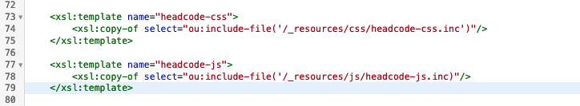
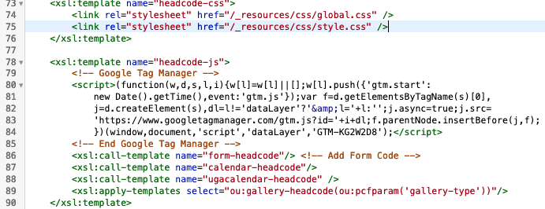
Replace server-side includes
Begin in common.xsl. Replace PHP includes
Insert contents of the included files

Slide 10
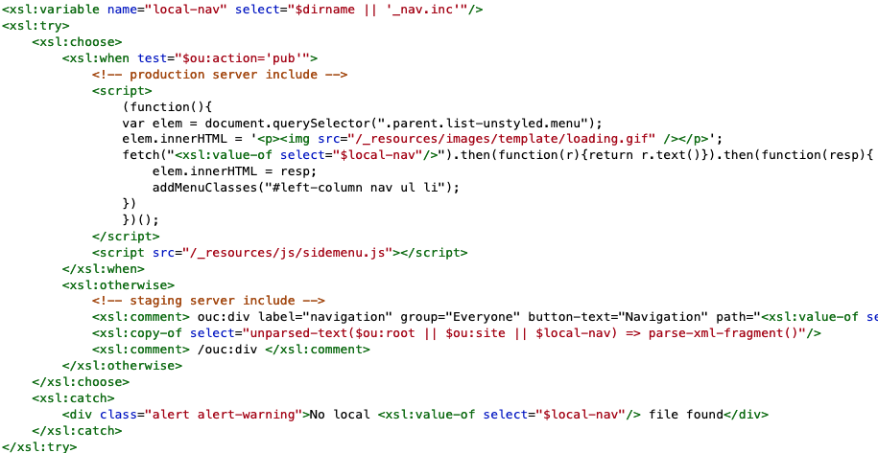
Sidebar Replacement
Create a simple JavaScript library which uses either jQuery Ajax or the fetch API to get the _nav.inc file from the server and replace it into a place-holder <div> tag.
Optionally add a spinner graphic while the menu is loading for slower connections.
This method is versatile and can be used for including all most any type of content.

Slide 11
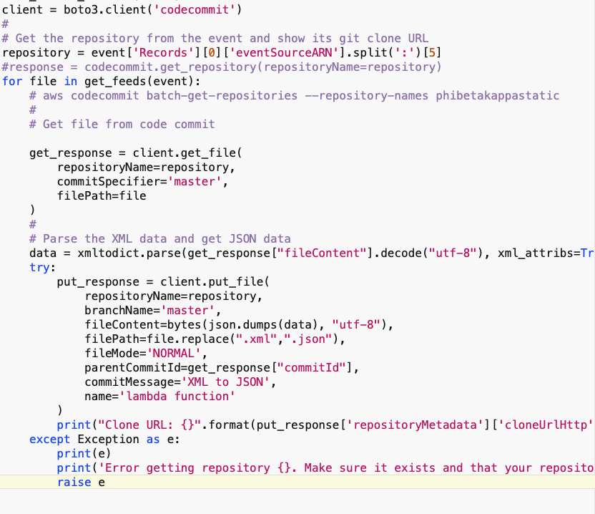
Lambda auto create JSON from XML – Server side
Simple Python Lambda function creates JSON version of your XML files and updates them each time you push to CodeCommit.
Code Commit informs the Lambda function about which files to update.
Need to install AWS CLI on dev machine and create a Python Layer with xmltodict library installed in it.
https://docs.aws.amazon.com/lambda/latest/dg/configuration-layers.html#configuration-layers-upload

Slide 12
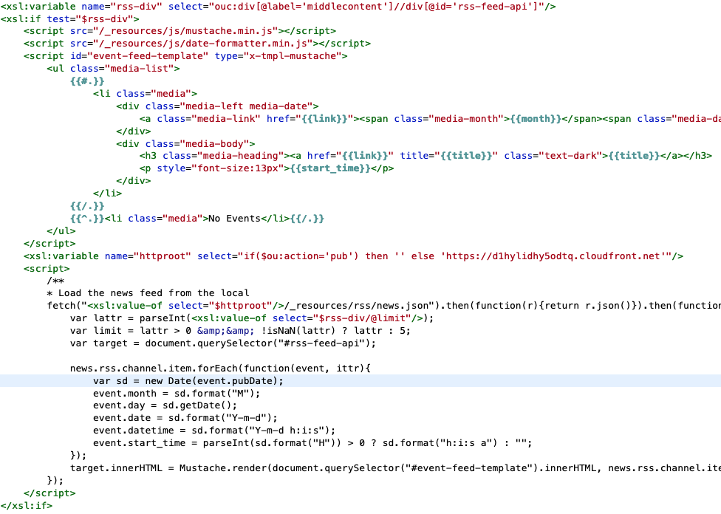
Lambda auto create JSON from XML – Client side
JavaScript on the client-side with MustacheJS templates display the data.
Use the JavaScript fetch API or jQuery to download the JSON file from the file system
MustacheJS: https://github.com/janl/mustache.js/
Date Formatting: https://gist.github.com/syad9000/c6b66dc98676d5b6c8578441c5a6addb

Slide 13
Webhook Publisher – Three Steps
Create an API site as an endpoint to listen to POST requests from webhooks.
API publishes your files directly to Amazon S3 or CodeCommit via AWS CLI.
Configure the website directly with Amazon using CloudFront, AWS Certificate Manager and your choice of AWS Amplify or CodePipeline/Amazon S3 for the website itself.

Slide 14
API website (data dispatch server)
Create a website with a custom URL such as api.sample.university.edu
Upload custom code and modify as needed (may want to add some more security to it).
Configure websites to publish to the api.sample.university.edu/webhooks/
Config file directs authorized services and restricts/allows publishing to Amazon Web Services CodeCommit/S3

Slide 15
Setup on Amazon Web Services
Create
SSL cert for Amazon Certificate Manager
Cloudfront distribution pointing to SSL Cert and either AWS Amplify or Amazon S3.
CNAME for Cloudfront Distribution with your DNS *

Slide 16
Setup on Amazon Web Services – S3
Create a CodeCommit repository
Create a Code Pipeline
Create CloudFront distribution pointing to SSL Certificate *
S3 Bucket(s) (this is normally created by the API publisher, but can be done manually)
Create a bucket for each subdomain which redirects to your main domain
References:
Hosting a Static S3 Website https://docs.aws.amazon.com/AmazonS3/latest/userguide/WebsiteHosting.html
Setting up a CodePipeline to integrate with S3 https://docs.aws.amazon.com/codepipeline/latest/userguide/tutorials-s3deploy.html

Slide 17
Setup on Amazon Web Services - Amplify
Create CodeCommit repository
Create Amplify app with
Link Amplify app to CodeCommit
Add SSL cert to Amazon Certificate Manager
Create CNAME for Cloudfront Distribution with DNS *
With older DNS servers or Proteus, you will need to create a Cloudfront distribution pointing to SSL Cert and Amplify App. Optionally you can use Route53 to host the zone with IP addresses that you let Amazon control.
AWS Amplify is mainly for configuring applications developed with JavaScript but can be used to quickly build applications and host them if your DNS can support the ‘_’ CNAME.

Slide 18
Building PHP Lambda Functions
Easily create PHP Lambda functions for just about any task using free software.
You don’t have to know all about AWS in order to get started.
Configure everything directly from your development machine
Steps
Install AWS CLI on dev machine
Install PHP Composer on development machine.
Insert your PHP libraries
Push to AWS
Edit memory allocation in AWS Lambda

Slide 19
PHP Lamda Functions - setup
Make sure you create an AWS account and install the CLI. Create the necessary console access keys for AWS. Follow installation steps here: https://bref.sh/docs/installation.html
Install necessary PHP (>7.3.0), Bref, Composer, NodeJS and the Serverless library.
Create the function and upload to AWS
$ composer require bref/bref
$ vendor/bin/bref init
$ serverless deploy
Post your form to the Lambda @Edge function given once the command finishes.
(i.e. https://3pjp2yiw97.execute-api.us-east-1.amazonaws.com)
Once the application has been deployed, you can edit it directly from the AWS Lambda console!
* Reference: https://bref.sh/docs/installation.html

Slide 20
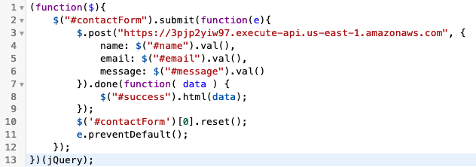
Simple Contact Form Replacement
Create a PHP Lambda API which listens for POST requests and emails to an internal email address.
Visitor submits form PHP Lambda function which validates the ID and sends the email. Optionally you can store the form values in a database.
Recommended: Use CloudFront function to generate a secure ID that a visitor receives upon visiting the contact page. This is returned to the Lambda function and validated before sending the email.

Slide 21
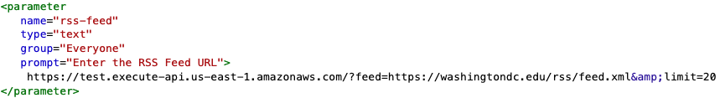
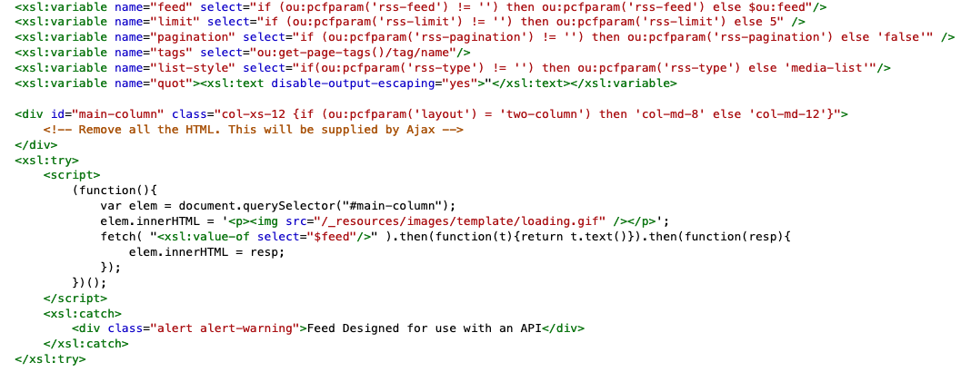
News Articles
This is done a PHP Lambda function created with Bref
PHP – create a Bref Lambda application, paste the OmniCMS PHP code for the wnl.php and its includes into the environment created by Bref. Upload this to AWS.
Edit the ”rss-feed” parameter to give the Lambda function an XML feed URL and parameter via a GET request. The HTML content is returned and placed within the innerHTML of the target HTML element.
https://bref.sh/docs/first-steps.html

Slide 22

Questions & Links
Amazon Web Services
AWS Console: https://console.aws.amazon.com/
Layers for adding additional libraries to Lambda: https://docs.aws.amazon.com/lambda/latest/dg/configuration-layers.html#configuration-layers-upload
S3 Website setup: https://docs.aws.amazon.com/AmazonS3/latest/userguide/WebsiteHosting.html
Installing AWS CLI: https://docs.aws.amazon.com/cli/latest/userguide/getting-started-install.html
Install AWS SDK for PHP: https://docs.aws.amazon.com/sdk-for-php/v3/developer-guide/getting-started_installation.html
OmniCMS
Webhooks: https://support.moderncampus.com/technical-reference/webhooks.html
Helpful XPATH functions for OmniCMS: https://maxtoroq.github.io/xpath-ref/
Networking
DNS Challenges: https://aws.amazon.com/blogs/networking-and-content-delivery/solving-dns-zone-apex-challenges-with-third-party-dns-providers-using-aws/

Slide 23
















Icons for use
Copy and paste these into your presentation as needed

