Slide 1

PYTHON FOR
DATA SCIENCE
USING
WITH EUROPE HOTEL BOOKING SATISFACTION DATASET
BY SYAFIQ FATHINAS SYADDID

Slide 2
TABLE OF CONTENT
DATASET
IMPORT, INFO, DESCRIBE
CODE & VISUALIZATION

Slide 3
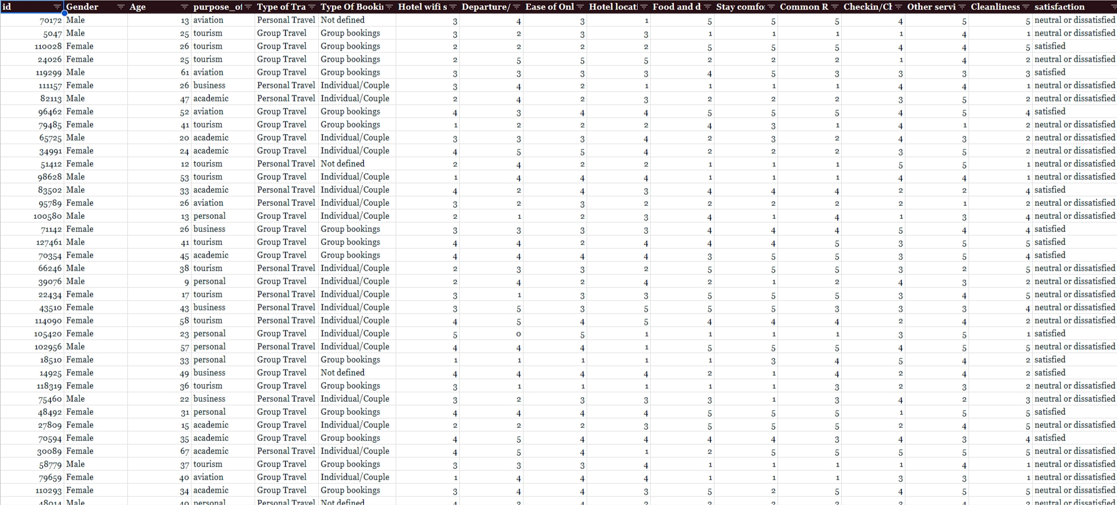
Here is an quick overview of the dataset i will be working with
Europe Hotel Booking Satisfaction Score.CSV

Slide 4
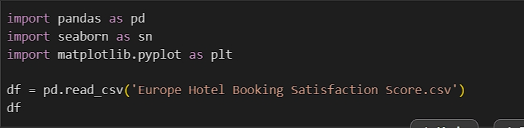
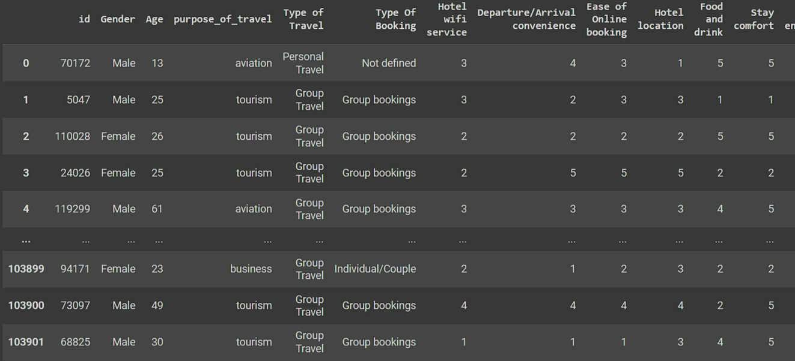
LOAD DATA
Importing 3 libraries : pandas, seaborn, and matplotlib.pyplot.
CSV file named “Europe Hotel Booking Satisfaction Score.CSV” is read and stored as a dataframe using pandas.
Finaly, displaying the dataframe containing Europe Hotel Booking Satisfaction Score data.

Slide 5

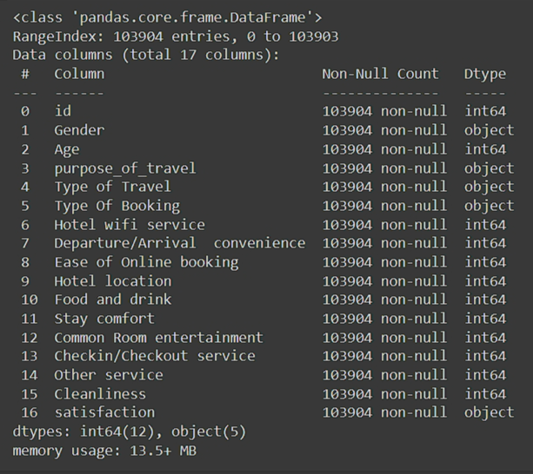
Warner & Spencer
DISPLAY INFO DATA
Based on information, there are 17 columns and 103904 rows. Most columns contain integers, except for ‘Gender’, ‘purpose_of_travel’, ‘Type of Travel’, ‘Type Of Booking’, and ‘satisfaction’, which are strings.

Slide 6

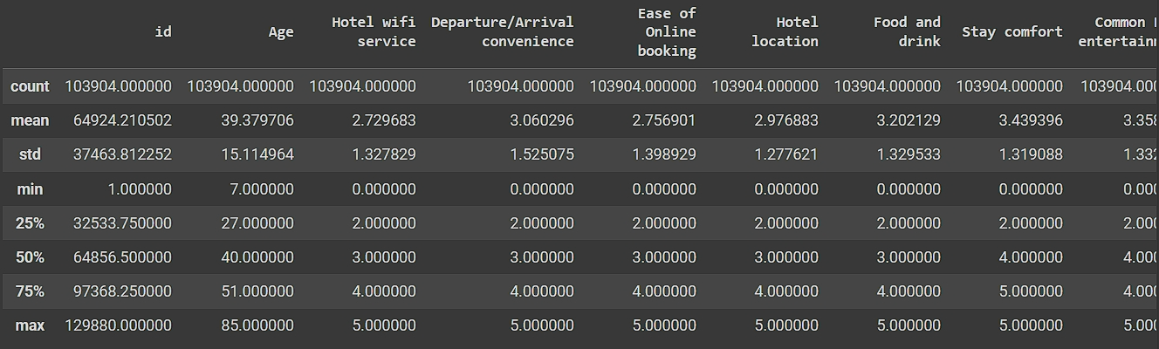
DESCRIBE DATA

Slide 7
#1
WHAT IS THE PERCENTAGE DIFFENCE BETWEEN MALE AND FEMALE?

Slide 8
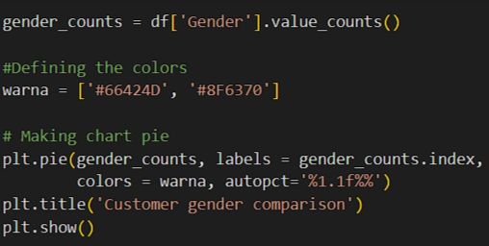
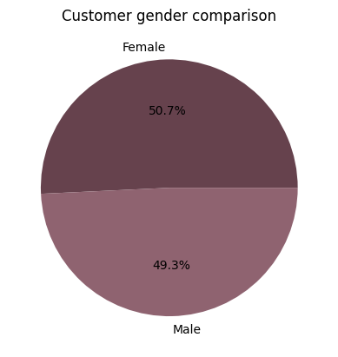
50.7 % of customers are female while 49.3% of customers are male.

Slide 9
#2
WHAT IS THE PERCENTAGE DIFFENCE TYPE OF BOOKING?

Slide 10
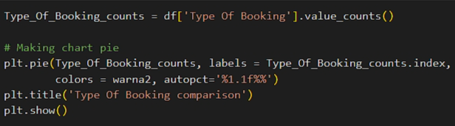
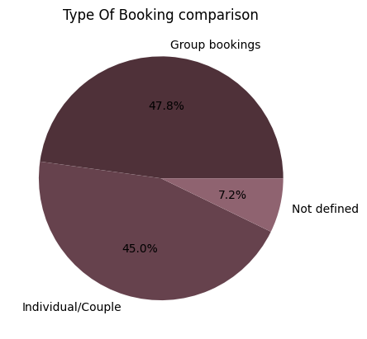
47.8% of the type of bookings are group bookings and 45.0% of the type of bookings are individual/couple while 7.2% are not defined

Slide 11
#3
WHAT IS THE PERCENTAGE DIFFENCE PURPOSE OF TRAVEL?

Slide 12
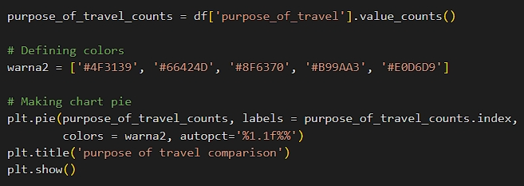
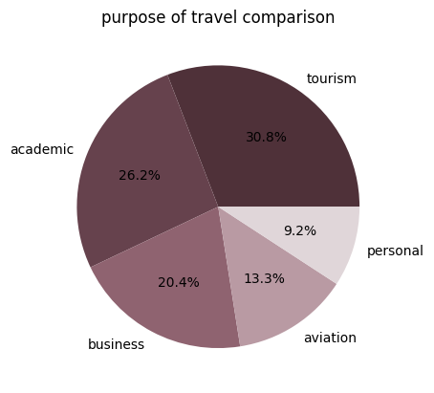
30.8 of the purpose of the travel is tourism. While for academic it is 26.2%, for business it is 20.4%, for aviation it is 13.3% and for personal it is only 9.2%.

Slide 13
#4
WHAT IS THE PERCENTAGE DIFFENCE TYPE OF TRAVEL?

Slide 14
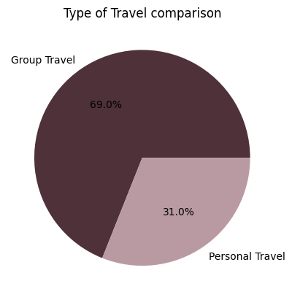
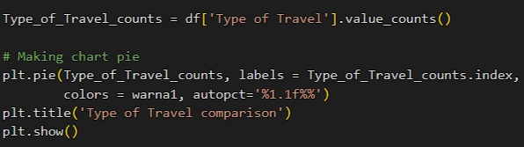
50.7 % of customers are female while 49.3% of customers are male.
Page 07

Slide 15
#5
WHAT IS THE HIGHEST SATISFACTION FACTOR BASED ON DATA FORM CUSTOMERS?

Slide 16
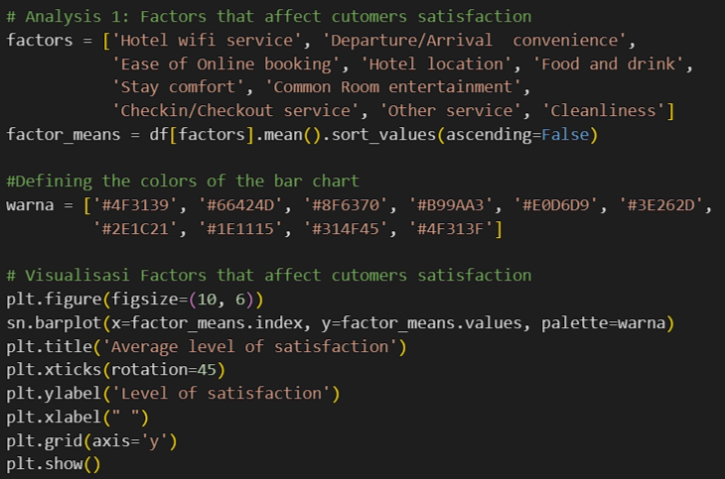
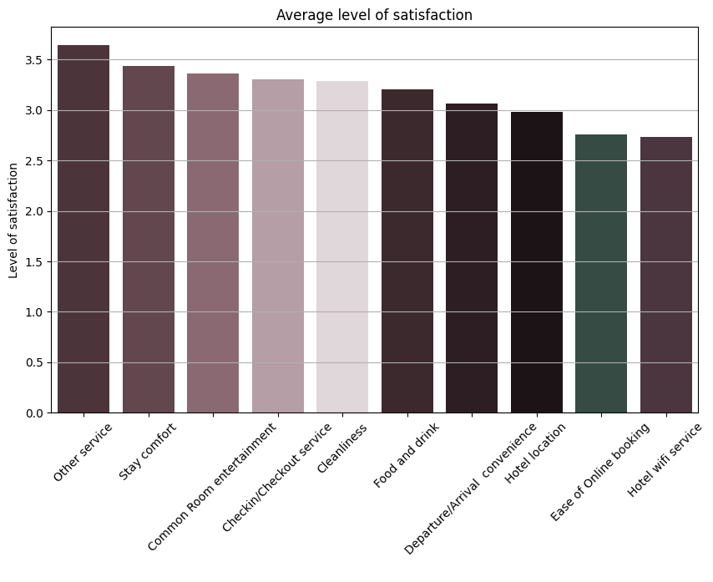
The level of satisfaction with other servuces has the highest satisfaction compared to other factors, which is inversely proportional to the hotel wifi service wich has the lowest level so that it needs to be improved.

Slide 17
#6
WHICH GENDER FEELS THE MOST SATISFIED?

Slide 18
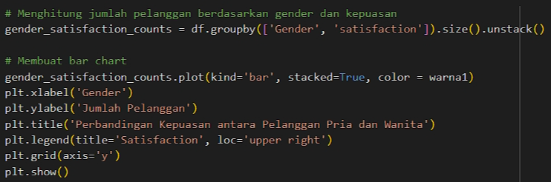
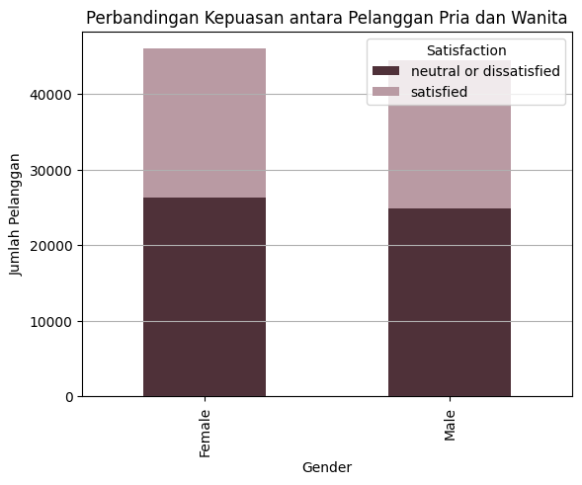
It can be seen that male are more satisfied than female by 0.25%.

Slide 19
#7
IS THERE ANY RELATION BETWEEN AGE VS TOTAL SATISFACTION?

Slide 20
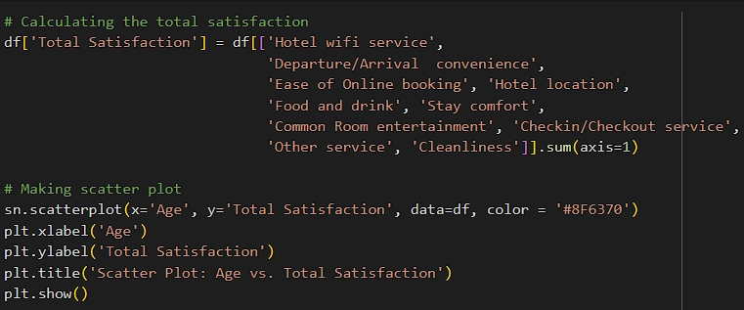
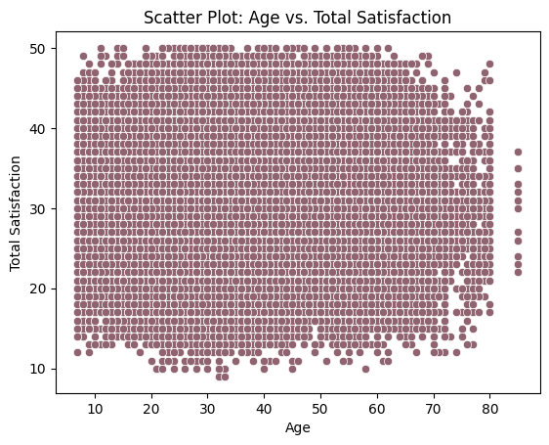
Based on this data, it can be seen that the data is spread evenly across various age ranges. There was no clear pattern indicating that certain ages had higher or lower levels of total satisfaction. And also the density of dots on the plot shows that most respondents have varying levels of total satisfaction in almost every age range. This suggests that age does not significantly influence the level of total satisfaction reported.

Slide 21
Thank You

