Slide 1
MINI PROJECT CHANGE REQUEST FORM SLIDE
Mohamad Zahid Bin Rasmi
52213219152
Mohd Ariff Syafiq Bin Arifen
52213219182
Arif Fahmi Bin Zakaria
52213219148

Slide 2
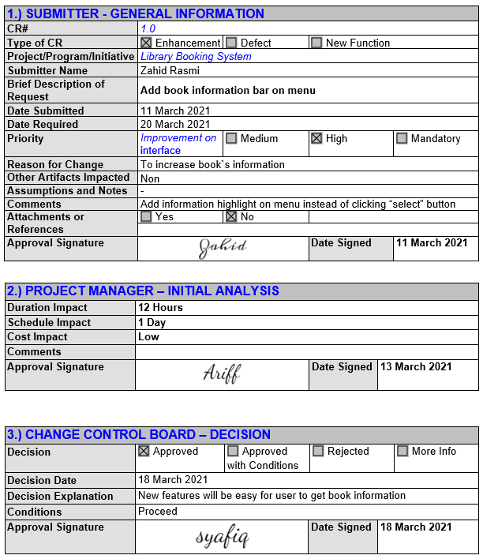
Change request #1: Highlight

Slide 3
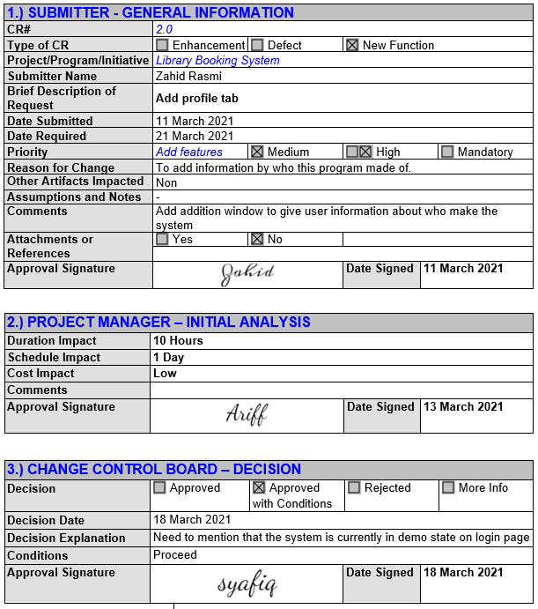
Change request #2: About us

Slide 4
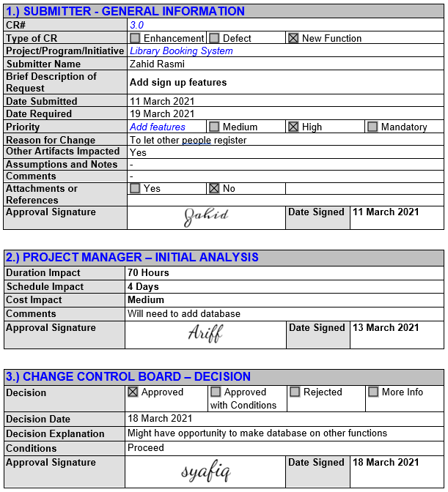
Change request #3: Sign up features

Slide 5
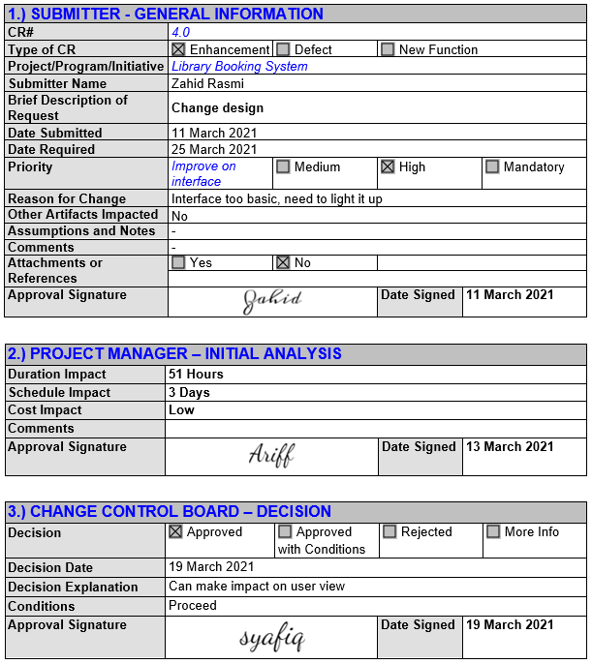
Change request #4: Change design

Slide 6
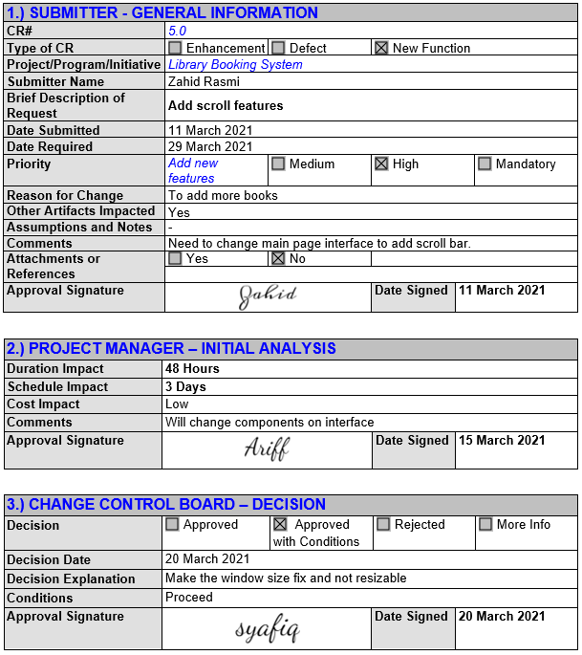
Change request #5: Scroll features

