Slide 1




Centralized bus management system (BusFriend)
Mohd Amirul Syafiq Bin Mohd Safie
2015839404
Supervisor:
Dr. Nor Shahniza Kamal Bashah

Slide 2
introduction
Background Of Study
Problem Statement
Objective
Project Scope
Project Significant

Slide 3
Background of study
Bus is one of the transports that normally used for travel and services such as school bus and charter bus.
Easy
Cheap
Comfortable
Current manual system takes longer time than computer application.
Slow
Not Reliable
Not Efficient

Slide 4
Problem statement
Parents hard to find and get the available school bus which can transport their children to the designated school.
People get wrong information about the charter bus services such as inactive bus status and contact information.
Many parents so worried about their children weather their children have arrived safely at home while they are not at home.

Slide 5
Objective
To identify the requirements for Centralized Bus Management System (BusFriend).
To develop a centralized web based bus management system which provides notification to the users via mobile application, information about school bus, charter bus and the payment method.
To evaluate the satisfactory level of user acceptance towards the system via User Acceptance Testing (UAT).

Slide 6
Project scope
Target user
People who are using bus as their main transportation system.
Coverage area
Selangor and Kuala Lumpur.
Transportation type
School bus and charter bus.
Technology
Web application and mobile application.

Slide 7
Project significant
User
End user : the system will ensure on the updated information about bus services.
Bus service operator : help to get customer who need their services and manage on the system bus process.
Time
Helps to reduce time especially for the people who want to find bus services.
Technology
The system utilized the current mobile and web technologies
Notification system for bus arrival to the destination.
Email system used for the notification to the user upon successful of the bus booking.

Slide 8
Literature review
Web Technology
Mobile Technology
Database
Online Payment Gateway
Comparison of Related Works

Slide 9
Web Technology
Client-side Technology | Server-side Technology
Browser | JAVA
 | Ruby on Rails
 | PHP | Zend Framework
 |  | Yii Framework
 |  | Laravel Framework

Slide 10
Mobile Technology | Database | Online Payment Gateway
Windows Phone OS | DB2 | iPay88
Apple iOS | Oracle | PayPal
Android | SQLite
 | MySQL

Slide 11
Comparison of related works
 | Differences | Similarity
Centralized Bus Management System (BusFriend) | Use programming to give notification. Web-based and mobile application School bus and charter bus. Online payment. | Transport management system CRUD
Car Rental Management System (CRMS) | For car rental.
Bus Alert System (BAS) | Use hardware like Arduino to alert user when the bus arrival.

Slide 12
Comparison of related works
 | Differences | Similarity
Bus Approaching Notification System | Use hardware like microcontroller to notify the user. | Transport management system CRUD
E-Transport Online Booking Transport | Booking bus only in UTeM.
E-Bus Ticketing System | Buy bus ticket.
Development of a Map-based Mobile Web Application with Mobile Payment Gateway for Public Transport Booking | Use QR code technology.

Slide 13
Research Methodology
Method
Project Development Methodology Summary
Use-case Diagram
Sequence Diagram
Entity Relationship Diagram
Web-based Interface
Mobile Application Interface
Hardware Requirements
Software Tools

Slide 14
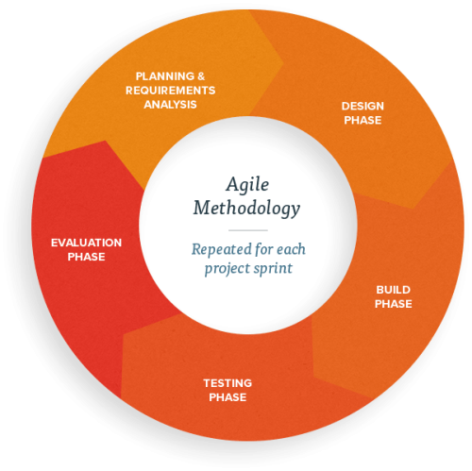
Method – agile methodology

Slide 15
Agile methodology
Defined as the ability to move quickly and easily.
Suitable to use for web-based system development and mobile application development.
Ability for release in a short period of time.

Slide 16
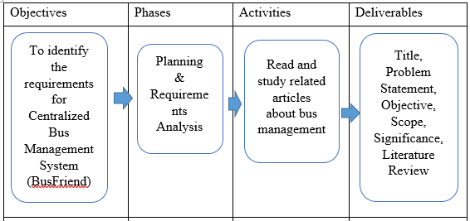
Project development methodology summary

Slide 17
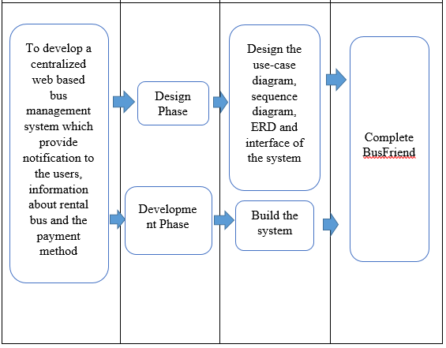

Slide 18
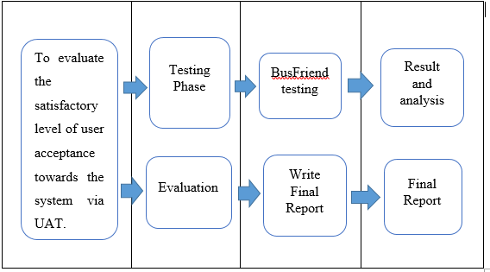

Slide 19
Use-case diagram

Slide 20
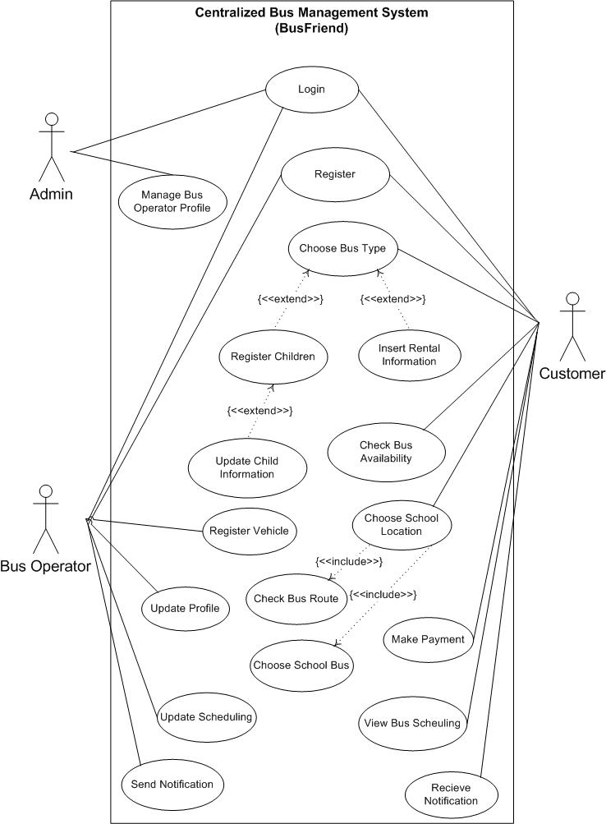

Slide 21
Sequence diagram

Slide 22
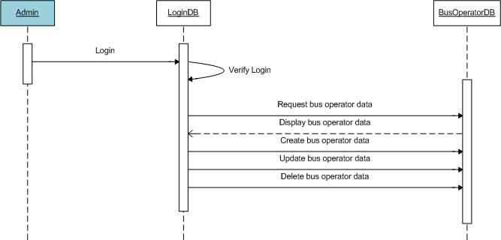

Slide 23
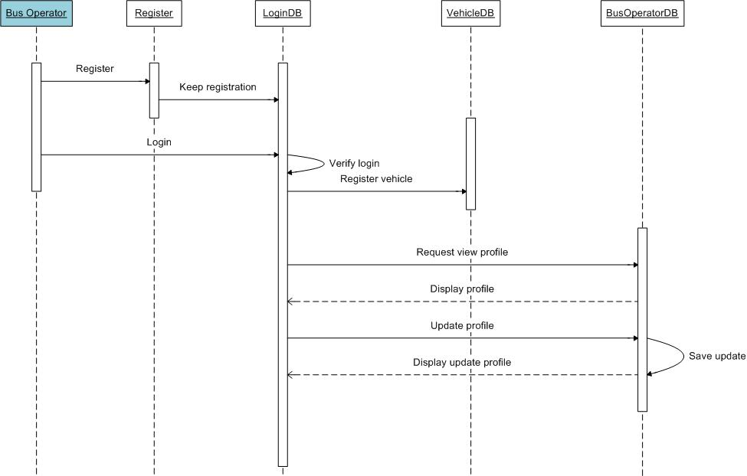

Slide 24
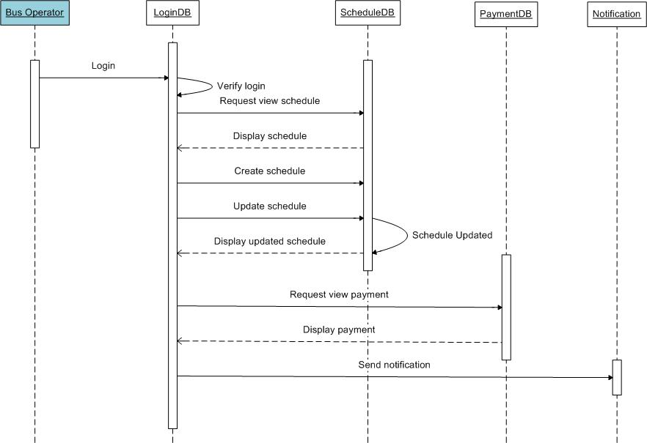

Slide 25
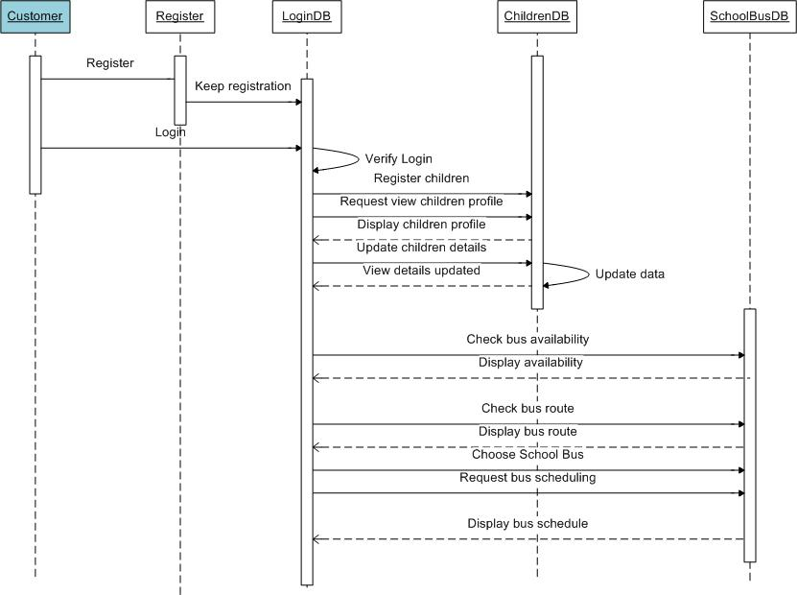

Slide 26
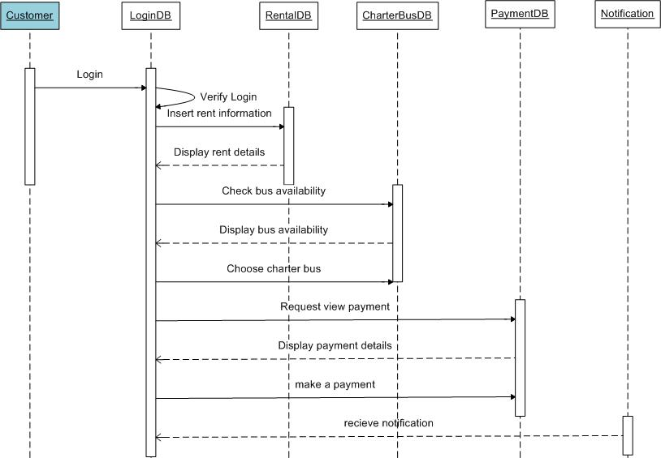

Slide 27
Entity relationship diagram

Slide 28
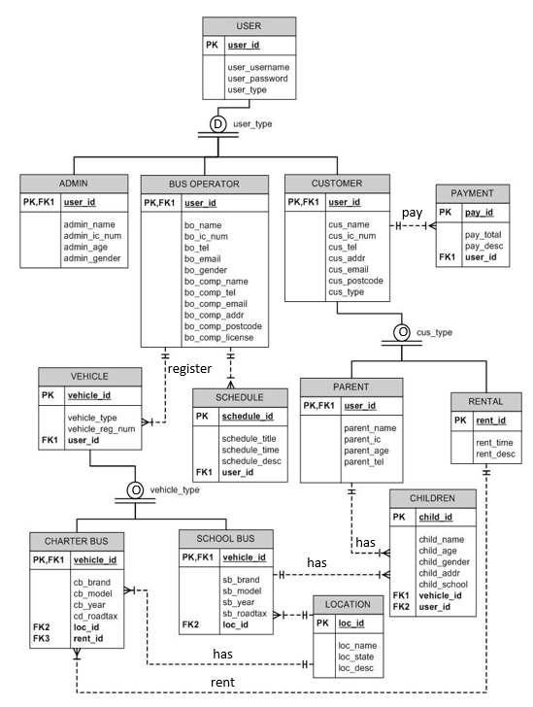

Slide 29
Web-based interface

Slide 30
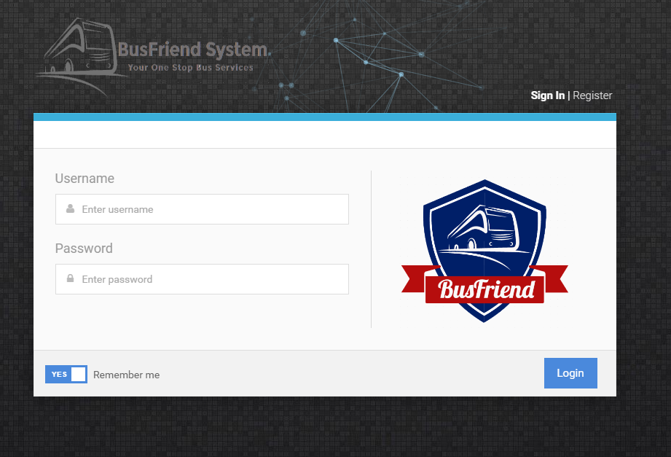

Slide 31
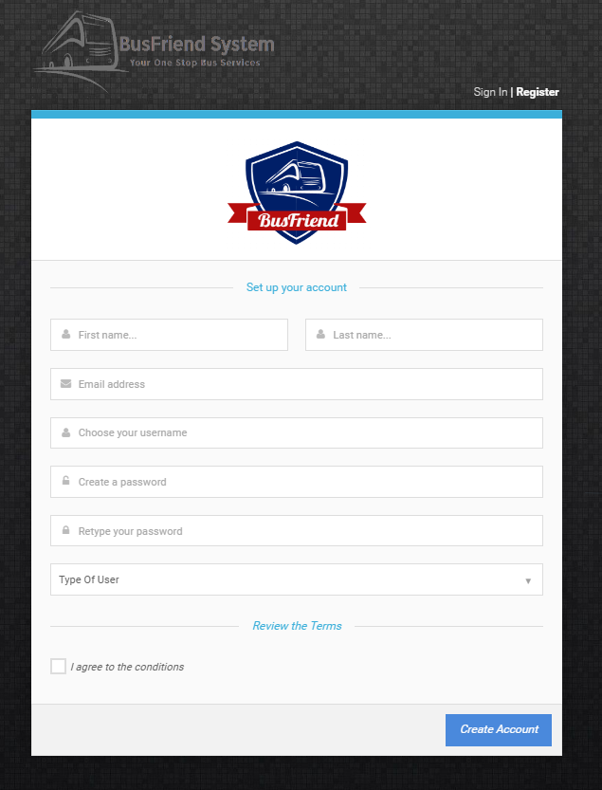

Slide 32
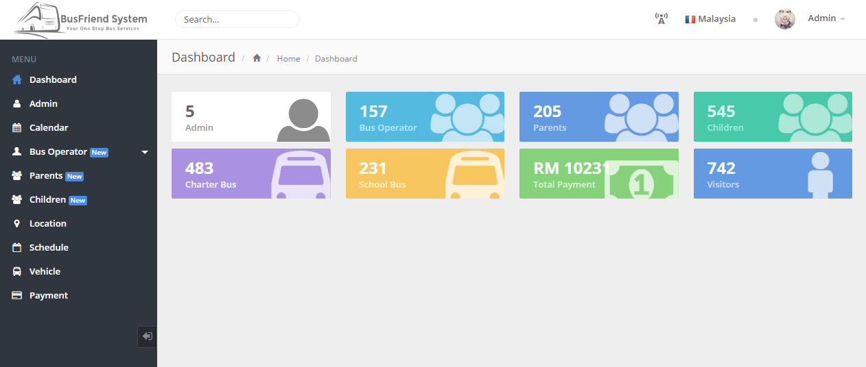

Slide 33
Mobile application interface

Slide 34
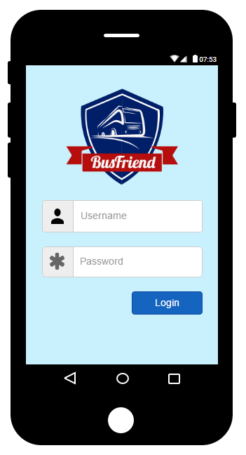
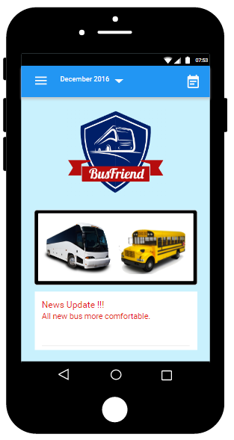
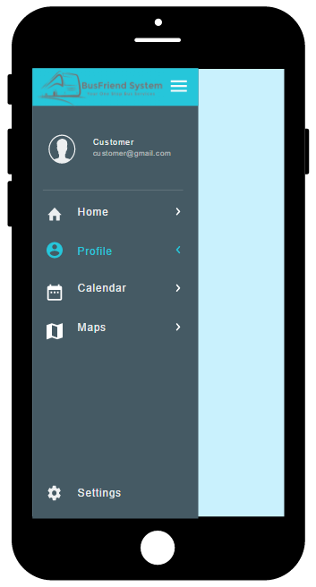

Slide 35
Hardware requirements
No | Hardware | Specification
1. | Laptop | Model | Acer
 |  | Processor | Intel® CoreTM i5-2450M processor
 |  | Processor Speed | 2.5 GHz
 |  | Memory (RAM) | 8 GB
 |  | Operating System | Windows 10 Pro
2. | Smartphone | Model | Sony Xperia Z2
 |  | Android Version | Marshmallow 6.0.1
 |  | Processor | Snapdragon 801
 |  | Processor Speed | 2.3 GHz Quad-Core
 |  | Memory (RAM) | 3 GB

Slide 36
Software tools
No. | Software | Type
1. | Windows 10 Pro | Operating System (OS)
2. | Google Chrome | Web Browser
3. | Microsoft Office 2016 | Report and Documentation
4. | Laravel 5 Framework | System Framework
5. | XAMPP | Bundle Server
6. | MySQL | Database Server
7. | Android Studio | Coding Workshop
8. | Moqups | Design Tools
9. | Sublime 2 | Coding Workshop
10. | Adobe Photoshop CS6 | Design Tools

