Slide 1
DATA SCIENCE Support Vector Machines

Slide 2
Support Vector Machines
Constructs a hyperplane to separate classes in space.
2 columns in your dataframe? Make a line to separate them
3 columns in your dataframe? Make a 2D-plane to separate them
4 columns… etc.

Slide 3
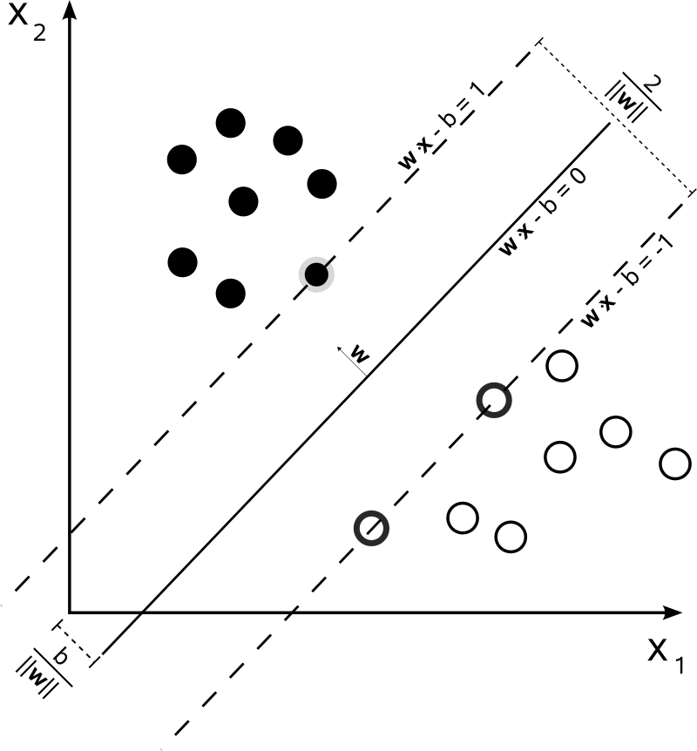
2D Example
These points leave us only one choice for the line, so these are the support vectors
We want to maximize
the width of the margin

Slide 4
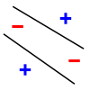
LINEAR SEPARABILITY
We can only draw one line, so in this picture: we can’t cleanly separate + and – with one straight line
Option #1: use a straight line and choose the one with the fewest mis-classifications
Option #2: use a curvy line

Slide 5
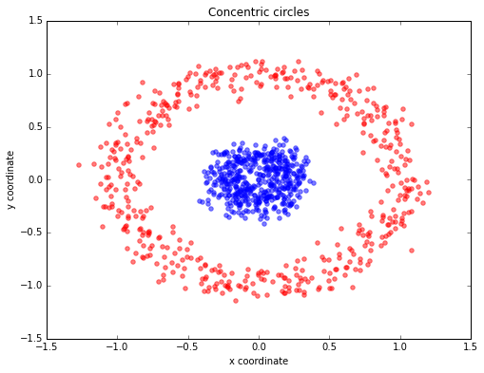
OPTION 2 (SLIGHTLY MORE REALISTIC)
Pretty much no hyper-plane
will separate this out, but what if we could add a third dimension?

Slide 6
Support Vector Machines
Q. OK fine, but what if I have 100 predictors? How many dimensions should I project into?
A. Probably around 10,000.
OK but this can take time..

Slide 7
KERNEL TRICK
There are a few dimensionality extenders which happen to be quite easy to compute with:
Linear Kernel | Creates a linear boundary
Polynomial Kernel | Creates a curved boundary: e.g. a parabola or a conic section. Useful when you have logical ANDs
Gaussian | Creates a spherical / circular boundary. Works well when there is some kind of continuity
Sigmoid | Creates a step-like shape; works well for some image recognition problems.

Slide 8
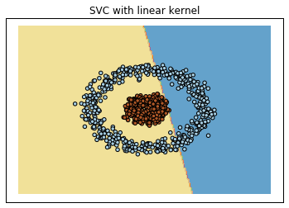
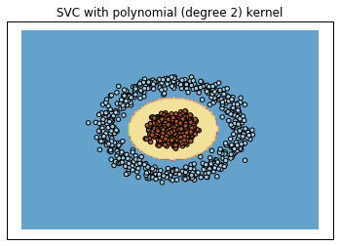

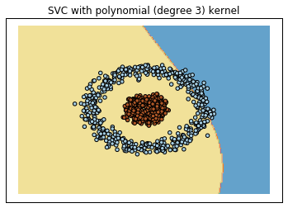

Slide 9
Support Vector Machines
Pros
Cons
Very fast training and predicting with kernel trick
Built on solid mathematical foundation (unlike ANN)
Very common and in sklearn
A lot of “guess work” with kernels
Hard to grasp math behind it (ok if you accept the black box)

Slide 10
CODE SAMPLE
rbf_svc = sklearn.svm.SVC() # default kernel='rbf'
svc = sklearn.svm.SVC(kernel='linear')
poly_svc = sklearn.svm.SVC(kernel='poly', degree=3)
svc.fit(…)
svc.predict(…)
svc.predict_proba(…)
# only if probability=True passed to constructor
Parameters to grid seach / CV: gamma, C

Slide 11
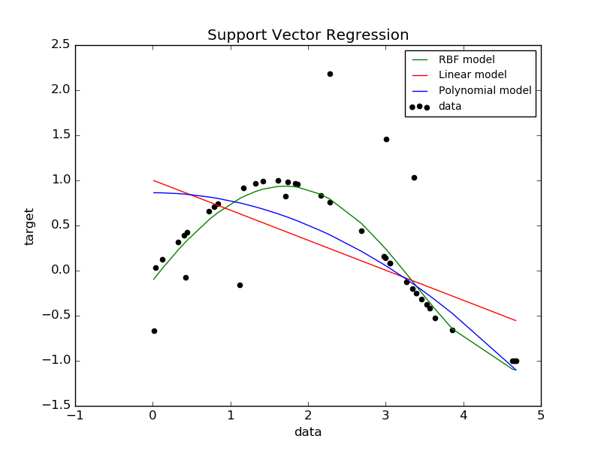
SUPPORT VECTOR REGRESSION

Slide 12
LAB
DATA SCIENCE PART TIME COURSE

