Slide 1


Kalbe Nutritionals Data Engineer Project Based Internship Program Final Project Create Database Connection, ETL Tools Processing, Pentaho, and GCP Integration for Data Warehouse Implementation
X
</
/>
Presented by
Ahmad Syahbana Nur

Slide 2
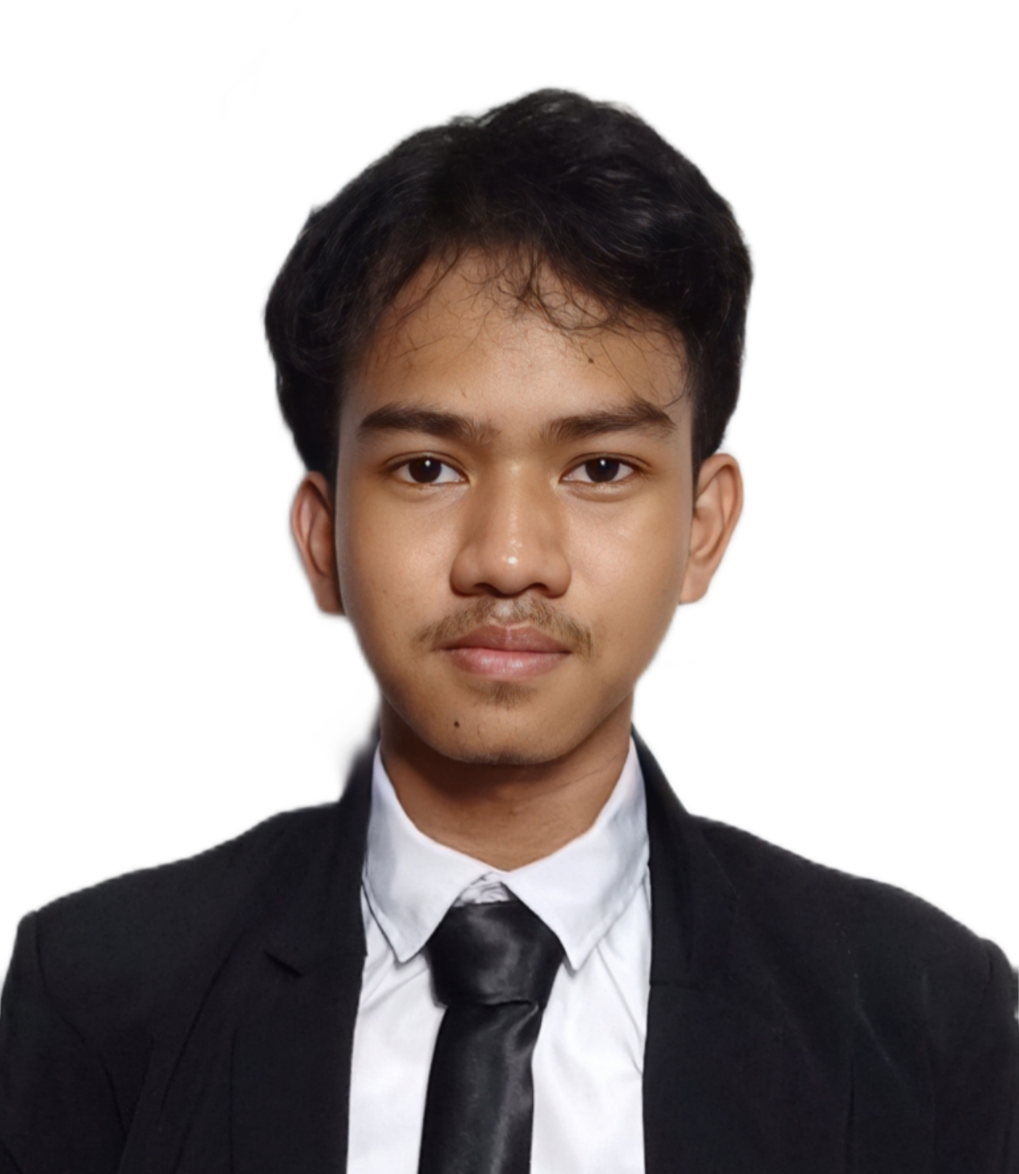
</About Me
/>
Ahmad Syahbana Nur
Mahasiswa Teknik Informatika Universitas Islam Muhammad Arsyad Al Banjari Semester 3 Angkatan 2022

Slide 3
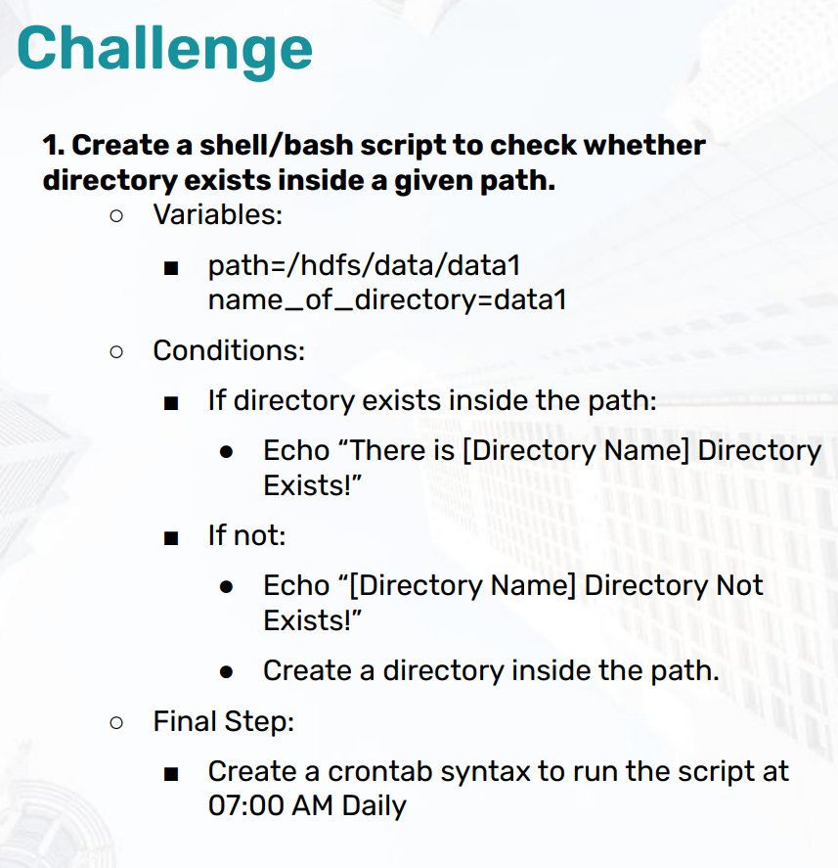
</Challenge 1

Slide 4
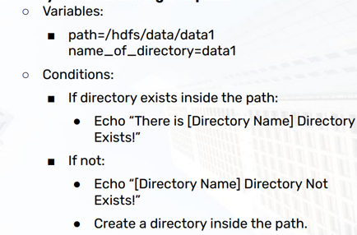
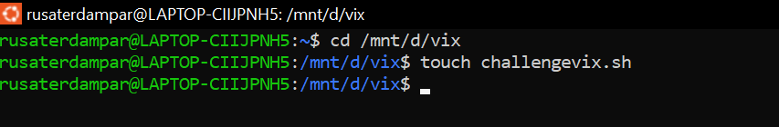

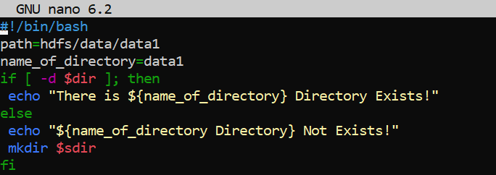

</Penyelesaian Challenge 1

Slide 5

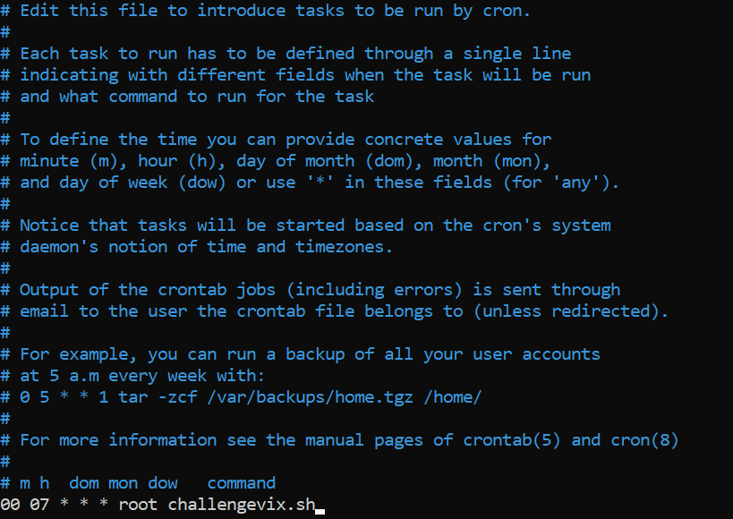
</Penyelesaian Challenge 1

Slide 6
</New operating system design
Jenna Doe
Kelly Smith
Venus is a very hot planet
Earth is the planet with life
Juan Jones
John Martin
Mars is full of iron oxide dust
Mercury is a small planet

Slide 7
</New operating system design
Them
Us
Mercury is small
Jupiter is a big planet
Venus is a hot planet
Saturn is a gas giant
Earth harbors life
Neptune is an ice giant
Mars is very cold
Pluto is a dwarf planet

Slide 8
</New operating system design
Problem
Process
Solution
{01}
{02}
{03}
Analysis
Evaluation
Synthesis
Earth is the planet with life
Mars is full of iron oxide dust
Jupiter is a huge gas giant

Slide 9
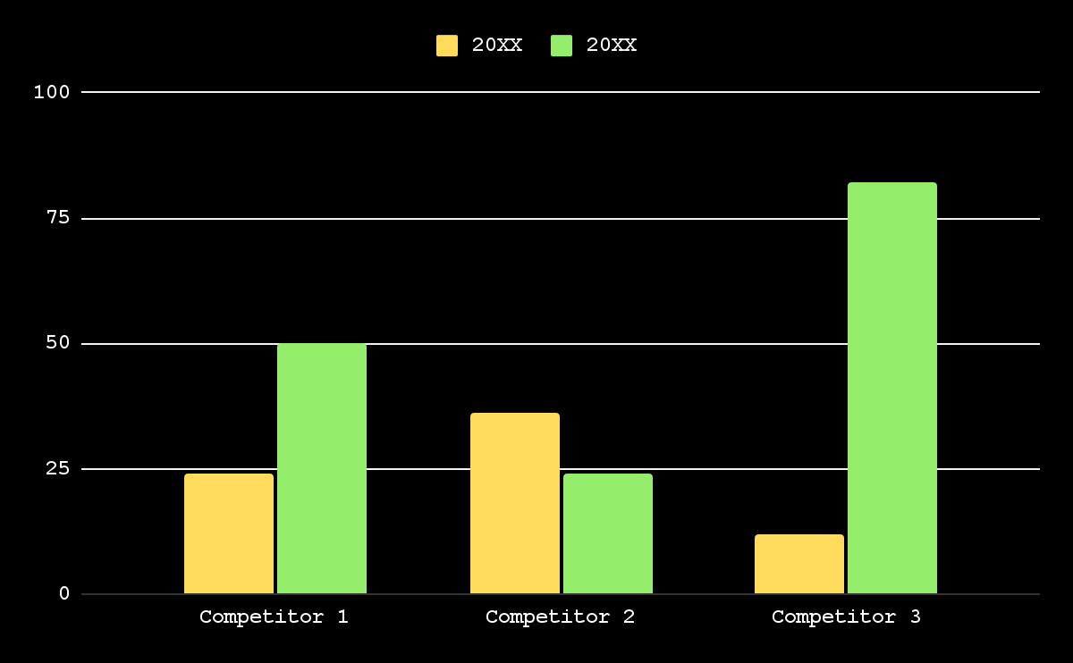
</New operating system design
20XX
Earth is the third planet from the Sun
20XX
Venus is the second planet from the Sun
Follow the link in the graph to modify its data and then paste the new one here. For more info, click here

Slide 10
</New operating system design
Venus
{01}
{02}
Mercury
It’s a hot planet
Mercury is small
Mars
{03}
{04}
Saturn
Mars is very cold
Saturn has rings
Earth
{05}
{06}
Neptune
Earth has life
It’s an ice giant
Jupiter
{07}
{08}
Pluto
Jupiter is big
It’s a dwarf planet

Slide 11
</New operating system design
Mercury
Venus
Earth
Jupiter
Saturn
Neptune
Earth is the planet with life
It doesn’t have a solid surface
It was named after a Roman god
Neptune is very far from us
40%
60%
20%
80%

Slide 12
</New operating system design
Venus
Mercury
{01}
{02}
It’s the second planet from the Sun
It’s the closest planet to the Sun
Earth
Mars
{03}
{04}
It’s the third planet from the Sun
Despite being red, Mars is very cold

Slide 13
</New operating system design
{10M}
Venus
Venus is a very hot planet
{1M}
Mars
Mars was named after a god
{10K}
Jupiter
Jupiter is a huge gas giant
{5K}
Saturn
Saturn has beautiful rings
{1K}
Neptune
Neptune is very far from us

Slide 14
</New operating system design
Our plans | Description | Price
Free | Mercury is the closest planet to the Sun Mercury is very small | $50
Freemium | Venus is the second planet from the Sun Venus is a hot planet | $75
Premium | Earth is the third planet from the Sun Earth is the planet with life We all live on Earth | $200

Slide 15
</New operating system design
{01}
{02}
{03}
Vision
Mission
Goals
Neptune is the farthest planet from the Sun
Saturn is composed mostly of hydrogen and helium
Despite being red, Mars is actually a cold place

Slide 16
</New operating system design
{50%}
Venus is the second planet from the Sun
{70%}
Mercury is the closest planet to the Sun
{10%}
Despite being red, Mars is very cold
{20%}
Jupiter is the biggest planet of them all
{90%}
Saturn was named after a Roman god

Slide 17
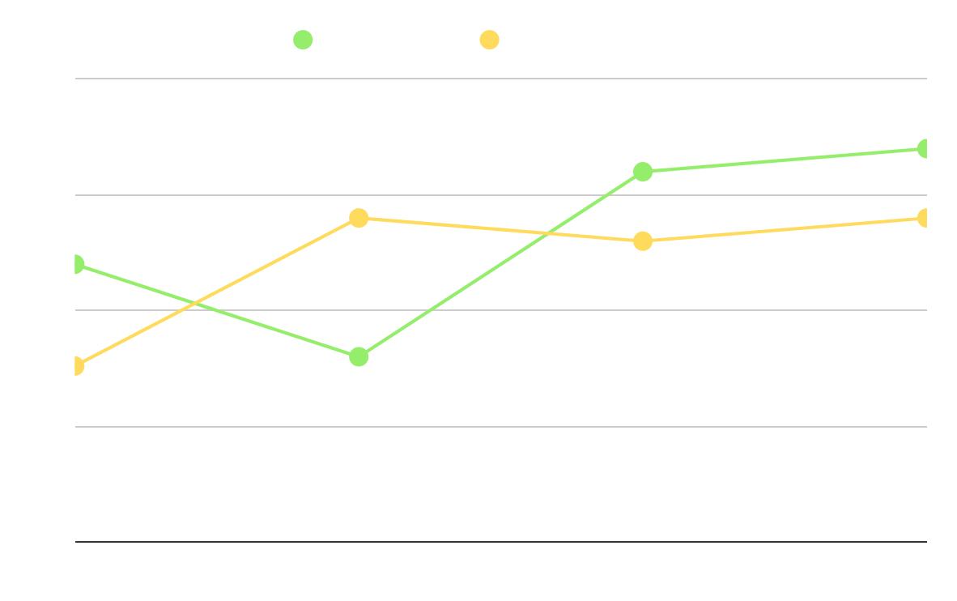
</New operating system design
Our company
Their company
Earth is the third planet from the Sun
Venus is the second planet from the Sun
Analysis
Saturn is a gas giant and has several rings. It’s composed mostly of hydrogen and helium
Follow the link in the graph to modify its data and then paste the new one here. For more info, click here

Slide 18
</New operating system design
{2/5}
By Mark Jones
{5/5}
By Timmy Jimmy
“Venus is the second planet from the Sun”
“Despite being red, Mars is very cold”
{4/5}
By Kim Williams
{3/5}
By Sue Lawson
“Jupiter doesn’t have a solid surface”
“Earth is the planet with life”

Slide 19
</New operating system design
Jupiter
It doesn’t have a solid surface
Mercury
Mercury is the closest planet to the Sun and the smallest of them all
Earth
Earth is the planet with life

Slide 20
</New operating system design
S
W
O
T
Strengths
Weaknesses
Opportunities
Threats
Earth is the planet with life
Jupiter is a huge gas giant
Mars is actually a cold place
Neptune is very far from us

Slide 21
</New operating system design
Brainstorming
Preparation
Facilitation
Venus is the second planet from the Sun
Despite being red, Mars is very cold
Follow through
Earth is the third planet from the Sun

Slide 22
</New operating system design
{01}
Awareness
Venus is a very hot planet
{02}
Interest
Mars was named after a god
{03}
Decision
Jupiter is a huge gas giant
{04}
Purchase
Saturn has beautiful rings

Slide 23
</New operating system design
 | Mon | Tue | Wed | Thu | Fri
Week 1 |  | Jupiter is a big planet
Week 2 |  |  | Mercury is a small planet
Week 3 |  |  |  |  | We all live on Earth
Week 4 | Neptune is an ice giant
</Jupiter
</Mercury
</Earth
</Neptune

Slide 24
</New operating system design
Budget model
It’s the closest planet to the Sun
It’s the second planet from the Sun
It doesn’t have a solid surface
Mercury
Venus
Jupiter
{30%}
{20%}
{50%}
{4,000,000}

Slide 25
</New operating system design
Mars was named after a god
Saturn has beautiful rings
Mars
Saturn
{20XX}
{20XX}
{20XX}
{20XX}
{20XX}
Venus
Jupiter
Earth
Venus is a very hot planet
Jupiter is a huge gas giant
It’s the planet with life

Slide 26
</New operating system design
Venus
Mars
It’s the second planet from the Sun
Despite being red, Mars is very cold
Earth
Jupiter
It’s the third planet from the Sun
It doesn’t have a solid surface

Slide 27
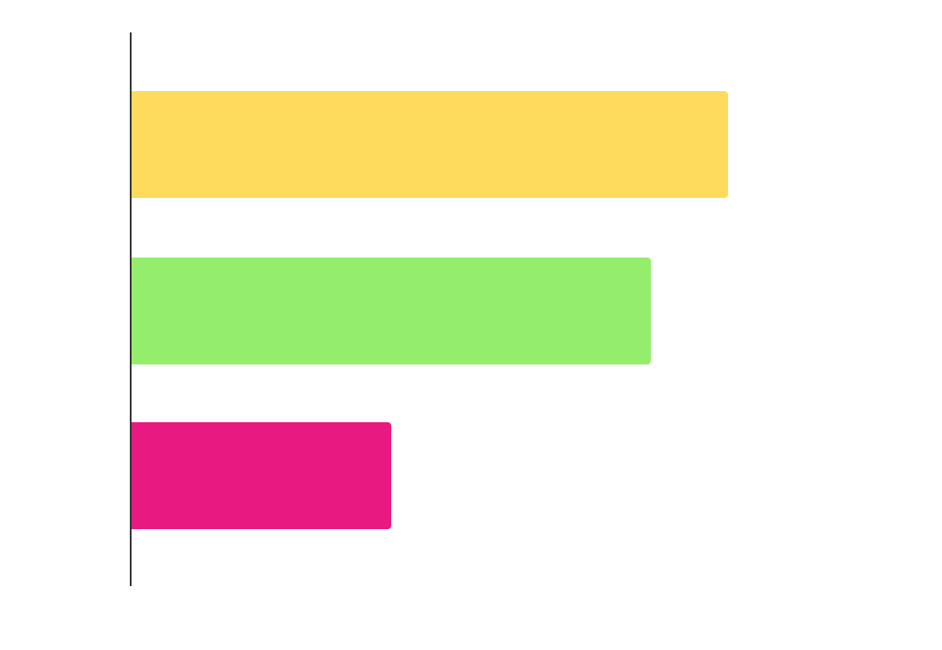
</New operating system design
{23K}
Mars
Mars was named after a god
{20K}
Venus
Venus is a very hot planet
{10K}
Jupiter
Jupiter is a huge gas giant
Follow the link in the graph to modify its data and then paste the new one here. For more info, click here

Slide 28
</New operating system design
Venus
{01}
Venus is a very hot planet
Mars
{02}
Mars was named after a god
Jupiter
{03}
Jupiter is a huge gas giant
Saturn
{04}
Saturn has beautiful rings

Slide 29
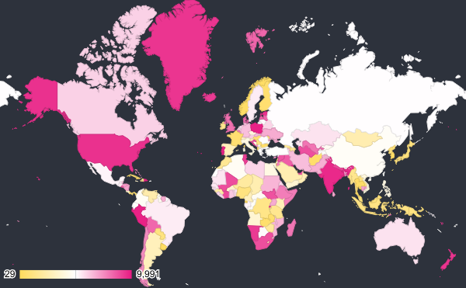
</New operating system design
Earth
Jupiter
Earth is the planet with life
It doesn’t have a solid surface
{4,000,000}
Saturn
It was named after a Roman god
Venus is the second planet from the Sun
Follow the link in the map to modify its data and then paste the new one here. For more info, click here

Slide 30
</New operating system design
Awards
Best team
Innovation
Experimental
Venus is the second planet from the Sun
Despite being red, Mars is very cold
Earth is the third planet from the Sun

Slide 31
</New operating system design
Mon | Tue | Wed | Thu | Fri | Sat | Sun
1 | 2 | 3 | 4 | 5 | 6 | 7
8 | 9 | 10 | 11 | 12 | 13 | 14
15 | 16 | 17 | 18 | 19 | 20 | 21
22 | 23 | 24 | 25 | 26 | 27 | 28
29 | 30
</Task 1
</Task 2
</Task 3
</Task 4

Slide 32
</New operating system design
Venus is the second planet from the Sun
Despite being red, Mars is actually a cold place
Earth is the planet on which we all live
Jupiter is the biggest planet in the Solar System
Venus
Mars
Earth
Jupiter
{01}
{02}
{03}
{04}

Slide 33
Instructions for use
If you have a free account, in order to use this template, you must credit Slidesgo in your final presentation. Please refer to the next slide to read the instructions for premium users.
As a Free user, you are allowed to:
- Modify this template.
- Use it for both personal and commercial projects.
You are not allowed to:
- Sublicense, sell or rent any of Slidesgo Content (or a modified version of Slidesgo Content).
- Distribute Slidesgo Content unless it has been expressly authorized by Slidesgo.
- Include Slidesgo Content in an online or offline database or file.
- Offer Slidesgo templates (or modified versions of Slidesgo templates) for download.
- Acquire the copyright of Slidesgo Content.
For more information about editing slides, please read our FAQs or visit our blog:
https://slidesgo.com/faqs and https://slidesgo.com/slidesgo-school

Slide 34
Instructions for use (premium users)
As a Premium user, you can use this template without attributing Slidesgo.
You are allowed to:
Modify this template.
Use it for both personal and commercial purposes.
Share this template in an editable format with people who are not part of your team.
You are not allowed to:
Sublicense, sell or rent this Slidesgo Template (or a modified version of this Slidesgo Template).
Distribute this Slidesgo Template (or a modified version of this Slidesgo Template) or include it in a database or in any other product or service that offers downloadable images, icons or presentations that may be subject to distribution or resale.
Use any of the elements that are part of this Slidesgo Template in an isolated and separated way from this Template.
Register any of the elements that are part of this template as a trademark or logo, or register it as a work in an intellectual property registry or similar.
For more information about editing slides, please read our FAQs or visit our blog:
https://slidesgo.com/faqs and https://slidesgo.com/slidesgo-school

Slide 35
Infographics
You can add and edit some infographics to your presentation to present your data in a visual way.
Choose your favourite infographic and insert it in your presentation using Ctrl C + Ctrl V or Cmd C + Cmd V in Mac.
Select one of the parts and ungroup it by right-clicking and choosing “Ungroup”.
Change the color by clicking on the paint bucket.
Then resize the element by clicking and dragging one of the square-shaped points of its bounding box (the cursor should look like a double-headed arrow). Remember to hold Shift while dragging to keep the proportions.
Group the elements again by selecting them, right-clicking and choosing “Group”.
Repeat the steps above with the other parts and when you’re done editing, copy the end result and paste it into your presentation.
Remember to choose the “Keep source formatting” option so that it keeps the design. For more info, please visit our blog.

