Slide 1
VIRTUAL INTERNSHIP EXPERIENCE · BANK MUAMALAT
Business Intelligence
Case Study
Analisis Penjualan PT Sejahtera Bersama
Syahrul Mubarak· 2025

Slide 2
01
Primary Key & SQL
Identifikasi PK dan query ALTER TABLE pada 4 tabel
Daftar
Isi
Table Relationship & FK
02
Atribut lengkap, ERD, dan query Foreign Key
03
Master Table (SQL)
LEFT JOIN untuk menggabungkan 4 tabel
04
Dashboard Looker Studio
Visualisasi interaktif data penjualan
05
Rekomendasi Bisnis
Bank Muamalat
BI Analyst Track
Strategi mempertahankan & meningkatkan penjualan

Slide 3
01
SOAL
Primary Key
Identifikasi kunci utama pada 4 tabel dan implementasi SQL di BigQuery

Slide 4
Soal 1 · Primary Key pada 4 Tabel
🗄 customers
🗄 orders
PRIMARY KEY
PRIMARY KEY
CustomerID
OrderID
Unik per pelanggan. FK di tabel orders merujuk ke kolom ini.
Unik per transaksi. Berisi FK ke customers dan products.
🗄 product_category
🗄 products
PRIMARY KEY
PRIMARY KEY
CategoryID
ProdNum
Unik per kategori. FK di tabel products merujuk ke sini.
Unik per produk. Menghubungkan produk ke kategori & pesanan.

Slide 5
Soal 1 · SQL Query – ALTER TABLE Primary Key (BigQuery)
BigQuery SQL – Primary Key Constraints
-- Customers
ALTER TABLE `bank-muamalat-493716.bank_muamalat.customers`
ADD PRIMARY KEY (CustomerID) NOT ENFORCED;
-- Orders
ALTER TABLE `bank-muamalat-493716.bank_muamalat.orders`
ADD PRIMARY KEY (OrderID) NOT ENFORCED;
-- Product Category
ALTER TABLE `bank-muamalat-493716.bank_muamalat.product_category`
ADD PRIMARY KEY (CategoryID) NOT ENFORCED;
-- Products
ALTER TABLE `bank-muamalat-493716.bank_muamalat.products`
ADD PRIMARY KEY (ProdNumber) NOT ENFORCED;
ℹ NOT ENFORCED digunakan karena BigQuery tidak melakukan validasi constraint secara otomatis, namun tetap mendokumentasikan relasi.

Slide 6
02
SOAL
Table Relationship & FK
Atribut lengkap, Entity Relationship, dan query Foreign Key

Slide 7
Soal 2 · Entity Relationship Diagram – Atribut Lengkap
product_category
products
customers
PK CategoryID
1 : N
PK ProdNumber
PK CustomerID
CategoryName
ProdName
FirstName / LastName
CategoryAbbreviation
FK Category
CustomerEmail
Price
CustomerPhone
CustomerAddress
1 : N
CustomerCity
orders
CustomerState / Zip
PK OrderID
Date
1 : N
FK CustomerID
FK ProdNumber
Quantity
Relasi: ProductCategory 1:N Products · Products 1:N Orders · Customers 1:N Orders

Slide 8
Soal 2 · SQL Query – Foreign Key Constraints (BigQuery)
BigQuery SQL – Foreign Key Constraints
-- FK: products.Category → product_category.CategoryID
ALTER TABLE `bank-muamalat-493716.bank_muamalat.products`
ADD CONSTRAINT fk_category FOREIGN KEY (Category)
REFERENCES `bank-muamalat-493716.bank_muamalat.product_category` (CategoryID) NOT ENFORCED;
-- FK: orders.CustomerID → customers.CustomerID
ALTER TABLE `bank-muamalat-493716.bank_muamalat.orders`
ADD CONSTRAINT fk_customer FOREIGN KEY (CustomerID)
REFERENCES `bank-muamalat-493716.bank_muamalat.customers` (CustomerID) NOT ENFORCED;
-- FK: orders.ProdNumber → products.ProdNumber
ALTER TABLE `bank-muamalat-493716.bank_muamalat.orders`
ADD CONSTRAINT fk_prod FOREIGN KEY (ProdNumber)
REFERENCES `bank-muamalat-493716.bank_muamalat.products` (ProdNumber) NOT ENFORCED;
ℹ 3 Foreign Key dibuat: fk_category (products→product_category), fk_customer (orders→customers), fk_prod (orders→products).

Slide 9
03
SOAL
Master Table (SQL)
LEFT JOIN 4 tabel untuk membuat tabel gabungan di Google BigQuery

Slide 10
Soal 3 · SQL Query – Master Table (LEFT JOIN)
BigQuery SQL – Master Table Query
Kolom Output
SELECT
cust_email
customers
c.CustomerEmail AS cust_email,
c.CustomerCity AS cust_city,
o.Date AS order_date,
cust_city
customers
o.Quantity AS order_qty,
p.ProdName AS product_name,
p.Price AS product_price,
order_date
orders
pc.CategoryName AS category_name,
order_qty
orders
(o.Quantity * p.Price) AS total_sales
product_name
products
FROM `...bank_muamalat.orders` AS o
LEFT JOIN `...customers` AS c ON o.CustomerID = c.CustomerID
product_price
products
LEFT JOIN `...products` AS p ON o.ProdNumber = p.ProdNumber
LEFT JOIN `...product_category` AS pc ON p.Category = pc.CategoryID
category_name
product_category
ORDER BY o.Date ASC;
total_sales
computed
ℹ LEFT JOIN digunakan agar semua data orders tetap tampil meskipun ada data customers/products yang tidak cocok. Diurutkan ASC by Date.

Slide 11
04
SOAL
Dashboard Looker Studio
Visualisasi interaktif data penjualan PT Sejahtera Bersama

Slide 12
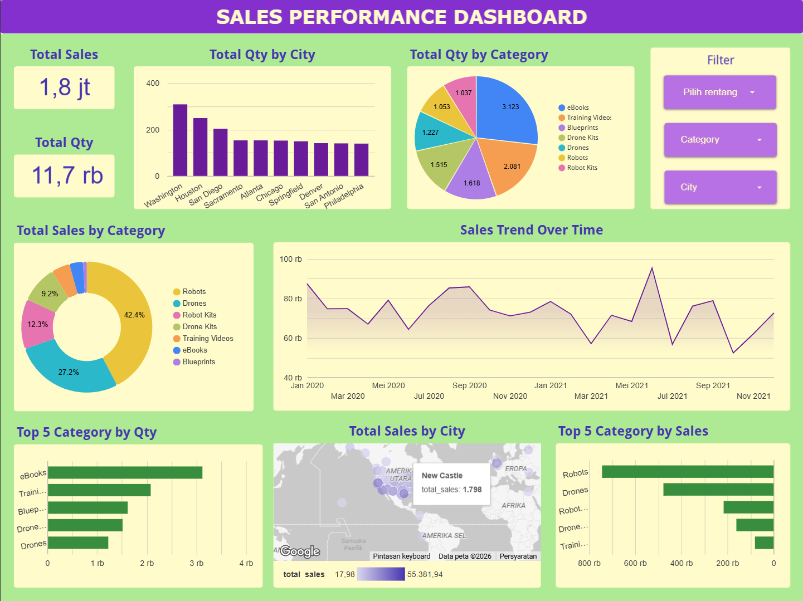
Soal 4 · Sales Performance Dashboard

Slide 13
05
SOAL
Rekomendasi Bisnis
Strategi mempertahankan & meningkatkan penjualan PT Sejahtera Bersama

Slide 14
Soal 5 · Business Recommendations
1
Bundle High-Value & High-Volume
2
Retensi di Kota Top
Paket Robot/Drone + eBook/Training Video untuk tingkatkan average order value dan cross-selling.
Loyalty program & targeted promotion di Washington & Houston sebagai dua pasar terkuat.
3
Ekspansi Kota Potensial
4
Upselling Produk Robots
Digital marketing campaign ke Philadelphia & San Antonio yang masih memiliki qty rendah.
Jaga stok & after-sales service. Dorong upselling ke varian Robot premium (42.4% revenue).
5
Investigasi Penurunan Akhir 2021
6
Subscription Konten Digital
Analisis penyebab (stok, kompetisi, musiman) dan terapkan promosi akhir tahun korektif.
eBooks & Training Videos volume tinggi tapi revenue kecil — terapkan model membership.

Slide 15
Terima Kasih
Virtual Internship Experience · Bank Muamalat
BI Analyst Track | PT Sejahtera Bersama | 2025
01
02
03
04
05

