Slide 1
Project Title: Automated Parking System
CSC1100 Element of Programming
Section: 4
Group: Ibn-Bajjah
Lecturer: Mdm. Suriani bt. Sulaiman
Muhammad Syahmi Fathimi bin Ahmad Fauzi | 1715845
Muhammad Farhan bin Azhar | 1718485
Muhammad Nur Aqmal bin Khatiman | 1712719
Irfan bin Jamil | 1711025

Slide 2
Introduction
“Park, Swipe, Leave”
Have you heard that statement?
Have you heard about Automated Parking System (APS)?
Real world APS building is a place where you can safely park your vehicle in a garage. Then you swipe your card at the sensor and that garage will move your vehicle to one of the parking lot in that building. You can leave your car there happily.
To illustrate the real world APS, Ibn-Bajjah APS will replace swipe the card with plate number and pin number;

Slide 3
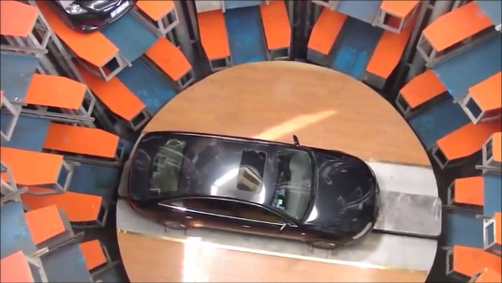
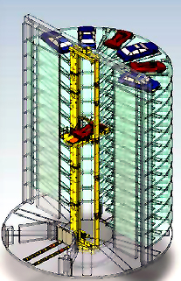
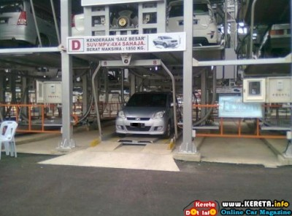
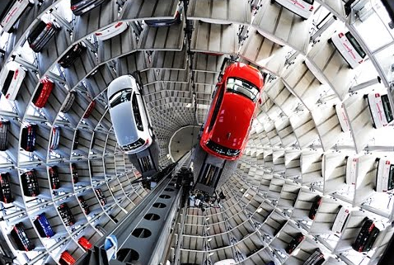
Real World APS
APS in China
APS in Kuala Terengganu, Malaysia
System
Overview
APS in Germany

Slide 4
Ibn-Bajjah APS User Features
Park/Unpark the vehicle
Select vehicle type (car/motorcycle)
Enter vehicle plate number
Set 6 digits PIN numbers (when park)
Enter valid 6 digits PIN numbers (when unpark)
Get the receipt (when unpark)

Slide 5
Ibn-Bajjah APS Admin Features
Monitor APS data
Select vehicle type (car/motorcycle)
View all parking lot (available/not)
View all vehicle details sorted by
(plate-no/lot-no/date-time-in)
Search vehicle plate number to find its lot number
Search lot number to find its vehicle plate number
View total sales
Shutdown the system

Slide 6
Ibn-Bajjah APS Rates
Car Rates
Hours | Rates/hour (for each day)
1st - 3rd hours | RM4.50
4th & 5th hours | RM3.50
6th - 9th hours | RM3.00
10th - 18th hours | RM2.00
19th - 24th hours | Free
Motorcycle Rates
→ RM2.00 per day

Slide 7
Functions/Methods Description
In main.cpp
- Basically the User Interface of the system
Functions | Description
initAdmin() | Create admin for the system
validateAdmin() | Asking admin permission to perform admin features
main(), userMenu(), adminMenu(), showReceipt(), showAtTop(), showAllParkingLots(), showAllDetails() | Display the the menus, receipt, total parking left, all parking lots and all vehicle details
userFeatures(), adminFeatures() | Doing/Calling the most important function of Ibn-Bajjah APS system
inputOption() | Validate all options inputs from user
calcTotalSales() | Calculate total sales each time user unpark their vehicle
pauseScreen(), clearScreen() | “pause, see, clear”

Slide 8
Functions/Methods Description
In aps.cpp/aps.h
- Basically the system of the Ibn-Bajjah APS system
Methods (or function) | Description
AutoParkingSystem() | Constructor: initialize data members
setPlateNo(), setPinNo(), setLotNo(), setVehicleType() | Set all this first before we read the file
validateInput() | Validate what we set above
readFile() | Read the appropiate file base on vehicleType we set above and store the data in the dynamic memory
writeFile() | Write the new vehicle data in the appropriate file or remove that particular data if it exist in the file
The gets methods (eg. getPinNo()) | Will return data that we want
The sortBys methods (eg. sortByPinNo()) | Will sort the data in the file using Insertion Sort Algorithm

Slide 9
Functions/Methods Description
In aps.cpp/aps.h
- Basically the system of the Ibn-Bajjah APS system
Methods (or function) | Description
The searchBys methods | Search data in the file using Binary Search Algorithm. The file need to be sorted first
formatString() | Format the user inputs for all strings to uppercase with no spaces
genLotNo() | Generate unique lot number for each new plate number
calcDuration() | Calculate the duration in seconds
calcCharges() | Calculate the total charges based on the total seconds
swapStr(), swapTime() | Swap 2 data during sorting

Slide 10
Generated Files
Four (4) files will be generated after the system run:
admin.dat (username and password)
sales.dat (current total sales)
apscar.dat (car data file)
apsmoto.dat (motorcycle data file)

