Slide 1

Smart Agriculture Advisor
Bridging Public & Private Agricultural Data with Open Source AI
Smart Agriculture Advisor is an AI-powered platform that integrates multiple European agricultural data sources, provides real-time analysis and recommendations, enables bidirectional data sharing between public and private sectors, and leverages open-source LLMs for cost-effective AI interpretation.

Slide 2

Problem Statement
1
Complex Decision-Making Challenges
European farmers face complex decision-making challenges in their agricultural operations.
2
Fragmented Data Access
There is fragmented access to agricultural data sources, making it difficult for farmers to gather comprehensive information.
3
Interpretation Difficulties
Farmers face difficulty interpreting multiple data streams, hindering their ability to make informed decisions.
4
Limited Integration
There is limited integration between public and private farming data, creating a gap in the available information.

Slide 3

Our Solution
Data Integration
Integrates multiple European agricultural data sources to provide a comprehensive view of farming information.
Real-Time Analysis
Provides real-time analysis and recommendations to help farmers make informed decisions.
Bidirectional Data Sharing
Enables bidirectional data sharing between public and private sectors, fostering collaboration and knowledge exchange.
Open-Source LLMs
Leverages open-source LLMs for cost-effective AI interpretation, making advanced technology accessible to farmers.

Slide 4
Key Features
1. Multi-Source Data Integration
2. Interactive Land Management
3. AI-Powered Analysis
Crop recommendations
EU Farm Sustainability Data Network
GIS-based field mapping
Sustainability metrics
Historical crop tracking
Market analysis
Weather data
Area calculation
Climate impact assessment
Market prices
Soil type management
Soil conditions
Private farm data

Slide 5





Technology Stack
AI/ML
Data Visualization
Backend
Frontend
Open Source LLMs (Groq, Deepseek R1 Distill 70B (Llama)
Plotly, Folium
Python, PostgreSQL
Streamlit
APIs
OpenWeather, Mapbox, EU Agricultural Data

Slide 6

Competitive Advantages
1
1. Cost-Effective
2
2. Data Privacy
Utilizes open-source technologies and reduces dependency on proprietary AI solutions.
Ensures local data processing, secure user authentication, and private data remains under farmer control.
3
3. Extensible Architecture
Offers easy integration of new data sources, modular design for feature additions, and an API-first approach.

Slide 7
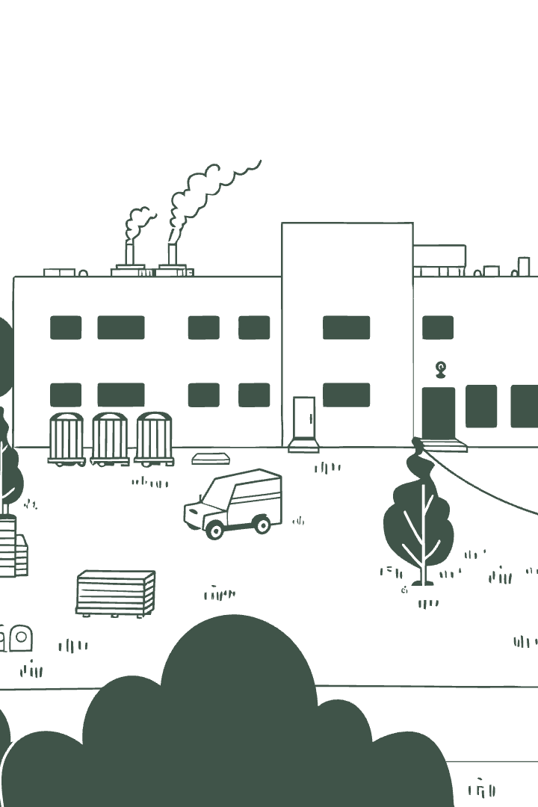



Market Opportunity
Target Market
European agricultural sector
Initial Focus
Small to medium-sized farms
Expansion Potential
Agricultural cooperatives, government agencies

Slide 8
Business Model
1. Subscription Tiers
2. Data Marketplace
Basic: Land management and public data access
Anonymous data sharing incentives
Premium: Advanced AI analysis and recommendations
Research institution partnerships
Agricultural insights commercialization
Enterprise: Custom integrations and API access

Slide 9

Roadmap
1
Phase 1 (Current)
Proof of concept deployment
Basic feature validation
Early adopter feedback
2
Phase 2 (Next 6 months)
Enhanced AI capabilities
Mobile app development
Additional data source integration
3
Phase 3 (12+ months)
Machine learning model training
IoT sensor integration
International market expansion

Slide 10
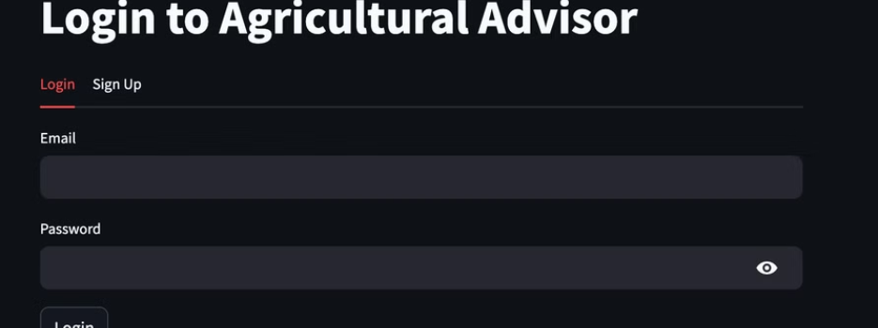
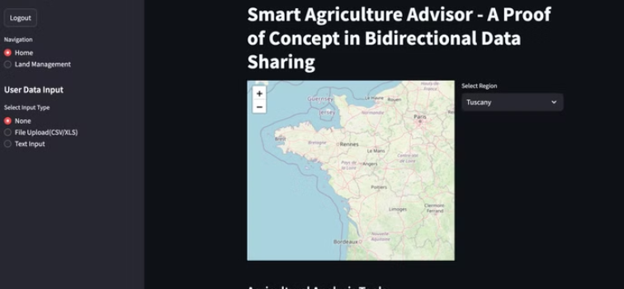
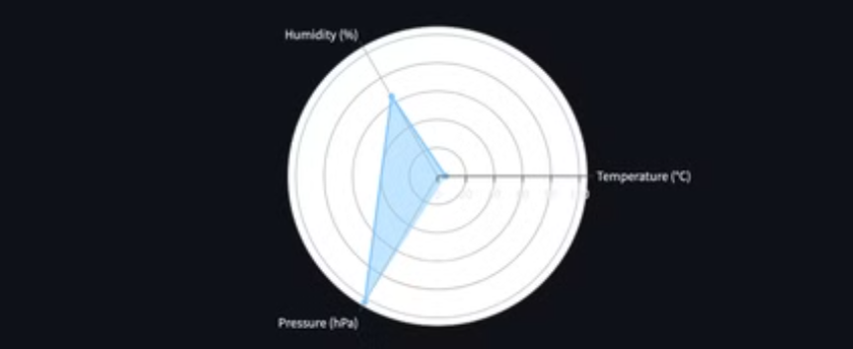

Screenshot

Slide 11

Call to Action
Looking for:
Strategic partnerships with agricultural institutions
Early adopter farms for beta testing
Investment for scaling infrastructure
Contact
Demo Link: https://precision-farm.streamlit.app/
Source Code: https://github.com/syaikhipin/precision-farm

