Slide 1

MUHAMMAD FAKHRUL HADI BIN NORAINI A18CS0136
MUHAMMAD AIMAN HAKIM BIN AHMAD RIDZO A18CS0121
AHMAD SYAKIR BIN ZAIDI A18CS0018

Slide 2
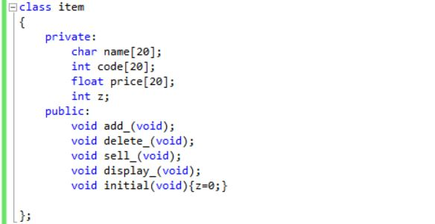
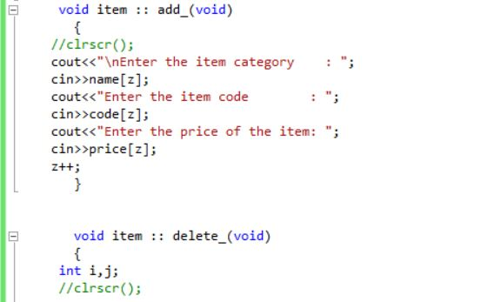
PROGRAM

Slide 3
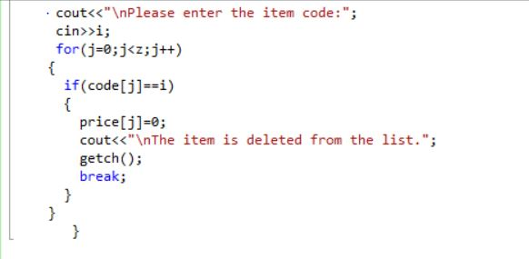
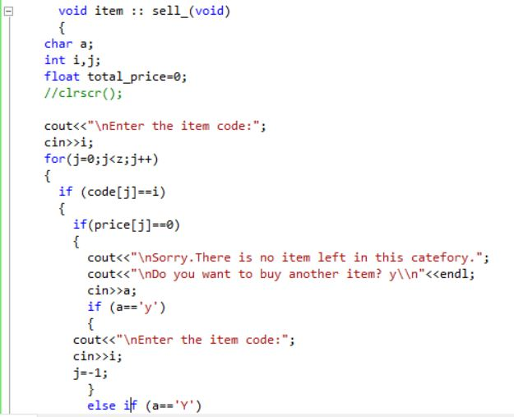

Slide 4
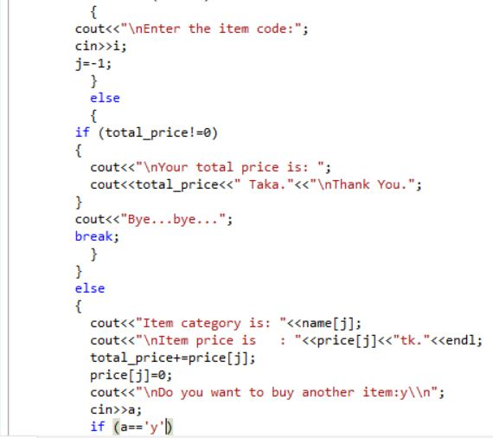
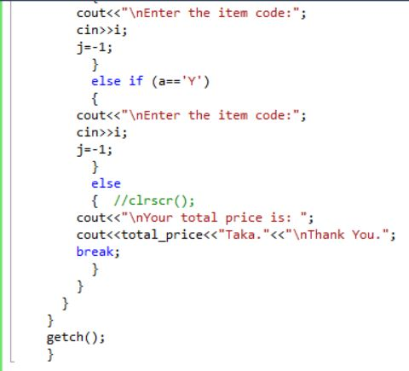

Slide 5
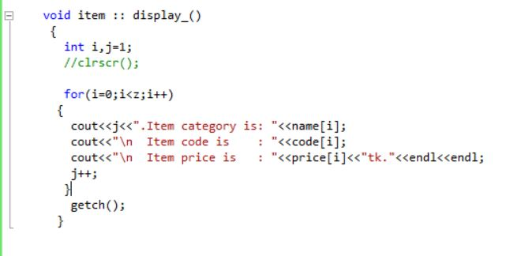
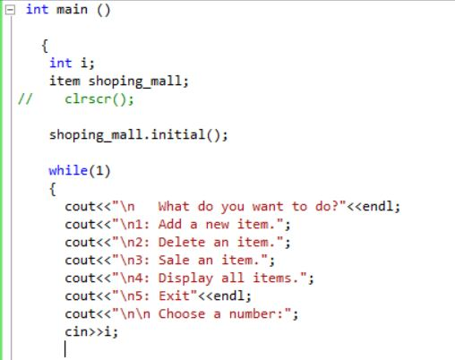

Slide 6
