Slide 1
Type Interface Synthesis for Unstructured Data: json-synthesizer
Steven Yuan
CS515 Programming Languages and Compilers I
Fall 2020

Slide 2
Overview
Modern technologies use Unstructured Data (JSON, XML, etc.) for a wide variety of use cases (Databases, APIs, etc.).
For developers, managing and cleaning data from multiple sources manually is both error-prone and tedious.
Even if the overall process on the data is independent from the source, custom code needs to be written for each source.
json-synthesizer uses a Modified Version Space Algebra to synthesize a Generic Type Interface given Input/Output Examples and Transforms

Slide 3
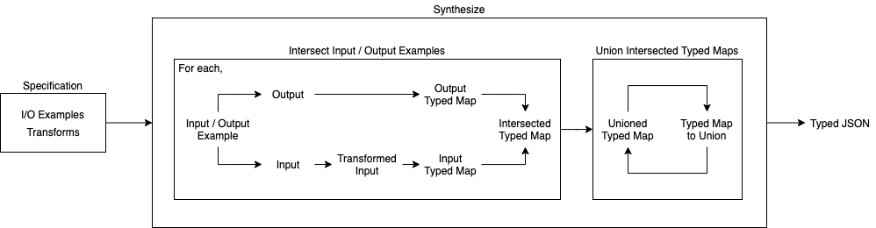
Architecture

Slide 4
Process
Given a Specification with Input/Output Examples and Transforms
For each Input/Output Example, learn a Typed Map
Apply relevant Transforms to the input based on Source Tags
Convert the transformed input to a Typed Map
Convert the output example to a Typed Map
Restructure and Intersect the Input Typed Map and Output Typed Map
Reduce with Union the Typed Maps to a Single Typed Map
Produce Typed JSON from the Final Typed Map

Slide 5
Specification
Specification: {
inputOutputExamples: List of Input/Output Examples
Transforms: List of Transforms
}
Input/Output Example: {
source: List of Tags to denote here the Input is from
input: JSON from the Source
output: Desired Restructured JSON considering Transforms
}
Transform: {
source: Single Tag that matches to Input/Output Example source
transform: JSON -> JSON function
}

Slide 6
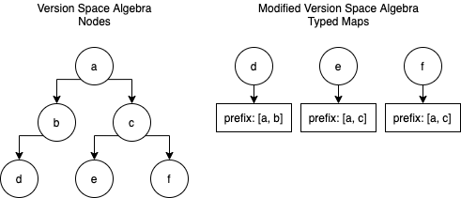
Version Space Algebra Synthesis
Version Space Algebra | Modified Version Space Algebra
Node | Typed Map
Values/Children | Types
Learn | Restructure
Intersect | Intersect
Union | Union

Slide 7
Types
Each Type acts a Struct that denotes possible types for a value:
Type {
array: Type | null
object: Typed Map | null
Types: Set of Single Value Types | null
}
Single Value Types: string, number, boolean, and null

Slide 8
Typed Maps
Typed Maps represent Unstructured Data for Keys with Concrete Values (Arrays, Single Value Types)
Instead of mapping the recursive structure of JSON, use dot “.” paths to denote structure
Typed Map = Map<key, {
prefix: List of Keys in dot “.” path
type: Type
}>
Typed Maps recover structure when serialized to Typed JSON

Slide 9
Limitations
Duplicate Key Restriction
Having duplicate keys that can be reached with a dot “.” path is illegal
No heuristic in VSA operations to determine which key to use
Loss of Semantic Keys
json-synthesizer only see keys as structural units, not semantic
Predefined schemas will lose information if not properly transformed
Limited Type Range
Semantic keys can sometimes denote complex types
However, only types in the JSON specification are in Type

Slide 10
Example: DynamoDB JSON
input:
{
'Surname': { 'S': 'Smith' },
'Members': {
'L': [
{
'M': {
'Name': { 'S': 'John' },
'Age': { 'N': '34' },
'Education': { 'S': 'GED' }
}
}
]
},
'Address': { 'S': '123 Mulberry Lane' },
'Count': { 'N': ‘1' }
}
output:
{
Surname: 'Smith’,
Members: [
{ Name: 'John’ },
],
Count: 1
}
Synthesized Typed JSON:
{
"Surname": {
"array": null,
"object": null,
"types": [
"string"
]
},
"Members": {
"array": {
"array": null,
"object": {
"Name": {
"array": null,
"object": null,
/* ... Too long to show on slide ... */
transform:
unmarshallDynamoJson
Unwraps Data Types, such as:
‘Surname’: {
‘S’: ‘Smith’
}
into
‘Surname’: ‘Smith’

Slide 11
Example: Generic JSON
input:
{
‘Pets’: [
{
‘Name’: ‘Fido’,
‘Type’: ‘Dog’,
‘Age’: 7,
‘Rescued’: false
},
{
‘Name’: ‘Polly’,
‘Type’: ‘Parrot’,
‘Age’: 2,
‘Color’: ‘Red’
}
]
}
output:
{
Other: {
Pets: [
{
‘Name’: ‘Name’,
‘Type: ‘Type’,
‘Age’: 0,
‘Rescued’: true
}
]
}
}
Synthesized Typed JSON:
{
"Other": {
"array": null,
"object": {
"Pets": {
"array": {
"array": null,
"object": {
"Name": {
"array": null,
"object": null,
"types": [
"string"
]
},
/* ... Too long to show on slide ... */
transform: None

Slide 12
Example: Multiple Input/Output Examples
Synthesized Typed JSON:
{
"Surname": {
"array": null,
"object": null,
"types": [
"string"
]
},
"Members": {
"array": {
"array": null,
"object": {
"Name": {
"array": null,
"object": null,
/* ... Too long to show on slide ... */
Combine the Input/Output Examples Lists and Transforms Lists from:
DynamoDB JSON
Generic JSON
As long as the duplicate key restriction is not broken, a new Type Interface will be synthesized

Slide 13
Evaluation
Test Suite
Transforms
Restructure Typed Maps
Intersect Types
Intersect Typed Maps
Union Types
Union Typed Maps
Evaluation of Unit Tests guarantees correctness for Generic JSON

Slide 14
Related Work
“Version Space Algebra and its Application to Programming by Demonstration” by Tessa Lau, Pedro Domingos, Daniel S. Weld
Canonical Paper on Version Space Algebra Synthesis
Explore Complex Program Spaces via Operations
“Error-Tolerant Version Space Algebra” by Eugene R. Creswick, Aaron M. Novstrup
“similar” heuristic operation may be useful for duplicate key restriction
Learning does not improve with repeated demonstration

Slide 15
Conclusion
json-synthesizer can synthesize Generic Type Interfaces from Input/Output Examples and Transforms
Representation-based search maps well to unstructured data
Modified Version Space Algebra with Typed Maps removes the complexity of tree structures
Implementation can be thoroughly tested to guarantee correctness

