Slide 1

Ocean Health Data: From Raw Data to Insights
Transforming ocean health data into actionable insights using Machine Learning and interactive visualizations for environmental stakeholders and policy makers.
Reinout Schols
Sophie Yam
2MA Statistics and Data Science | UHasselt | 12 Nov 2025

Slide 2
Strategy
Exploratory Data Analysis + cleaning
Try different Machine Learning Models and optimise the Models
Identify important features
Conclusions

Slide 3
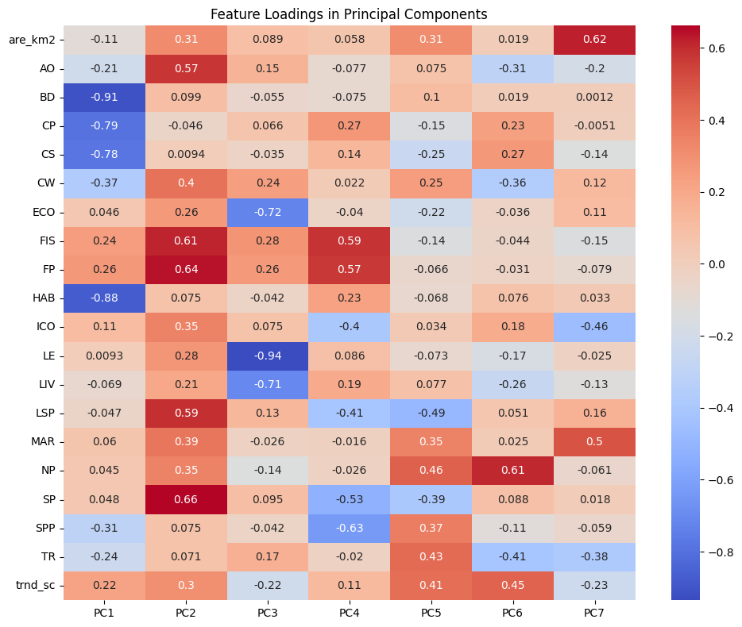
Exploratory Data Analysis : Principle Component Analysis
LIV : Livelihoods
ECO : Economies
SP : Sense of Place
SPP : Species
AO : Artisanal Fisheries
Are_km2 : surface area in km²

Slide 4
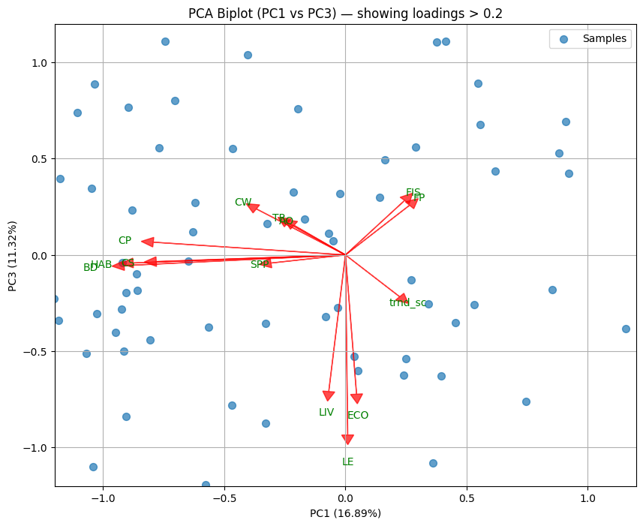
Exploratory Data Analysis : Biplot of PC1 and PC3
LIV : Livelihoods
ECO : Economies
SP : Sense of Place
SPP : Species
AO : Artisanal Fisheries
Are_km2 : surface area in km²
=> Focus on Clean Water

Slide 5
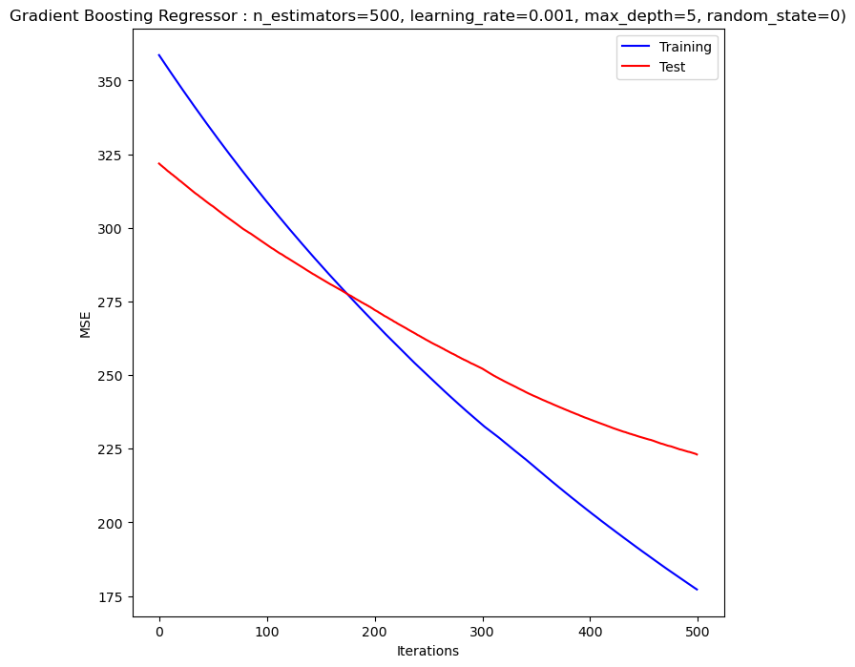
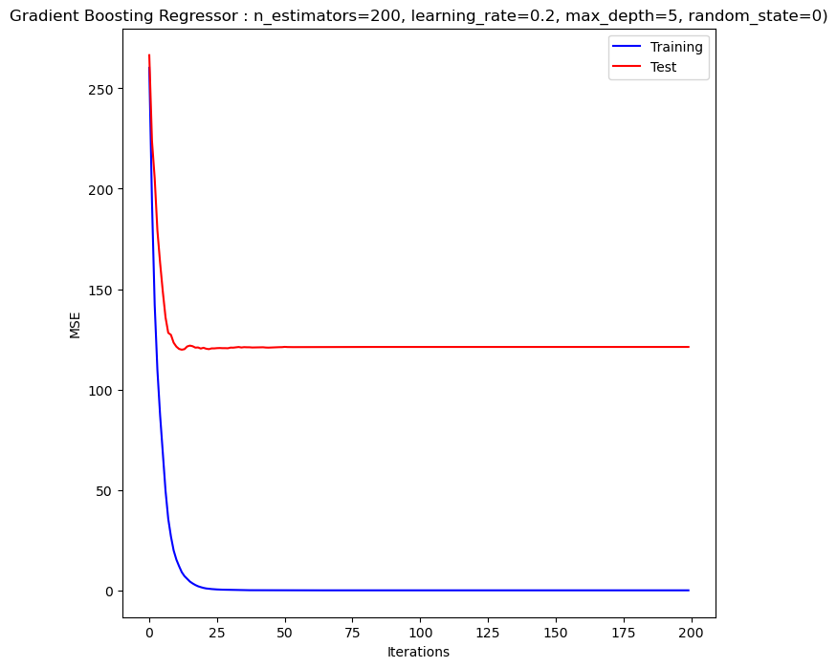
Different ML models evaluated
Hyperparameter
tuning
Model | Validation_Strategy | Hyperparameters | MSE
Decision Tree | K-fold = 5 | max_depth=3 | 205
Random Forest | 0.7/0.3 | n_estimators=500 | 122
Gradient Boosting Regressor | 0.7/0.3 | n_estimators=200, learning_rate=0.2, max_depth=5 | 121

Slide 6
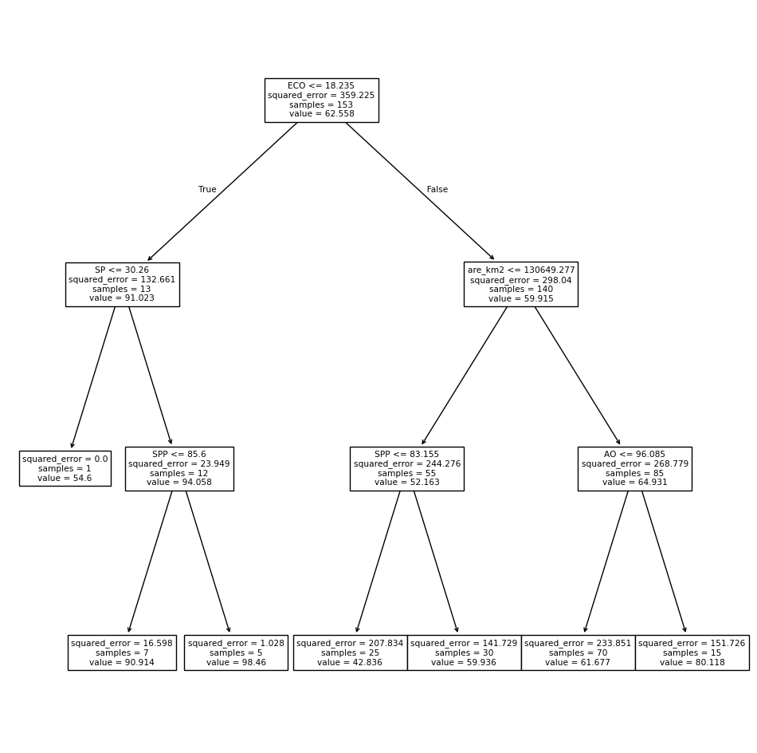
Decision Tree
Visualisation
Outcome : Clean Water
ECO : Economies
SP : Sense of Place
SPP : Species
AO : Artisanal Fisheries
Are_km2 : surface area in km²
Notes:
The concept of Sense of Place is a fundamental aspect of cultural geography, influencing how humans experience and interact with their environments.

