Slide 1
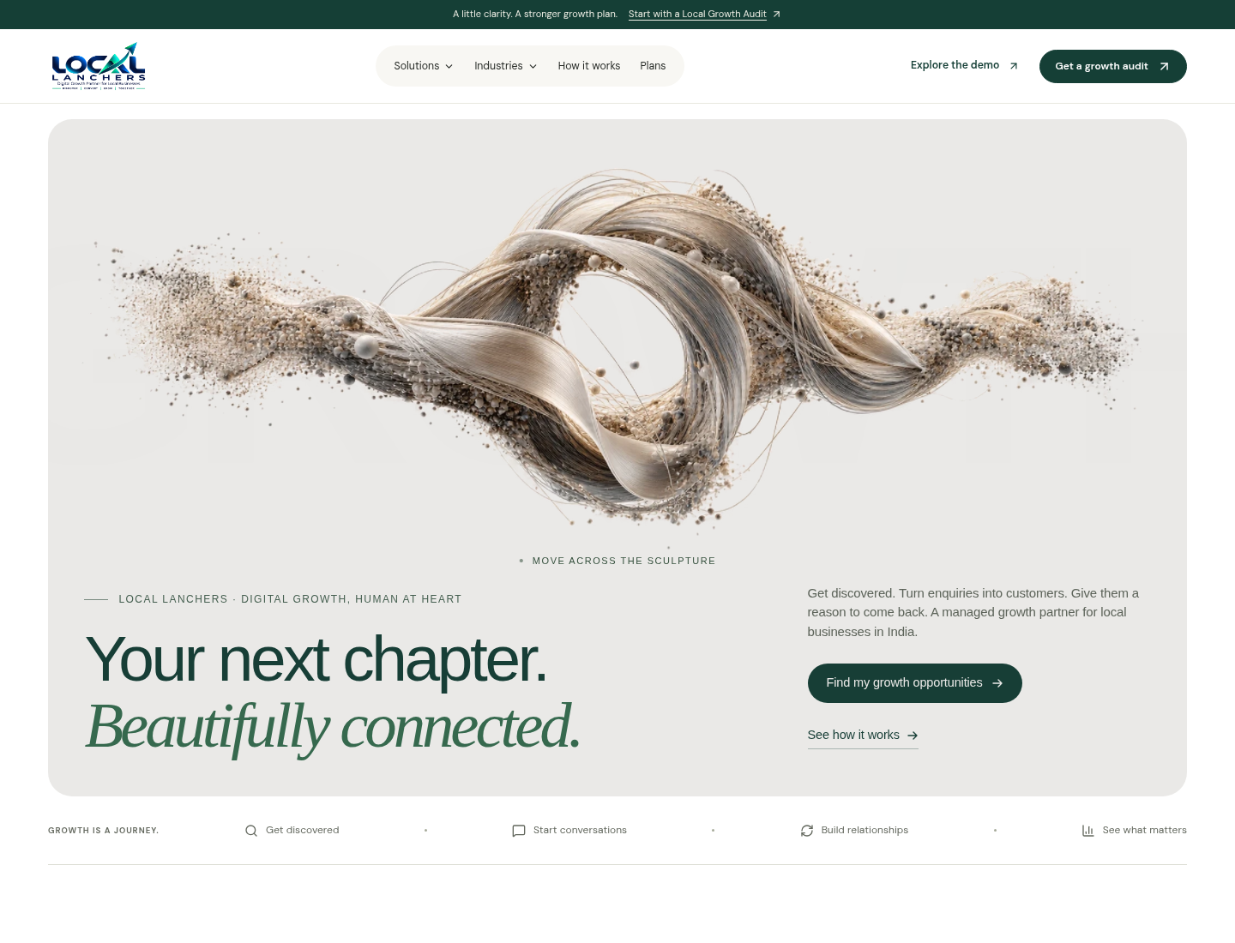
THE PROJECT GOAL
Local businesses. A clearer path to growth.
A practical guide to what customers see, what admins do, and what comes next.
DISCOVER → CONVERT → RETAIN
The customer is a
local business owner.
Current public site: an interactive preview.
Real intake and accounts need persistent hosting.
LOCAL LANCHERS / VERSION 2.2 / CUSTOMER + ADMIN JOURNEYS
01

Slide 2
01 / FIND YOUR WAY
One familiar navigation. Two working journeys.
The shared header serves visitors; workspace and operations serve different tasks.
Home + Solutions
Industries + Plans
/ · /growth
/industries · /plans
Understand the offer and four growth pillars.
Choose a sector and compare indicative options.
How it works + Audit
Demo + Footer
/how-it-works · /audit
/workspace · /ops
Understand delivery, then request a conversation.
Try workflows; admins use the private operations desk.
LOCAL LANCHERS / VERSION 2.2 / CUSTOMER + ADMIN JOURNEYS
02

Slide 3
02 / CUSTOMER JOURNEY
From interest to an agreed growth plan.
The audit starts a human conversation. It does not automatically book or charge the customer.
01
02
03
04
Understand
Choose a fit
Request an audit
Agree the work
Home → Solutions
Identify the main growth priority.
Industry → Process → Plans
Compare the approach and scope.
Business → Contact → Review
Submit when the backend is enabled.
Team follow-up → proposal
Confirm scope, access and terms manually.
A saved reference confirms receipt. Proposals, payments, scheduling and onboarding agreements remain outside the app.
LOCAL LANCHERS / VERSION 2.2 / CUSTOMER + ADMIN JOURNEYS
03

Slide 4
03 / WORKSPACE + ACTIVITY
Try the workflow. Understand the rhythm.
Growth overview · Enquiry desk · Review drafts · Visibility setup · Onboarding
AVAILABLE ON THE PUBLIC PREVIEW
FULL BACKEND WHEN ENABLED
Demo profiles
My real activity
No login needed. Choose “Act as”, perform practice actions, then inspect the heatmap. Filter by person, day or 30/90/365-day range.
Create an account or sign in. Your successful logins and workspace interactions form a private history. Clear history or delete the account when needed.
Quiet 0 · Light 1–2 · Steady 3–5 · Active 6–9 · Busy 10+ actions per day. Counts describe app usage, not growth.
LOCAL LANCHERS / VERSION 2.2 / CUSTOMER + ADMIN JOURNEYS
04

Slide 5
04 / ADMIN JOURNEY
Turn an audit request into a clear next step.
Open /ops and use the configured operations password. Customer accounts use a separate sign-in.
NEW
REVIEWING
CONTACTED
COMPLETED
Review the request
Prepare the audit
Follow up manually
Close the request
Check business details, priorities and permission to reply.
Review the opportunity and save useful internal notes.
Use an agreed channel outside the app. Record the outcome.
Save the final status and next step; export the queue if needed.
The operations desk does not manage customer passwords, organization roles, subscriptions or all users’ heatmaps.
LOCAL LANCHERS / VERSION 2.2 / CUSTOMER + ADMIN JOURNEYS
05

Slide 6
05 / REACH THE GOAL
Launch the service. Then grow the software.
A sensible sequence from the current preview to a working growth operation.
FIRST
NEXT
THEN
Enable real intake
Run a small pilot
Connect and measure
Persistent storage, HTTPS and secure team access. Test saved requests and account sign-in. Finalize privacy and support details.
Manually deliver audit → proposal → onboarding → review. Prove the workflow with a focused group of local businesses.
Connect authorized providers. Measure qualified enquiries, attended bookings, repeat visits and revenue from real source data.
LOCAL LANCHERS / VERSION 2.2 / CUSTOMER + ADMIN JOURNEYS
06

