Slide 1
BLUESTOCK
Mutual Fund Analytics
End-to-End Data Analytics & Business Intelligence
DATA ANALYST INTERNSHIP SUBMISSION
Python | SQL | SQLite | Power BI | Github
Presented by - Manthri Syama Chandrika

Slide 2
Problem & Objective
2
Turning fragmented mutual-fund data into decision-ready analytics.
THE CHALLENGE
THE OBJECTIVE
Mutual-fund data is distributed across fund, NAV, AUM, SIP, investor, portfolio and benchmark datasets. Without a unified workflow, comparison and insight generation become difficult.
Build an end-to-end analytics platform that ingests, cleans, validates, analyzes and visualizes mutual-fund data for industry, performance, risk and investor insights.
ANALYTICS JOURNEY
01
02
03
04
Data
ETL
Analytics
BI
10 core CSVs + API
Clean • validate • transform
SQL • EDA • financial metrics
Power BI • insights
BLUESTOCK MUTUAL FUND ANALYTICS • DATA ANALYST INTERNSHIP SUBMISSION

Slide 3
Data Sources
3
10 core datasets covering the mutual-fund ecosystem, plus selected NAV API data.
Fund Master
NAV History
Scheme attributes, category, plan, expense ratio
Daily NAV for historical performance
AUM by Fund House
Monthly SIP Inflows
AMC-level assets and scheme counts
SIP inflow, accounts and SIP AUM
Category Inflows
Industry Folio Count
Monthly category-level net inflows
Total, equity, debt, hybrid folios
Scheme Performance
Investor Transactions
Returns, risk metrics, AUM, rating
Amount, geography, demographics, KYC
Portfolio Holdings
Benchmark Indices
Stock, sector, weight and market value
Market index closing values
BLUESTOCK MUTUAL FUND ANALYTICS • DATA ANALYST INTERNSHIP SUBMISSION

Slide 4
End-to-End ETL & Analytics Architecture
4
A reproducible pipeline from raw data to interactive business intelligence.
01
SOURCES
CSV datasets + mfapi.in
02
EXTRACT
Python / Pandas
03
TRANSFORM
Date parsing • deduplication • validation • standardization
04
LOAD
Processed CSVs → SQLite via SQLAlchemy
05
ANALYZE
SQL • EDA • performance • risk • investor analytics
06
PRESENT
Power BI dashboard → report & presentation
BLUESTOCK MUTUAL FUND ANALYTICS • DATA ANALYST INTERNSHIP SUBMISSION

Slide 5
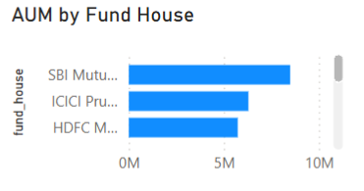
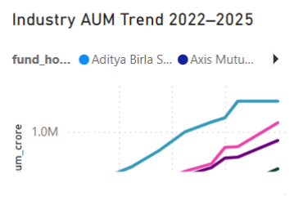
EDA — Industry Overview
5
Exploring AUM, SIP activity, category flows and investor participation.
AUM GROWTH
SIP INFLOWS
FOLIO GROWTH
Grouped by fund house and year (2022–2025) to identify scale and changes in AMC-level assets.
Monthly SIP trend from Jan 2022–Dec 2025, including YoY growth and peak inflow monitoring.
Industry folio count trend used as a proxy for investor participation and market reach.
INDUSTRY CONTEXT
The project tracks industry-scale indicators alongside fund-level performance, connecting market growth with investor behavior.
BLUESTOCK MUTUAL FUND ANALYTICS • DATA ANALYST INTERNSHIP SUBMISSION

Slide 6
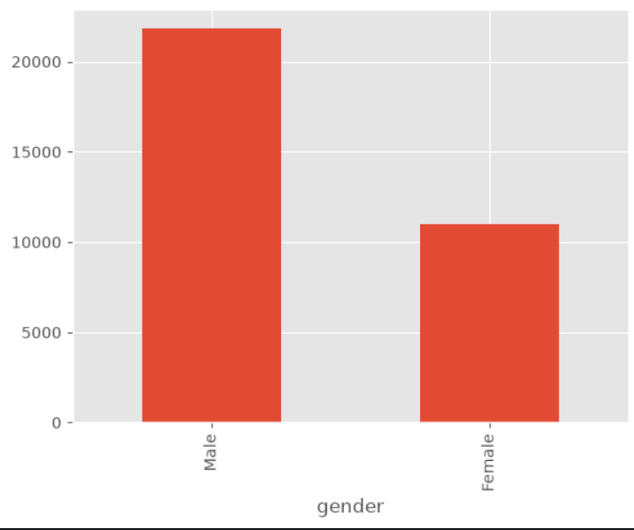
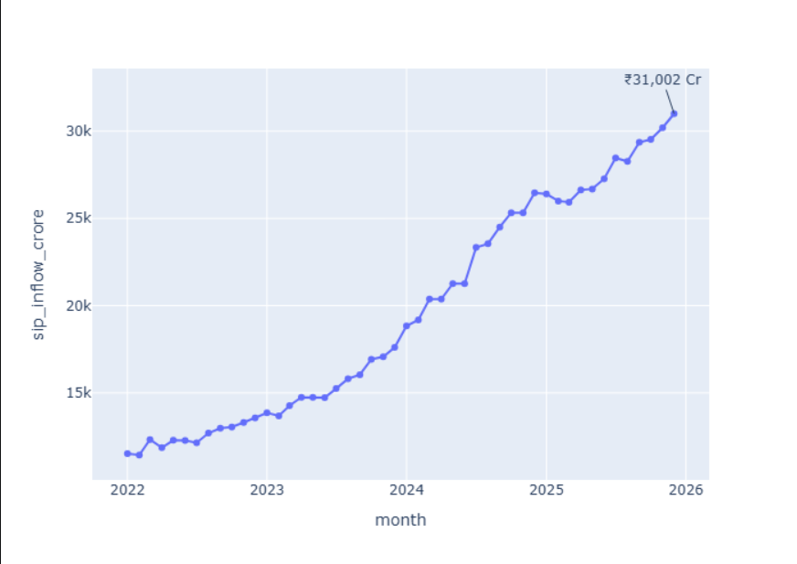
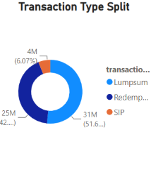
EDA — Investor Analytics
6
Understanding who invests, how much they invest and where activity is concentrated.
DEMOGRAPHICS
GEOGRAPHY
TRANSACTIONS
Age-group distribution and gender split provide a high-level view of investor composition.
Transaction amount by state and T30 vs B30 city tier highlight geographic concentration.
SIP, Lumpsum and Redemption activity is compared across time and investor segments.
TRANSACTION TYPES
BLUESTOCK MUTUAL FUND ANALYTICS • DATA ANALYST INTERNSHIP SUBMISSION

Slide 7
Fund Performance Analytics
7
40 schemes evaluated using return, risk-adjusted performance and drawdown metrics.
Daily Return
CAGR
Sharpe
Sortino
NAVt / NAVt-1 − 1
(End / Start)^(1/n) − 1
(Rp − Rf) / Std(Rp) × √252
Downside-risk adjusted return
Alpha
Beta
Max Drawdown
Annualized regression intercept
Sensitivity to benchmark
Peak-to-trough decline
FUND SCORECARD — 0–100
30% 3Y Return Rank • 25% Sharpe • 20% Alpha • 15% Expense Ratio (inverse) • 10% Max Drawdown (inverse)
BLUESTOCK MUTUAL FUND ANALYTICS • DATA ANALYST INTERNSHIP SUBMISSION

Slide 8
Advanced Risk & Portfolio Analytics
8
Moving beyond returns to quantify downside risk, consistency and concentration.
95% HISTORICAL VaR
CVaR
ROLLING 90-DAY SHARPE
5th percentile of daily returns. Estimates the historical downside threshold under the observed return distribution.
Mean of returns below the VaR threshold. Captures the severity of losses in the tail.
Rolling mean / rolling standard deviation × √252. Five key funds monitored over time.
SECTOR HHI
SIP CONTINUITY
FUND RECOMMENDER
Σ(weight²) measures concentration. Higher HHI indicates a more concentrated equity portfolio.
Investors with 6+ SIPs analyzed by average gap; >35 days flagged as potentially at-risk.
Risk appetite → matching risk grade → top 3 funds by Sharpe Ratio. Analytical demonstration, not financial advice.
BLUESTOCK MUTUAL FUND ANALYTICS • DATA ANALYST INTERNSHIP SUBMISSION

Slide 9
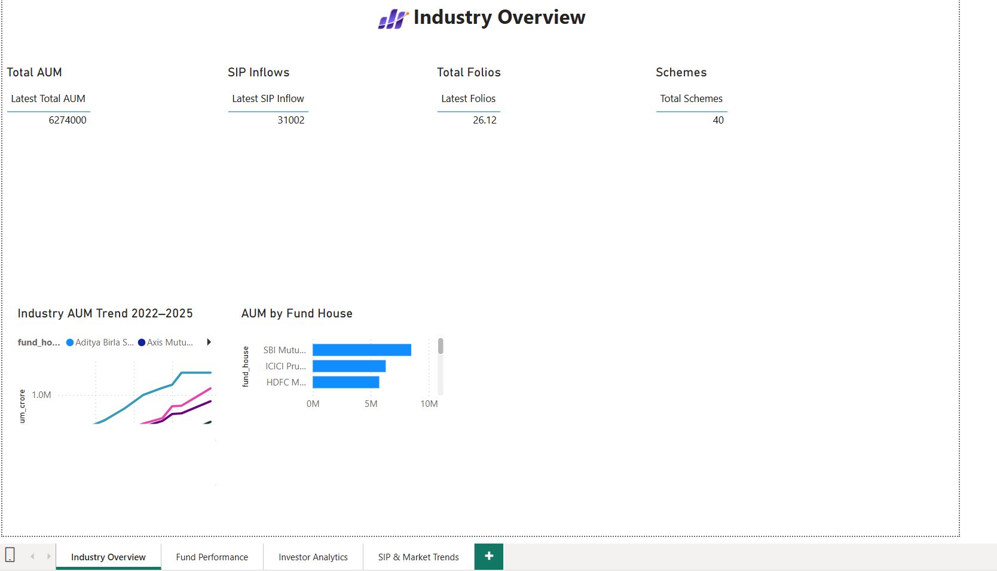
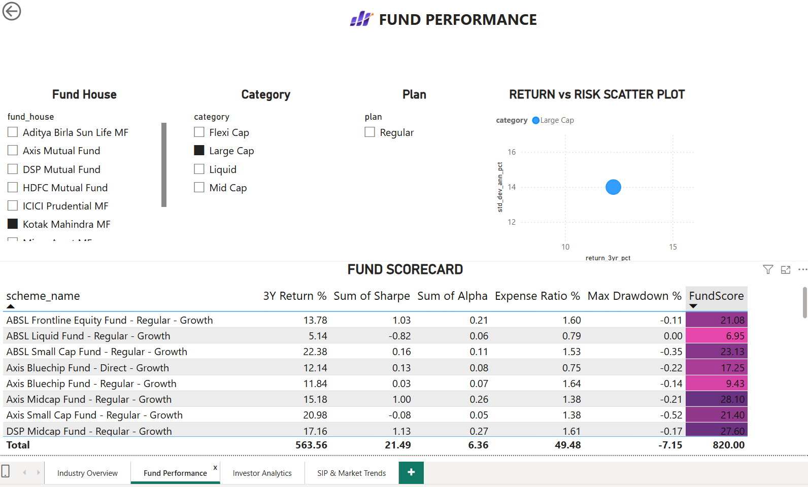
Power BI Dashboard — Industry & Performance
9
Interactive decision layer built on the cleaned analytical data.
PAGE 1 • INDUSTRY OVERVIEW
PAGE 2 • FUND PERFORMANCE
INTERACTIVITY
Slicers • Tooltips • Drill-through • Fund-level filtering
BLUESTOCK MUTUAL FUND ANALYTICS • DATA ANALYST INTERNSHIP SUBMISSION

Slide 10
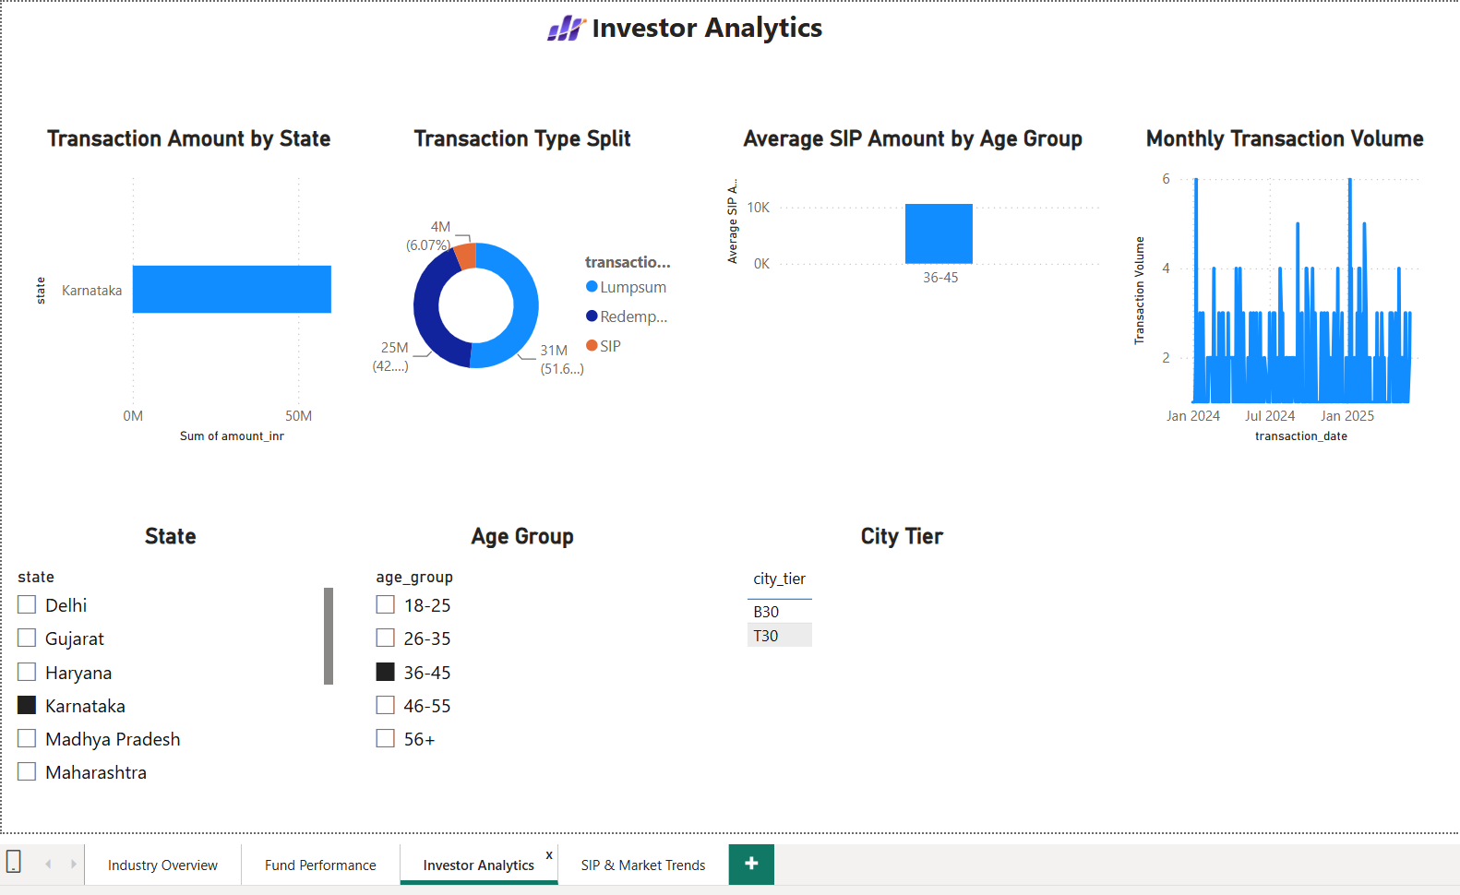
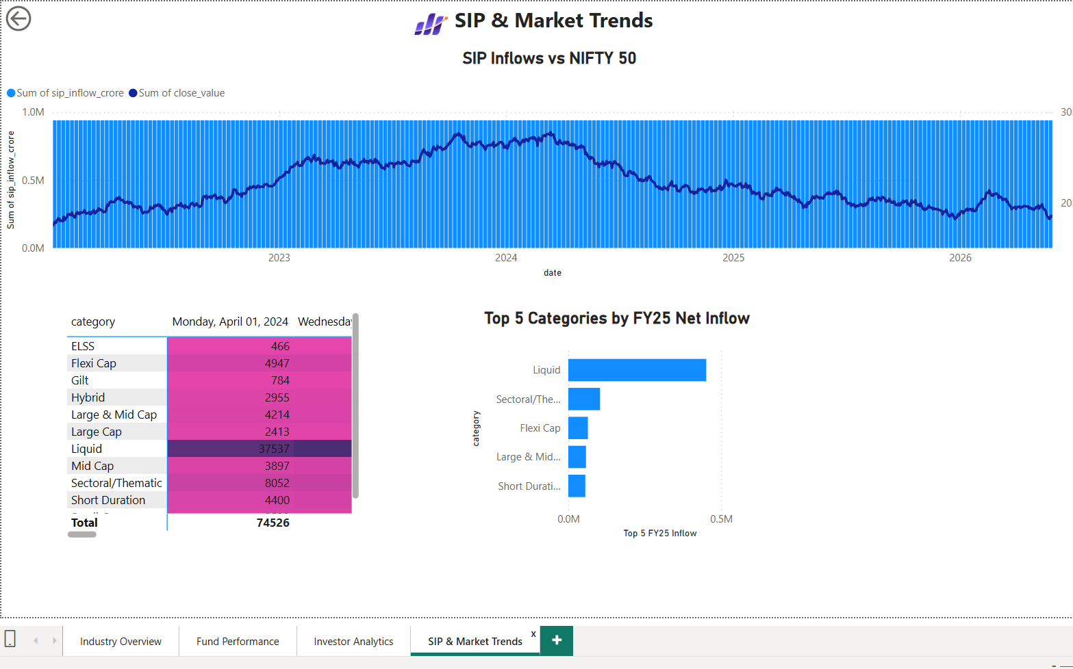
Power BI Dashboard — Investor & Market Trends
10
Two pages connect investor behavior with SIP and market-level trends.
PAGE 3 • INVESTOR ANALYTICS
PAGE 4 • SIP & MARKET TRENDS
BLUESTOCK MUTUAL FUND ANALYTICS • DATA ANALYST INTERNSHIP SUBMISSION

Slide 11
Key Findings & Recommendations
11
What the analytics framework enables an analyst or business user to see.
Performance
RECOMMENDATION
Return alone is insufficient; risk-adjusted measures such as Sharpe and Sortino improve fund comparison.
Build decisions around return + risk + cost + benchmark context; use SIP continuity to identify potential retention opportunities; monitor concentrated portfolios.
Industry Growth
AUM, SIP and folio trends provide complementary views of industry scale and investor participation.
Investor Behavior
Age, geography, city tier and transaction type reveal meaningful differences in investment activity.
NEXT STEP
Risk
VaR, CVaR, drawdown and rolling Sharpe quantify downside risk and consistency.
Automate refreshes, move to cloud storage, add ML-based investor churn / fund analytics, and improve the recommender with investor goals and horizon.
Portfolio
HHI highlights differences in sector concentration across equity funds.
BLUESTOCK MUTUAL FUND ANALYTICS • DATA ANALYST INTERNSHIP SUBMISSION

Slide 12
Conclusion
A complete analytics workflow was developed—from raw mutual-fund data and ETL to financial analytics, risk measurement and interactive Power BI reporting.
10 core datasets
40 schemes analyzed
SQLite + SQL
Financial & risk analytics
Power BI dashboard
GitHub project
Presented by - Manthri Syama Chandrika

