Slide 1
REMINDER We are here to remind…!!
Syamala Reddy Arimanda
Swathi Boyanapalli
Vinod Kumar Vakalapudi
Rayan Katib Faruq

Slide 2
Motivation:
Our application is designed to benefit all kinds of users irrespective of their field, say business, education, entertainment, etc.

Slide 3
Functionality:
Our application is here to remind about all the daily stuff along with the special events based on resources like
Weather
Location
Blackboard
Social networking

Slide 4
Services Used:
Bluemix Services:
Mobile Data
Mobile Cloud
Android

Slide 5
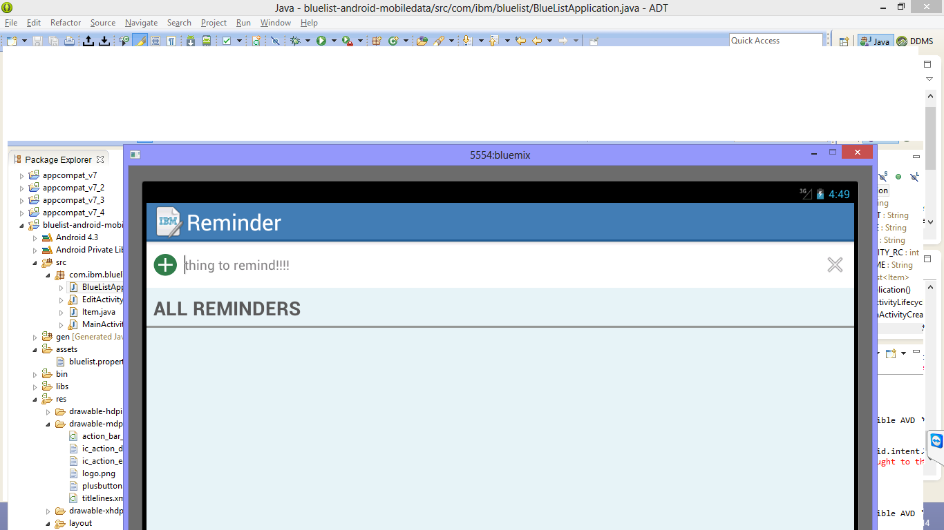
Features of our app:

Slide 6
Based on Location:
Our app can be used based on the location also, i.e. it reminds us the various events or occasions that were held at different locations.
Example:
1. Soccer At CHIEF Stadium in Kansas City on May 26th 2015.
2. India Fest at Convention Center in Kansas City on December 14th 2015.

Slide 7
Based on Weather:
Our app can be used based on the weather also, i.e. it reminds us what are the precautions that should be taken in different types of climate.

Slide 8
Based on blackboard
Our application synchronizes the blackboard and reminds the students about the class schedule, assignment submission , exams etc.

Slide 9
Based on Social Networking
Reminds about the birthdays or special events of our friends from the social networking sites.

Slide 10
THANK YOU

