Slide 1

Title : An Advanced Security Framework for Active and Passive Reconnaissance
Mentor : Mrs. P Madhavi Latha
Assistant Professor, Department of CSE(CS)
Project Team Members
K. Prudhvi (21ME1A4628)
M. Syam Babu (21ME1A4635)
P. Karun Kumar (21ME1A4664)
P. K. Satya Prasad (22ME5A4642)

Slide 2

Contents
Abstract with keywords
Introduction and Background
Problem Statement and Objectives
Literature Survey
Existing / Traditional system
Methodology / Proposed System
Hardware & Software Requirements
Design & Implementation
Results & Observations
Advantages
Conclusion
References

Slide 3
Abstract
Abstract In the ever-evolving landscape of web security, identifying and mitigating vulnerabilities is crucial. This project presents a comprehensive framework that integrates URL extraction, subdomain analysis, and advanced vulnerability testing into a single, user-friendly GUI-based platform. Unlike traditional tools, which often rely on either brute-forcing or passive information gathering, our framework combines both approaches seamlessly. It automates the discovery of subdomains, directory fuzzing, and URL extraction, making it an efficient reconnaissance tool. Furthermore, it facilitates SQL Injection, Cross-Site Scripting (XSS), and Command Injection testing to uncover potential security weaknesses. With a modular and scalable design, the tool allows customization to adapt to emerging threats, ensuring flexibility and efficiency in web application security. The automated reporting feature enhances security workflows, making it a powerful alternative to existing solutions that lack simultaneous passive and active scanning capabilities. By bridging this gap, our framework provides a robust, adaptable, and effective solution for penetration testers and security professionals.
Keywords: Web Security, Vulnerability Testing, URL Extraction, Subdomain Analysis, Reconnaissance Tool, Brute-Forcing, Passive Information Gathering
,

Slide 4
Introduction & Background
The exponential growth of web technologies has transformed the way organizations operate, communicate, and deliver services. As web applications continue to evolve and become more dynamic and interconnected, their exposure to security threats and vulnerabilities also increases. Cyberattacks targeting web applications are a major concern in modern computing, as they can lead to data breaches, financial losses, and damage to organizational reputation. Therefore, securing web applications is a critical aspect of software development and deployment.
To address these concerns, automated vulnerability scanning tools play a vital role in identifying and mitigating common web-based security issues.
This project introduces a Web Application Vulnerability Scanner that aims to provide an efficient, user-friendly, and accessible solution for detecting security flaws. The system is built using Html ,Css for its graphical user interface (GUI) and Flask as the backend framework, enabling smooth interaction between users and the core scanning functionalities.
The scanner targets four primary categories of vulnerabilities: SQL Injection (SQLi), Cross-Site Scripting (XSS), Directory Traversal, and Subdomain Enumeration.

Slide 5
Problem statement
As web applications become increasingly complex and integral to business operations, they also become prime targets for cyberattacks. Common vulnerabilities such as SQL Injection (SQLi), Cross-Site Scripting (XSS), Directory Traversal, and insecure subdomain configurations can be exploited by attackers to gain unauthorized access, manipulate data, or disrupt services. Despite the availability of some security tools, many existing vulnerability scanners are either too complex for average users, lack support for customization, or do not provide real-time feedback during scans.
Moreover, integrating scanning capabilities with a responsive user interface while maintaining performance and modularity remains a challenge. There is a need for a system that not only automates the detection of critical web vulnerabilities but also provides a user-friendly and interactive platform for managing scans, monitoring progress, and analyzing results.
This project aims to solve these issues by developing an interactive web vulnerability scanner using Html,Css for the GUI and Flask for the backend. The system will enable users to efficiently detect, understand, and manage potential security threats within web applications through a modular, extensible, and easy-to-use platform.

Slide 6
Proposed Solution
To address the challenges of web application security testing, this project proposes an interactive vulnerability scanner built using Html and Css for the graphical user interface and Flask for the backend.
The system enables users to easily initiate and manage scans for common web vulnerabilities such as SQL Injection, Cross-Site Scripting, Directory Traversal, and Subdomain Enumeration.
It offers a modular design with support for uploading custom payloads, real-time scan monitoring, and structured result visualization. By incorporating multi-threading and asynchronous I/O.
The tool ensures high performance and responsiveness. Additionally, it provides features for secure file handling and scan log storage, making it both efficient and user-friendly for developers and security professionals.

Slide 7
Objectives of the Proposal
The primary objective of this project is to design and implement an interactive, user-friendly web application vulnerability scanner that can effectively detect common security flaws in web applications. The system aims to:
Identify critical vulnerabilities such as SQL Injection, Cross-Site Scripting, Directory Traversal, and Subdomain Enumeration.
Provide a graphical user interface (GUI) using PyQt5 for ease of use and intuitive interaction.
Utilize Flask as the backend to manage scanning logic and enable seamless communication between components.
Ensure real-time scan monitoring, structured result display, and secure handling of payloads and logs.
Promote modularity and extensibility for easy maintenance and future enhancements.

Slide 8
Literature Survey (Research on existing solutions and concepts)
Sl. # | Reference | Objective | Method | Key Findings | Relevance
1 | OWASP ZAP | To detect security vulnerabilities in web applications through automated scanning | Uses active and passive scanning, spidering, and scriptable test cases | Efficient in identifying common web flaws such as XSS and SQLi; highly extensible | Foundation for understanding key scanning principles and techniques
2 | Burp Suite | To offer professional-grade tools for penetration testing of web apps | Integrates scanning, intercepting proxy, and advanced testing modules | Powerful manual and automated testing; widely used in industry | Demonstrates need for GUI and modular architecture for usability
4/19/2025
4

Slide 9
Sl. # | Reference | Objective | Method | Key Findings | Relevance
3 | Nikto | To check for outdated server software and common vulnerabilities | Performs tests against web servers for dangerous files/CGIs and outdated versions | Fast scanning; lightweight; limited to server misconfigurations | Highlights gap in modern web app testing, supporting need for advanced payload-based scanning
4 | Wapiti | To provide black-box scanning for detecting common web vulnerabilities | Crawls web applications and injects payloads to find vulnerabilities like XSS, SQLi | Detects vulnerabilities without access to source code | Informs the concept of black-box scanning used in the proposed system
4/19/2025
4

Slide 10
Sl. # | Reference | Objective | Method | Key Findings | Relevance
5 | SQLMap | To automate detection and exploitation of SQL injection flaws | Command-line tool; injects payloads to exploit SQLi on URLs, forms, headers | Extremely accurate in SQLi detection and database takeover | Motivates inclusion of powerful payload-based scanning in custom GUI
6 | Acunetix | To deliver enterprise-grade automated web vulnerability scanning | Uses advanced crawling and AI-powered vulnerability detection | High-speed scanning with accurate vulnerability reports | Reinforces importance of result visualization and scan performance optimization in custom tool

Slide 11
Existing / Traditional system
Currently, several web application vulnerability scanners are widely used by security professionals and developers to detect and assess vulnerabilities. These systems range from open-source tools to commercial solutions, each offering different levels of automation, accuracy, and usability.
OWASP ZAP (Zed Attack Proxy)
OWASP ZAP is a popular open-source tool designed for finding vulnerabilities in web applications. It provides active and passive scanning, a proxy for intercepting traffic, and supports various scripting options. However, the user interface can be overwhelming for beginners, and it lacks real-time collaboration or customizable GUI features.
Burp Suite Burp Suite is a commercial-grade vulnerability scanner that offers both manual and automated testing tools. It is known for its advanced scanning engine and robust features like intruder, repeater, and sequencer. While effective, its full functionality requires a paid license and may be complex for basic users.
Nikto Nikto is a command-line based web server scanner that checks for outdated software, misconfigurations, and known vulnerabilities. Although lightweight and fast, it focuses mostly on surface-level issues and lacks deep payload-based scanning.
Wapiti Wapiti is a black-box scanner that identifies vulnerabilities like XSS, SQL injection, and file disclosure without accessing the source code. It is open-source and supports several testing techniques but lacks a modern GUI and real-time result tracking.

Slide 12
Drawbacks in Existing Systems
Not easy to use – Most tools use command-line interface, which is hard for beginners to understand.
Covers only a few vulnerabilities – One tool can detect only specific issues. You need multiple tools to scan everything.
Hard to add custom test inputs (payloads) – Users cannot easily upload or use their own payloads to test.
Slow and uses a lot of resources – Some scanners take a long time to scan and slow down the system.
No live scan progress – Users have to wait until the scan finishes to see results. No real-time updates.
Not flexible or easy to update – The code is not modular, making it hard to add new features or fix problems.
Poor file and log handling – Cannot safely upload files or save and view previous scan results easily.

Slide 13
Methodology / Proposed System
Our methodology follows a systematic workflow to deliver a comprehensive web security scanning solution.
The process begins with thorough research and analysis of existing tools, identifying key gaps in usability and functionality. Based on these findings, we designed a modular architecture with an intuitive HTML/CSS frontend interface coupled with a powerful Flask backend.
The scanning workflow progresses through three key phases:
reconnaissance (combining passive subdomain enumeration from sources like crt.sh with active DNS brute-forcing, along with comprehensive URL extraction through web scraping and Wayback Machine integration).
vulnerability assessment (employing specialized techniques for SQL injection, XSS, and directory traversal detection), and real-time reporting (displaying live results through Server-Sent Events while maintaining detailed logs).
Throughout development, we implemented multithreading for efficiency and conducted rigorous testing on vulnerable testbeds to validate accuracy. The final solution addresses critical industry needs by offering an all-in-one scanning platform with beginner-friendly GUI, immediate results during scans, and flexible payload support - making advanced web security assessment accessible to users of all skill levels while maintaining enterprise-grade detection capabilities. The entire system is optimized for cross-platform deployment across Windows, Linux and macOS environments

Slide 14
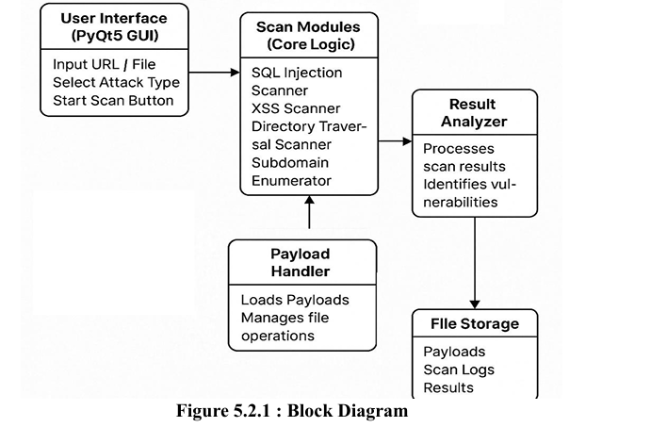
Block Diagram/Flow Chart

Slide 15
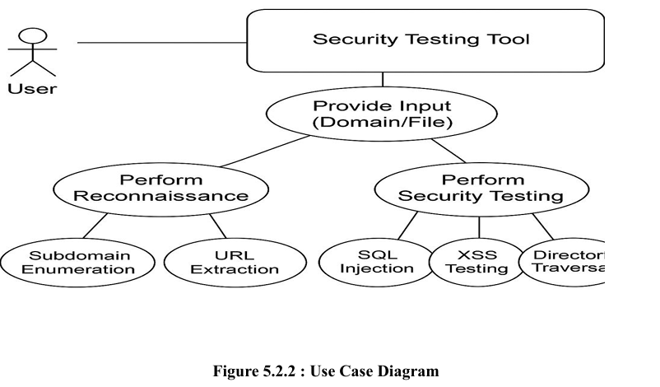
Block Use Case Diagram

Slide 16
Hardware & Software Requirements
Hardware Components:
2.Software Requirements:
Component | Minimum Requirement
Processor | Intel Core i3 or equivalent
RAM | 4 GB (8 GB recommended)
Hard Disk | 250 MB of free space
Display | 1024x768 resolution or higher
Internet Connection | Required for live scanning (optional)
Component | Details
Operating System | Windows 10/11, Linux, or macOS
Programming Language | Python 3.7 or above.
Python Libraries | Flask, Requests, Threading, Socket, Subprocess, etc.
IDE/Text Editor | Visual Studio Code / PyCharm / Any Python-compatible IDE
Web Browser | Google Chrome / Mozilla Firefox (for testing scanned websites)

Slide 17
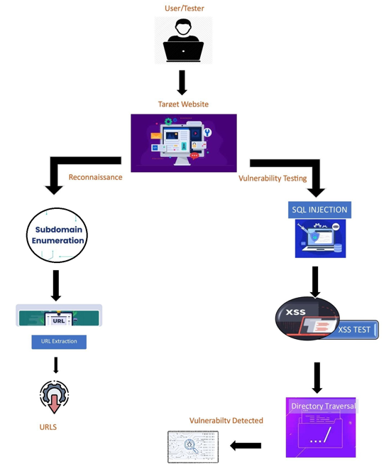
Design & Implementation

Slide 18
Implementation
User/Tester begins analysis on a Target Website
Reconnaissance Phase:
Subdomain Enumeration
URL Extraction
Vulnerability Testing Phase:
SQL Injection
XSS (Cross-Site Scripting)
Directory Traversal
Result: Vulnerabilities Identified and Reported
4/19/2025
18

Slide 19
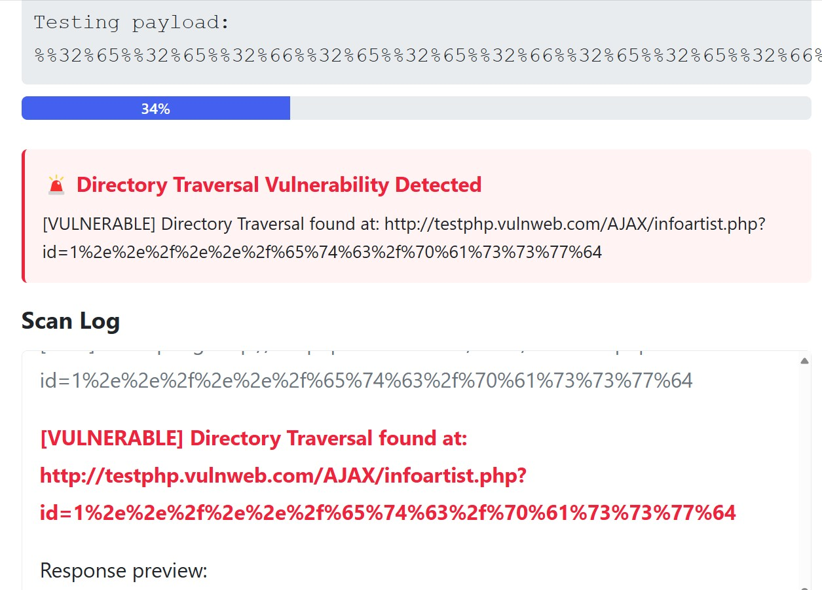
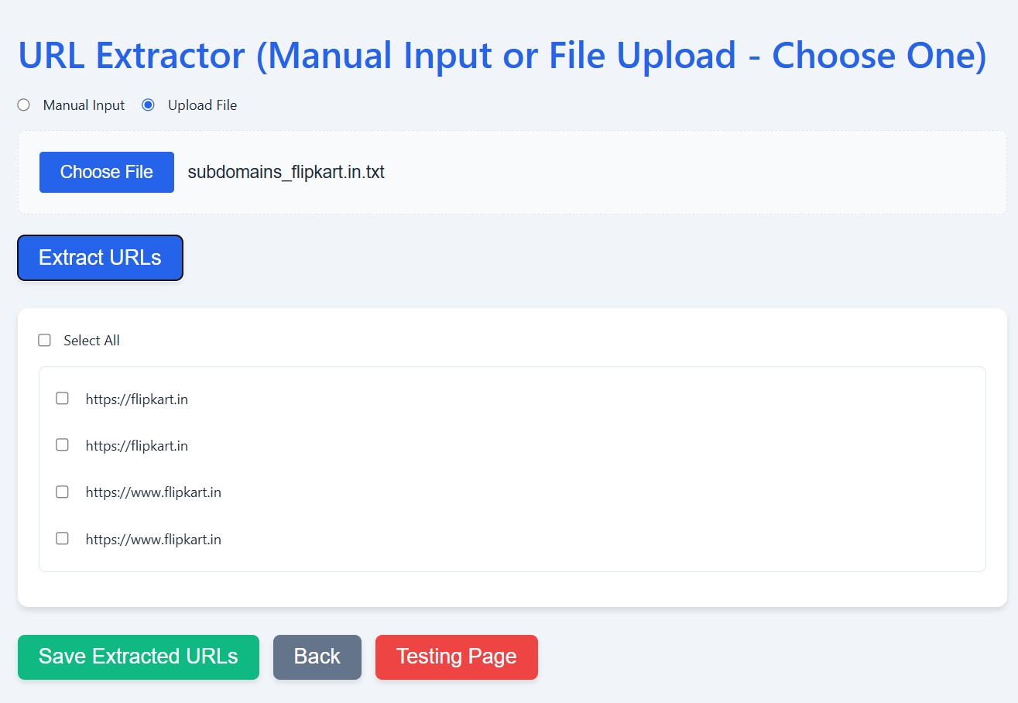
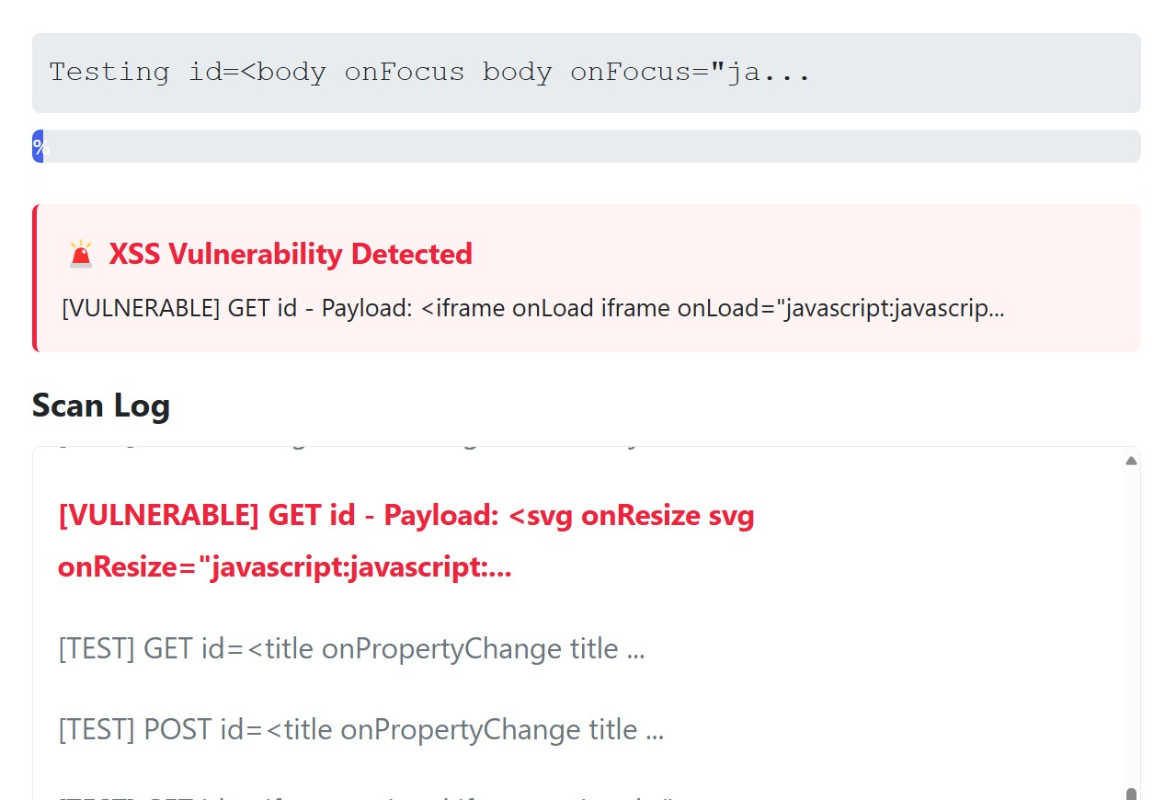
Results & Observations
Figure: Directory Traversal Detected
Figure:Urls Extracted
Figure: XSS Detected

Slide 20
Results & Observations
The developed web application vulnerability scanner performed effectively in identifying various security flaws, including SQL Injection, Cross-Site Scripting (XSS), Directory Traversal, and Subdomain Enumeration. The graphical user interface made the system easy to use, allowing users to select scan types, upload custom payloads, and view results in real time.
During testing, the scanner accurately detected vulnerabilities and displayed the results in a clear and structured format. Real-time progress updates helped users monitor the scanning process without delays.
The system also generated and stored log files automatically, enabling users to review past scans when needed. Multi-threading ensured that the application remained responsive throughout, even during extended scans. Overall, the scanner proved to be a reliable, efficient, and user-friendly tool for web vulnerability detection.

Slide 21
Advantages
Easy-to-use interface with buttons and clear layout
Shows scan progress in real time
Allows uploading of custom payloads
Finds common web issues like SQL Injection and XSS
Saves scan results as log files
Works fast and doesn’t freeze during scans
Easy to update or add new features
Can run on any system with Python (Windows, Linux, macOS)

Slide 22
Conclusion
In conclusion, the proposed web application vulnerability scanner provides an easy-to-use and effective solution for detecting common security issues like SQL Injection, XSS, Directory Traversal, and Subdomain Enumeration With a user-friendly interface and into a Framework with real-time scanning, and support for custom payloads, the system makes it simple for users to test web applications for vulnerabilities. The modular design, fast performance, and ability to save logs make the tool useful for both beginners and professionals. Overall, the project successfully meets its goal of creating a flexible, efficient, and accessible vulnerability scanning system.

Slide 23
References
OWASP Foundation. OWASP Top 10 – Web Application Security Risks. https://owasp.org/www-project-top-ten
SQLMap Project. Automatic SQL Injection and Database Takeover Tool. https://sqlmap.org
PortSwigger. Cross-site scripting (XSS). https://portswigger.net/web-security/cross-site-scripting
Flask Documentation. Flask Web Framework. https://flask.palletsprojects.com
Nikto Web Scanner. Open Source Web Server Scanner. https://cirt.net/Nikto2
Sublist3r. Subdomain Enumeration Tool. https://github.com/aboul3la/Sublist3r
Gupta, B., Badve, O. (2015). Web Application Vulnerability Detection Using Static and Dynamic Analysis: A Review. IEEE International Conference on Information Processing (ICIP), 604-609.

Slide 24



