Slide 1
CATERPILLAR TUBE PRICING
Syam Dokuparthi
Praveen Bollampalli

Slide 2
Project Description
Caterpillar company would like to determine the prices a supplier would quote for the given tube assembly and challenged this competition (30,000$ prize) for the price prediction so that caterpillar could quote the amount for a profitable business.
The dataset is comprised of a large number of relational tables distributed in 21 files that describes the physical properties of tube assemblies.

Slide 3
Top method
Winner of the competition implemented XG Boost algorithm in Python
XG boost algorithm is implemented with Linear Regression and Linear Booster model for price prediction.
The winner would had expected that the features he used in model would influence the price prediction linearly.
Preprocessing, features selection, prediction model iterating for 30 times, averaging the predictions.
RUNTIME – 426.04S in Python

Slide 4
Our method
Implementation 1 (Ensemble method in Matlab):
Ensemble method with Bagging technique with Tree as learner is used in our implementation.
For this problem statement Regression Technique is best fit solution approach.
Bagging Technique replicates the Training dataset and decision trees are grown on these replicas. Test data is fitted in this tree model and response is predicted from this trained model taking an average over predictions from individual trees. 200 Learn Rate
Data preprocessing, features selection, mapping attributes, prediction model implemented with Ensemble method.
RUNTIME - 276 sec in Matlab

Slide 5
Our method
Implementation 2 (XGBoost Algorithm in R):
XGBoost algorithm is implemented with Linear Regression and Tree Booster for price prediction which we felt is similar to our Matlab Implementation.
A Model Frame is developed generating a Formula with features of the Train and Test dataset.
A Sparse Matrix is generated with the Train and Test Model Frame.
XGBoost is applied on the Train Sparse Matrix (200 Learn Rate) to generate the Tree model and Test Sparse Matrix is fitted in this Tree model to predict the response.
Data preprocessing, features selection, mapping attributes, prediction model implemented with XGBoost algorithm for 50 iterations, averaging the predictions.
RUNTIME - 741 sec in R

Slide 6
Discussions and Observations
We tried to implement Linear Regression & Gaussian Regression in Matlab but we found the predicted price we obtained is negative values for some fields in predicted response.
Data Preprocessing would help in building the correct training data and simple prediction model.
Feature selection plays a key role in the regression model for accuracy in results.
We tried to implement XGBoost in Python & Random Forest in R but we faced some issues. If we have chance we will implement our solution with above algorithms & will improve our accuracy.

Slide 7
Contribution
We did the every step of our process together right from Data preprocessing, Solution implementation in Matlab & R till Improving accuracy with Feature selection.
We discussed the methodologies together and implemented the solution and our discussion helped each other a lot for resolution of issues we faced.
Contributions: Syam :50 %, Praveen 50%

Slide 8
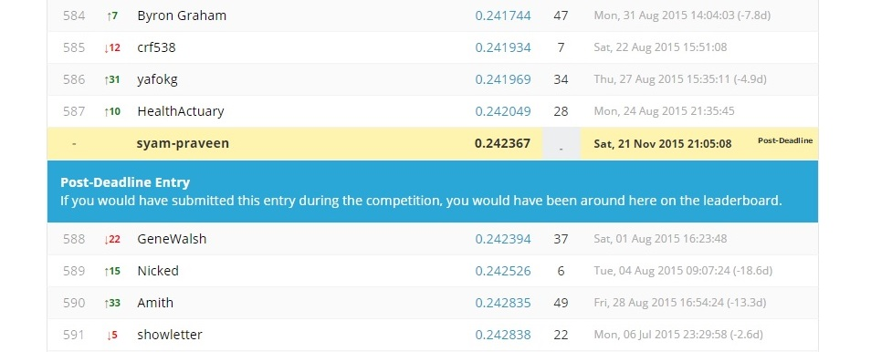
Leaderboard
Total No of Teams 1323
All Zero Benchmark Rank 1278 and RMSLE score is 2.354036
Winner RMSLE score is 0.196557
Our Initial Rank 945 & RMSLE Score is 0.313317
Our Final Rank is 587 & RMSLE Score is 0.242367
Total 96 Submissions

Slide 9
Miscellaneous
Why Log Transformation in preprocessing step ?
Don’t always trust that your data is correct and platform you have chosen will give the best solution.
References:
1. http://www.mathworks.com/help/
2. https://github.com/dmlc/xgboost/blob/master/doc/
parameter.md
3. https://cran.r-project.org/web/packages/xgboost/
xgboost.pdf

