Slide 1
J2EE
By Kumar

Slide 2
Web Terminology
Website: Website is a collection of related web pages that may contain text, images, audio and video
Each website has specific internet address (URL) that you need to enter in your browser to access a website.
Types of websites
Static website
Dynamic website
Client side scripting
Server side scripting

Slide 3
Static Website :
Prebuilt content is same every time the page is loaded.
It uses the HTML code for developing a website.
It sends exactly the same response for every request
Dynamic Website:
Content is generated when requested and changes regularly
It uses the server side languages such as PHP,SERVLET, JSP, and ASP.NET etc. for developing a website.
It may generate different HTML for each of the request.

Slide 4
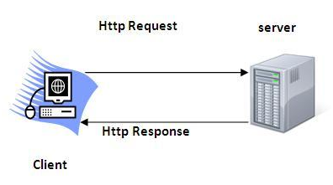
HTTP (Hyper Text Transfer Protocol)
It is the data communication protocol used to establish communication between client and server.
It allows web servers and browsers to exchange data over the web.

Slide 5
Http Requests
Get
Post
Put
Delete
Head
GET- It requests the data from a specified resource
POST- It submits the processed data to a specified resource

Slide 6
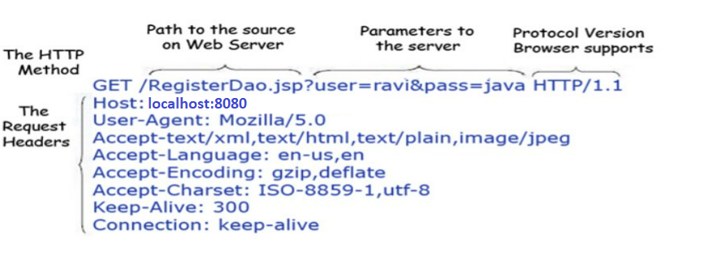
GET METHOD
The query string (name/value pairs) is sent inside the URL of a GET request:

Slide 7
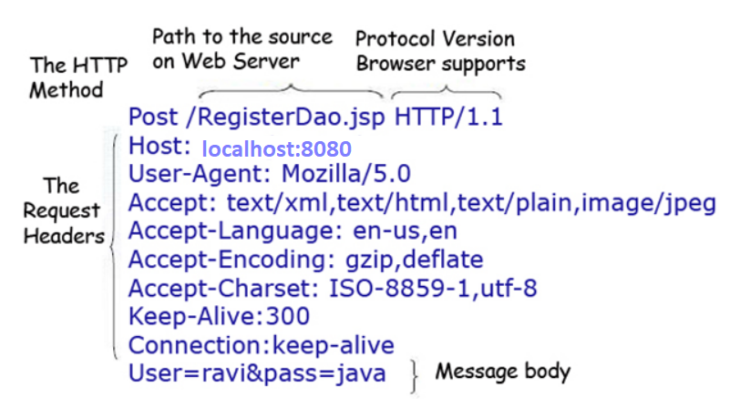
POST Method
POST/RegisterDao.jsp HTTP/1.1
Host: localhost:8080
name1=value1&name2=value2

Slide 8
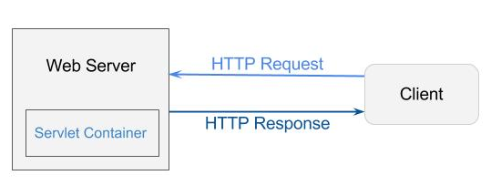
Servlet Container
It provides run time environmnets for Servlet Applications
The Servlet Container performs many operations that are given below:
Life Cycle Management
Multithreaded support
Object Pooling
Security etc.

Slide 9
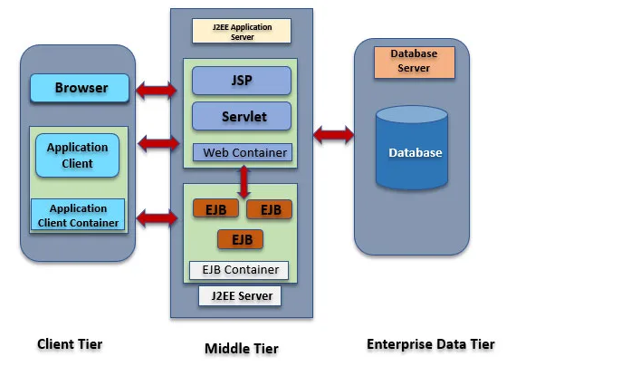
Java Web Application Architecture

Slide 10
What is Servlet
Servlet technology is used to create a web application (resides at server side and generates a dynamic web page).
A servlet is a Java programming language class that is used to extend the capabilities of servers that host applications accessed by means of a request-response programming model
The javax.servlet and javax.servlet.http packages provide interfaces and classes for writing servlets
All servlets must implement the Servlet interface, which defines life-cycle methods
Using Servlets, you can collect input from users through web page forms, present records from a database or another source, and create web pages dynamically.

Slide 11
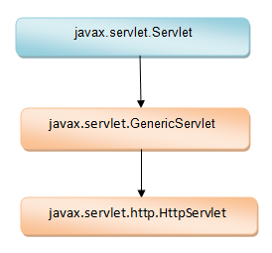
Servlet Hierarchy

Slide 12
Servlet Interface
Servlet interface needs to be implemented for creating any servlet either directly or indirectly
Lifecycle methods:
Init(ServletConfig config): Initializes the servlet and invoked only once
service(ServletRequest req, ServletResponse res) : Responds to the incoming request and invoked for each request by the web container
Destroy(): invoked only once and indicates servlet being destroyed
Other Methods:
getServletConfig() : holds servlet configuration
getServletInfo(): returns the information whoch user wants to send
from the servlet

Slide 13
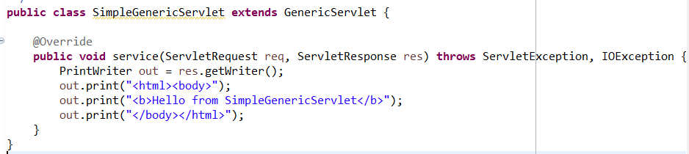
GenericServlet
This class implements Servlet interface and gives implementation to init(), destroy(), getServletConfig(), getServletInfo() except service() method.

Slide 14
HttpServlet
HttpServlet extends GenericServlet. It provides http specific methods such as doGet, doPost, doHead, doTrace etc.
service(ServletRequest req, ServletResponse res): receives request from user and dispatch it to another service method by converting request and response object to http type.
service(HttpServletRequest req, HttpServletResponse resp): recives request from previous method and dispatch request to doGet() or doPost() or doPut() etc based on the method present in the request
String method = req.getMethod();

Slide 15
Writing Simple Servlet using HttpRequest
Import the appropriate package and classes, including the following:
import javax.servlet.*; import javax.servlet.http.*; import java.io.*;
Extend javax.servlet.http.HttpServlet. For example:
public class GreetingServlet extends HttpServlet{
Implement doGet() and doPost() method

Slide 16
Set the content type, as follows:
res.setContentType("text/html");
Get a reference to a java.io.PrintWriter object to use for output, as follows:
PrintWriter out = res.getWriter();
Create some HTML using the println() method on the PrintWriter object, as shown in the following example:
out.println("<html><head><title>Hello World!</title> </head>"); out.println("<body><h1>Hello World!</h1></body></html>"); } }

Slide 17
Compile the servlet
Deploy the servlet as part of a Web Application hosted on Tomcat Server
Call the servlet from a browser.
http://host:port/webApplicationName/mappedServletName?parameter
Ex:http://localhost:8080/servlets/GreetingServlet

Slide 18
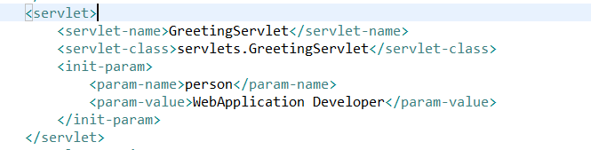
Servlet Initialization Attributes

Slide 19
Servlet Life cycle
Load the servlet into container
Servlet instance is created
Init method is invoked
Service method is invoked
Destroy method is invoked

Slide 20
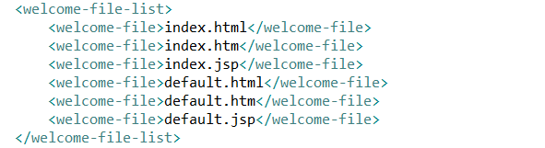
Welcome file list

Slide 21
Welcome file list
By default server looks for the welcome file in following order:
welcome-file-list in web.xml
index.html
index.htm
Index.jsp
Priority goes to welcome-file-list

Slide 22
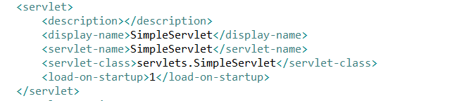
Load on start up
<load-on-startup>0</load-on-startup>
<load-on-startup>1</load-on-startup>
The 0 value will be loaded first then 1, 2, 3 and so on.

Slide 23
ServletRequest Interface
public String getParameter(String name);
public String[] getParameterValues(String name);
public Enumeration<String> getParameterNames();
public String getContentType();
public int getContentLength();
public String getServerName();
public int getServerPort();

Slide 24
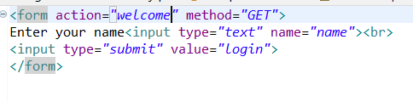
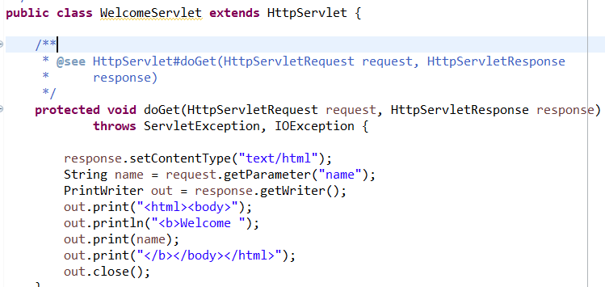
Example

Slide 25
RequestDispatcher
Defines an object that receives requests from the client and sends them to any resource (such as a servlet, HTML file, or JSP file) on the server.
forward(ServletRequest request, ServletResponse response)
include(ServletRequest request, ServletResponse response)

Slide 26
Content type
text/html
text/plain
application/msword
application/vnd.ms-excel
application/jar
application/pdf
application/octet-stream
application/x-zip
images/jpeg
images/png
images/gif
audio/mp3
video/mp4
video/quicktime etc

Slide 27
Session
Session simply means a particular interval of time.
Session Tracking is a way to maintain state (data) of an user. It is also known as session management in servlet.
Http protocol is a stateless so we need to maintain state using session tracking techniques

Slide 28
Session tracking techniques
Cookies
Hidden Form Field
URL Rewriting
HttpSession

Slide 29
JSP

Slide 30
JSP tags
scriptlet tag : <% java source code %>
expression tag : <%= statement %> out.print(new java.util.Date());
declaration tag : <%! field or method declaration %>

Slide 31
Implicit objects
Object | Type
out | JspWriter
request | HttpServletRequest
response | HttpServletResponse
config | ServletConfig
application | ServletContext
session | HttpSession
pageContext | PageContext
page | Object
exception | Throwable

Slide 32
Out,Request and Response
<%
String name=request.getParameter("name");
out.print("welcome "+name);
%>
<%
response.sendRedirect("http://www.google.com");
%>

Slide 33
config
<servlet>
<servlet-name>welcome</servlet-name>
<jsp-file>/welcome.jsp</jsp-file>
<init-param>
<param-name>test</param-name>
<param-value>test</param-value>
</init-param>
</servlet>

Slide 34
context
<context-param>
<param-name>test</param-name>
<param-value>test</param-value>
</context-param>
<%
String value=application.getInitParameter("test");
out.print("application parameter is="+value);
%>

Slide 35
Exception
In JSP, exception is an implicit object of type java.lang.Throwable class. This object can be used to print the exception. But it can only be used in error pages
<%@ page isErrorPage="true" %>
<html>
<body>
Exception :<%= exception %>
</body>
</html>

Slide 36
Contd..
<html>
<body>
<%@ page errorPage="error.jsp" %>
<%= 1/0 %>
</body>
</html>

Slide 37
JSP directives
page directive : <%@ page attribute="value" %>
EX: <%@ page import="java.util.Date" %>
include directive : <%@ include file="resourceName" %>
Ex: <%@ include file="header.html" %>
taglib directive:
<%@ taglib prefix="prefixoftaglibrary" uri="uriofthetaglibrary" %>
Ex: <%@ taglib prefix = "c" uri = "http://java.sun.com/jsp/jstl/core" %>

Slide 38
Important attributes of page directives
import
contentType
info
language
pageEncoding
errorPage
isErrorPage

Slide 39
Include directive
The include directive is used to include the contents of any resource it may be jsp file, html file or text file.
The include directive includes the original content of the included resource at page translation time
The jsp page is translated only once so it will be better to include static resource
<%@ include file="resourceName" %>

Slide 40
JSP Action Tags
JSP Action Tags | Description
jsp:forward | forwards the request and response to another resource.
jsp:include | includes another resource.
jsp:useBean | creates or locates bean object.
jsp:setProperty | sets the value of property in bean object.
jsp:getProperty | prints the value of property of the bean.

Slide 41
JSTL
JSTL stands for JSP Standard Tag Library
It provides tags to control the JSP page behavior.
JSTL tags can be used for iteration and control statements, internationalization, SQL etc
JSP EL have limited option to write code like html and we can't loop through list and we can't check conditons.

Slide 42
Tags types
JSTL Core Tags: JSTL Core tags provide support for iteration, conditional logic, catch exception, url, forward or redirect response etc. To use JSTL core tags, we should include it in the JSP page like below.
<%@ taglib uri="https://java.sun.com/jsp/jstl/core" prefix="c" %>
JSTL Formatting and Localisation Tags: JSTL Formatting tags are provided for formatting of Numbers, Dates and i18n support through locales and resource bundles. We can include these jstl tags in JSP with below syntax:
<%@ taglib uri="https://java.sun.com/jsp/jstl/fmt" prefix="fmt" %>

Slide 43
Tag types
STL SQL Tags: JSTL SQL Tags provide support for interaction with relational databases such as Oracle, MySql etc. Using JSTL SQL tags we can run database queries, we include these JSTL tags in JSP with below syntax:
<%@ taglib uri="https://java.sun.com/jsp/jstl/sql" prefix="sql" %>
JSTL XML Tags: JSTL XML tags are used to work with XML documents such as parsing XML, transforming XML data and XPath expressions evaluation. Syntax to include JSTL XML tags in JSP page is:
<%@ taglib uri="https://java.sun.com/jsp/jstl/xml" prefix="x" %>

Slide 44
Tag Types
JSTL Functions Tags: JSTL tags provide a number of functions that we can use to perform common operation, most of them are for String manipulation such as String Concatenation, Split String etc. Syntax to include JSTL functions in JSP page is: <%@ taglib uri="https://java.sun.com/jsp/jstl/functions" prefix="fn" %>

Slide 45
Core tags
<c:out value="${1>2}" />
<c:forEach var="j" begin="1" end="3">
Item <c:out value="${j}"/><p>
</c:forEach>

