Slide 1
Core Java

Slide 2
Introduction to Java
Java is computer programming language that enforces an object oriented programming model
James Gosling is known as the father of java
Before java, its name was oak!!
Java is a platform independent programming language
Its works on "Write once, Run anywhere" logic
Eveything in java would have state and behavior and which would be defined by class.

Slide 3
Types of java applications
Standalone applications
Web applications
Enterprise applications
Mobile Applications

Slide 4
Java features
Simple
Object-Oriented
Portable
Platform independent
Secured
Multithreaded
Distributed
Dynamic

Slide 5
Simple:
Java is very easy to learn and its syntax is simple, clean and easy to understand
Java removed complicated and rarely used features like pointers and operator overloading
No explicit garbage collection
Object Oriented Programming:
Java is an object-oriented programming language.
Everything in Java is an object.

Slide 6
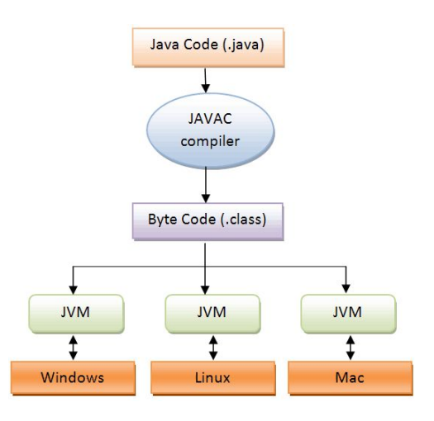
Paltform Independent

Slide 7
Portable
Java is portable because it facilitates you to carry the Java bytecode to any platform. It doesn't require any implementation.
Secured
Its programmes always run in a Java Runtime Environment (JRE) with almost null interaction with the Operating System, thus it is one of the most secure.
Bytecode Verifier: It checks the code fragments for illegal code that can violate access rights to objects.
Security Manager: It determines what resources a class can access such as reading and writing to the local disk.

Slide 8
Multi-threaded:
It is basically the ability to do multiple tasks at the same time
It supports multithreading and thus multiple tasks can be done at the same time in parallel
Its feature helps save memory and resources.

Slide 9
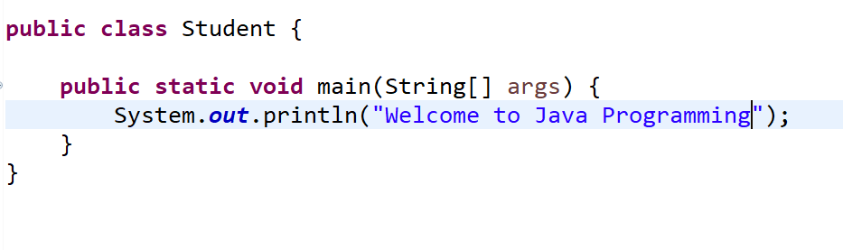
Simple program in Java

Slide 10
Java path setting
Temporary : set path in command prompt
Permanent: set path in environment variables of your machine

Slide 11
Java variables
local variable : variable declared within the method is local variable.
instance variable : variable declared outsiden the method is instance variable.
static variable : variable declared outside the method with static keyword.

Slide 12
Data Types
Primitive Data Types :- which include integer, character, boolean, and float
Non-primitive Data Types :- which include classes, arrays and interfaces.
Data Type | Default Size | Default Value
boolean | 1 bit | false
char | 2 byte | '\u0000'
byte | 1 byte | 0
short | 2 byte | 0
int | 4 byte | 0
long | 8 byte | 0L
float | 4 byte | 0.0f
double | 8 byte | 0.0d

Slide 13
Boolean data type
The Boolean data type is used to store only two possible values: true and false.
This data type is used for simple flags that track true/false conditions.
Syntax: boolean isValuePresent=true/false;
Ex: boolean isValuePresent=true;

Slide 14
Byte
Byte is and 8 bit signed integer
Minimum value is –128
Maximum value is 127
Default value is 0
Ex: byte a=10, byte b=-100

Slide 15
Short
Short data type is a 16-bit signed integer
Minimum value is -32,768 (-2^15)
Maximum value is 32,767 (inclusive) (2^15 -1)
Default value is 0.
Example: short s = 20000, short r = -30000

Slide 16
Int
Int data type is a 32-bit integer.
Minimum value is - 2,147,483,648 (-2^31)
Maximum value is 2,147,483,647(2^31 -1)
The default value is 0
Example: int a = 100000, int b = -200000

Slide 17
Long
Long data type is a 64-bit signed two's complement integer
Minimum value is -9,223,372,036,854,775,808(-2^63)
Maximum value is 9,223,372,036,854,775,807(2^63 -1)
This type is used when a wider range than int is needed
Default value is 0L
Example: long a = 100000L, long b = -200000L

Slide 18
Typecasting(Widening and Narrowing)
Widening:
int a=20;
float f=a;
Narrowing:
float f=20.5;
int a=f // error
Int a=(int)f;

Slide 19
Constructor
Constructor is called right after the memory allocation for an object
It has same name as class name.
Similar to method but without return type.
Whether you define or not all the classes will have constructor.
Syntax:
access_specifier class_name(){
}

Slide 20
Types of constructors
No argument Constructors
Parameterized Constructors

Slide 21
Control flow statements
Decision Making statements
if statements
switch statement
Loop statements
do while loop
while loop
for loop
for-each loop
Jump statements
break statement
continue statement
Return Statement

Slide 22
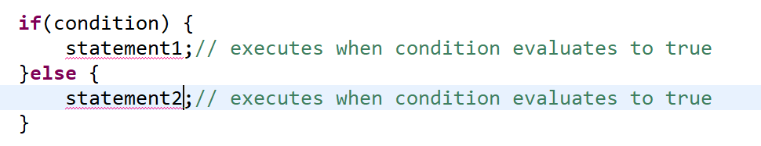
If else statement

Slide 23
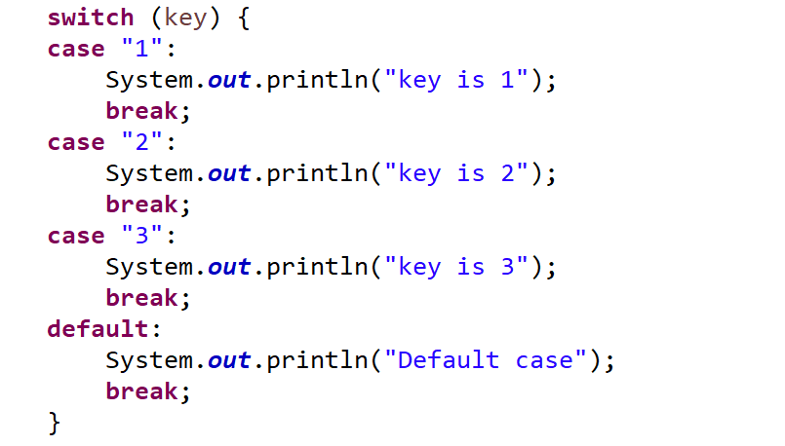
Switch statement

Slide 24
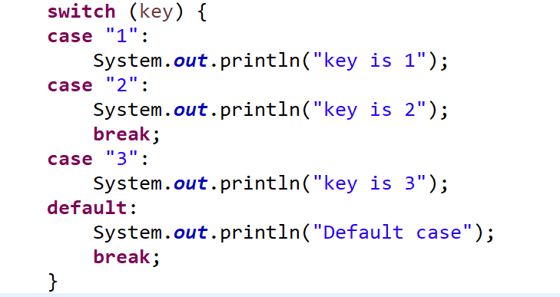

Slide 25
Java oop's concepts
Object
Class
Inheritance
Polymorphism
Abstraction
Encapsulation

Slide 26
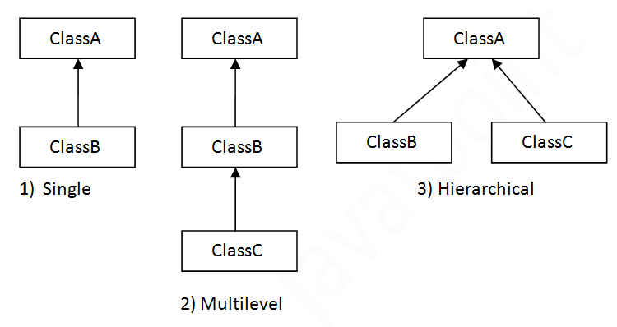

Slide 27
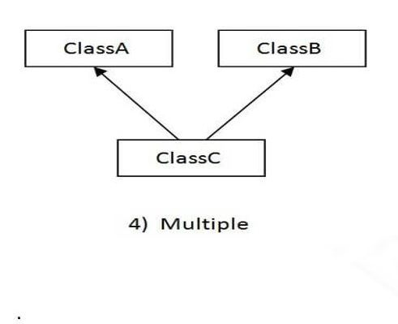
No Multiple inheritence in java

Slide 28
Modifiers in java
Modifiers are keywords that you add to those definitions to change, modify or specify their meanings.
There are two types of modifiers
Access
Non-Access

Slide 29
Access Controll modifiers:
Java provides a number of access control modifiers to set access levels for classes, variables, methods and constructors
Default : visible to package
Private: visible to the class only
Protected: visiblet to the package and all subclasses
Public : Visible to the world

Slide 30
Non-Access Modifiers:
Java provides a number of non-access modifiers to provide additional functionalities to a class, variable, method or constructor.
Some of them are
Static : The static modifier for calling methods and variables without an object to which it belongs.
Final : The final modifier for finalizing the implementations of classes, methods and variables.
Abstract : The abstract modifier for creating abstract classes and methods.

Slide 31
Strings
Java String is a sequence of characters
They are objects of type String class
Once a string object is created , it cannot be changed.
Strings are immutable
In java String literals are stored in string pool

Slide 32
String pool
Pool of strings stored in java heap memory
String pool helps in saving lot of space for Java runtime
String S1="Good"
S1.concat("Morning") : concats the string
S1.length(): gives length of string
S1.substring(2): gives string starting from index 2
S1.isEmpty(): is string empty? return true
S1.toUpperCase()
S1.toLowerCase()

Slide 33
ValueOf():
Replace(char old, char new)
Contains():
CharAt()
EndsWith()
Equals()

Slide 34
Exception
An exception is a problem that arises during the execution of a program
Exception is an event that disrupts the normal flow of the program
Exception Handling is a mechanism to handle runtime errors

Slide 35
Types of exception
Checked Exceptions
Unchecked Exceptions
Error

Slide 36
Collection
Collections are objects that group multiple elements into a single unit.
In Java, a separate framework named the “Collection Framework” has been defined in JDK 1.2 which holds all the collection classes and interface in it.
The Collection interface (java.util.Collection) and Map interface (java.util.Map) are the two main “root” interfaces of Java collection classes.

Slide 37
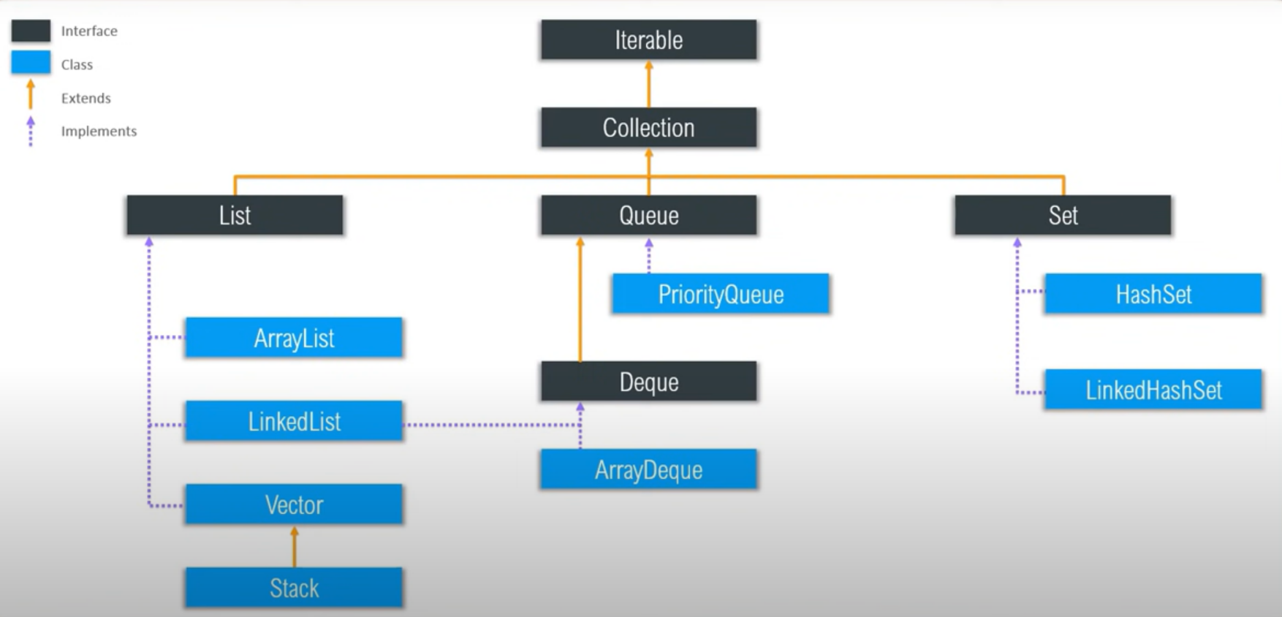

Slide 38
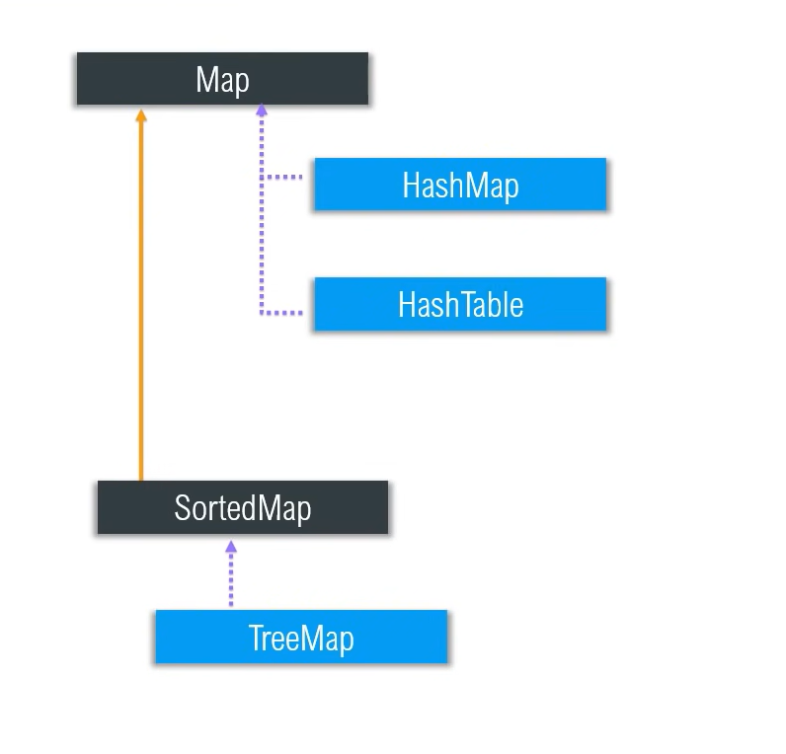

Slide 39
Collection framework
A framework is set of classes and interfaces which provide a ready-made architecture.
The Collection framework represents a unified architecture for storing and manipulating a group of objects
The utility package, (java.util) contains all the classes and interfaces that are required by the collection framework.
The collection framework contains an interface named an iterable interface which provides the iterator to iterate through all the collections

Slide 40
Iterable interface
This is the root interface for the entire collection framework.
The collection interface extends the iterable interface.
The main functionality of this interface is to provide an iterator for the collections.
Therefore, this interface contains only one abstract method which is the iterator. It returns the
Iterator iterator();
There are only three methods in the Iterator interface. They are:
public boolean hasNext()
public Object next()
public void remove()

Slide 41
Collection interface
This interface extends the iterable interface and is implemented by all the classes in the collection framework
This interface contains all the basic methods which every collection has like adding the data into the collection, removing the data, clearing the data, etc.
In short, we can say that this interface builds a foundation on which the collection classes are implemented.

Slide 42
Collection interface methods
boolean add(Object obj)
boolean addAll(Collection c)
void clear( )
boolean contains(Object obj)
boolean containsAll(Collection c)
boolean equals(Object obj)
int hashCode( )
boolean isEmpty( )
Iterator iterator( )
boolean remove(Object obj)
boolean removeAll(Collection c)
boolean retainAll(Collection c)
int size( )
Object[ ] toArray( )

Slide 43
List Interface
This is a child interface of the collection interface.
This interface is dedicated to the data of the list type in which we can store all the ordered collection of the objects.
This also allows duplicate data to be present in it.
This list interface is implemented by various classes like ArrayList, Vector, Stack and LinkedList
Since all the subclasses implement the list, we can instantiate a list object with any of these classes. For example,
List <T> al = new ArrayList<> (); List <T> ll = new LinkedList<> (); List <T> v = new Vector<> ();

Slide 44
List interface methods
void add(int index, Object obj)
boolean addAll(int index, Collection c)
Object get(int index)
int indexOf(Object obj)
int lastIndexOf(Object obj)
ListIterator listIterator( )
ListIterator listIterator(int index)
Object remove(int index)
Object set(int index, Object obj)
List subList(int start, int end)

Slide 45
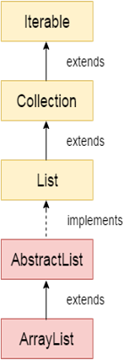
ArrayList
Java ArrayList class uses a dynamic array for storing the
Elements.
The size of an ArrayList is increased automatically if the collection grows or shrinks if the objects are removed from the collection
It is like an array, but there is no size limit
ArrayList can contain duplicate elements.
Arraylist can contain null value
ArrayList allows random access because array works
at the index basis
ArrayList can not be used for primitive types, like int, char, etc.
We will need a wrapper class for such cases

Slide 46
Contd..
There are three ways to create an ArrayList in Java:
The no-arg constructor : List list = new ArrayList();
The constructor that takes initial capacity: List list = newArrayList(50);
Existing Collection: List list = newArrayList(oldList);

Slide 47
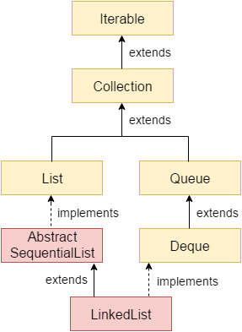

LinkedList
The LinkedList class implements the List and Deque interfaces
Stores elements in insertion order
Supports duplicate elements
Allows any number of null elements
There are two ways to create a LinkedList in Java:
The no-arg constructor:
List<Integer> list = new LinkedList<Integer>();
Existing Collection:
List<Integer> list = new LinkedList<Integer>(oldList);

Slide 48
Vector
A vector provides us with dynamic arrays in Java.
This is identical to ArrayList in terms of implementation
However, the primary difference between a vector and an ArrayList is that a Vector is synchronized and an ArrayList is non-synchronized
There are four ways to create a Vector in Java:
The no-arg constructor: Vector<Integer> v = new Vector<Integer>();
Existing Collection: Vector<Integer> v = new Vector<Integer>(oldlist);
3. The constructor that takes initial capacity:
Vector<Integer> vector = new Vector(int initialCapacity)
4. The constructor that takes initial capacity and capacityIncrement
Vector<Integer> vector = new Vector(int initialCapacity,
int capacityIncrement)

Slide 49
Stack
Stack class models and implements the Stack data structure.
The class is based on the basic principle of last-in-first-out or first-in-last-out.
In addition to the basic push and pop operations, the class provides three more functions of empty, search and peek
Stack is a subclass of Vector and a legacy class. It is thread safe which might be an overhead in an environment where thread safety is not needed
Stack can be created by calling no-arg constructor
The no-arg constructor: Stack<Integer> stack=new Stack<Integer>();

Slide 50
HashCode
A hash code is an integer value that is associated with each object in Java and used to insert and identify an object in a hash –based collection.
The default hashCode() is typically implemented by converting the internal address of the object into an integer.
Multiple objects can have same hashcode. If two objects are equal (using the equals() method) then they have the same hashcode.
hashCode() is used for bucketing in Hash implementations like HashMap, HashTable, HashSet, etc.
The value received from hashCode() is used as bucket number for storing elements of the Set/Map.
Its used to facilitate hashing in hash tables, which are used by data structures like HashMap. This bucket number is the address of the element inside the set/map.

Slide 51
Equals
In java equals() method is used to compare equality of two Objects. The equality can be compared in two ways:
Shallow comparison: The default implementation of equals method is defined in Java.lang.Object class which simply checks if two Object references (say x and y) refer to the same Object. i.e. It checks if x == y. Since Object class has no data members that define its state, it is also known as shallow comparison.
Deep Comparison: Suppose a class provides its own implementation of equals() method in order to compare the Objects of that class w.r.t state of the Objects. That means data members (i.e. fields) of Objects are to be compared with one another. Such Comparison based on data members is known as deep comparison.

Slide 52
Contd..
public boolean equals (Object obj) // This method checks if some other Object // passed to it as an argument is equal to // the Object on which it is invoked.

Slide 53
Queue
Java Queue interface orders the element in FIFO(First In First Out) manner
Queue Interface declaration
public interface Queue<E> extends Collection<E>
Priority Queue:
PriorityQueue doesn’t permit null.
PriorityQueue<Integer> priorityQueue=new PriorityQueue<>();
Deque:
Java Deque Interface is a linear collection that supports element insertion and removal at both ends. Deque is an acronym for "double ended queue".

Slide 54
ArrayDeque
Unlike Queue, we can add or remove elements from both sides.
Null elements are not allowed in the ArrayDeque.
ArrayDeque is not thread safe, in the absence of external synchronization.
AddFirst(10);
AddLast(11);
pollLast();
OfferFirst(1);
Offer() and add() are same

Slide 55
Set Interface
A set is an unordered collection of objects in which duplicate values cannot be stored.
This collection is used when we wish to avoid the duplication of the objects and wish to store only the unique objects
This set interface is implemented by various classes like HashSet, TreeSet, LinkedHashSet
Set<T> hs = new HashSet<> (); Set<T> lhs = new LinkedHashSet<> (); Set<T> ts = new TreeSet<> (); Where T is the type of the object.

Slide 56
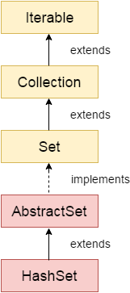
HashSet
The HashSet class is an inherent implementation of the hash table data structure.
The objects that we insert into the HashSet do not guarantee to be inserted in the same order.
The objects are inserted based on their hashcode.
Doesn’t allow duplicate elements
Only allows one null element
Internally backed by a HashMap
HashSet<Integer> hs = new HashSet<Integer>();
This will create a HashSet with an initial capacity of 16 and a load factor of 0.75.

Slide 57
LinkedHashSet
A LinkedHashSet is very similar to a HashSet.
The difference is that this uses a doubly linked list to store the data and retains the ordering of the elements.
Java LinkedHashSet class contains unique elements only like HashSet.
Java LinkedHashSet class provides all optional set operation and permits null elements.
Java LinkedHashSet class is non synchronized.
LinkedHashSet<String> set=new LinkedHashSet();

Slide 58
SortedSet Interface
This interface is very similar to the set interface. The only difference is that this interface has extra methods that maintain the ordering of the elements.
The sorted set interface extends the set interface and is used to handle the data which needs to be sorted.
The class which implements this interface is TreeSet. Since this class implements the SortedSet, we can instantiate a SortedSet object with this class. For example,
SortedSet<T> ts = new TreeSet<> (); Where T is the type of the object.

Slide 59
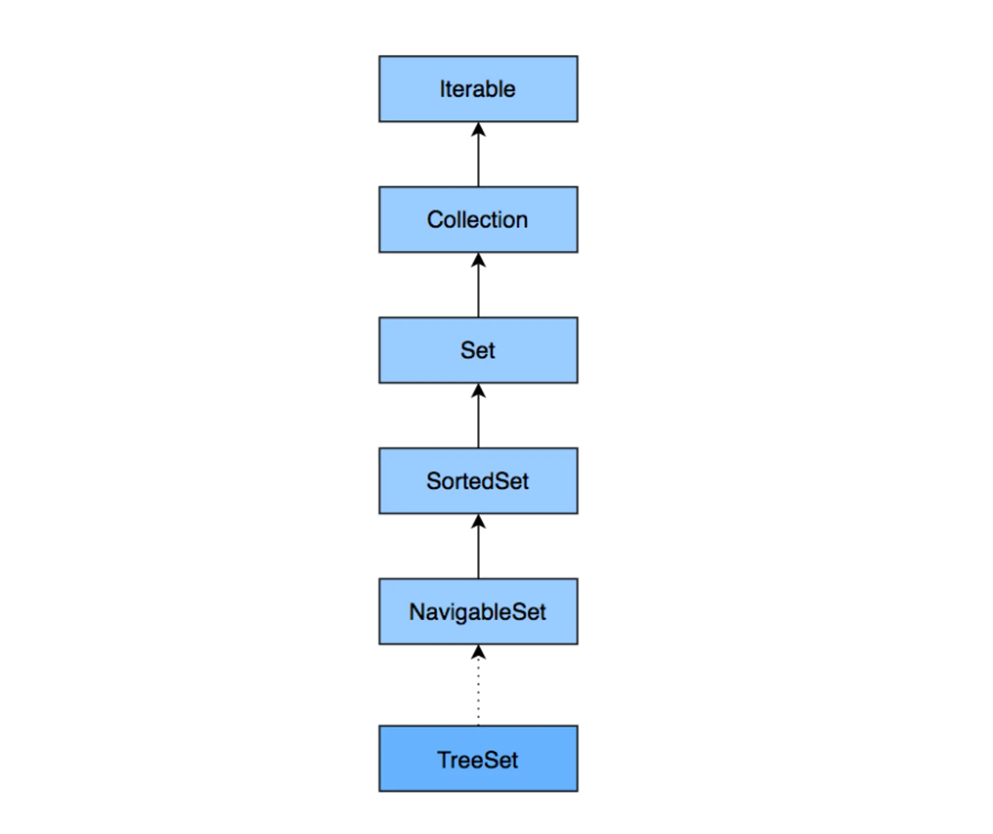
TreeSet
Doesn’t allow duplicate elements
Doesn’t allow null elements
Quick access and retrieval times
Elements stored in ascending order
TreeSet<String> ts=
new TreeSet<String>();

Slide 60
Map Interface
A map is a data structure which supports the key-value pair mapping for the data.
This interface doesn’t support duplicate keys because the same key cannot have multiple mappings
A map is useful if there is a data and we wish to perform operations on the basis of the key.
This map interface is implemented by various classes like HashMap, TreeMap etc.
Map<K,V> hm = new HashMap<> (); Map<K,V> tm = new TreeMap<> (); Where T is the type of the object.

Slide 61
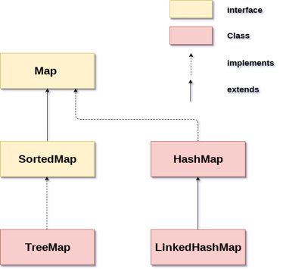

Slide 62
HashMap: HashMap is the implementation of Map, but it doesn't maintain any order.
LinkedHashMap: LinkedHashMap is the implementation of Map. It inherits HashMap class. It maintains insertion order.
TreeMap: TreeMap is the implementation of Map and SortedMap. It maintains ascending order.

Slide 63
HashMap
HashMap provides the basic implementation of the Map interface of Java. It stores the data in (Key, Value) pairs.
To access a value in a HashMap, we must know its key.
HashMap uses a technique called Hashing
HashMap<Integer, String> hm = new HashMap<Integer, String>();

Slide 64
LinkedHashMap
Java LinkedHashMap contains values based on the key.
Java LinkedHashMap contains unique elements.
Java LinkedHashMap may have one null key and multiple null values.
Java LinkedHashMap is non synchronized.
Java LinkedHashMap maintains insertion order.
The initial default capacity of Java HashMap class is 16 with a load factor of 0.75.

Slide 65
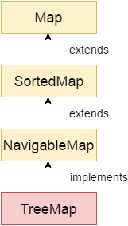
TreeMap
Java TreeMap contains values based on the key. It implements the NavigableMap interface and extends AbstractMap class.
Java TreeMap contains only unique elements.
Java TreeMap cannot have a null key but can have multiple null values.
Java TreeMap is non synchronized.
Java TreeMap maintains ascending order.

Slide 66
Comparable interface
Java Comparable interface is used to order the objects of the user-defined class.
This interface is found in java.lang package and contains only one method named compareTo(Object).
It provides a single sorting sequence only, i.e., you can sort the elements on the basis of single data member only.
public int compareTo(Object obj): It is used to compare the current object with the specified object. It returns
positive integer, if the current object is greater than the specified object.
negative integer, if the current object is less than the specified object.
zero, if the current object is equal to the specified object.

Slide 67
Comparator interface
Java Comparator interface is used to order the objects of a user-defined class.
This interface is found in java.util package and contains 2 methods compare.
It provides multiple sorting sequences, i.e., you can sort the elements on the basis of any data member
public int compare(Object obj1, Object obj2)
public boolean equals(Object obj)

