Slide 1
LEADING CLUB CASE STUDY
SUBMISSION
Janjanam syam koteswar

Slide 2
Problem statement
A business leading company wants to identify and reduce the risky borrowers
Like most of the other leading companies banks want to avoid the risk borrowers and to know them the bank need some info of the following
The company needs the driving factors behind loan default

Slide 3
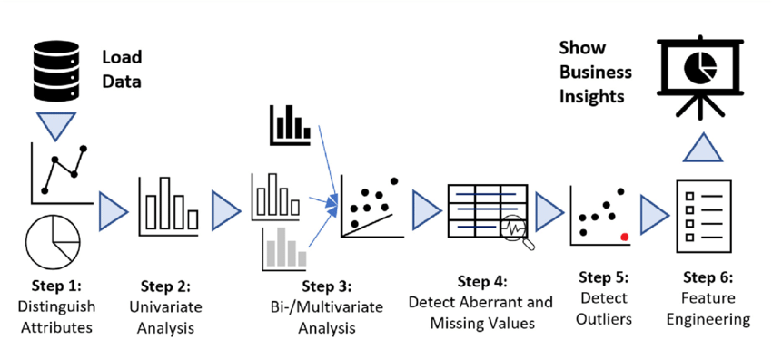
Problem Solving Methodology

Slide 4
Data cleaning steps
Remove duplicates or irrelevant observations
Fix structural errors
Filter unwanted outliers
Handle missing data
Validate and QA

Slide 5
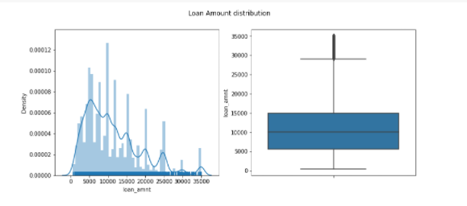
Univariate Analysis
Loan amount:
more number of people took loan amount of 10000, and also median of distribution is 10000. And very few people took more than 30000 loan amount.

Slide 6
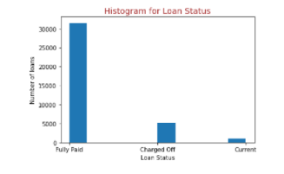
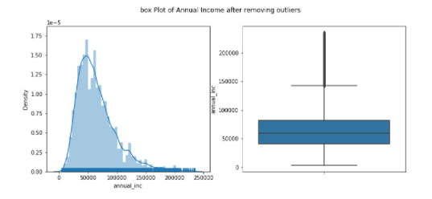
Loan status :
we can see that most of the charged off are under 5000
Annual_income:

Slide 7
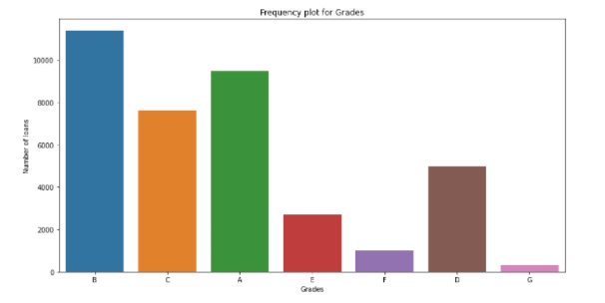
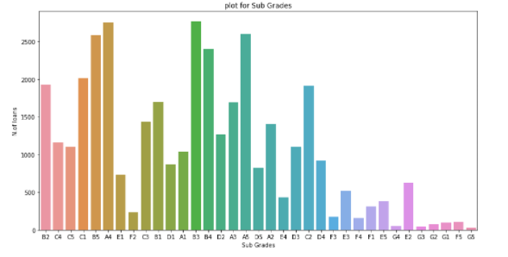
Grade and subgrade
Majority of the loan given were of Grade B and Grade A
High levels have more chance of loan given

Slide 8
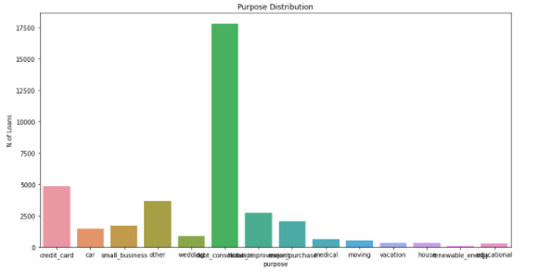
Purpose:
The loans taken are more on debt_consolidation

Slide 9
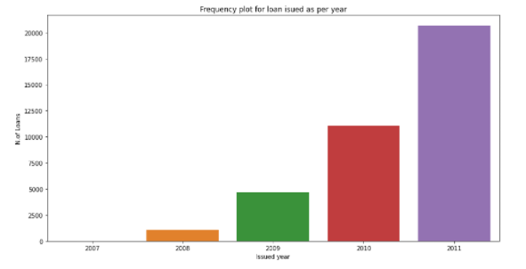
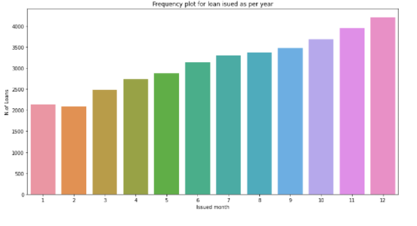
Issued date by year and months
There were linear increase in loan distribution

Slide 10
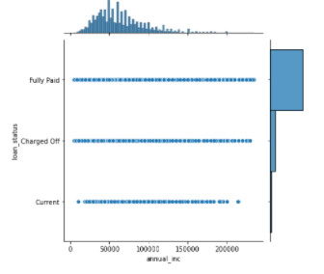
Bivariate analysis
Annual_income vs loan status

Slide 11
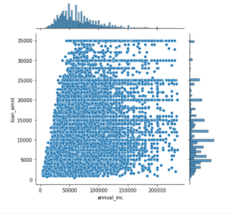
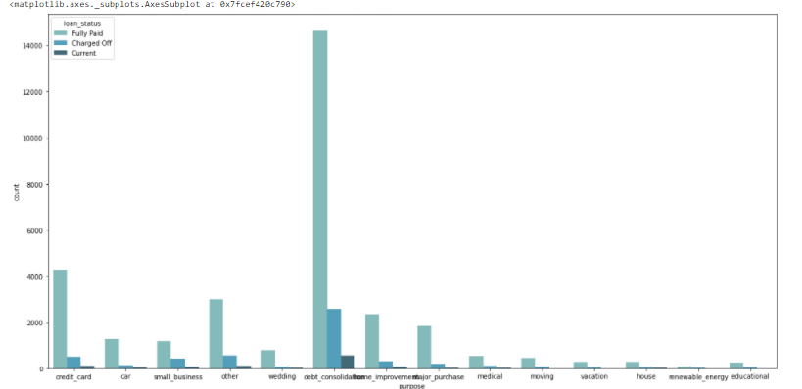
Annual income vs loan amount
The loan amount taken is depend on the annual income
Purpose vs loan status
Most of the purpose is for debt consideration

Slide 12
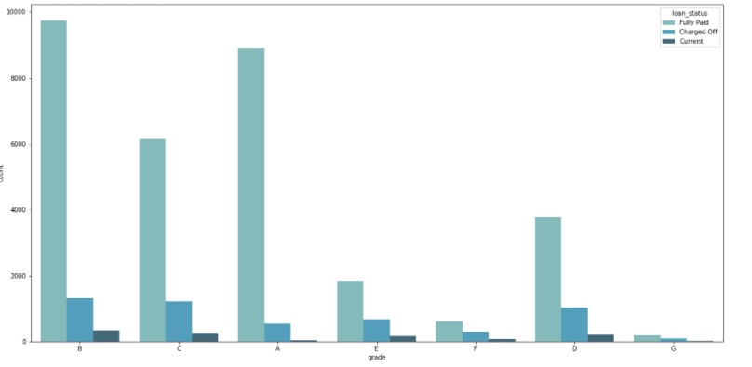
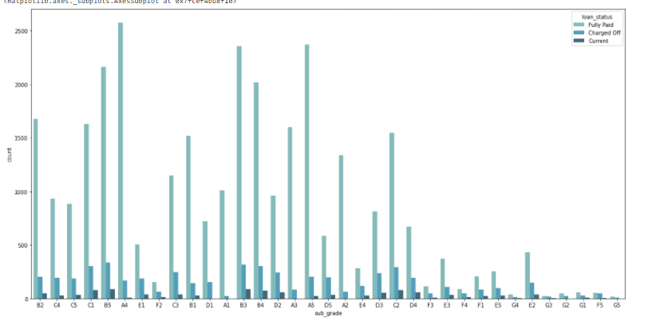
Grade vs loan status
Grade B customer category is the category is the one whose loans are getting approved
Subgrade vs loan status

Slide 13
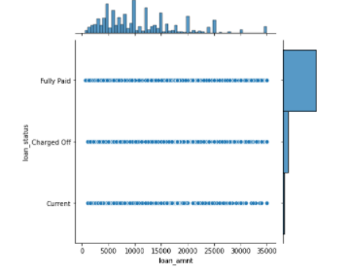
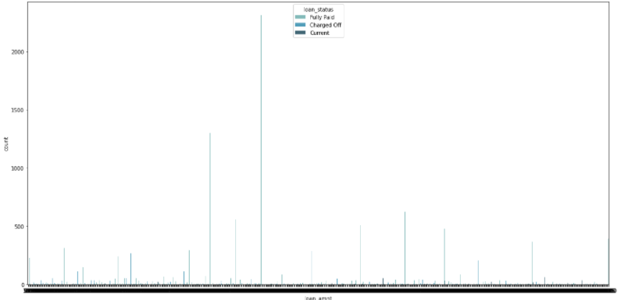
Loan amount vs loan status
Customer whose income is either not verified or just verified are more prone to being charged off

Slide 14
Observations and conclusions
Low grade loans have high tendency to default. Grading system is working as expected.
Customers with home ownership mortgage are the top most applicants
Average loan amount is around 10K
Customers applying loan most of them comes under debt consolidation
When the purpose is debt consolidation check application thoroughly as it has high tendency to default
Driver variables:
interest rate
Annual income
Loan amount
Fund amount
Purpose
Grades
subgrades

