Slide 1
Road Mech
“Feel Free to Travel”
BY
Syam krishna p
KITM24MCA-2028

Slide 2
Introduction
Customer Features: Request roadside assistance, view nearby mechanics, track mechanic arrival in real time, and make secure digital payments.
Mechanic Features: Receive service requests, view customer location, provide repair updates, and manage completed jobs efficiently.
Admin Role: Approve mechanic registrations, monitor service activities, manage users, and generate reports for performance and service analytics.
Technology Stack: Developed using Django and Python (backend), SQLite (database), and HTML, CSS, Bootstrap, JavaScript (frontend).
Benefits: Reduces vehicle breakdown stress, connects users with verified mechanics instantly, ensures transparency, and modernizes on-road assistance services

Slide 3
objective
To create a user-friendly online platform for requesting on-road vehicle repair and breakdown assistance.
To connect vehicle owners with nearby verified mechanics for quick and reliable service.
To enable real-time tracking and status updates of service requests.
To provide role-based access for users, mechanics, and administrators for efficient management.

Slide 4
Existing System
Vehicle owners rely on personal contacts or search manually for nearby garages during breakdowns.
There is no centralized platform to connect users with available mechanics in real time.
Service requests are handled through phone calls, often causing delays and miscommunication.
Tracking mechanic arrival time or service status is difficult, leading to uncertainty for users.

Slide 5
Proposed System
Introduces a digital platform that connects vehicle owners directly with nearby verified mechanics.
Allows users to request services, track mechanic location, and view real-time status updates.
Provides role-based access for users, mechanics, and admins to ensure secure and efficient operations.
Includes feedback and rating features to help users choose reliable mechanics based on past performance.

Slide 6
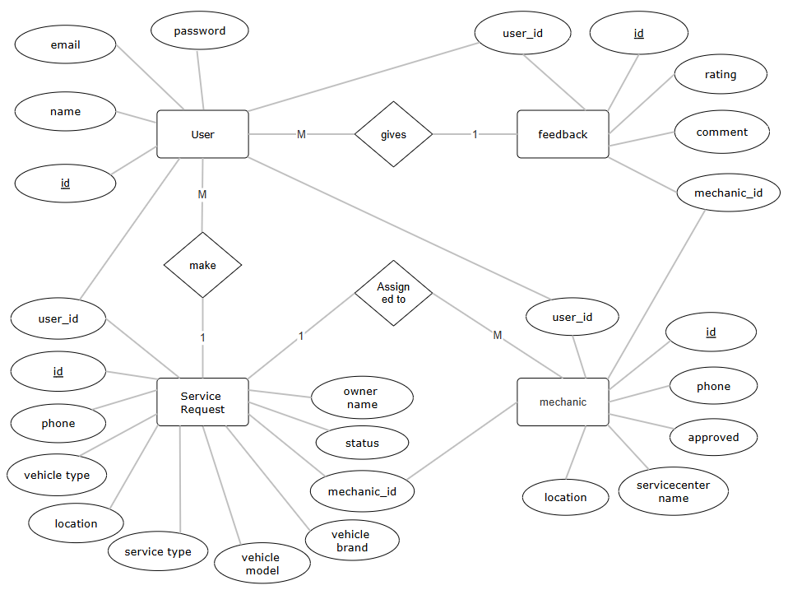
ER Diagram

Slide 7
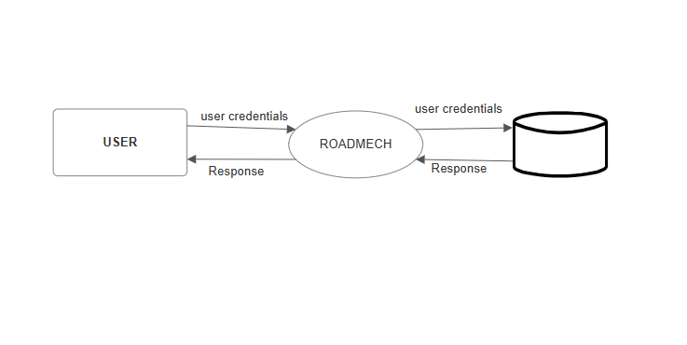
DFD(Dataflaw Diagram)
Level 0

Slide 8
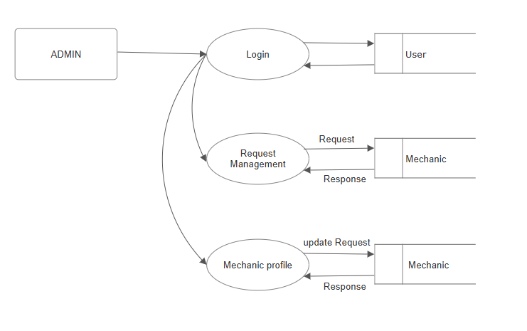
Level 1

Slide 9
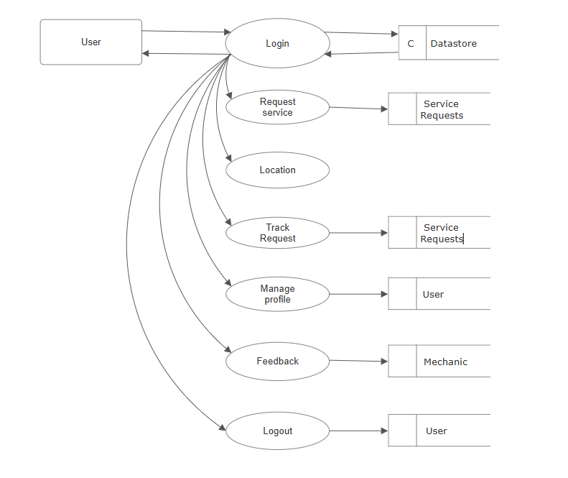
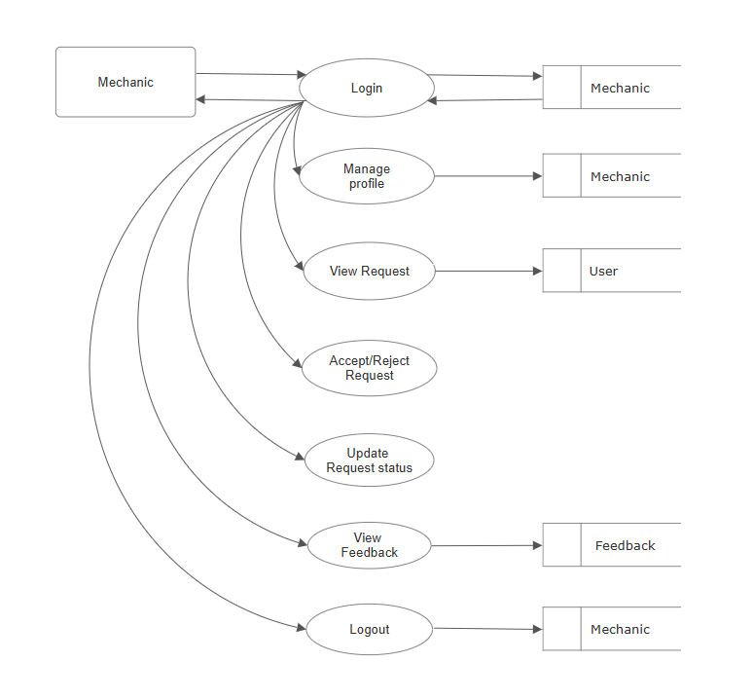
Level 2

Slide 10
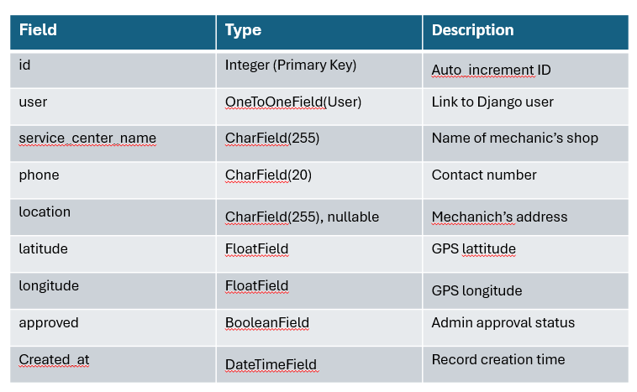
Tables
1. Mechanic

Slide 11
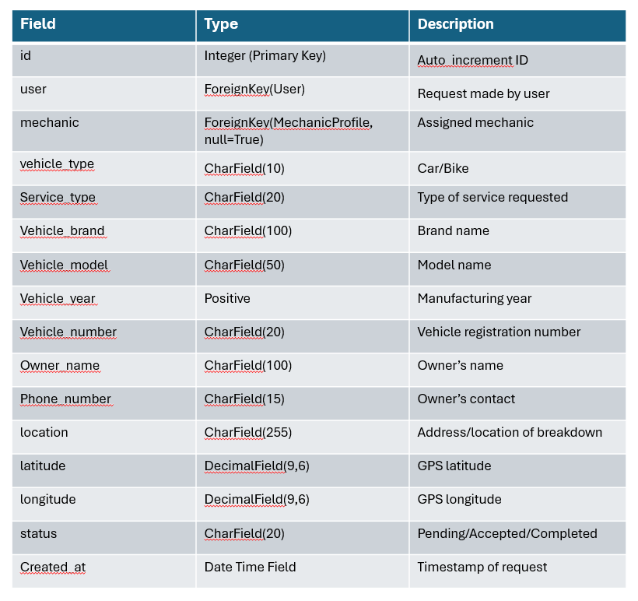
2. Service Request

Slide 12
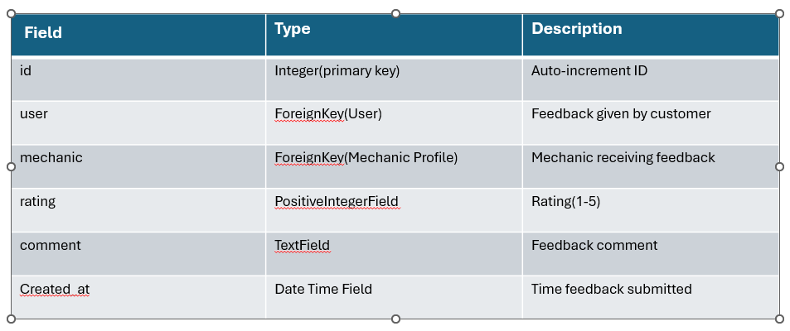
3. Feedback

Slide 13
FUTURE ENHANCEMENTS
In the future, RoadMech can be upgraded with advanced features such as real-time mechanic tracking, AI-based mechanic recommendations, and smart cost estimation based on distance and service type. Integration with secure online payment systems and a dedicated mechanic mobile app can enhance convenience and efficiency. Additionally, an admin analytics dashboard and multi-language support will improve system management and accessibility. These enhancements would transform RoadMech from a simple roadside assistance platform into a complete, intelligent, and scalable vehicle service ecosystem

Slide 14
Conclusion
RoadMech provides a modern, efficient, and reliable solution for handling vehicle breakdown assistance. By connecting vehicle owners, mechanics, and administrators on a single digital platform, it ensures quick response, real-time tracking, and transparent communication. The system not only enhances convenience for users but also supports local mechanics and promotes a more organized roadside assistance network. Ultimately, RoadMech contributes to building a smarter and more connected vehicle service ecosystem.

Slide 15
Thank You….

