Slide 1
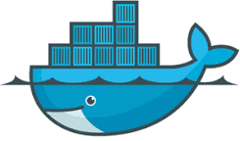
Syamkrishna P
Docker
11-08-2018

Slide 2
Road Map
What is Docker?
Docker vs. Virtual Machine
Repositories, Images and Containers
Some Basic Docker Operations
AWS ECS & ECR

Slide 3
What is Docker
Docker is the world’s leading software container platform. Developers use Docker to eliminate “works on my machine” problems when collaborating on code with co-workers. Operators use Docker to run and manage apps side-by-side in isolated containers to get better compute density. Enterprises use Docker to build agile software delivery pipelines to ship new features faster, more securely and with confidence for both Linux and Windows Server apps.

Slide 4
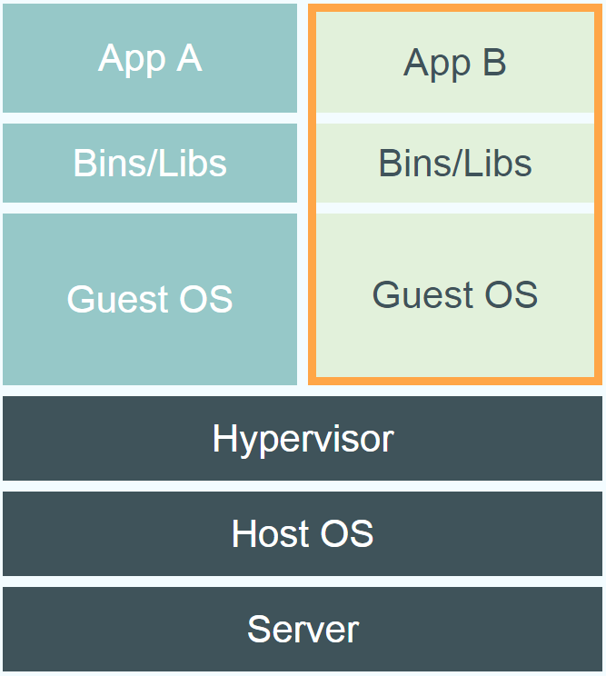
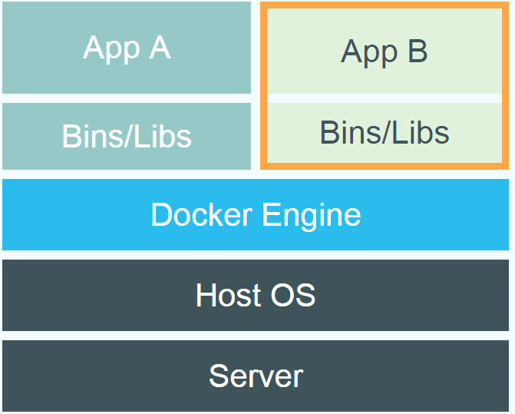
Docker Vs Virtual Machine
Docker
Virtual Machine

Slide 5
Docker image Repositories
Private
Eg: AWS ECR
Public
DockerHub

Slide 6
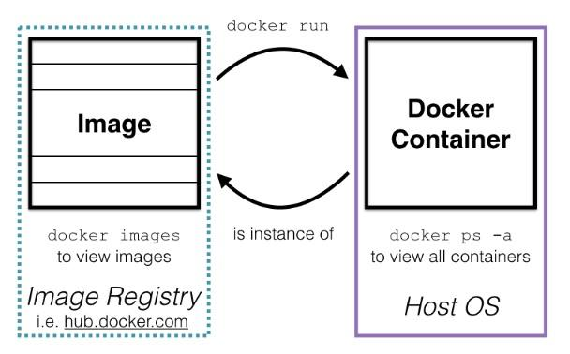
Images and Containers

Slide 7
Some Basic Docker Operations
Build
Push
Pull
Run
Start
Stop
Compose
Network
Tag
Logs
Port mapping
Volumes
Env variables
Mounting

Slide 8
Advantages
Simplified Configuration
Consistent Environment
Easy App Isolation
Fast Deployment
Security

Slide 9
Disadvantages
Docker is good but cannot completely replace virtual machines. There are some applications that cannot be perfectly deployed in containers. Docker is good for micro-services.
Tools to manage and monitor containers are limited as of now. However, in coming days, this limitation will shred off.

