Slide 1
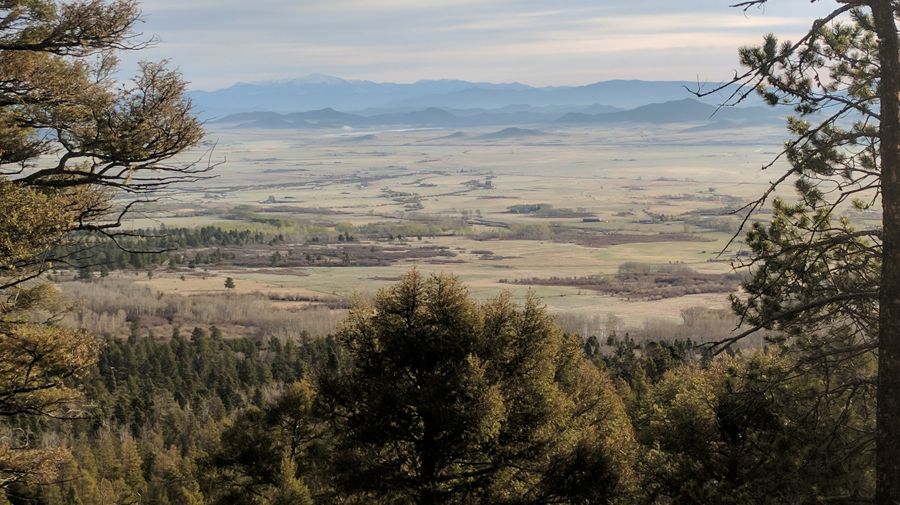
Contact Us!
Michael Wunder, PhD
michael.wunder@ucdenver.edu
Allison Pierce
allison.pierce@ucdenver.edu
@AlliKPierce
Scott Yanco
scott.yanco@ucdenver.edu
@scottyanco
Lab Website: https://mikewunder.wordpress.com/
Workshop Website:
https://syanco.github.io/CECAM_2019_Occupancy_Workshop/

