Slide 1
Decision Trees

Slide 2
Nominal Data
So far we consider patterns to be represented by feature vectors of real or integer values
Easy to come up with a distance (similarity) measure by using a variety of mathematical norms
What happens if features are not numbers?
  May not have a numerical representation
  Distance measures might not make sense
PR , ANN, & ML

Slide 3
Examples
Colors of fruit
  Green fruits are no more similar to red fruits then black fruits to red ones
Smell
Usefulness
Interesting
Etc.
PR , ANN, & ML

Slide 4
Examples (cont.)
Instead of a feature vector of numbers, we have a feature list of anything
Fruit {color, texture, taste, size}
DNA as a string of four letters AGCTTCGA, etc.
PR , ANN, & ML

Slide 5
Classification
Visualizing using n-dimensional space might be difficult
  How to map, say, smell, onto an axis?
  There might only be few discrete values (an article is highly interesting, somewhat interesting, not interesting, etc.)
Even though that helps, do remember you cannot take distance measure in that space
  (e.g., Euclidean distance in r-g-b color space does not correspond to human perception of color)
PR , ANN, & ML

Slide 6
Decision Trees
A classification based on a sequence of questions on
  A particular feature (E.g., is the fruit sweet or not?) or
  A particular set of features (E.g., is this article relevant and interesting?)
Answer can be either
  Yes/no
  Choice (relevant & interesting, interesting but not relevant, relevant but not interesting, etc.)
  Usual a finite number of discrete values
PR , ANN, & ML

Slide 7
Use of a Decision Tree
Relatively simple
  Ask question represented at the node
  Traverse down the right branch until a leaf node is reached
  Use the label at that leaf for the sample
Work if
  Links are mutually distinct and exhaustive (may include branches for default, N/A, D/N, etc.)
PR , ANN, & ML

Slide 8
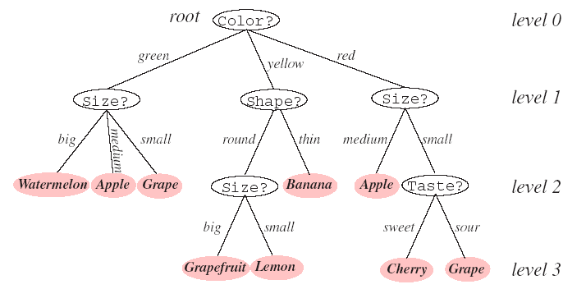
Use of a Decision Tree (cont.)
PR , ANN, & ML

Slide 9
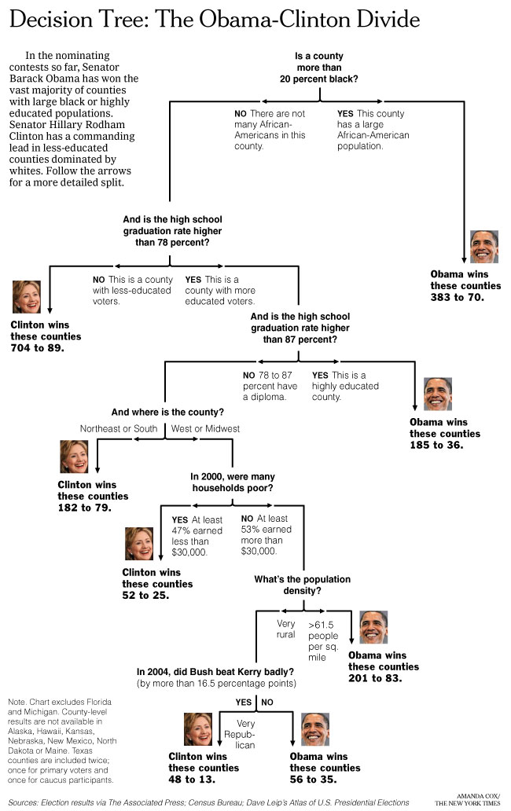
PR , ANN, & ML

Slide 10
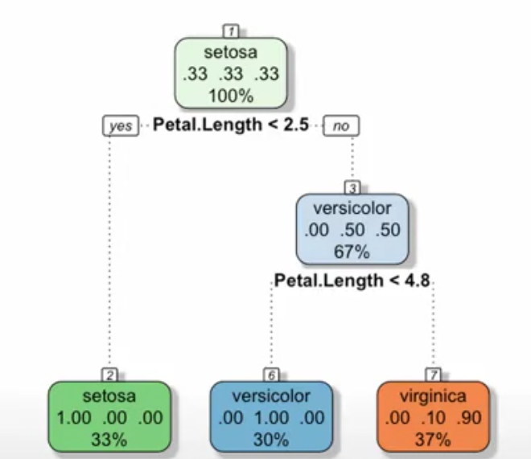
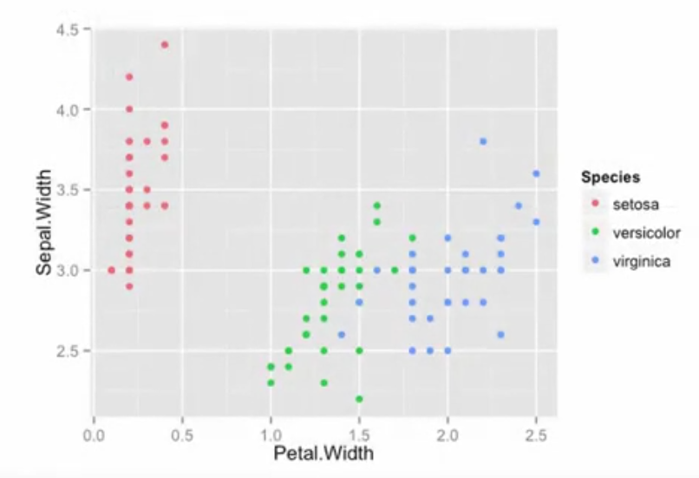
Popular Iris Dataset
{Sepal.length, sepal, width, petal.length petal.width}-> {setosa, versicolor, virgnica}
More “powerful” than linear discriminant
More variables to tune (overfitting?)
PR , ANN, & ML

Slide 11
Creation of a Decision Tree
Use supervised learning
  Samples with tagged label (just like before)
Process
  Number of splits
  Query selection
  Rule for stopping splitting and pruning
  Rule for labeling the leaves
  Variable combination and missing data
Decision tree CAN be used with metric data (even though we motivate it using nonmetric data)
PR , ANN, & ML

Slide 12
Number of Splits
Binary vs. Multi-way
  Can always make a multi-way split into binary splits
Color=green
Color?
yes
no
Color=yellow
green
green
yellow
red
yes
no
yellow
red
PR , ANN, & ML

Slide 13
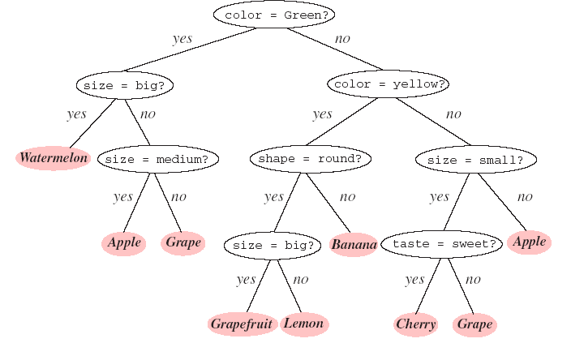
Number of Splits (cont.)
PR , ANN, & ML

Slide 14
Test Rules
If a feature is an ordered variable, we might ask is x>c, for some c
If a feature is a category, we might ask is x in a particular category
Yes sends samples to left and no sends samples to right
Simple rectangular partitions of the feature space
More complicated ones: is x>0.5 & y<0.3
PR , ANN, & ML

Slide 15
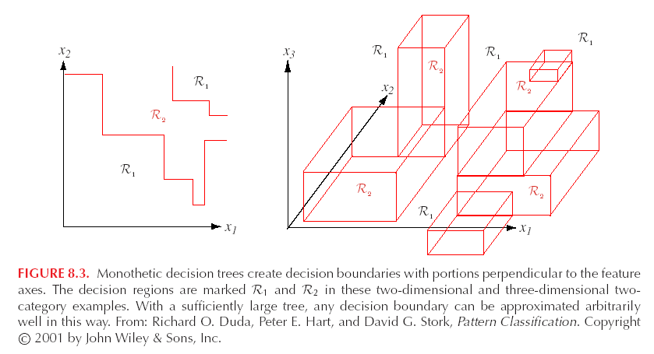
Test Rules (cont.)
PR , ANN, & ML

Slide 16
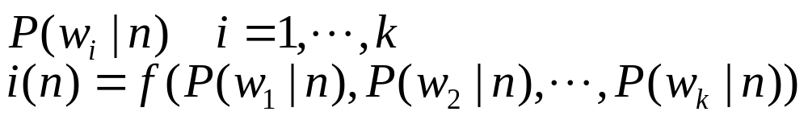
Criteria for Splitting
Intuitively,to make the populations of the samples in the two children nodes purer than the parent node
What do you mean by pure?
General formulation
  At node n, with k classes
  Impurity depends on probabilities of samples at that node being in a certain class
PR , ANN, & ML

Slide 17
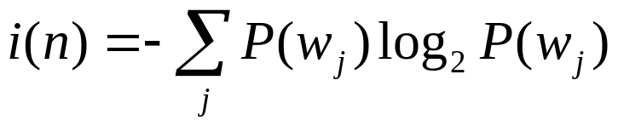
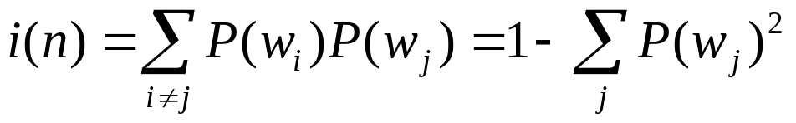
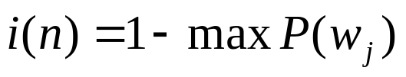
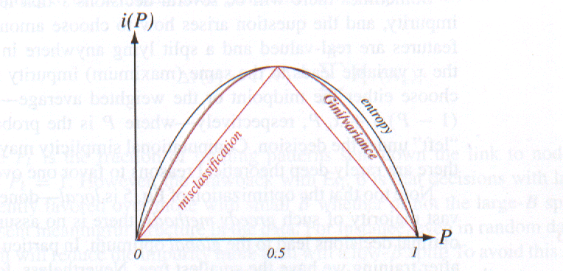
Possibilities
Entropy impurity
Variance (Gini) impurity
Misclassification impurity
PR , ANN, & ML

Slide 18
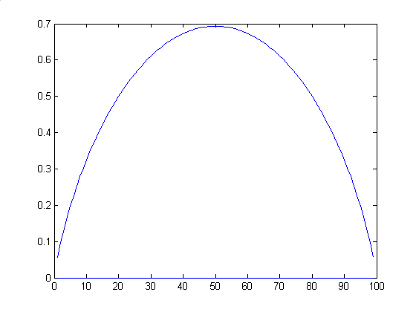
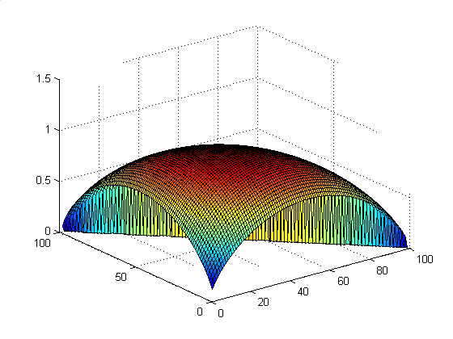
Entropy
A measure of “randomness” or “unpredictability”
In information theory, the number of bits that are needed to code the transmission
PR , ANN, & ML

Slide 19







Split Decision
Before split – fixed impurity
After split – impurity depends on decisions
The goal is maximize the drop in impurity
Difference between
  Impurity at root
  Impurity at children (weighted by population)
PR , ANN, & ML

Slide 20

Split Decision
We might also just minimize
The reason to use delta is because if entropy impurity is used, the delta is information gain
Usually, a single feature is selected from among all remaining ones (combination of features is possible, but very expensive)
PR , ANN, & ML

Slide 21
Example
Day | Outlook | Temperature | Humidity | Wind | Play tennis
D1 | Sunny | Hot | High | Weak | No
D2 | Sunny | Host | High | Strong | No
D3 | Overcast | Hot | High | Weak | Yes
D4 | Rain | Mild | High | Weak | Yes
D5 | Rain | Cool | Normal | Weak | Yes
D6 | Rain | Cold | Normal | Strong | No
D7 | Overcast | Cool | Normal | Strong | Yes
D8 | Sunny | Mild | High | Weak | No
D9 | Sunny | Cool | Normal | Weak | Yes
D10 | Rain | Mild | Normal | Weak | Yes
D11 | Sunny | Mild | Normal | Strong | Yes
D12 | Overcast | Mild | High | Strong | Yes
D13 | Overcast | Hot | Normal | Weak | Yes
D14 | Rain | Mild | High | Strong | No
PR , ANN, & ML

Slide 22
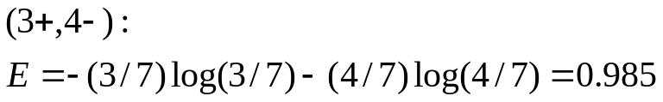
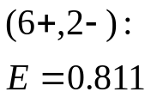
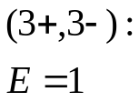
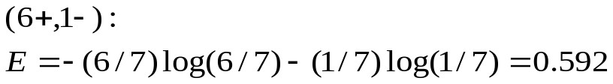
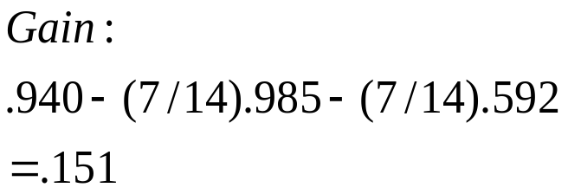
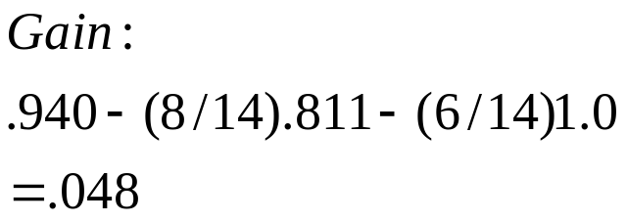
Example
Humidity
Wind
High
Normal
Weak
Strong
PR , ANN, & ML

Slide 23
Example
Outlook
Overcast
Rain
Sunny
Humidity
Yes
Wind
Strong
Weak
High
Normal
No
Yes
No
Yes
PR , ANN, & ML

Slide 24
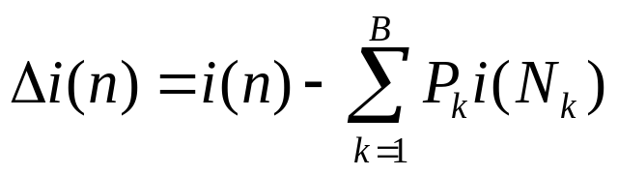
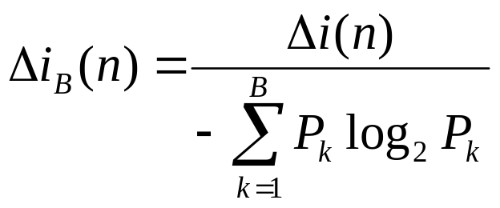
Multiway Splits
In general, more splits allow impurity to drop
  Splits reduce the samples in each branch
  With few samples, it is likely that one sample might dominate (1 sample, impurity=0, 2 samples, 50% chance impurity=0)
Proper scaling of change of impurity
  Large split is penalized
PR , ANN, & ML
Large entropy -> bad split

Slide 25
Caveats
Decisions are made locally, one steps at a time (greedy)
  Search in a “tree space” with all possible trees
  There is no guarantee that the tree is going to be optimal (shortest height)
  Other techniques (e.g., DP) can guarantee the optimal solution, but are more expensive
PR , ANN, & ML

Slide 26
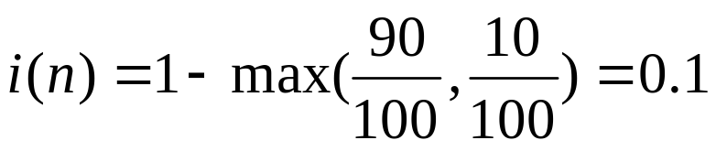
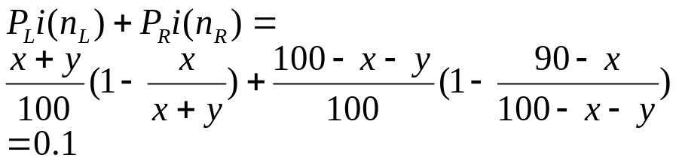
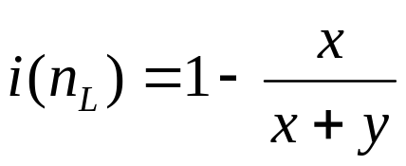
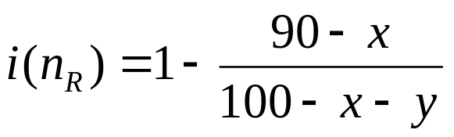
Caveats (cont.)
Some impurity may not be as good as others
E.g., 90 of w₁ and 10 of w₂ at a node, x of w₁ and y of w₂ go left and x > y and w₁ still dominate at both children
Using misclassification impurity
90w1,10w2
x w1, y w2
90-x w1,
10-y w2
PR , ANN, & ML

Slide 27

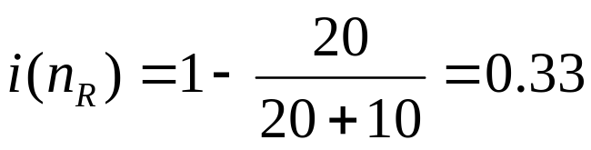
Caveats (cont.)
E.g., 90 of w₁ and 10 of w₂ at a node, 70 of w₁ and 0 of w₂ go left
Using misclassification impurity
70 w1,
0 w2
20 w1,
10 w2
PR , ANN, & ML

Slide 28
Caveats (cont.)
It may also be good to split based on classes (in a multi-class binary tree) instead of based on individual samples (twoing criterion)
C = {c1,c2,…, cn} breaks into
  C1 = {ci1,ci2,…cik}
  C2 = C –C1
PR , ANN, & ML

Slide 29
When to Stop Split?
Keep on splitting you might end up with a single sample per leaf (overfitting)
Not doing enough you might not be able to get good labels (it might be an apple, or an orange, or an …)
PR , ANN, & ML

Slide 30
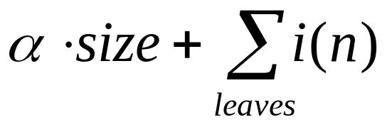
When to Stop Split? (cont.)
Thresholding: if split results in small impurity reduction, don’t do it
  What should the threshold be?
Size limit: if the node contains too few samples, don’t split anymore
  If region is sparse, don’t split
Combination of above (too small, stop)
PR , ANN, & ML

Slide 31
Pruning (bottom-up)
Splitting is a top-down process
We can also do bottom up by splitting all the ways down, followed by a merge (bottom-up process)
Adjacent nodes whose merge induces a small increase in impurity can be joined
Avoid horizontal effect
  Hard to decide when to stop splitting, the arbitrary threshold set an artificial “floor”
Can be expensive (explore more branches that might eventually be thrown away and merged)
PR , ANN, & ML

Slide 32
Assigning Labels
If a leaf is of zero impurity – no brainer
Otherwise, take the label of the dominant samples (similar to k-nearest neighbor classifier) – again, no brainer
PR , ANN, & ML

Slide 33
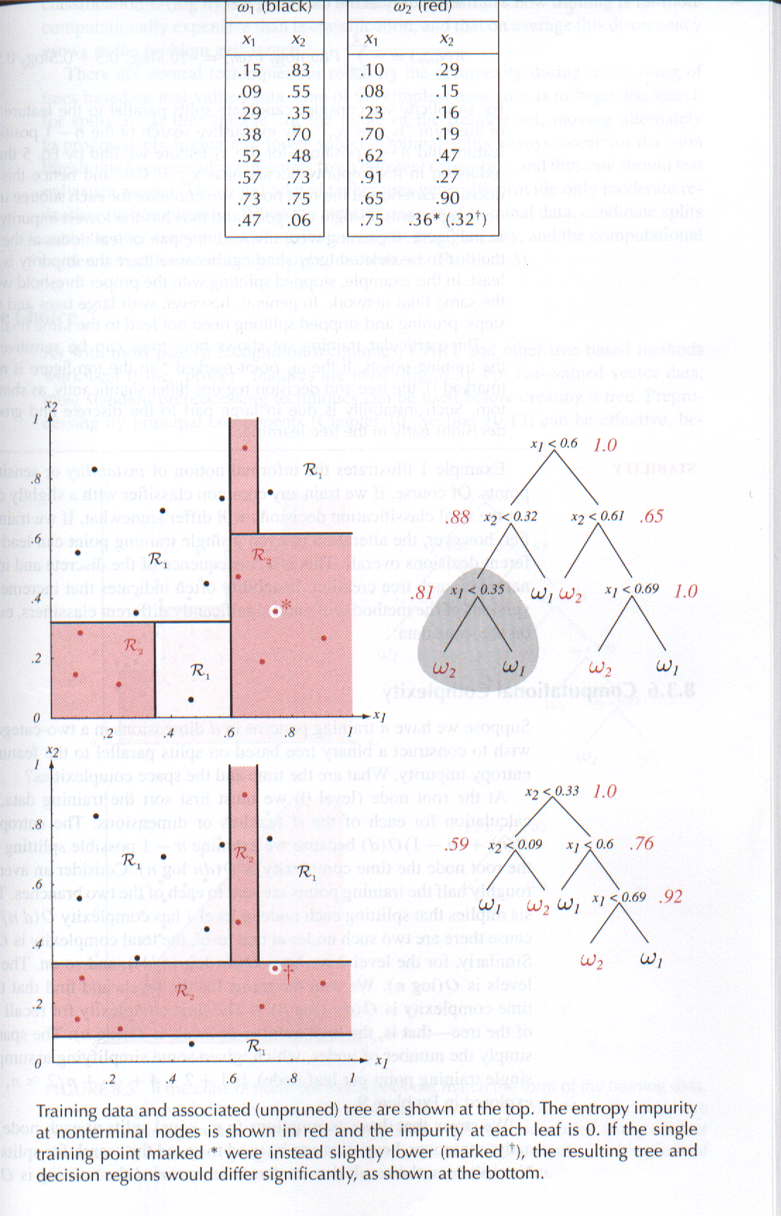
Example
PR , ANN, & ML

Slide 34
Missing Attributes
A sample can miss some attributes
In training
  Don’t use that sample at all – no brainer
  Use that sample for all available attributes, but don’t use it for the missing attributes – again no brainer
PR , ANN, & ML

Slide 35
Missing Attributes (cont.)
In classification
  What happens if the sample to be classified is missing some attributes?
  Use surrogate splits
    Define more than one split (primary + surrogates) at nonterminal nodes
    The surrogates should maximize predictive association (e.g., surrogates send the same number of patterns to the left and right as the primary)
    Expensive
  Use virtual values
    The most likely value for the missing attribute (e.g., the average value for the missing attribute of all training data that end up at that node)
PR , ANN, & ML

Slide 36
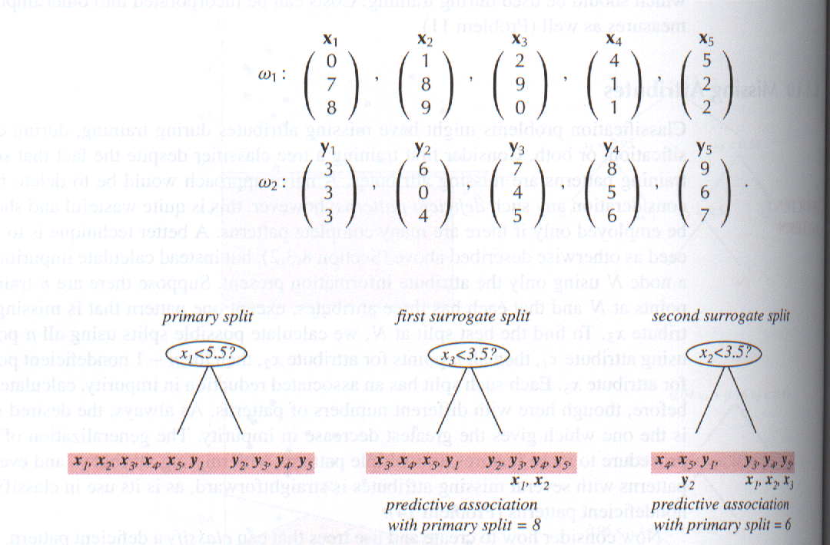
Missing Attributes (cont.)
PR , ANN, & ML

Slide 37
Feature Choice
No magic here – if feature distribution does not line up with the axes, the decision boundary is going to zigzag, which implies trees of a greater depth
Principal component analysis might be useful to find dominant axis directions for cleaner partitions
PR , ANN, & ML

Slide 38
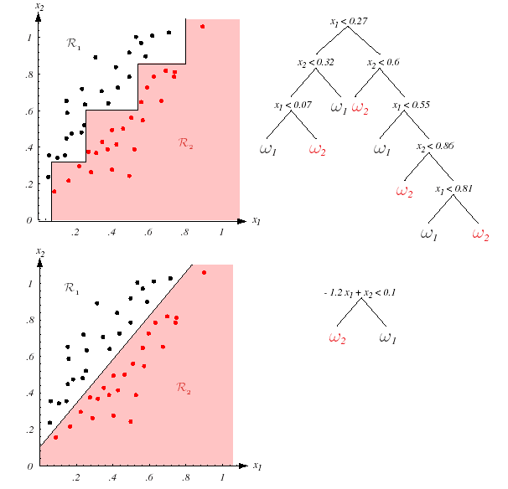
Feature Choice (cont.)
PR , ANN, & ML

Slide 39
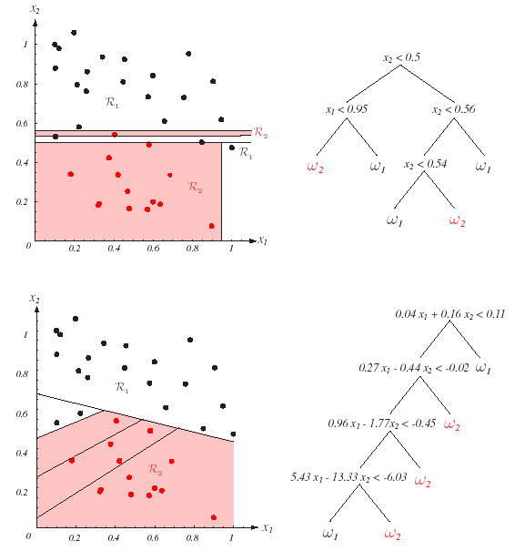
Feature Choice (cont)
PR , ANN, & ML

Slide 40
Other Alternatives
What we described is the CART (classification and regression tree)
ID3 (interactive dichotomizer)
  Nominal data
  Multi-way split at a node
  # level = # variables
C4.5
  No surrogate split (save space)
PR , ANN, & ML

Slide 41
A Pseudo Code Algorithm
ID3(Examples, Attributes)
  Create a Root node
  If all Examples are positive, return Root with label = +
  If all Examples are negative, return Root with label = -
  If no attributes are available for splitting, return Root with label = most common values (+ or -) in Examples
PR , ANN, & ML

Slide 42
  Otherwise
    Choose a best attribute (A) to split (based on infogain)
    The decision attribute for Root = A
    For each possible value vi of A
      Add a new branch below Root for A=vi
      Example_{vi} = all Examples with A=vi
      If Example_{vi} is empty
        Add a leaf node under this branch with label=most common values in Example
      Else
        Add a leaf node under this branch with label = ID3(Example_{vi},Attributes-A)
PR , ANN, & ML

Slide 43
Characteristics
Tree tends to be low biased but high variance (it has many tunable parameters)
Instead of using a single tree, a forest can be built (idea of bagging) and then the results averaged (random forest)
Important to reduce correlation between trees to get best results
PR , ANN, & ML

Slide 44
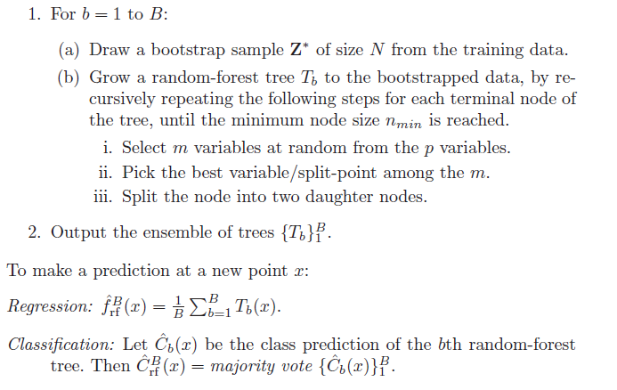
Random Forest
Trees are not constructed the same way
To reduce correlation
PR , ANN, & ML

Slide 45
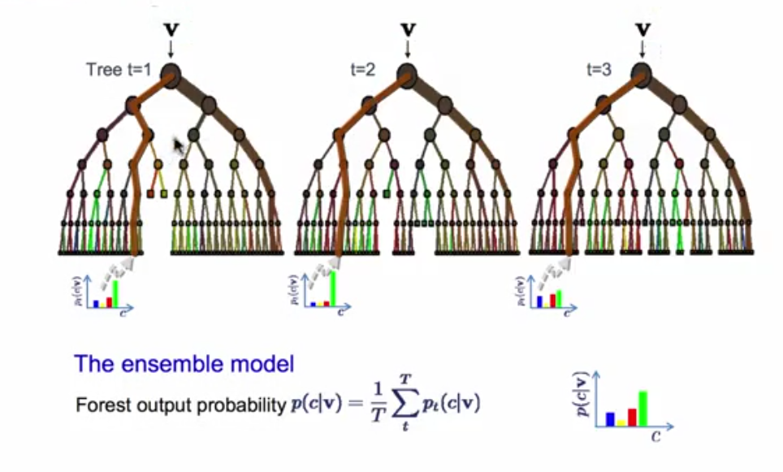
PR , ANN, & ML

