Slide 1
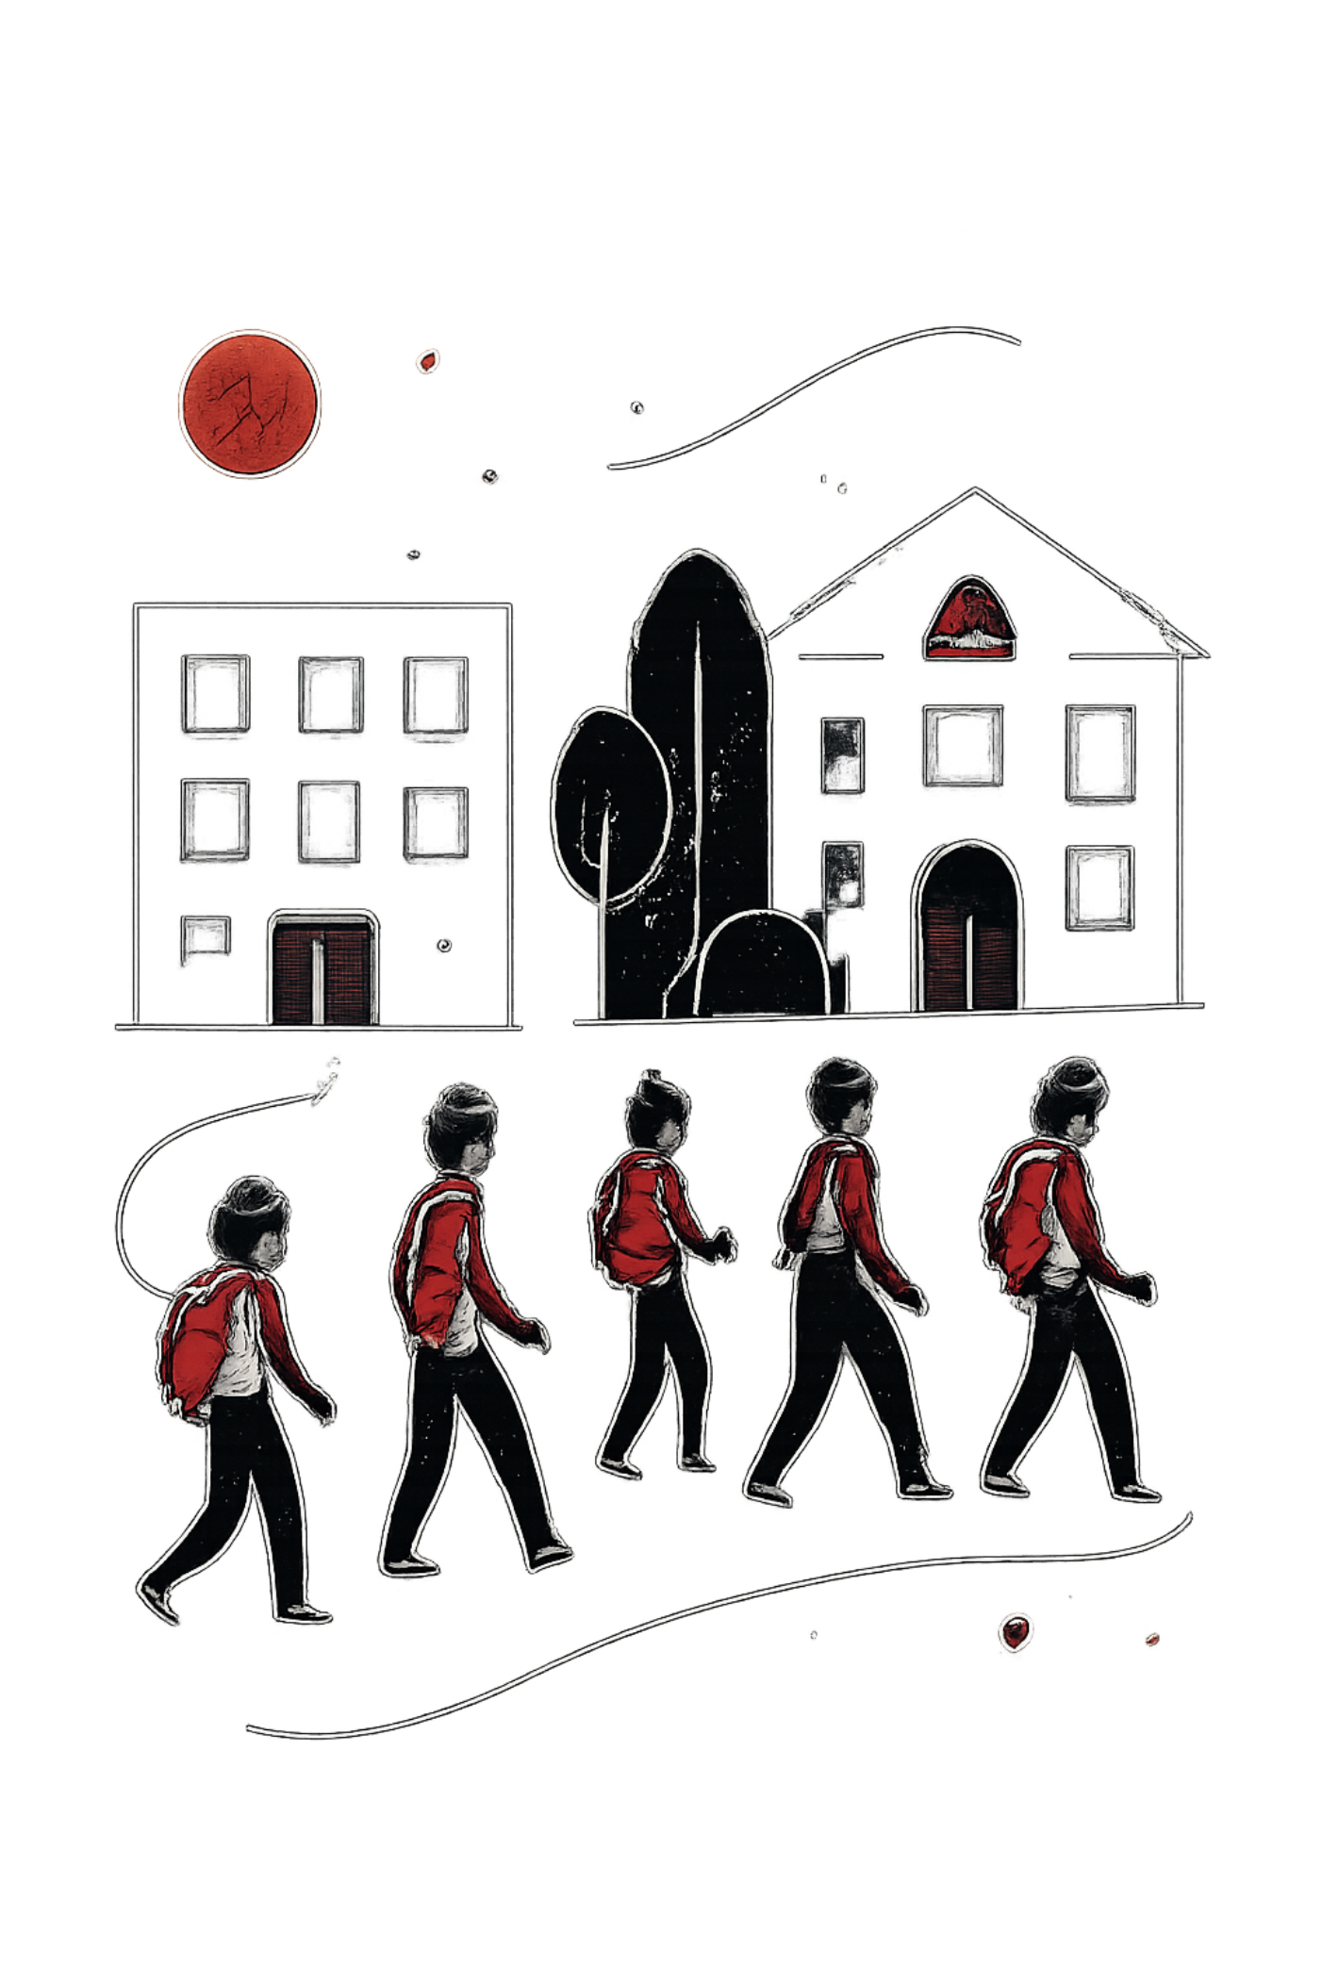
Notebook
One Campus. One Platform.
NITER's Unified Digital Campus Platform — NITER Innovate Hackathon 2026 "Be The Solution"

Slide 2
The Problem: Fragmented Campus Information
Academic
Notices
Transport
Information scattered across sources
Important updates difficult to track
Uncertain schedules and routes
Communication
Services
Split across multiple platforms
No unified digital experience

Slide 3
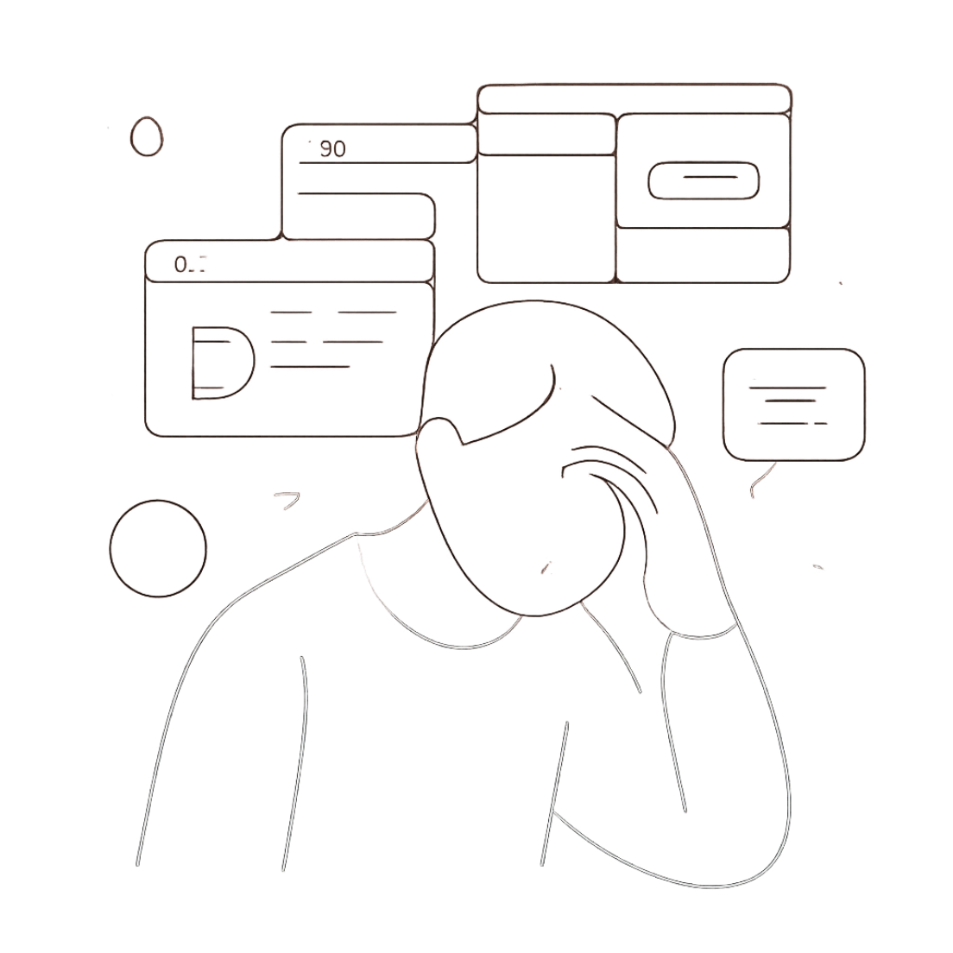
CORE PROBLEM
Students have information — but it's scattered across too many places.
The official hackathon identifies similar pain points across Academic, Transport, Student Welfare, Health, and Logistics. Notebook solves this by unifying everything into one platform.

Slide 4


Introducing Notebook
Notebook is a unified digital campus platform that brings NITER's entire student experience into one ecosystem. Instead of relying on multiple disconnected platforms, students can use Notebook as a central place to:
Access campus information
Connect with the student community
Share and interact with content
Manage their profile
Control profile visibility and privacy
Access academic resources
Discover campus services
One platform instead of scattered digital experiences.

Slide 5





A Student's Digital Campus Journey
Notebook guides students through five stages of their digital campus experience.
Discover
Find campus information and updates in one place.
Connect
Interact with classmates and the wider NITER community.
Organize
Access and save important information.
Control
Manage profile visibility and privacy.
Expand
Integrate additional campus services as the platform grows.
Designed to grow with NITER.

Slide 6




Key Features
Community
Academic
Create and interact with posts, user profiles, saved posts, and media sharing.
Centralized access to academic resources and campus information.
Privacy
Platform
User-controlled profile visibility and privacy settings.
Responsive interface, modular architecture, and cloud-based media management.

Slide 7

Technology Stack
Frontend
Backend & Database
Authentication
HTML5 • CSS3 • JavaScript
Supabase Auth
Supabase
Media Storage
Deployment
Version Control
Cloudinary
Netlify
Git • GitHub
Domain & DNS
Cloudflare
Modular
Scalable
Cloud-Based
Responsive

Slide 8
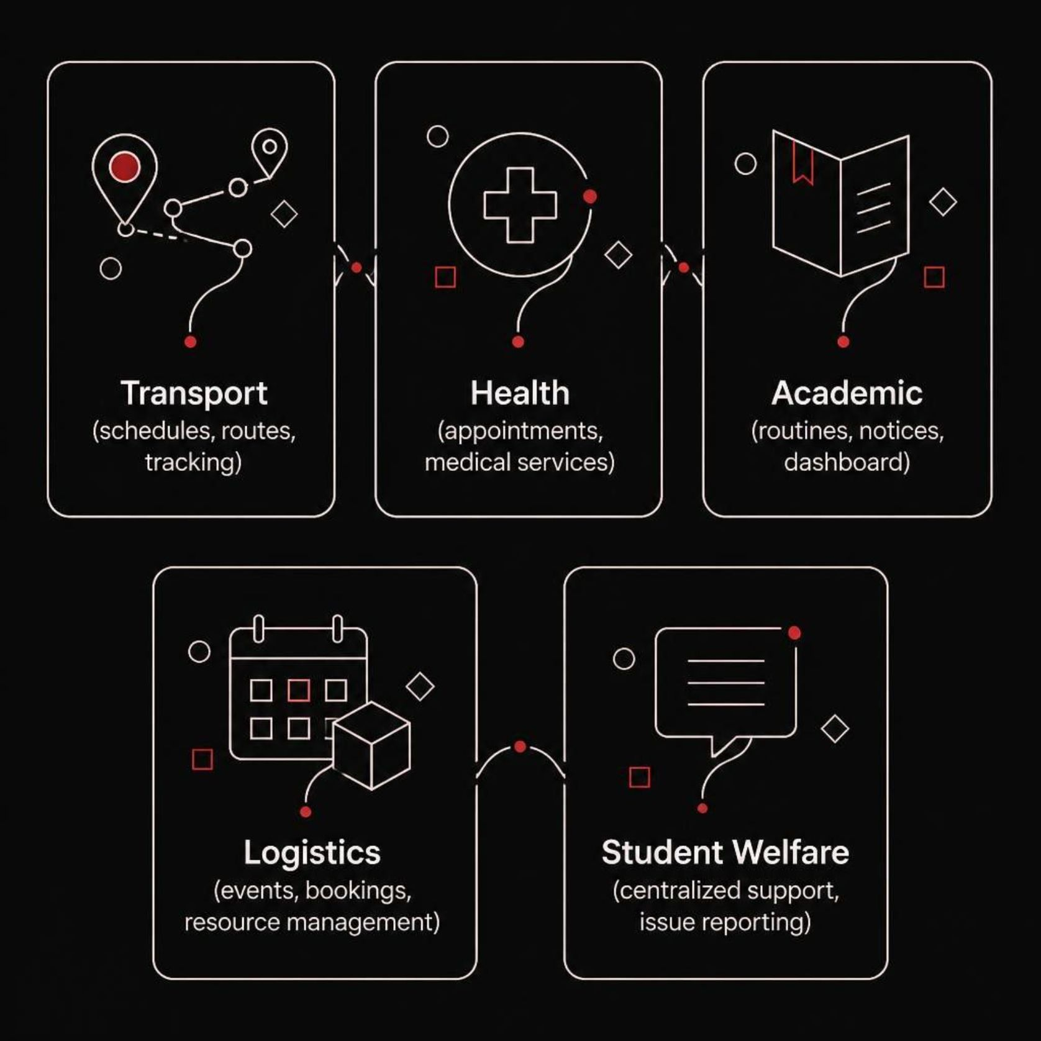
Future Impact: From Prototype to Ecosystem
Notebook can progressively integrate the following campus services:
Each module addresses a key pain point identified by the hackathon, building toward a fully unified digital campus experience.

Slide 9

Long-Term Vision
A single digital ecosystem connecting students, faculty, administration, and campus services.
The hackathon emphasizes solutions that are practical, usable, and scalable for real deployment at NITER. Notebook is designed to grow from a student-facing platform into a comprehensive campus ecosystem.

Slide 10

Notebook
One Campus. One Platform.
We don't need more places to look. We need one place that connects everything.
Thank You — NITER Innovate Hackathon 2026 "Be The Solution"

