Slide 1
Disease Diagnostic Expert System
By Group-6

Slide 2
Members
IIT2015007 Kunal Gupta IIT2015012 Aditya Pimparkar IIT2015014 Sandeep Singh IIT2015036 Abhinav Khare
IIT2015058 Boris Hembrom IIT2015064 Jayesh Patil IIT2015065 Soumik Chatterjee IIT2015067 S Akash IIT2015074 Shubham Padia IIT2015075 Tushar Jandial IIT2015078 Jitendra Kumar IIT2015080 Ayush Bhatt IIT2015085 Swapnil Sharma IIT2015087 Atul Sinha
IIT2015096 Ritika Mowani
LIT2015002 Raghav Khandelwal

Slide 3
What is an Expert System ?
An Expert System is a computer program that represents and reasons with knowledge of some specialist subject with a view to solving problems or giving advice.
Expert Systems are a subfield of Artificial Intelligence.

Slide 4
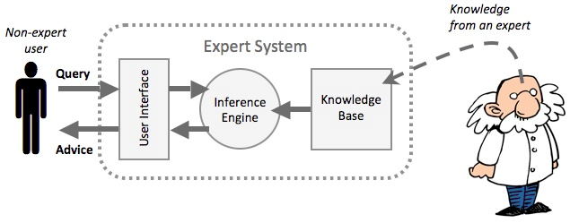
How does an expert system work?

Slide 5
User Interface:
This is the system that allows a non-expert user to query (question) the expert system, and to receive advice..
Knowledge Base:
This is a collection of facts and rules. The knowledge base is created from information provided by human experts.
Interface Engine:
This acts rather like a search engine, examining the knowledge base for information that matches the user's query.
Non Expert user:
The non-expert user queries the expert system. This is done by asking a question, or by answering questions asked by the expert system.

Slide 6
What are expert systems used for?
Medical diagnosis.
Playing strategy games like chess against a computer.
Providing financial advice.
Helping to diagnose car engine problems.
Helping to discover locations.

Slide 7
About Our Project
The project is a disease diagnosis system that requires three user inputs, namely the body part affected, the symptom and the degree of illness. This data is evaluated to generate a result.
The tools used : Front-end – JAVA Swing
Back-end - JESS

Slide 8
Procedure followed
The Knowledge base consisting of facts and rules is in a .txt file which is deficiency.txt.
We take symptoms as input and use them as facts, then use rules in knowledge base to deduct the outcome.
The mapping is done in the data.clp file.
The reset button helps in entering the new input.

Slide 9
Result
The developed expert system successfully diagnoses the diseases/causes according to the provided symptoms in input.
The diagnostic accuracy increases according to the number of symptoms provided.

Slide 10
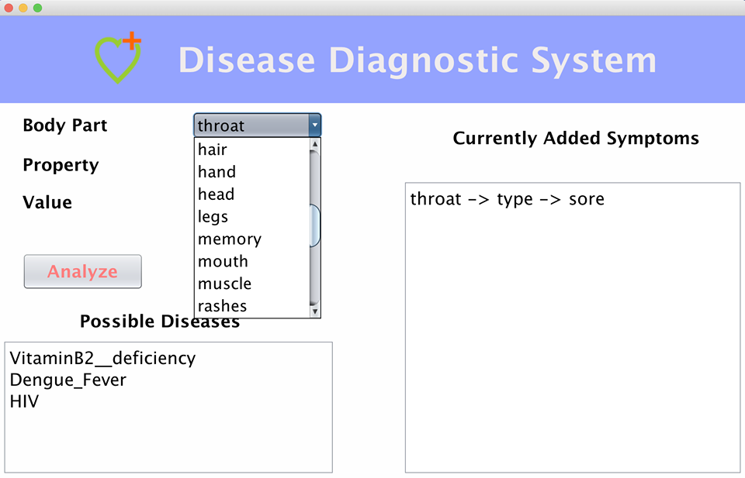
Place your screenshot here
Screenshots

Slide 11
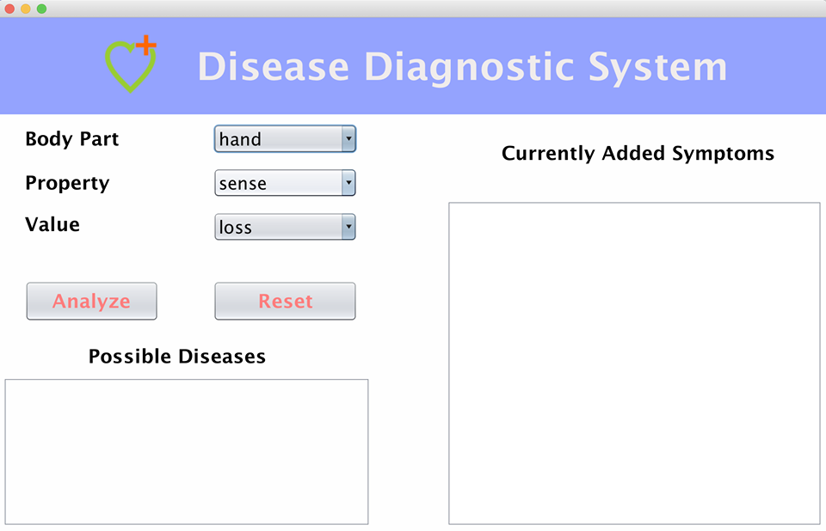
Place your screenshot here
Screenshots

Slide 12
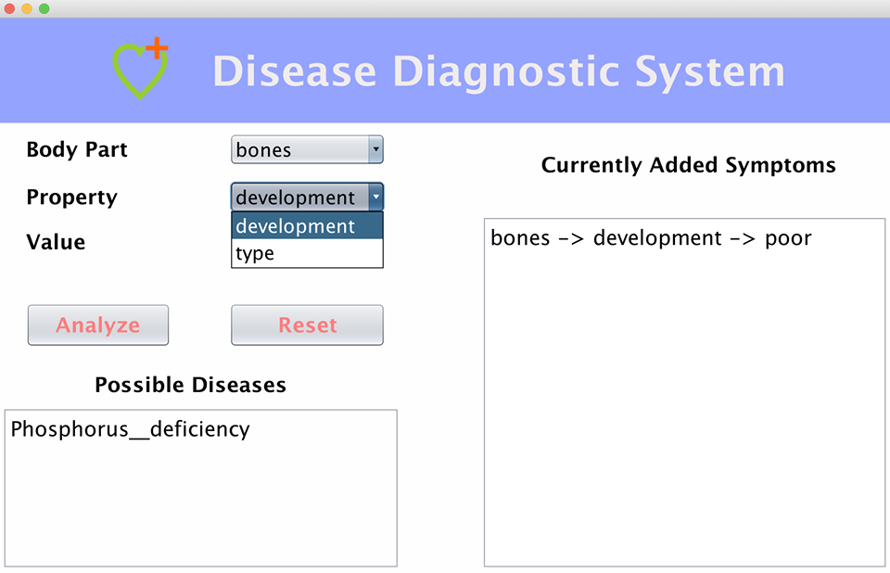
Place your screenshot here
Screenshots

Slide 13
Limitations
The limitations of our project include:
1. Though the disease predicted is almost precise but the accuracy can be increased by storing more elaborate data in the database.
2. It can not redesign itself if circumstances change.

Slide 14
Product Scope
This product can be used by anyone to detect the diseases even without any Medical Background.

Slide 15
Thank You!

