Slide 1


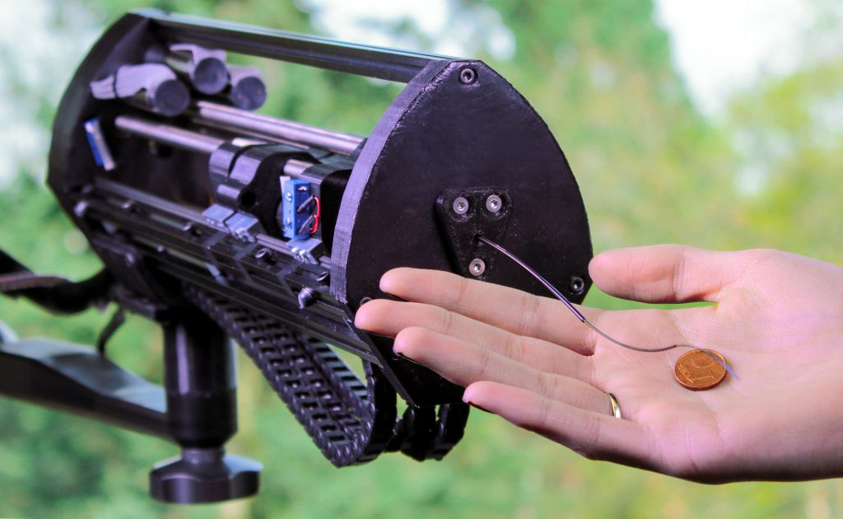
Data-Driven Forward Kinematics Modeling of Concentric Tube Continuum Robot
Ali Syaugi Bilfagih
Bionics Engineering
2024/2025

Slide 2
Outline
Problem Description
Dataset Description
Exploratory Data Analysis
Train-Test Split
Cross-Validation and Hyperparameter Tuning
Model Comparison and Evaluation
Conclusion

Slide 3
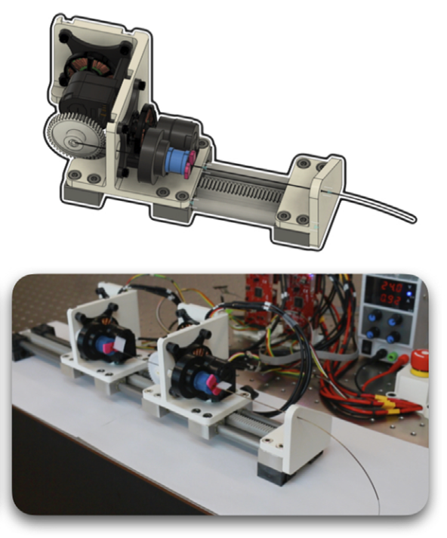
Problem Description
Continuum Robots are a type of robot which is characterized by its absence of rigid-links and joint and continuous appearance.
Among types of Continuum Robots, Concentric Tube refers to the mechanism which utilizes curved multi-tube catheter structures.
Difficulties to model Concentric Tube Continuum Robot Forward Kinematics using traditional physical based approach due to its non-linearity behaviour of elastic interactions between the flexible tubes.
Data-driven approach can be utilized to be an alternative method, thus a smaller error motion could be achieved.
Techniques:
Linear Regression
Random Forest Regression
Extra Trees Regression
Notes:
Benefit? Motion planning

Slide 4
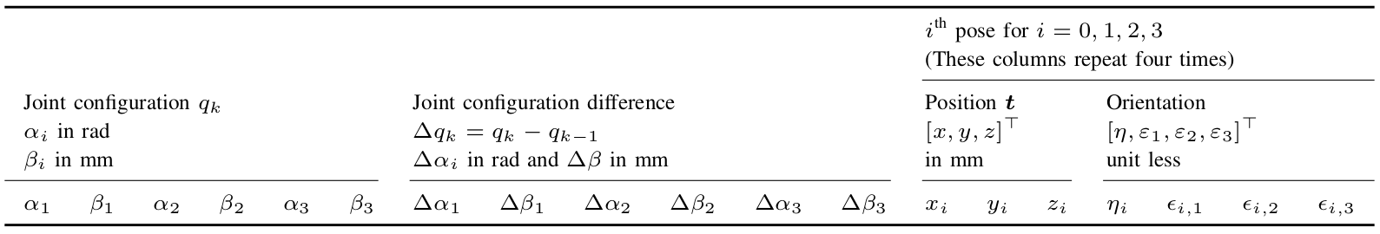
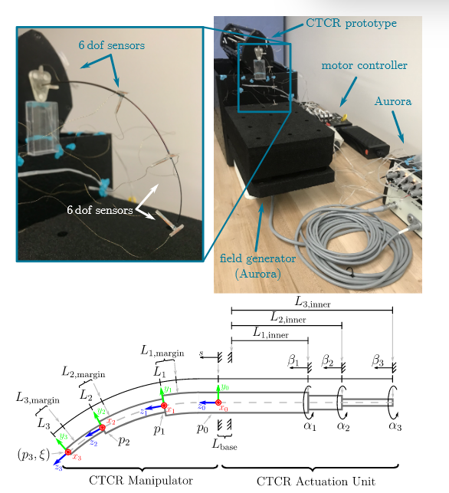
Dataset Description
Dataset Source: https://github.com/ContinuumRoboticsLab/CRL-Dataset-CTCR-Pose
Dataset 40 column and 100000 row
six absolute joint values
six relative joint values
pose of the base
pose of the proximal sensor attached to the outermost tube
pose of the sensor attached to the middle tube
pose of the distal sensor attached to the most inner tube

Slide 5
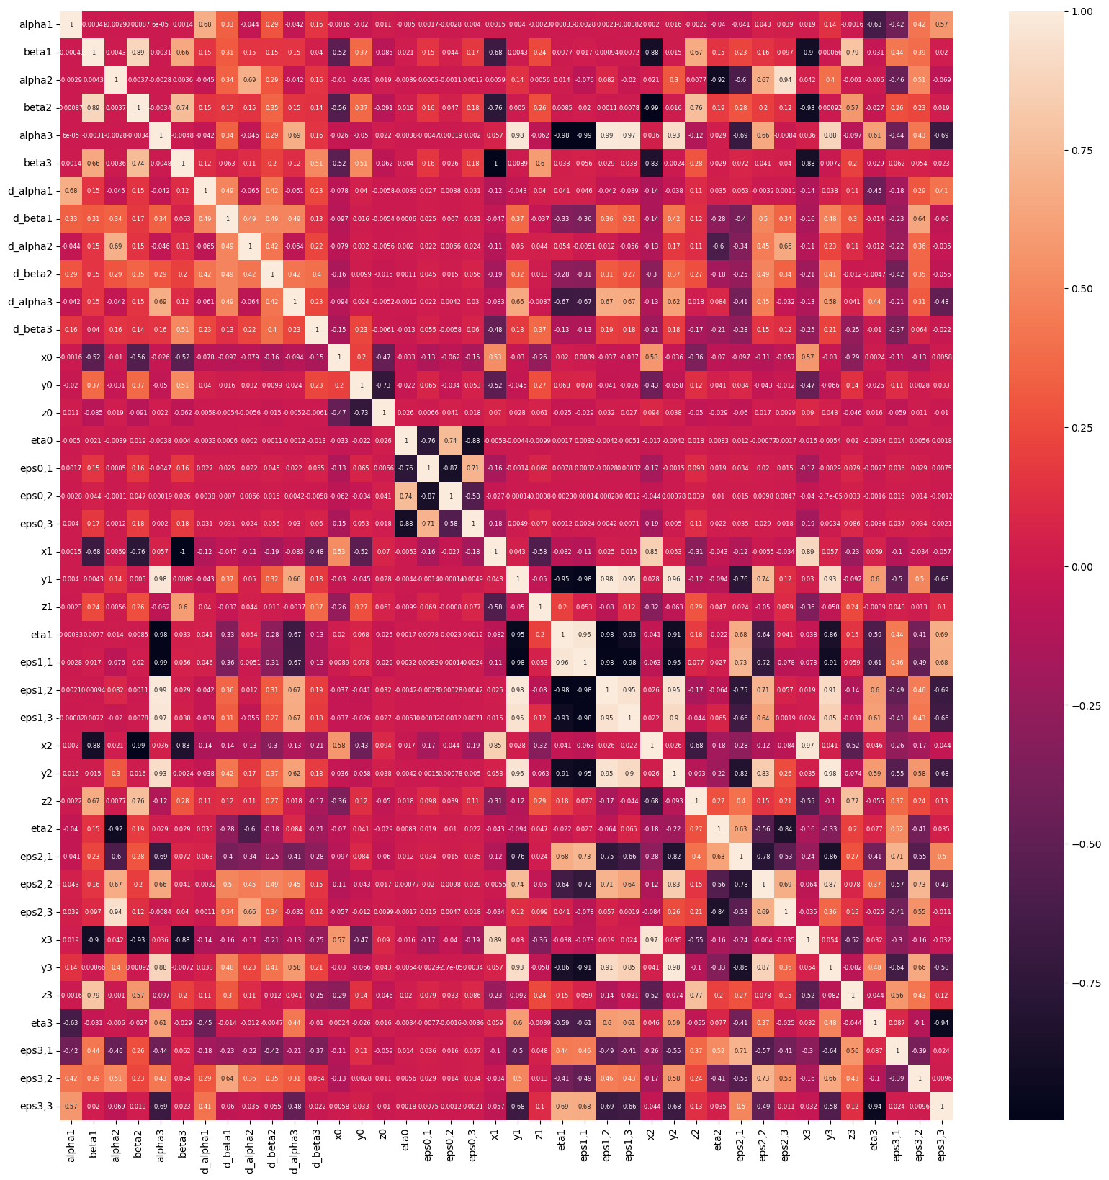
Exploratory Data Analysis
General heatmap of the dataset was generated.
Then, the heatmap is simplified only among joint configurations and tip pose [x₃, y₃, z₃, η, ε₁, ε₂, ε₃]⊤.

Slide 6
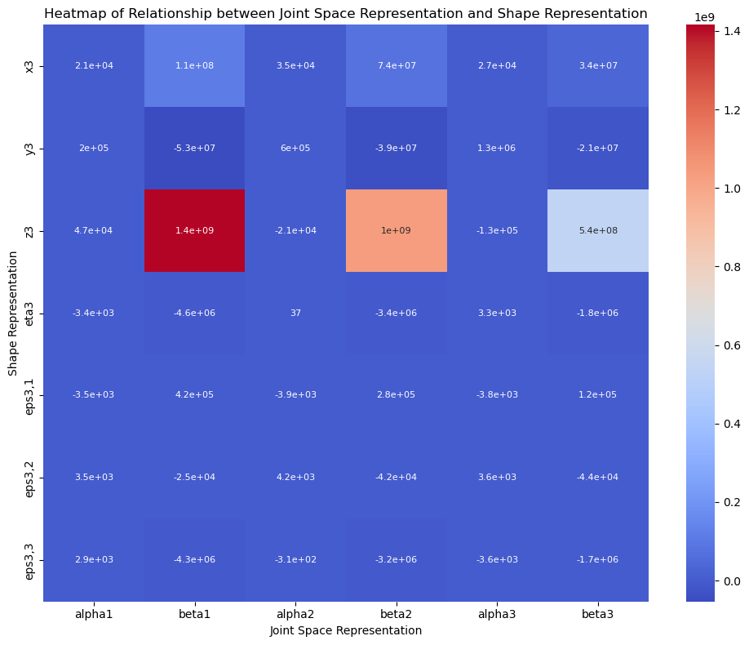
Exploratory Data Analysis
General heatmap of the dataset was generated.
Then, the heatmap is simplified only among joint configurations and tip pose [x₃, y₃, z₃, η, ε₁, ε₂, ε₃]⊤.

Slide 7
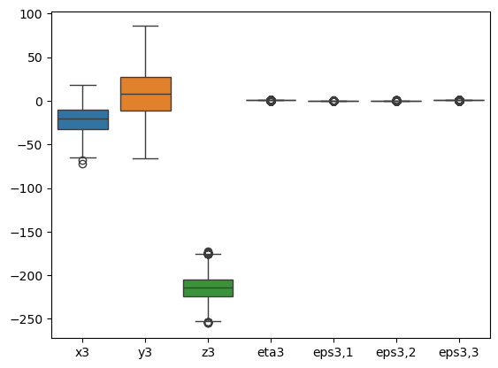
Exploratory Data Analysis
The outlier on the dataset was observed by using boxplot. These outliers for each position points and orientation angles indicate a phenomenon which is called as ‘snapping’.

Slide 8
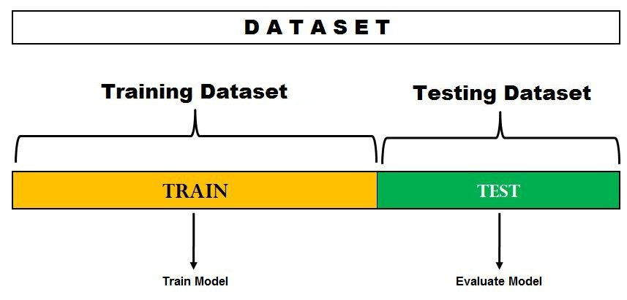
Dataset Splitting
Dataset is separated into three main dataframes, including joint configuration, position representation, and orientation representation.
Then, each are separated into training and test sets with proportions 80:20 respectively.

Slide 9
Cross-Validation and Hyperparameter Tuning
Parameter | List of Values | Best Parameter Value
Linear Regression
fit_intercept | True, False | True
n_jobs | 1, 5, 10, 15, None | 1
positive | True, False | False
Random Forest Regressor
n_estimators | 10, 50, 100, 500 | 500
max_depth | 5, 10, 20, None | None
max_features | None, log2, sqrt | Log2
Extra Trees Regressor
n_estimators | 10, 50, 100, 300 | 300
max_depth | 5, 10, 20, None | None
max_features | None, log2, sqrt | None
Grid Search Hyperparameter tuning and K-folds Cross-Validation was implemented, where k=10.

Slide 10
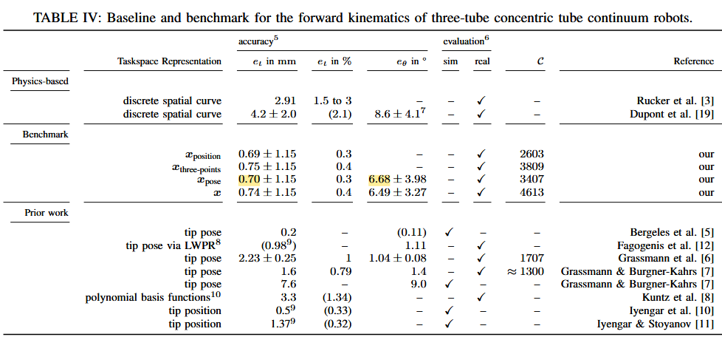
Model Comparison and Evaluation
Model | R2 Score | Error Position (mm)
Linear Regression | 0.9199 | 3.451
Random Forest Regressor | 0.991 | 1.17
Extra Trees Regressor | 0.994 | 0.923
Model | R2 Score | Error Orientation (°)
Linear Regression | 0.832 | 14.17
Random Forest Regressor | 0.965 | 8.968
Extra Trees Regressor | 0.972 | 9.116

Slide 11
Conclusion
Extra Trees outperformed Linear Regression and Random Forest Regressor in both position and orientation predictions
All model generally performs better for position prediction compared to orientation.
Although it could not surpass the paper result, Extra Trees can be utilized for rapid data-driven forward kinematics modeling of Concentric Tube Continuum Robot

Slide 12
References
Grassmann, R.M., Chen, R.Z., Liang, N., & Burgner-Kahrs, J. (2022). A Dataset and Benchmark for Learning the Kinematics of Concentric Tube Continuum Robots. 2022 IEEE/RSJ International Conference on Intelligent Robots and Systems (IROS), 9550-9557.
Grassmann, R. M., Shentu, C., Hamoda, T., Dewi, P. T., & Burgner-Kahrs, J. (2024). Open continuum robotics–one actuation module to create them all. Frontiers in Robotics and AI, 11.

Slide 13
Thank you!

