Slide 1
GPIO
Programming by Registers

Slide 2
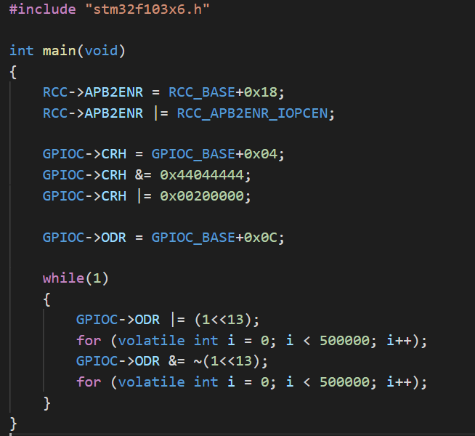
Any thoughts ?

Slide 3
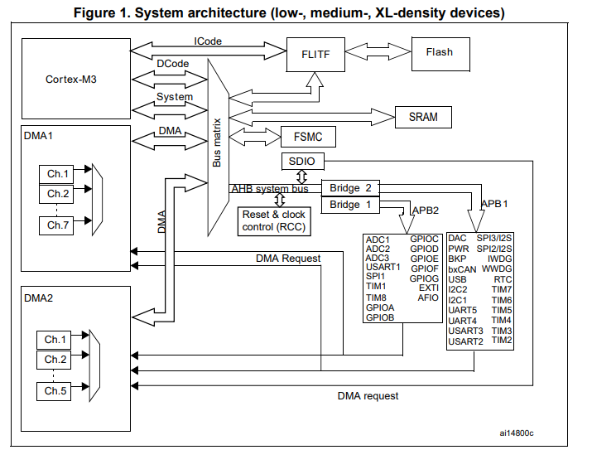
System Architecture

Slide 4
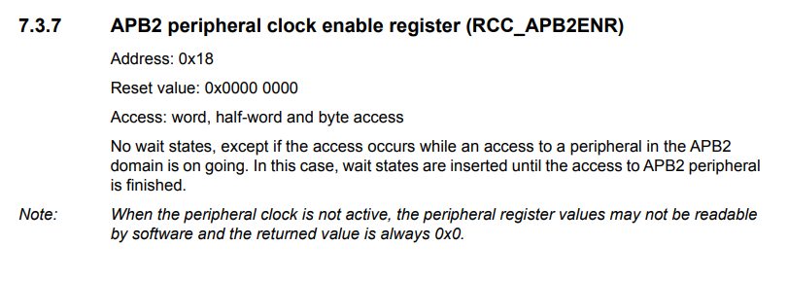
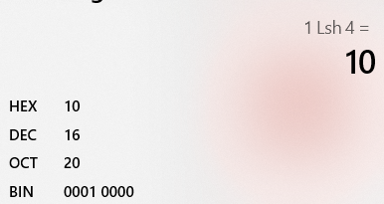
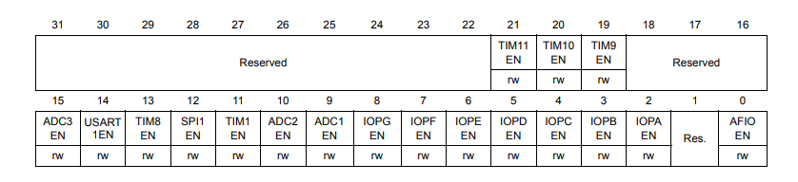

Therefore…

Slide 5
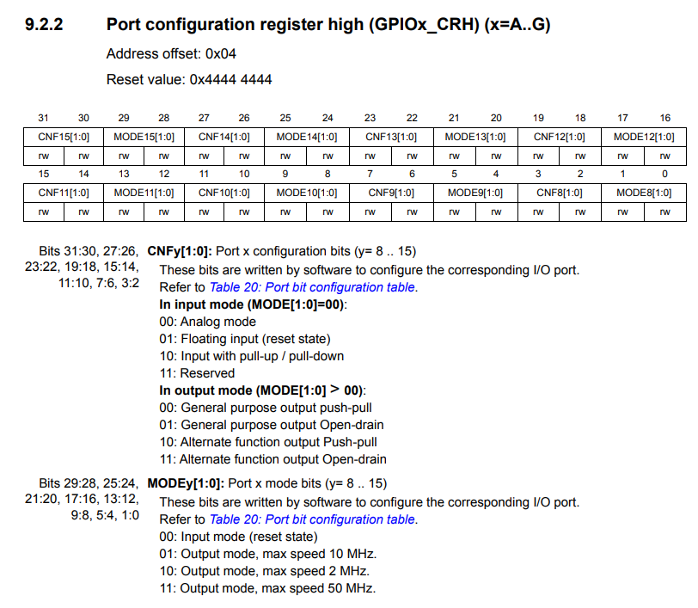
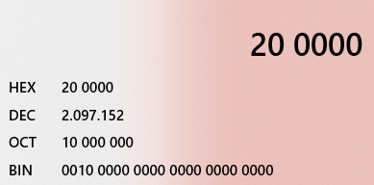
Set Port C Pin 13 as Output

Slide 6
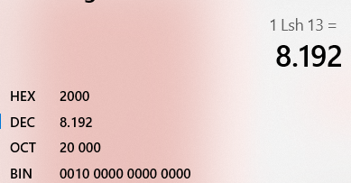
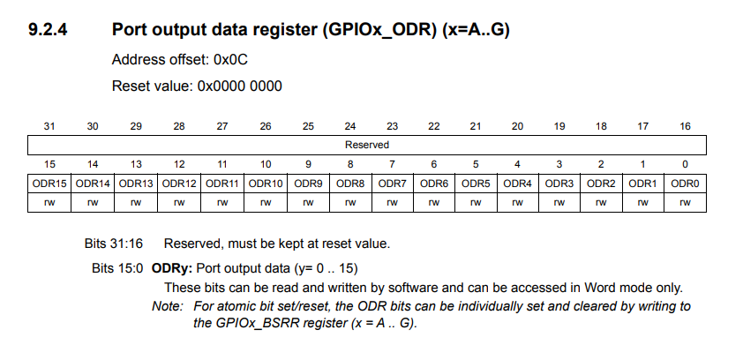
Set and Reset Port C Pin 13

Slide 7
Practices :
Make a Traffic Light using LEDs in Port B
Read Input from Button (clue : read about GPIOx_IDR)

Slide 8
Thank you!

