Slide 1
Final Presentation for Sponsors
EMC Education Services
Data Science & Big Data Analytics
[Marina Belyalova, Vladimir Matveev]
[Final Lab]
[19.01.17]
Notes:
EMC Ed Services CA and DCA Launch Master V8

Slide 2
Project Goals
A financial planning company, FPC would like to expand the set of services they offer by creating an online site for loan advice.
FPC realizes that the customers are looking for fast responses and the online -service must provide an answer within 45 seconds.
Ideally, the model behind this advice site can give reasonable, grounded predictions.

Slide 3
Model Description
Overview of Basic Methodology: We have created a basic model based on random forest algorithm and SGDClassifier algorithm, that was realised in python and R. To test the predictive power of the model using standard scoring and roc-auc curve.
Model: Random forest model and SGDClassifier
Dependent variable: Binary variable, of churn/no churn
Scope:
  230,000 subscribers about clients from state 27, Minnesota
  The data provided for analysis in this lab is an extract for the year 2010.
Sampling
  Training sample: 23,000 subscribers
  Testing sample: 207,000 subscribers
The model developed has predictive power at least as good as the bank’s current churn model
  The model developed has predictive power at least 0.79-0.81 at score. ROC-AUC curve squar is nearly 0.67-0.68.

Slide 4
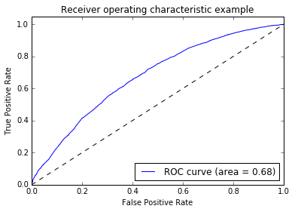

Key Points
Example of Key Points Using Yoyodyne Scenario
Both models have approximately the same sensitivity. Such indicators are very good for models of this class, this is not the final banking predictive model.

Slide 5
Recommendations
Implement the model as a pilot, before more wide-scale rollout – test and learn from initial pilot on performance and precision.
Run the predictive model daily or weekly to be proactive on customer churn
In-database scorer can score large datasets in a matter of minutes and can be run daily.
Develop targeted customer surveys to investigate there financial behavior.

