Slide 1
Waymo
Analysis of Ride Hailing Data

Slide 2
Index
Data Integrity
High Frequency Neighborhoods
Low Frequency Neighborhoods
Pricing Regression Analysis
Competitive Pricing

Slide 3
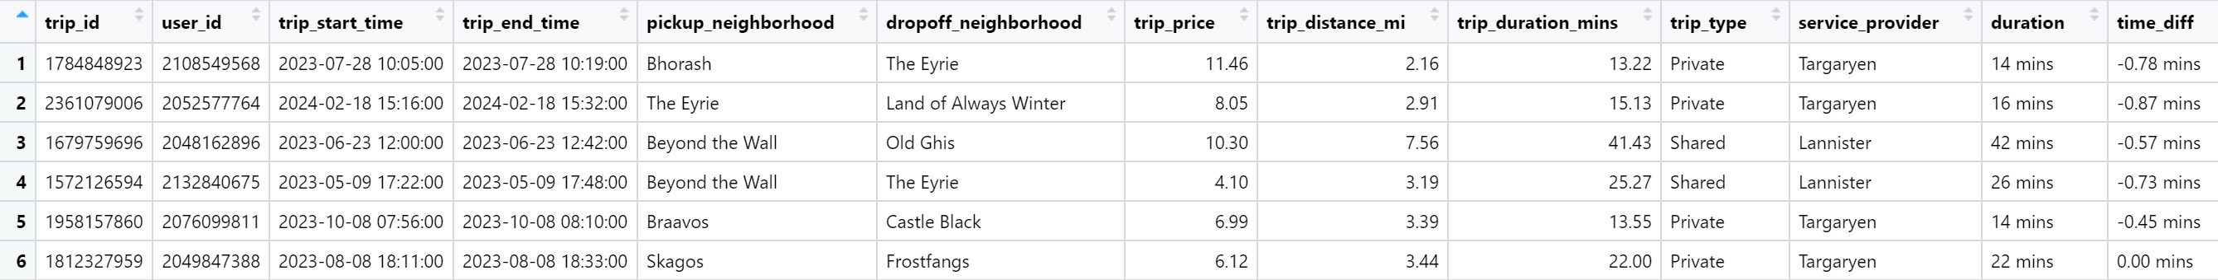
Data Integrity
To verify integrity of our ride hailing dataset:
Check for Completeness. A preliminary test indicates one record of missing values.
Check for Accuracy. A key field in the dataset being trip_duration_mins. Verify against trip_end_time-trip_start_time to rule out anomalies > 1 min. This ensures accuracy of data rendered.

Slide 4
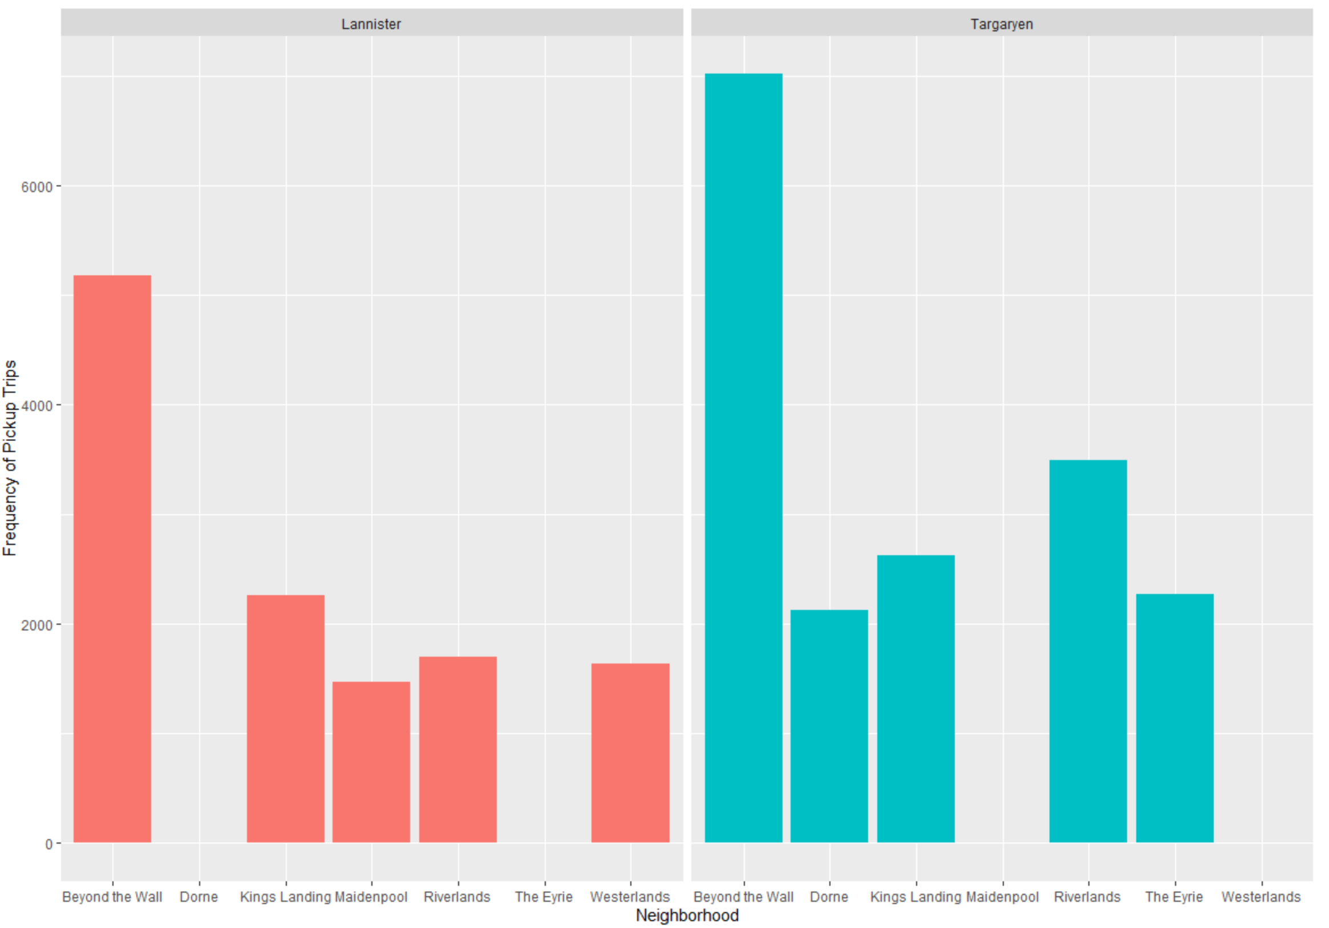
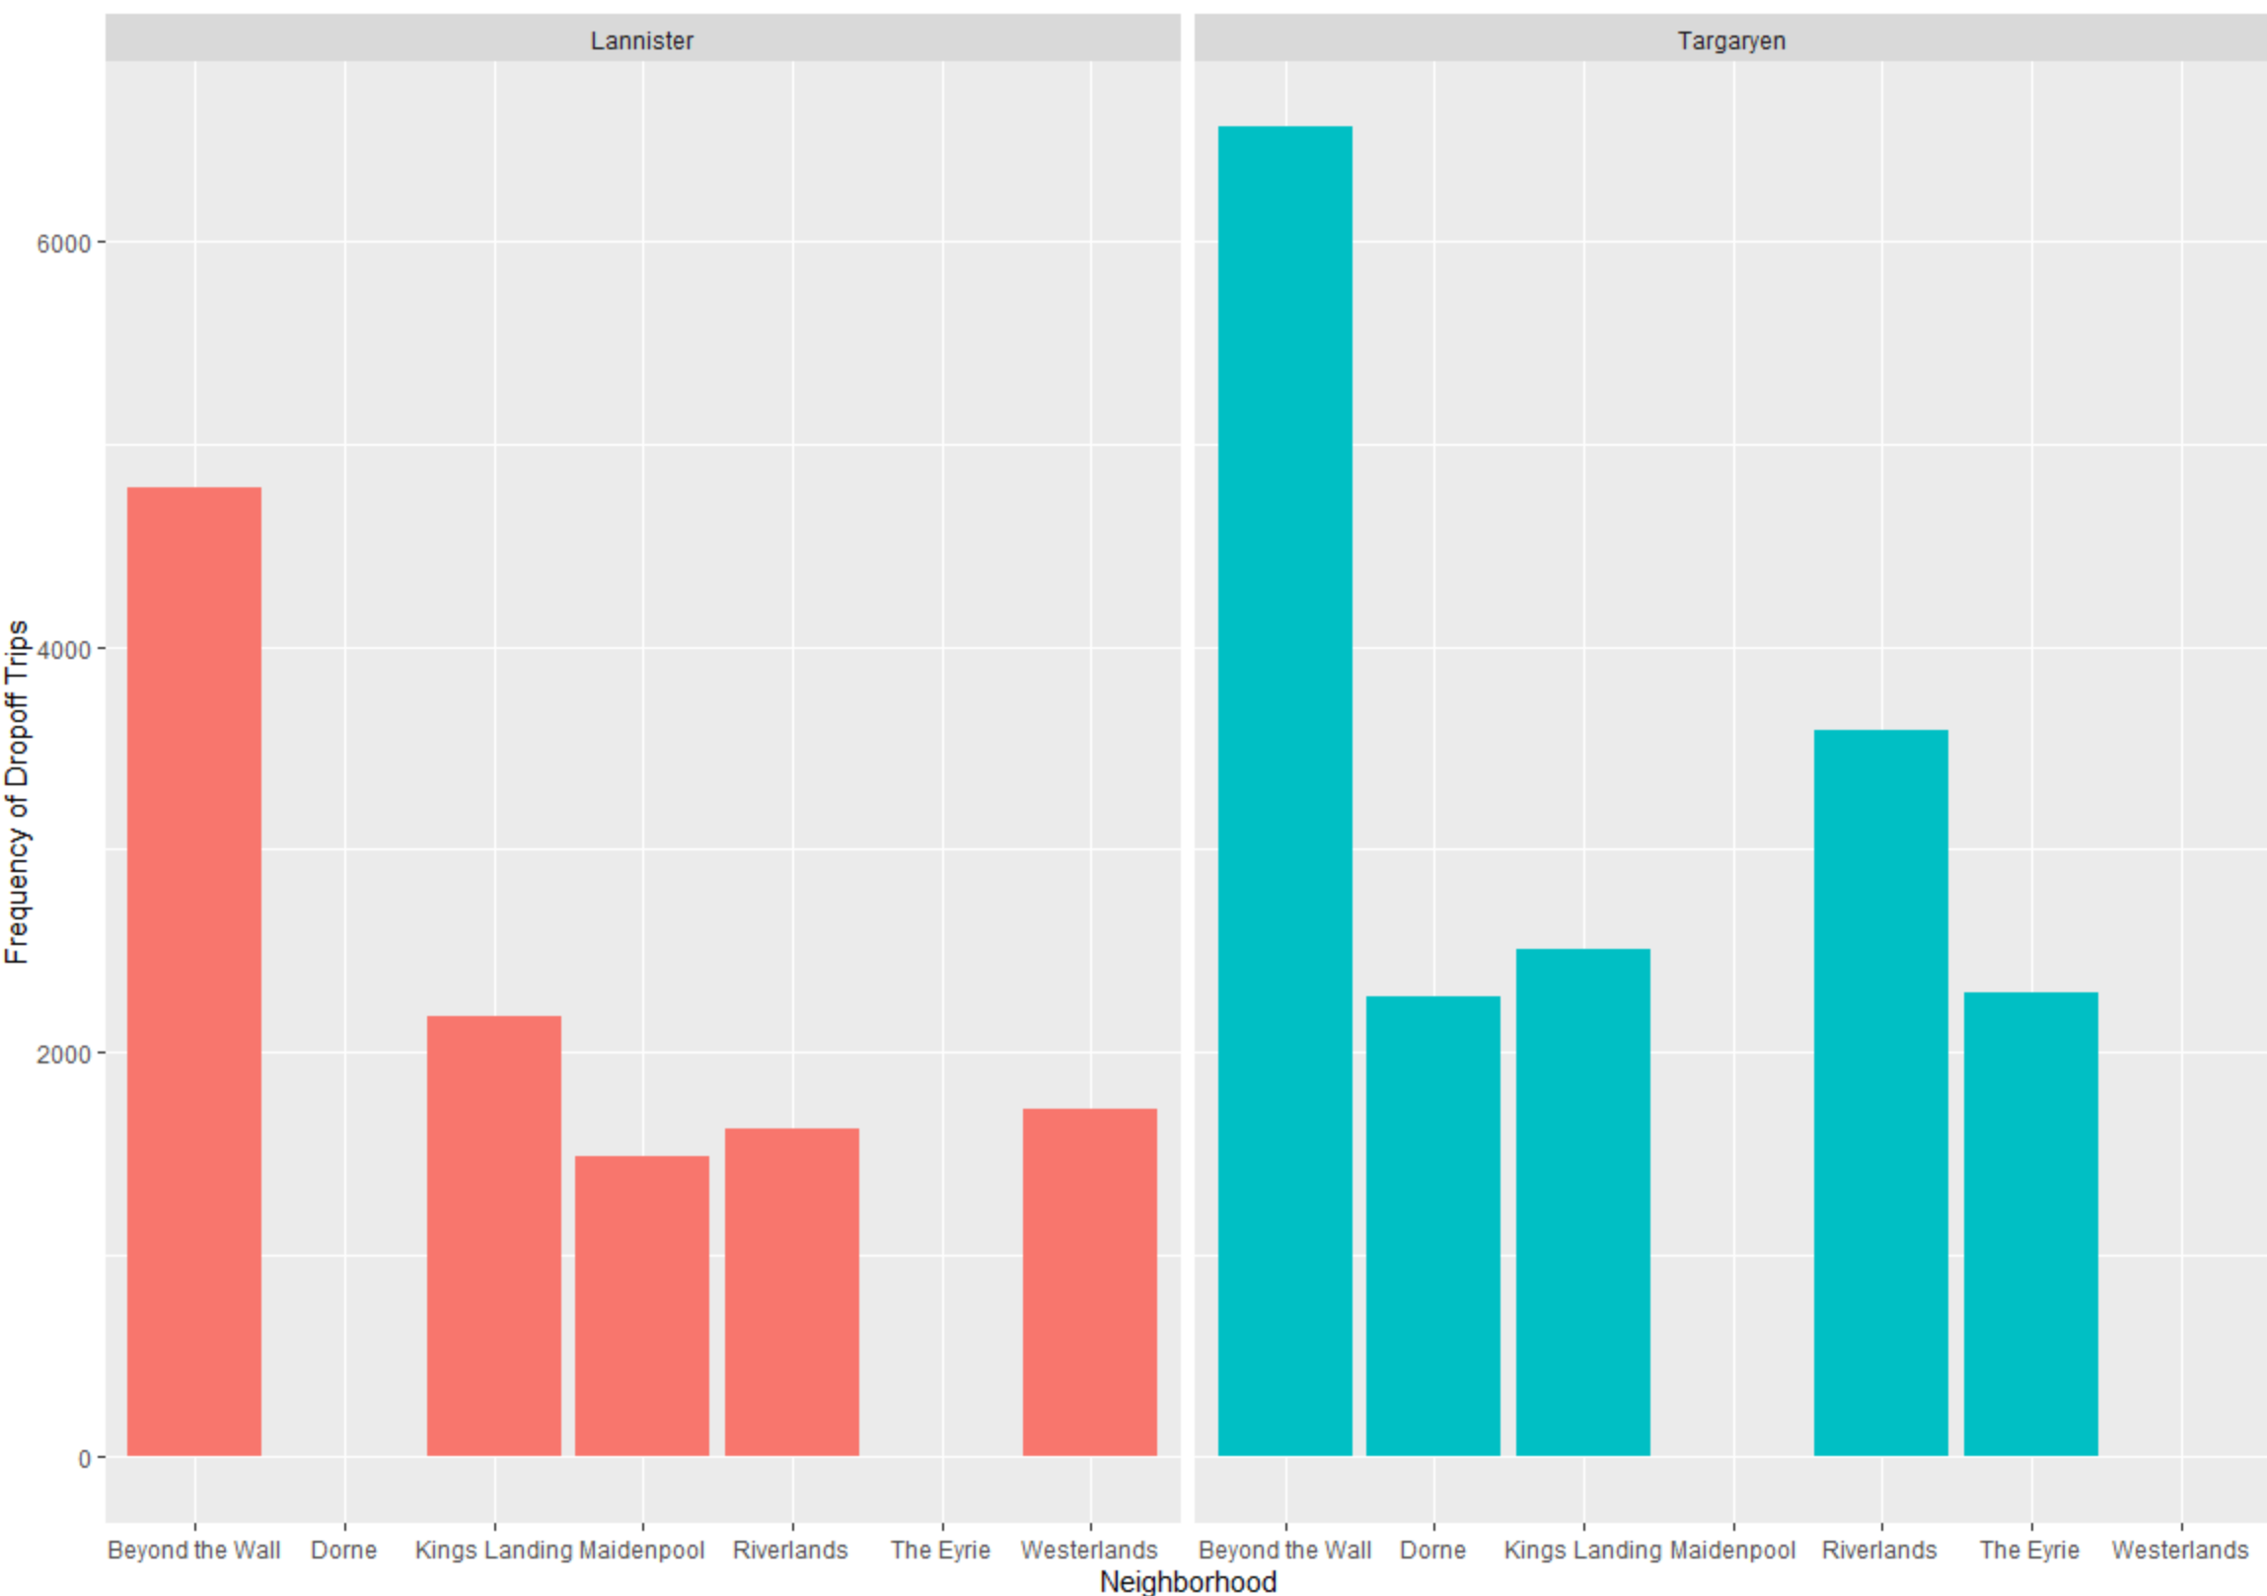
High Frequency Neighborhoods
Neighborhoods with high frequency pickups/drop-offs by Service Provider
The accompanying frequency charts indicate Lannister and Targaryen are competing in certain neighborhoods and operating stand-alone in few others.
In the shared market space, Targaryen has a larger share of rides.
The frequency charts also indicate potential gaps in service, which can be capitalized on by a new ride hailing service provider.

Slide 5
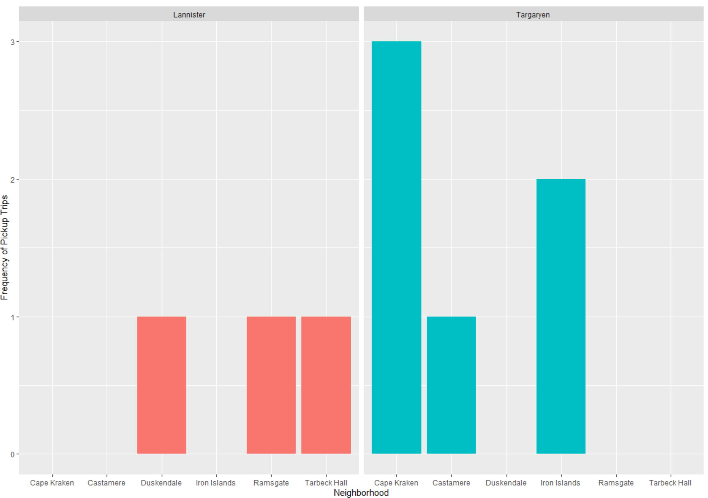
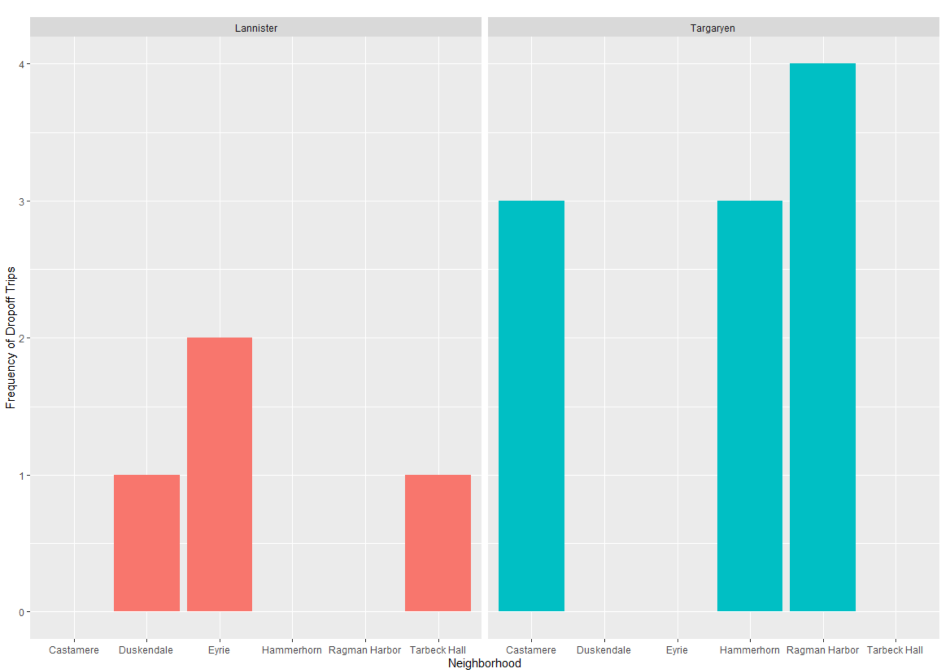
Low Frequency Neighborhoods
While neighborhoods with low frequency of existing rides may be insignificant to demand analysis, they do present possible market opportunities for being untapped.
The ride hailing dataset would benefit from an additional data capture of neighborhood demographics.

Slide 6
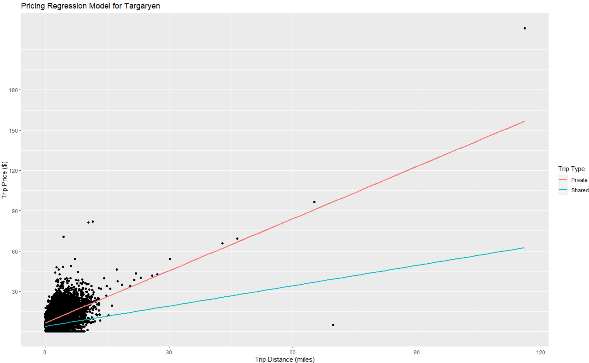
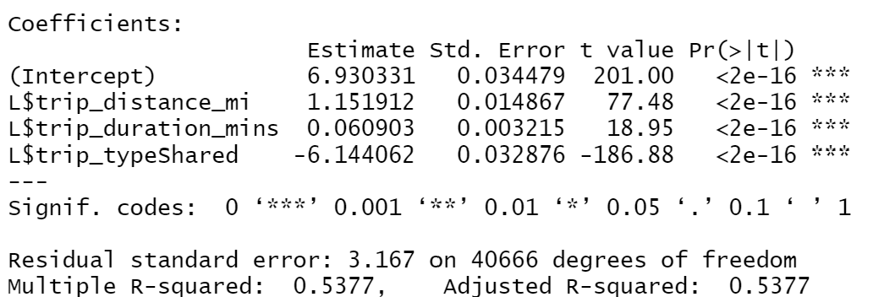
Pricing Regression Analysis- Targaryen
Pricing model for Targaryen indicates a linear regression between Trip Price and the variables Trip Distance, Trip Duration and Trip Type.
High Positive beta coefficient and t value observed for Trip Distance, indicating highly linear relationship with Trip Price.
High Negative beta coefficient and t value observed for Trip Type- Shared, indicating inverse regressive relationship with Trip Price.

Slide 7
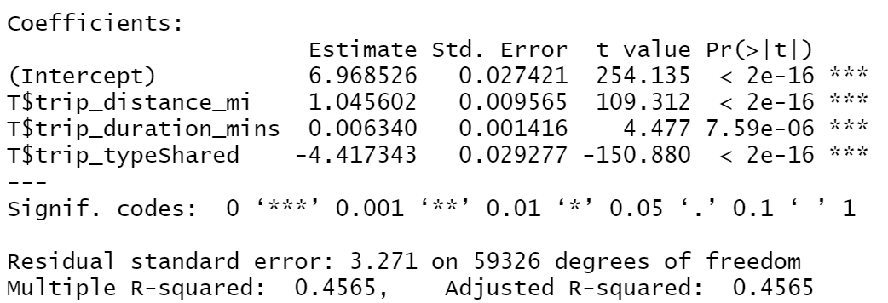
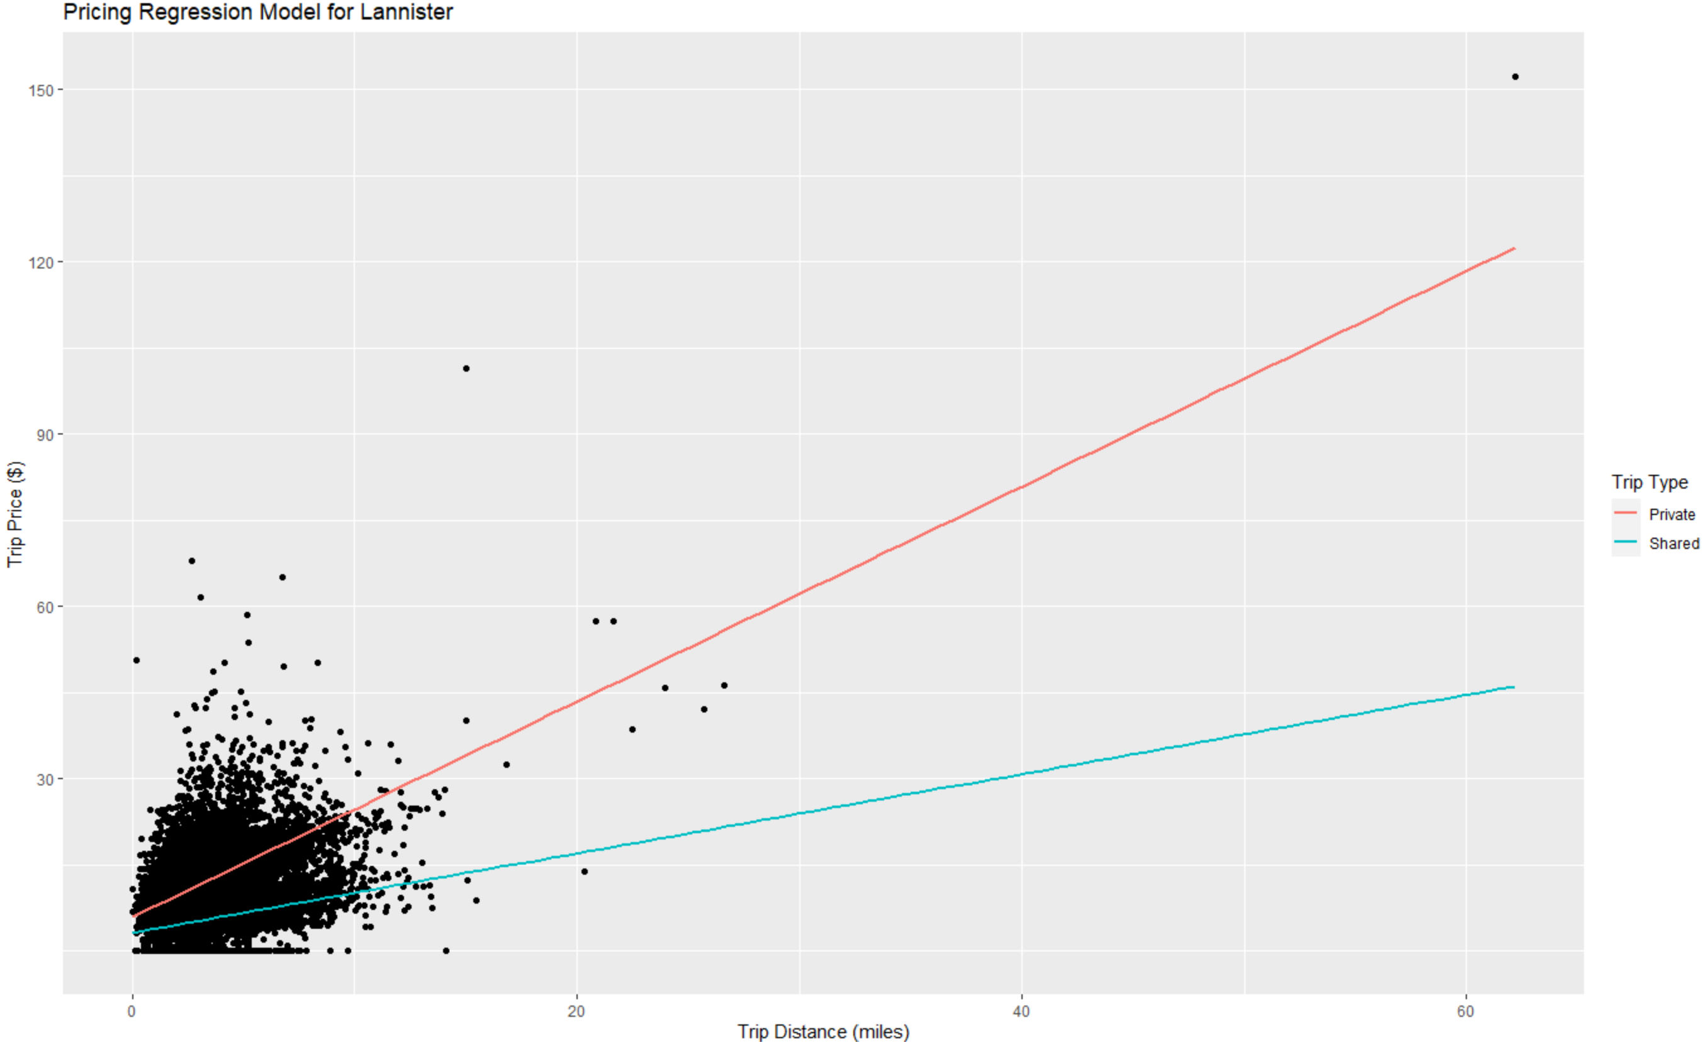
Pricing Regression Analysis- Lannister
Likewise, Pricing model for Lannister indicates a linear regression between Trip Price and the variables Trip Distance, Trip Duration and Trip Type.
High Positive beta coefficient and t value observed for Trip Distance, indicating highly linear relationship with Trip Price.
High Negative beta coefficient and t value observed for Trip Type- Shared, indicating inverse regressive relationship with Trip Price.

Slide 8
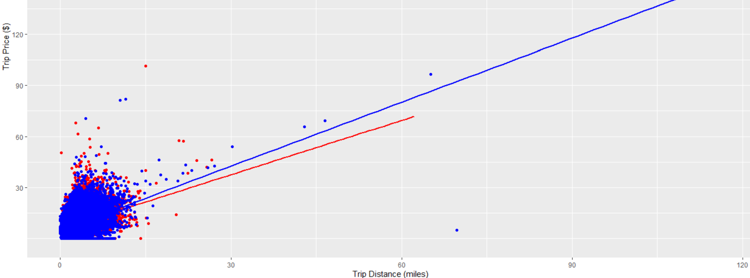
Competitive Pricing
Overall, Targaryen (blue) shows better competitive pricing trip price/mile in the shared market space while Lannister (red) provides a more competitive trip price per mile in the private market space.

