Slide 1
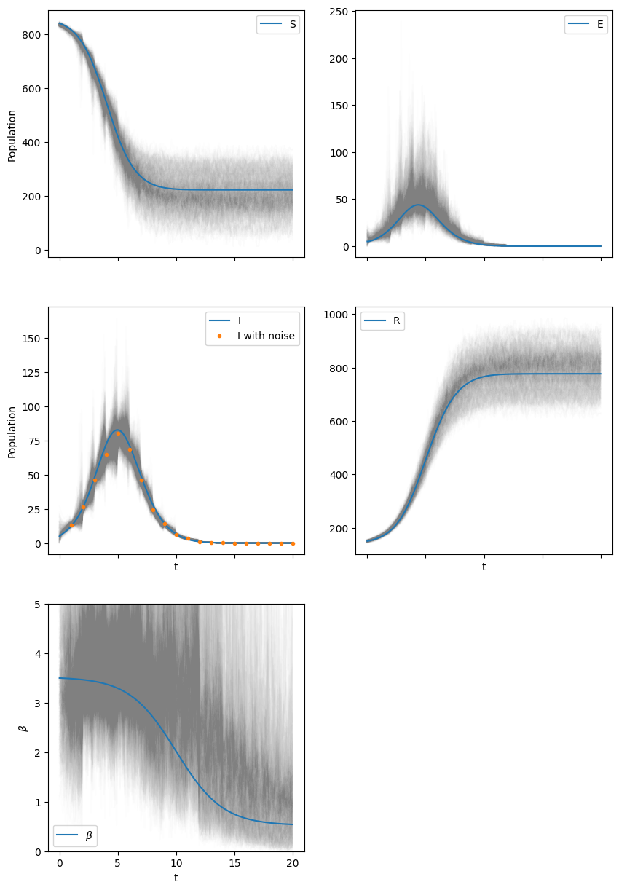
Estimating constant and time-varying parameters in dynamical system
Sibo Wang
Dec 14, 2022
Notes:
Name, Date, title of project, and a graphic that conveys some information
Hi …
I would ike to sahre my final project on …
The figure shown on the left is the prosteior distribution of the syste states tracjectories, with blue lines indicating the true reference. Beta at the bottom left corner is a time-varying parameter, and as shown, its variation has been successfully inferred

Slide 2
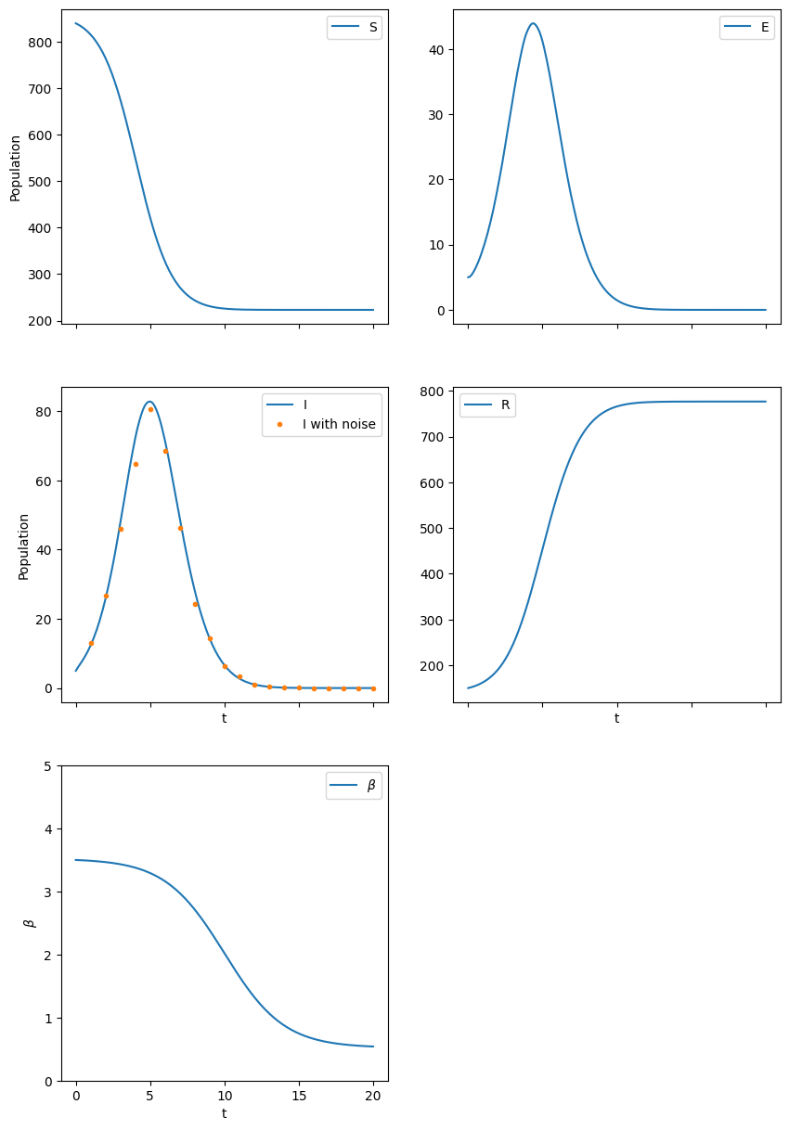
Introduction
Goal: learn constant and time-varying parameters in the SEIR disease transmission model
Motivation: study system parameter estimation, especially particle Markov-chain Monte Carlo (PMCMC)
Focus of project: estimate all the parameters for a simulated SEIR model via a combination of state-parameter augmentation and adaptive PMCMC
Notes:
High-level introduction to problem and your motivation for pursuing it, and the main questions

Slide 3
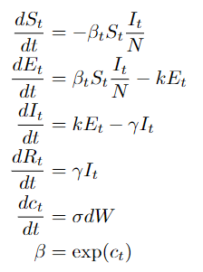

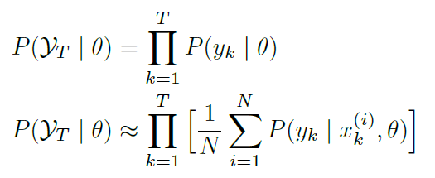
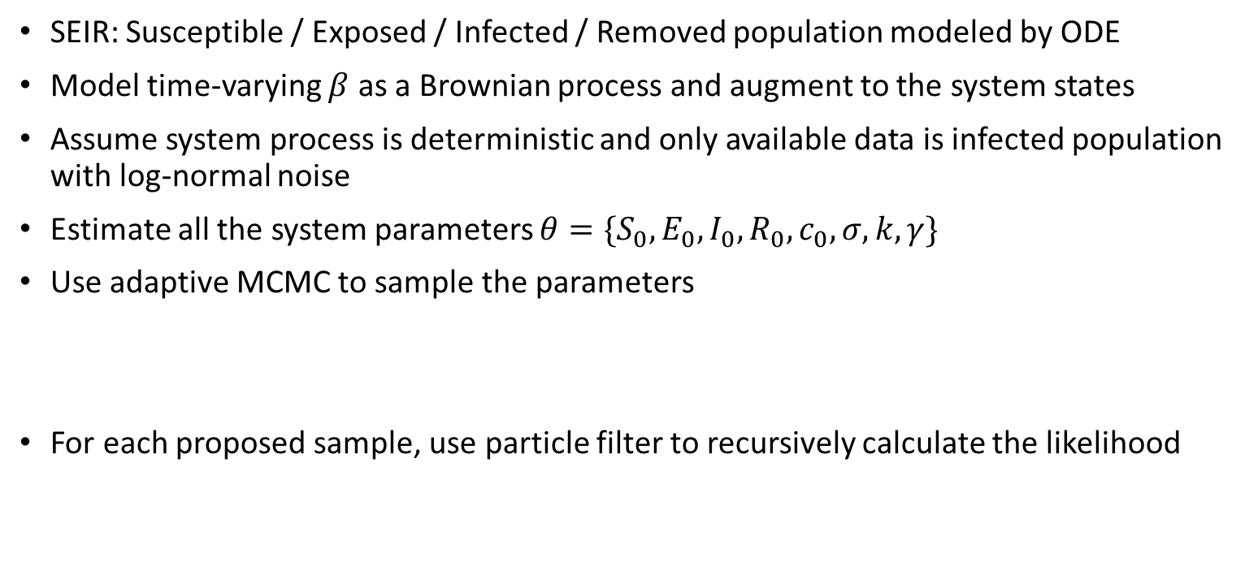
Mathematical formulation and algorithm
SEIR: Susceptible / Exposed / Infected / Removed population modeled by ODE
Model time-varying $β$ as a Brownian process and augment to the system states
Assume system process is deterministic and only available data is infected population with log-normal noise
Estimate all the system parameters $θ={\{S}_{0}, E_{0}, I_{0}, R_{0}, c_{0}, σ, k, γ\}$
Use adaptive MCMC to sample the parameters
For each proposed sample, use particle filter to recursively calculate the likelihood
Notes:
Mathematical Formulation of the problem and the algorithmic approach
The SEIR disease model have four states with three parameters in an ODE. The four states are …., while the three parameters are beta, k, and gamma. Specifically, beta, the effective contact rate, is often time-varying and greatly dependent on external factors such as policies and holidays. Thus, beta is modeled as a Brownian process and augmented to the system. The overall system process model is shown here. In the model, we assume SEIR are deterministic and the only stochastic process is in beta. We also only have weekly infected population with log-normal noise as the data.
In this given system, we are trying to estimate all the system parameters, ….
The posterior distribution of theta can be expeanded based on Baryes rule. Then,with known pprior and likelihood the posterior can be sampled via MCMC. To find likelihood, we then adopt partciel filter. The overall likelihood can be recursively updated as a product of inividual state’s likelihood. Then, the likelihood of each state can be approximated by performing Monte Carlo on the likelihood on the particles.

Slide 4
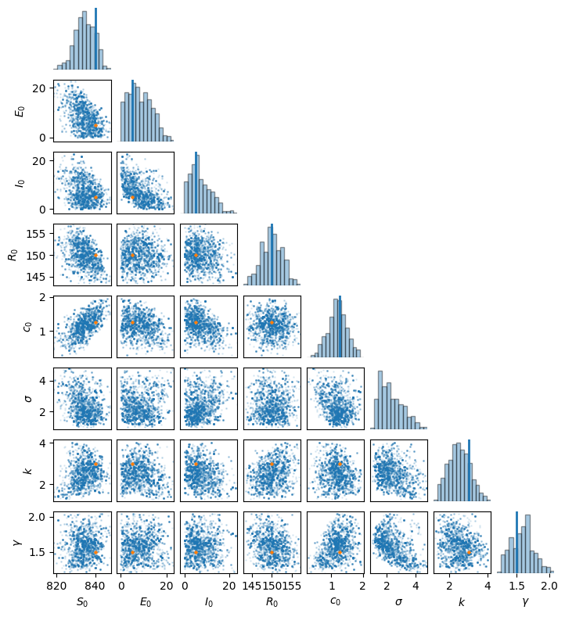
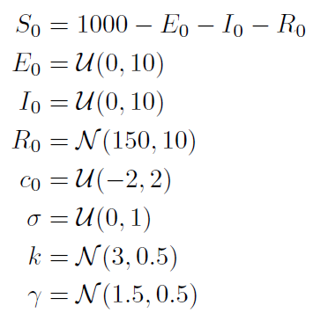
Results
Priors:
IAC:
{47.13, 52.35, 47.96, 37.18,
42.32, 66.07, 46.53, 56.00}
Notes:
Results
For tis project, informative priors are only given to R0, k, and gamma. Vague ranges are given to all the other parameters. Shown here are the marginal of the MCMC samples, with blue lines an dorange dots indicating th etrue reference values. Reference value si not appcaliable for the Bronian process standard deviation sigma, as beta of th ereference system aws modeled by alogistic function, not via Bronian process. As seen, all other marginal dsitributions have covereved the rtue values, with most of them having MAP point at the true values. I tis also noted that many parameters do not have gaussian posteriors, which indicate the difficulty for sampling.
The IAC valus are around 50, which are satisfratory. The posterior for the system state trajectories wer shown on the first slide All states have been recoered along with the trajctoery of beta, Although beta has a very large variance.

Slide 5
Conclusions
Adaptive PMCMC has successfully estimated all the constant system parameters, as well as the trajectory of β
The trajectory for the system states has also been well recovered.
Future work:
Effect of sample size
Incorporate adaptive rejection
More analysis on the particle filter in PMCMC (e.g. MSE, marginals of empirical state distributions, etc.)
Notes:
Conclusions and Lessons learned

