Slide 1
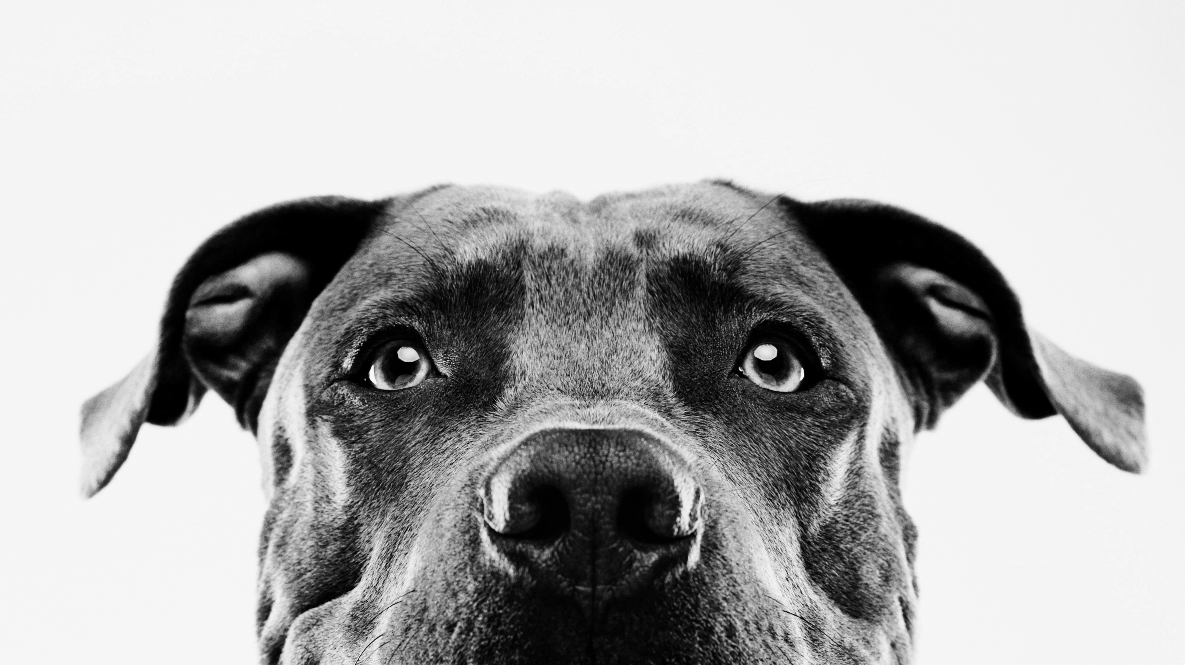
Animal shelter adoptions and data: an exploration
Sylvia Bueno
ENTITY Data Science Academy/WOZ-U

Slide 2
My background

Slide 3
Professional background
BBA in Marketing; Quantitative Business Analysis from Baylor University
Various Administrative, Accounting, and Finance positions in businesses ranging from a local radio station to a Big Five accounting firm
Currently in Sales Support at Insurance Company. Future Data Scientist!
Hair & Makeup artist for 13 years
Moved from Texas to Oregon in 2003

Slide 4
animal care Background
For 20 yrs my own cats and dogs have been strays, adopted from shelters, or rescued from neglect situations.
Focus on seniors and special needs
Pet sitter since 2014
Volunteered at Oregon Humane Society 2014-2015

Slide 5
Project introduction

Slide 6
Data and Animal shelters
www.aspca.org
Curious how data is used in animal shelters
Who gets adopted from US shelters?
ASPCA estimates 6.3 million companion animals in US shelters every year. 4.1 million are adopted.
There is no national responsibility for gathering and tabulating statistics on animal protection.
However, efforts are being made at local levels and by non-profits to bring awareness to data-driven decisions in shelters.
Notes:
Currently, no government institution or animal organization is responsible for tabulating national statistics for the animal protection movement.

Slide 7
Austin, data, and adoptions
Data Portal – Oct 2013 to present. Publicly shared monthly and yearly reports. Use as an exploratory model.
www.austintexas.gov/austin-animal-center
www.bestfriends.org
Austin Animal Center – the municipal shelter City of Austin and Travis County, TX. The country’s largest no-kill shelter.
Questions: Who gets adopted from Austin Animal Center? What factors influence adoption?
Austin is the largest no-kill city in the country. 90% save rate = no-kill status
Notes:
Currently, no government institution or animal organization is responsible for tabulating national statistics for the animal protection movement.

Slide 8
methods

Slide 9
Data Collection
Research: Shelter Animals Count – www.shelteranimalscount.org
Research: American Society for the Prevention of Cruelty to Animals – www.aspca.org
Research: The Humane Society of the United States – www.humanesociety.org
Main dataset: Austin Animal Center - www.austintexas.gov/austin-animal-center
Research: www.bestfriends.org

Slide 10
Data wrangling
Austin Animal Center 2014-2021. 136,757 rows of data.
Variables used: Type, Sex, Age, Color, Month, Year, Outcome
Filtered and grouped variables to: Cat/Dog, Female/Male, 5 Age Groups, 27 Colors, Adopted YN.
All categorical variables. Recoded to numeric data type (int) for analyses.

Slide 11
Languages, tools, and Analyses
Data Wrangling: Python
Analysis: R (Correlation Matrix, Stepwise Regression, Independent Chi-Squares).
Analysis: Python (Random Forest)
Exploration and Visualization: Tableau
Project Management: Trello
Cloud Storage: GitHub

Slide 12
Results Austin Animal Center Adoptions: 2014-2021

Slide 13
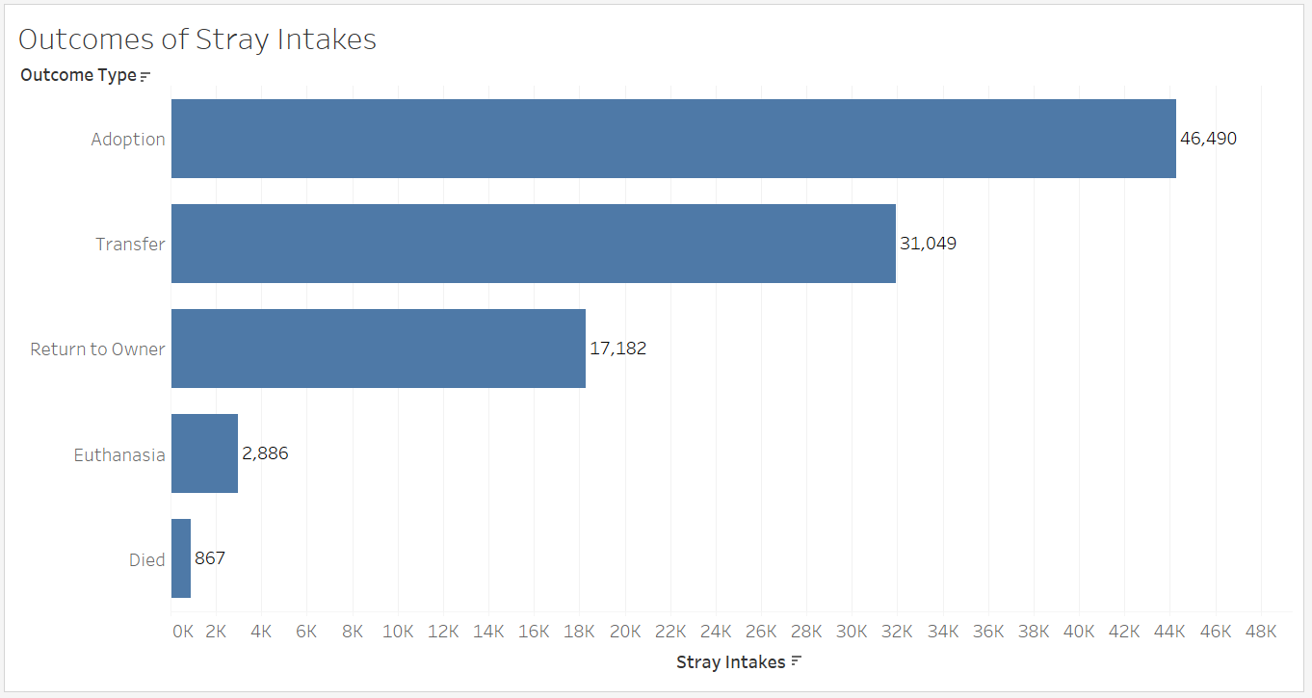
47.2% stray cats and dogs were adopted
98,474 Stray Cats and Dogs
47.2% Adopted
31.5% Transferred*
17.5% Return to Owner
96.2 % Live Outcome
2.9% Euthanized
0.9% Died
*to other shelters and rescues for adoption

Slide 14
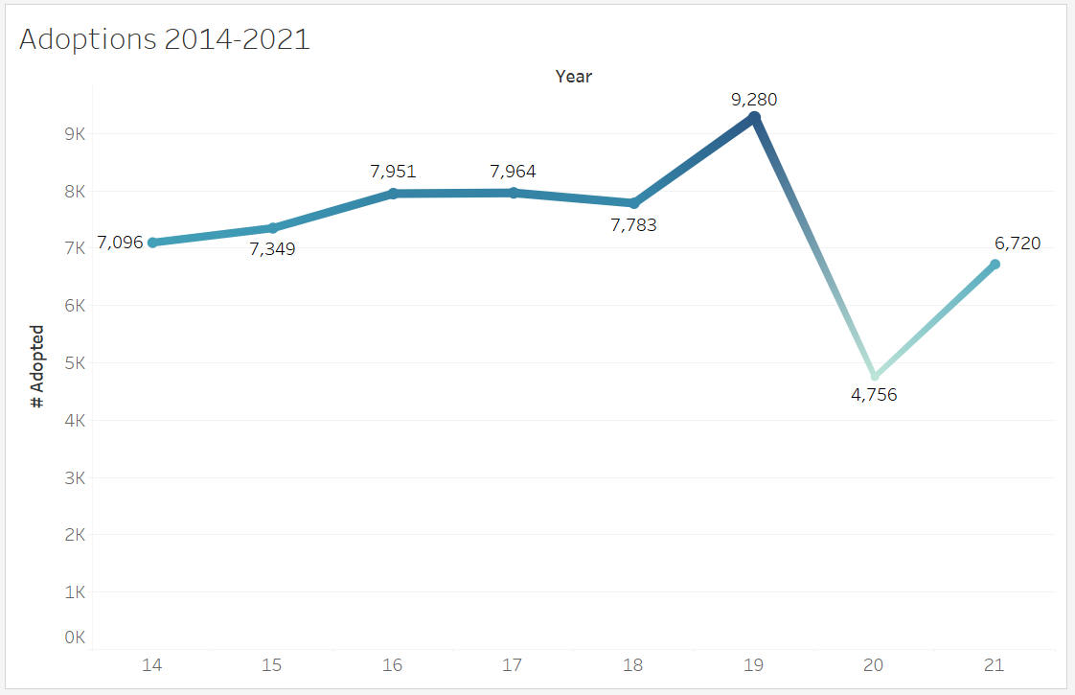
Highest adoption rate was in 2019
High: 2019
Low: 2020 (COVID)
2021: Picking Back Up

Slide 15
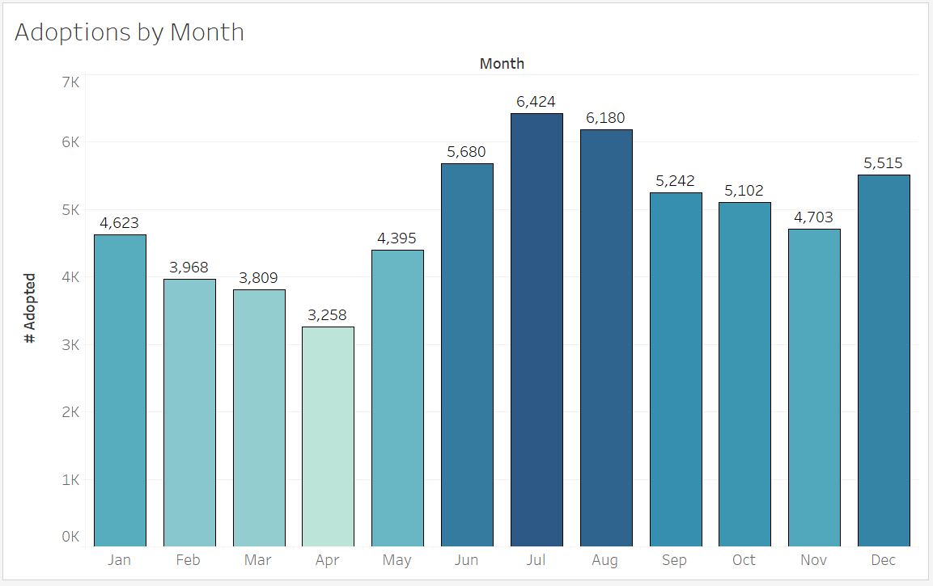
Highest number of adoptions occurred in July
Most Adoptions
July: 10.9%
August: 10.5%
June: 9.6%
Fewest Adoptions
February: 6.7%
March: 6.5%
April: 5.5%

Slide 16
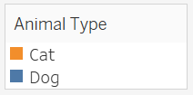
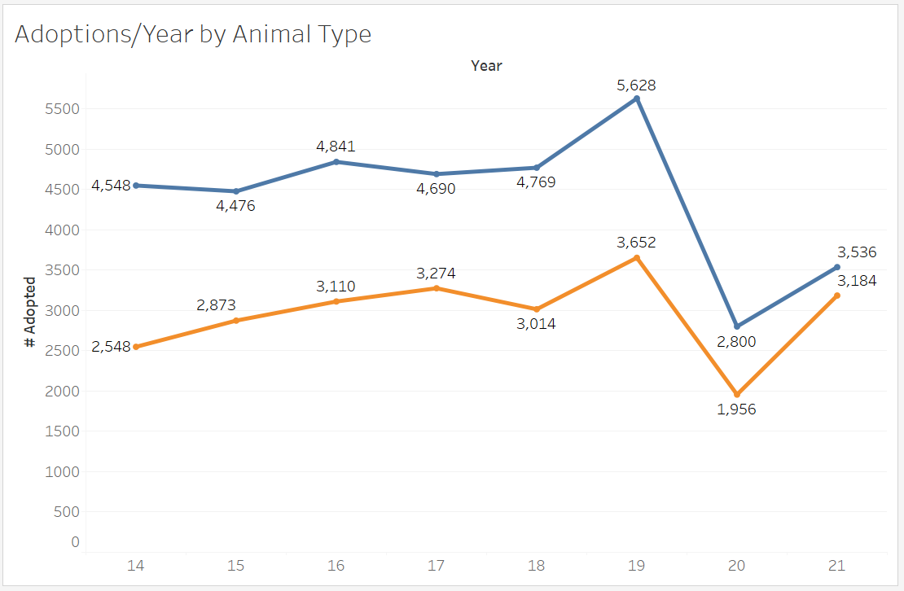
More dogs than cats were adopted
2020-2021: Gap Narrowing
Fewer dogs adopted than expected.
More cats adopted than expected.
p-value < 2.2e-16

Slide 17
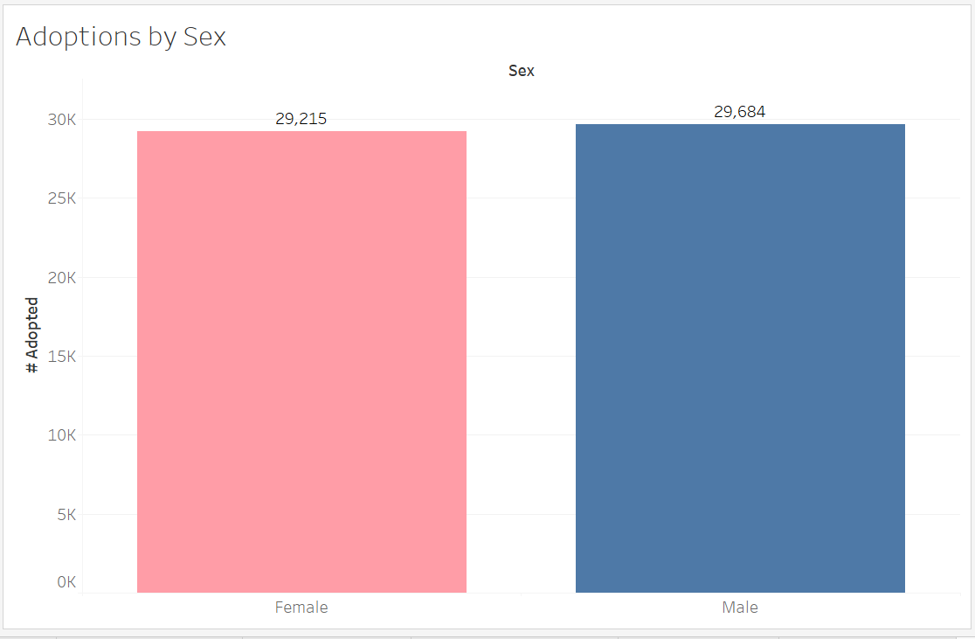
More males than females are adopted by less than 1%
Sex
Male: 50.4%
Female: 49.6%
Fewer males than expected.
More females than expected.
p-value < 2.2e-16

Slide 18
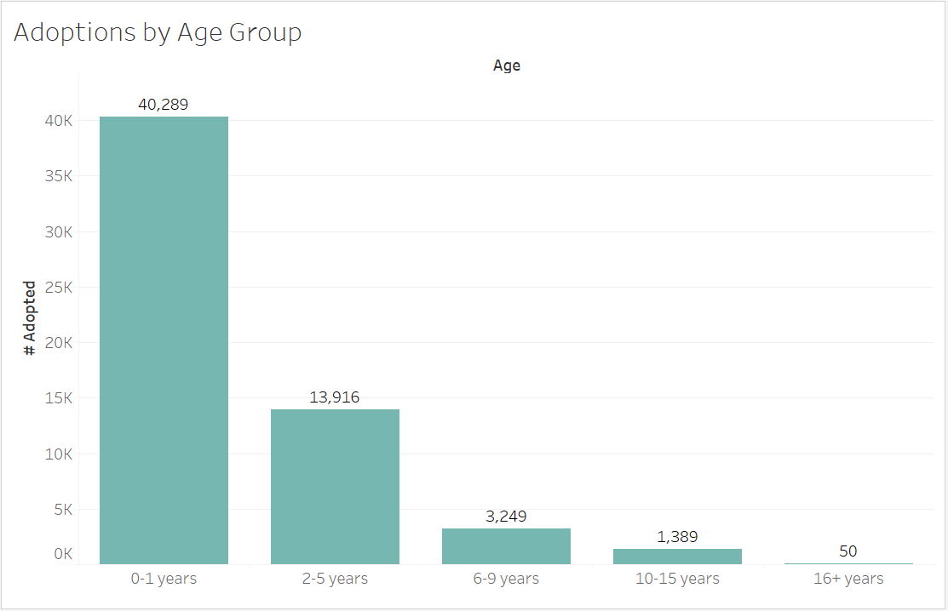
Most adopted animals were between 0 and 1 year old
Age Group
0-1 years: 68.41%
2-5 years: 23.63%
6-9 years: 5.52%
10-15 years: 2.36%
16+ years: 0.08%
More 0-1 year olds than expected.
Fewer all other ages than expected.
p-value < 2.2e-16

Slide 19
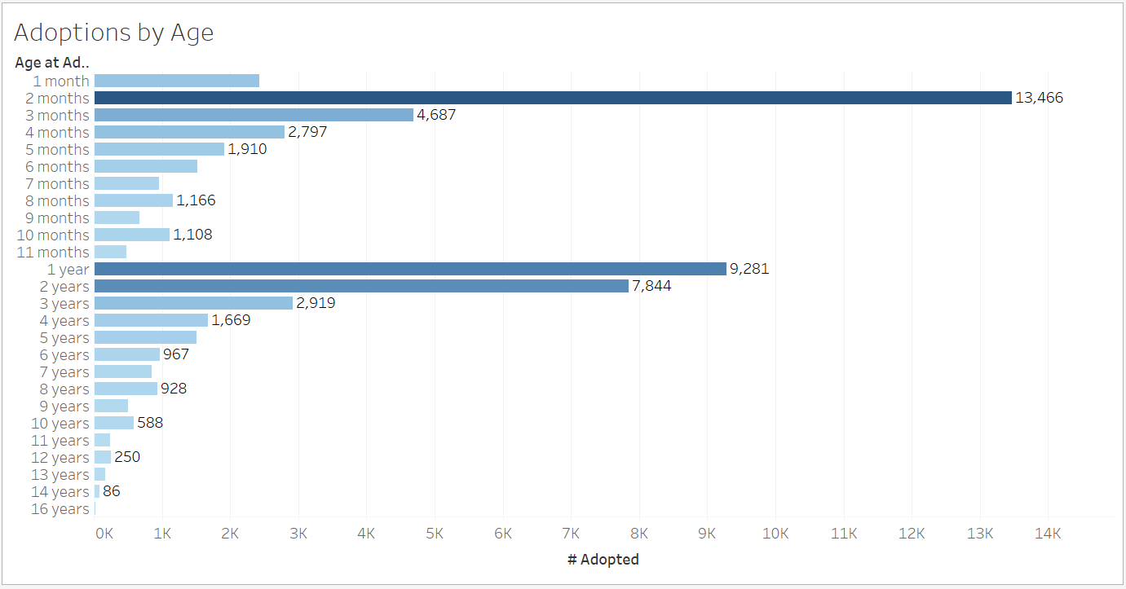
Most adopted age was 2 months old
Age
2 months: 22.8%
1 year: 15.7%
2 years: 13.3%

Slide 20
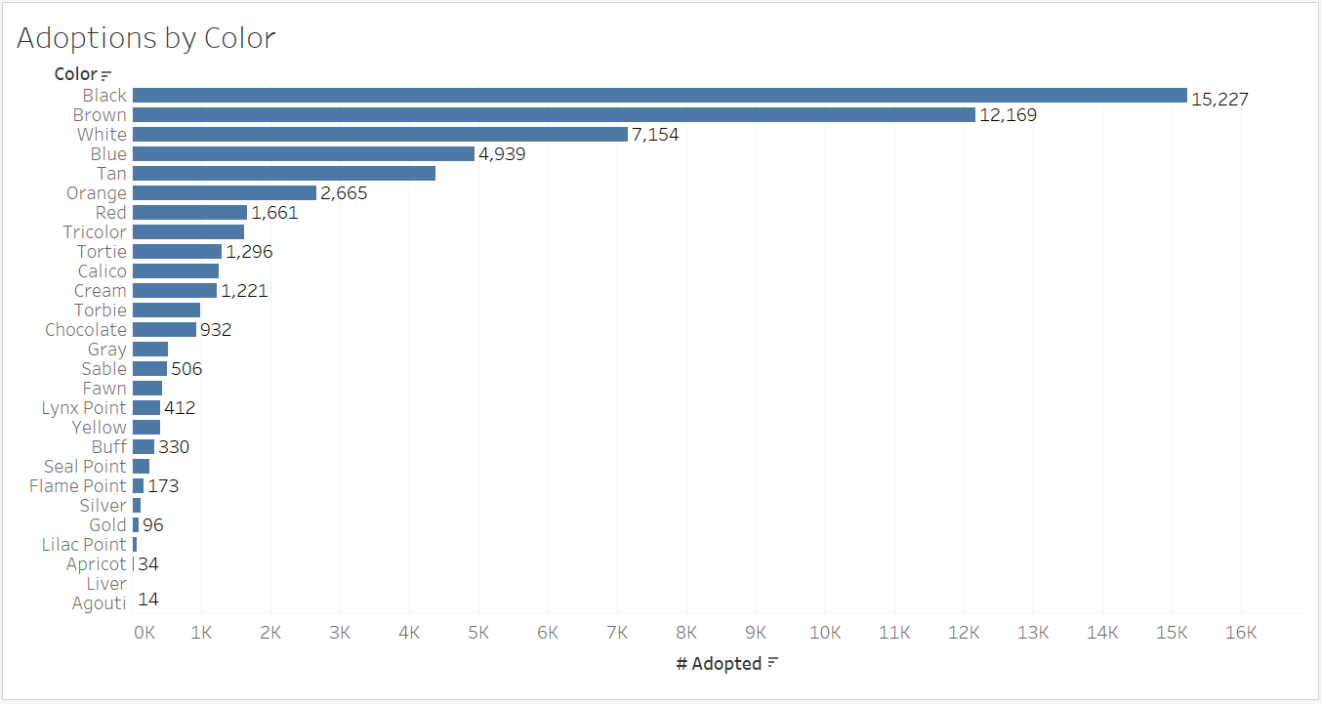
Black animals were the most adopted overall
Animal Color
Black: 25.9%
Brown: 20.7%
White: 12.2%
Black animals were
adopted more than expected.
p-value < 2.2e-16

Slide 21
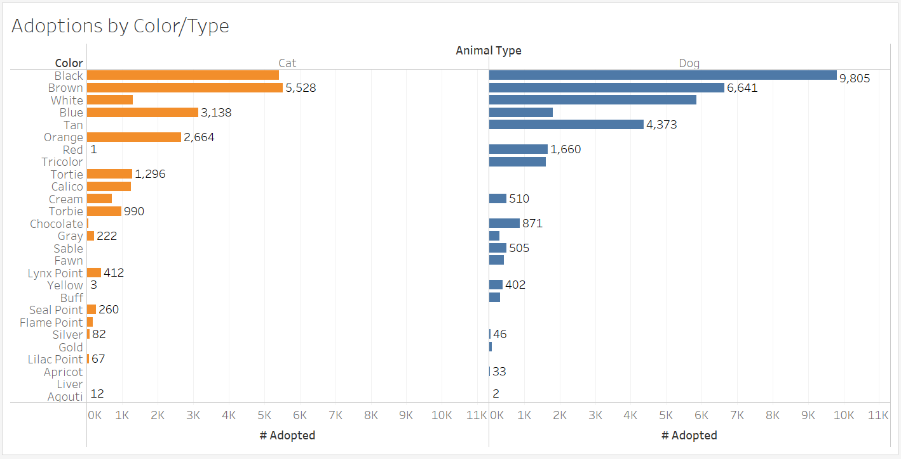
most adopted cats were brown. Most adopted dogs were black.
Cat Color
Brown: 9.4%
Black: 9.2%
Blue: 5.3%
Dog Color
Black: 16.7%
Brown: 11.3%
White: 9.9%

Slide 22
Summary

Slide 23
Who was adopted? When? Influences?
Who is adopted from the country’s largest no-kill shelter?
Most adopted Type: Dog
Most adopted Sex: Male
Most adopted Age Group: 0-1 Year
Most adopted Age: 2 months
Most adopted Color: Black
What time of year are adoptions most popular?
Month with Highest # of adoptions: July
Do type, sex, age, and color influence adoption?
Statistical tests show that there is sufficient evidence that adoption is dependent on these 4 variables.

Slide 24
Conclusions

Slide 25
Animal shelter adoptions and data
Adoptions
Fun exploration of which animals are adopted from the shelter.
Focus programs on adult and senior adoptions.
Data
Austin Animal Center and the City of Austin are models for no-kill shelters and cities.
Gather, track, and publicly share their data and reports for 8 years now
Consistently exceed the 90% save rate benchmark for no-kill status
Effective no-kill strategies include data-driven decision-making for shelters and communities.
Data helps shelters and communities save and improve lives by focusing programs and operations where most needed.
National responsibility for gathering and sharing animal protection statistics is needed to understand trends and what programs are needed.
bestfriends.org

Slide 26
What did I learn? What would I do differently?
Correlation Matrix and Random Forest are not effective predictive models for categorical data.
Perhaps should have dummy coded all variables for independent chi-squares and stepwise regression.
Join Intake and Outcome datasets to see adoptions against intakes for a more holistic view. Are my stepwise regression and independent chi-square analyses an accurate depiction of predictors without the intake data?
Research how to use a variable with over 2000 levels, so that I can add in the variable Breed. Would make it more interesting.
Gain a better understanding of what the different analysis methods are used for. What questions are they answering? What are they testing?

Slide 27
Questions?

