Slide 1

Dynamic Pricing for User Data Sharing
Alexandra Diener, Filippo Gentile, Shiying Li, Stephanos Matsumoto, Andrea Mock
BIOTS 2016, ETH Zurich
Notes:
Sensor, trading, data, sale, IoT, dynamic pricing, user data, market, platform,

Slide 2
Overview
IoT ecosystem
Users share data with collectors who aggregate and analyze
Problem
Users don’t want to contribute all types of data
Users may want to mask data to preserve privacy
Contributions
Dynamic pricing function to incentivize users to share data
Smart contract framework implementation

Slide 3
System Architecture
User
(with ETH addr)
Collector
Send
data
Operate
contract
Send
payments
Web Interface
Call functions
Smart Contract
Pricing Table
Set price function
Payment function
Query function

Slide 4
Smart Contract Design

Slide 5
Dynamic Pricing
priceInfo structure
price (p), lastUpdate (u), subCount (c), subThresh (S), timeThresh (T)
Time threshold passed ➔ increase price
Set new price as follows: p * (2 – c / S)
Submission threshold exceeded ➔ decrease price
Set new price as follows: p * (now – u) / T
Normal case
Update submission count in priceInfo without changing price

Slide 6
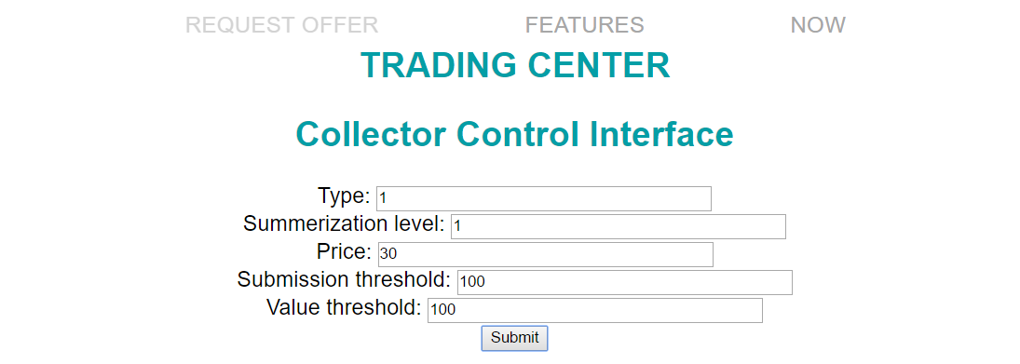
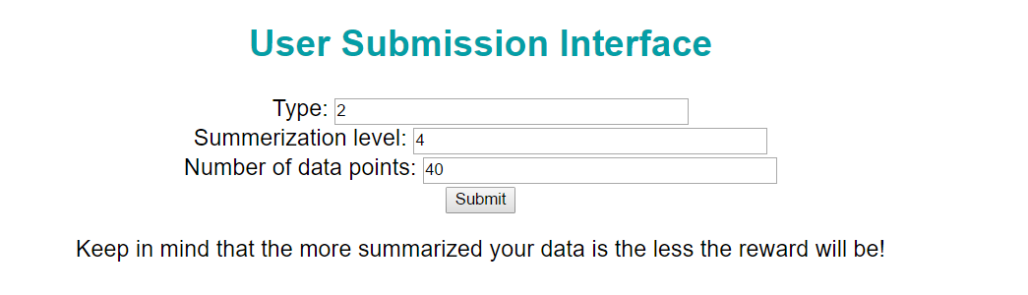
Website/Demo

Slide 7
Applications
NoiseHood
How loud is the neighborhood you want to live in?
How? Smart homes and map interface
Privacy? Filtering system
Dynamic Pricing
LocationSharing
When do you mind giving your location?
Dynamic Pricing

Slide 8
Future Work: Matching Buyers and Sellers
Smart Contract
• • •
Buyer Registry
• • •
Register
policy
Register
policy
User
(with ETH addr)
Seller Registry
Aggregator
(with ETH addr)
Set bid
Registration function
Set bid
• • •
Bid function
• • •
Query function

Slide 9
Future Work: Nervousnet Integration
Log claim code,
payment amount
Nervousnet CORE
Log data stream
Verify claim code
Send
data
Send
claim code
Oraclize API
Smart Contract
User
(with app, ETH addr)
Claim function
Claim payment
with code

