Slide 1
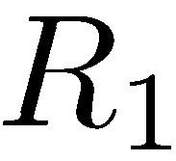
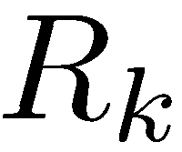


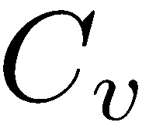
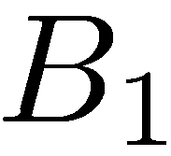
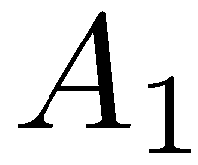
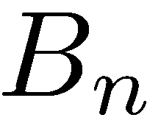
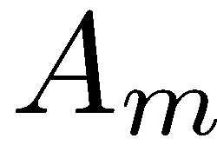

TexPoint fonts used in EMF.
Read the TexPoint manual before you delete this box.: AAAA

Slide 2
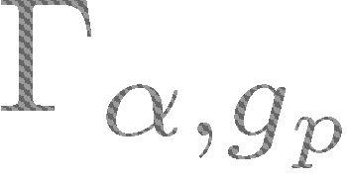

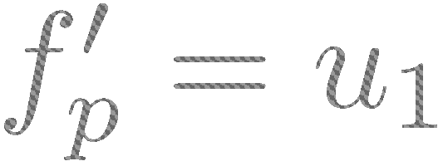
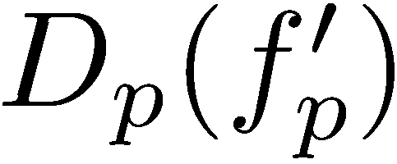


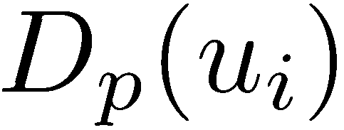
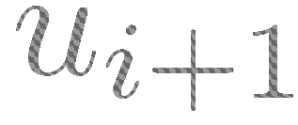
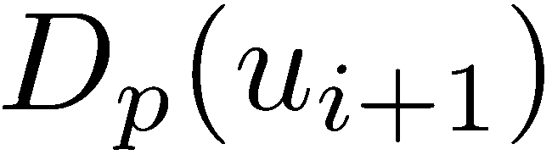
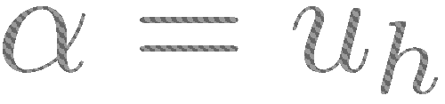
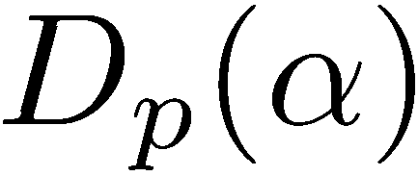


Slide 3
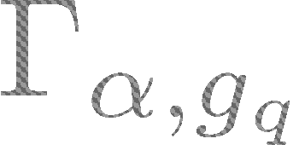
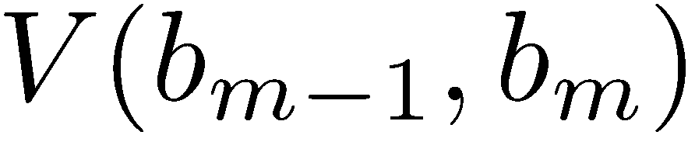
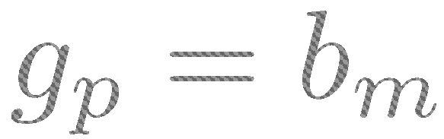
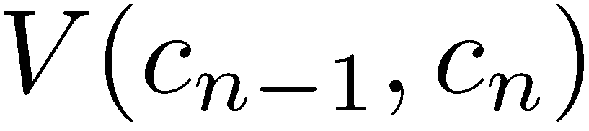

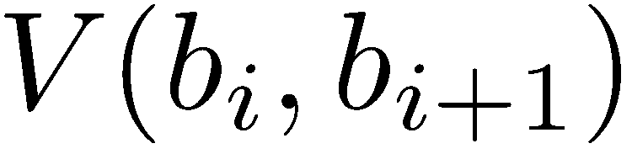
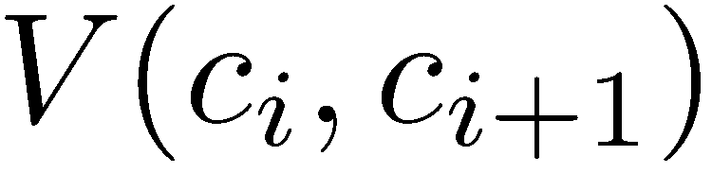
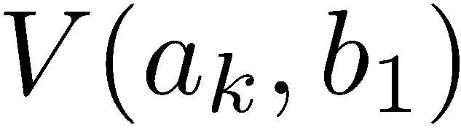
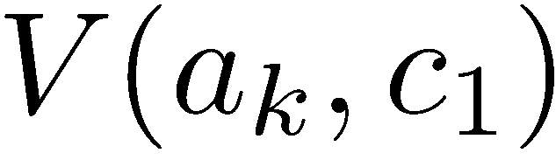
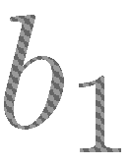


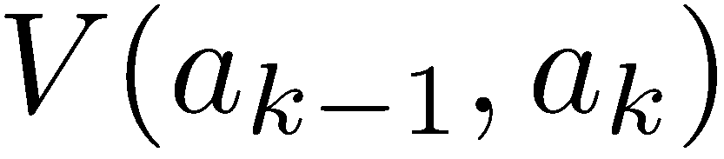
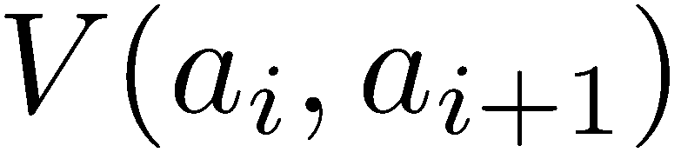
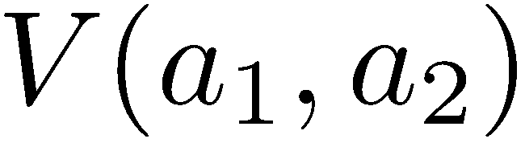



Old index

Slide 4
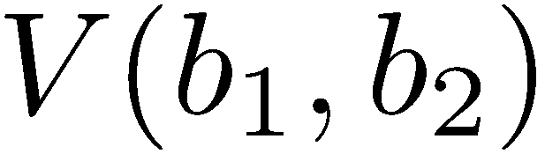
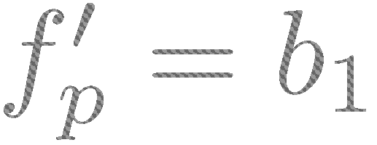
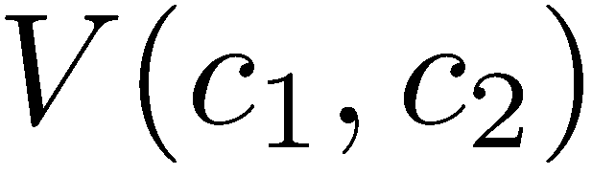
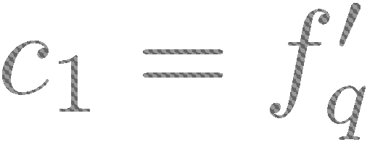
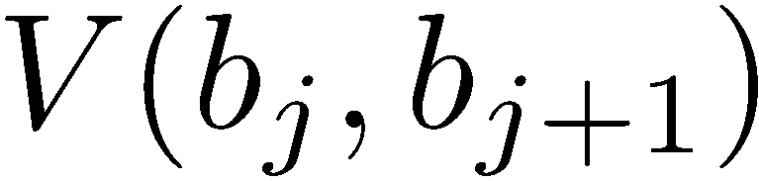
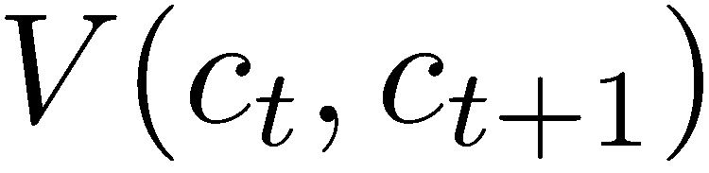
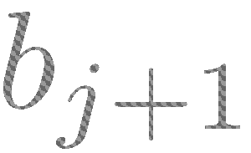
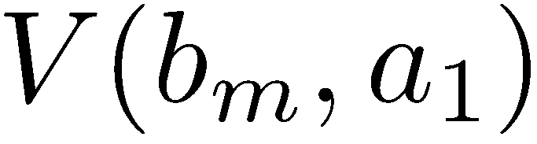
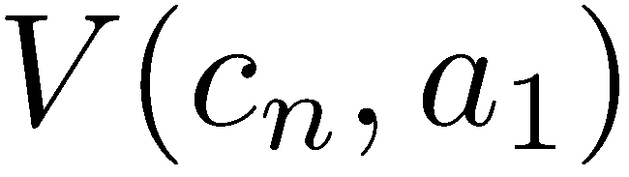
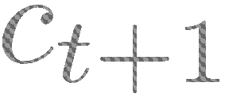


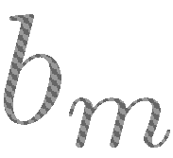


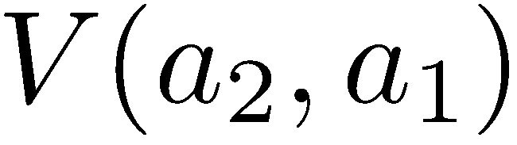
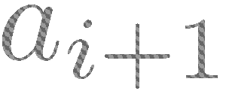
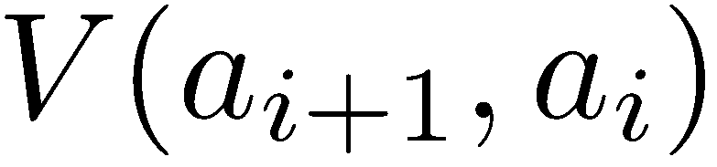

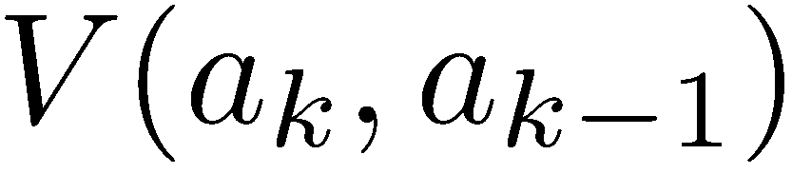


Proof Of Correctness

Slide 5
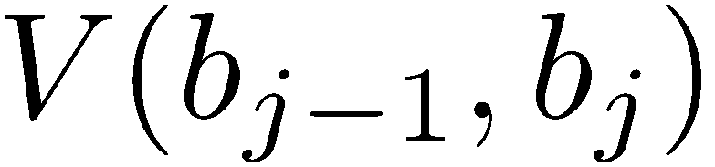
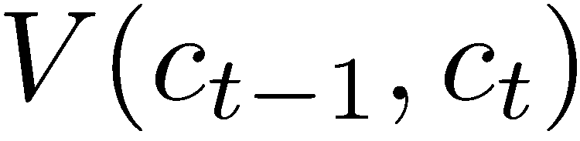
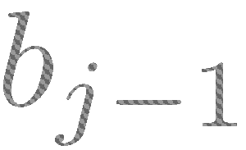
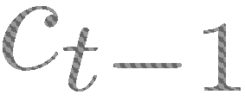
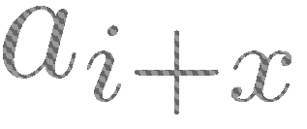
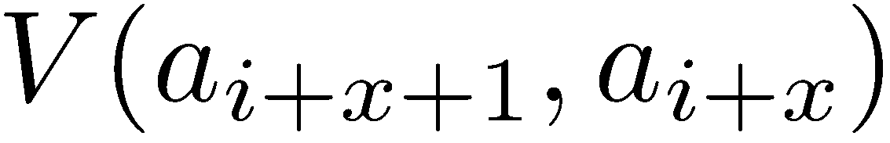
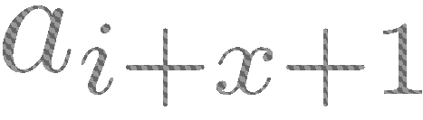
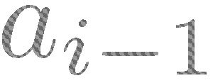

Proof Of Correctness aa

Slide 6













Slide 7






















Slide 8





Slide 13





Slide 14



Slide 18


0
1
2
0
0

Slide 19


O
1/2
1/2
1/2
1/2
1/2
….

Slide 20
 | R | A | B | C | D | E
R | -1 | 0 | -1 | -1 | -1 | -1
A | -1 | -1 | 0.1 | 1 | 3 | -1
B | -1 | -1 | -1 | -1 | -1 | 6
C | -1 | -1 | -1 | -1 | -1 | -1
D | -1 | -1 | -1 | -1 | -1 | -1
E | -1 | -1 | -1 | -1 | -1 | -1

Slide 21
child
label symbol |  | R | A | B | C | D | E
label index |  | 0 | 1 | 2 | 3 | 4 | 5
 |  | 0 | 1 | 2 | 3 | 4 | 5
R | 0 | -1 | 0 | -1 | -1 | -1 | -1
A | 1 | -1 | -1 | 0.1 | 1 | 3 | -1
B | 2 | -1 | -1 | -1 | -1 | -1 | 6
C | 3 | -1 | -1 | -1 | -1 | -1 | -1
D | 4 | -1 | -1 | -1 | -1 | -1 | -1
E | 5 | -1 | -1 | -1 | -1 | -1 | -1
parent

Slide 22
child
 | R | A | B | C | D | E
R | -1 | 0 | -1 | -1 | -1 | -1
A | -1 | -1 | 0.1 | 1 | 3 | -1
B | -1 | -1 | -1 | -1 | -1 | 6
C | -1 | -1 | -1 | -1 | -1 | -1
D | -1 | -1 | -1 | -1 | -1 | -1
E | -1 | -1 | -1 | -1 | -1 | -1
parent

Slide 23
symbol
120 voxels
index
R | 0
A | 1
B | 2 |  |  |  |  |  |  |  |  |  |  |  |  |  |  |  |  |  |  |  |  |  |  | ………….
C | 3
D | 4
E | 5
6 labels

Slide 24


Slide 27



Slide 28


Slide 30

Star/Hedgehog Shape prior

Slide 31

Star/Hedgehog Shape prior In Topological setting
Layered Hedgehog shape prior: Let T(A) ={ A and any label inside it}, If p belongs to T(A) then q must belong to T(A) as well.

Slide 32
















Slide 35





Slide 36









Slide 37










Slide 38




Slide 39





Slide 40



Slide 41



Slide 42









Slide 43








In this case, for p and q we need to forbid labelling L G because G can not be on top of L. However, at the same time we need to allow LT but since G comes before T along q’s path-move by forbidden G we are also forbid T implicitly.

Slide 44























Slide 45









Slide 46






Slide 47



